Slide 1


Chapter 1
Chapter 1

Slide 2

WiFi Access
Campus WiFi is quite slow with so many people using it. So, we have set up a local hotspot. If you want faster Internet, scan this QR Code to connect to the hotspot network in this classroom.
Genesis PW: Adam&Eve

Slide 3

Class Registration
Register for this class (if you haven’t already) so that I can communicate with you by Email important information from time to time.

Slide 4

Class Website (http only!)
We have set up a website for this class that has calls materials, as well as excellent supplementary materials. If you want to learn even more, please visit the site. Click the Genesis Menu item.
http://sound-doctrine.us

Slide 5

Zoom Link
We realize some of you can’t make it every week (but please try!). We have arranged for a Zoom meeting for each class. Click the QR code here; or take a picture of it to send it to friends who may want to follow the class remotely.

Slide 6

Anonymous Questions?
Sometimes people are hesitant to ask questions in class. We have the solution. Anonymously ask any question by texting “Answers” to 877-324-4480 to register; and then text your question. Or scan this QR code, which also appears on the website.

Slide 7

DNA Replication

Slide 8
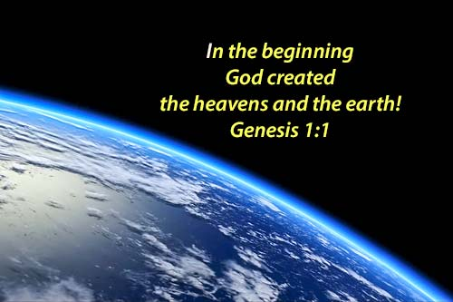
“In one sense, this first verse is the most important in the bible” – Jonathan D. Sarfati
“In one sense, this first verse is the most important in the bible” – Jonathan D. Sarfati

Slide 9
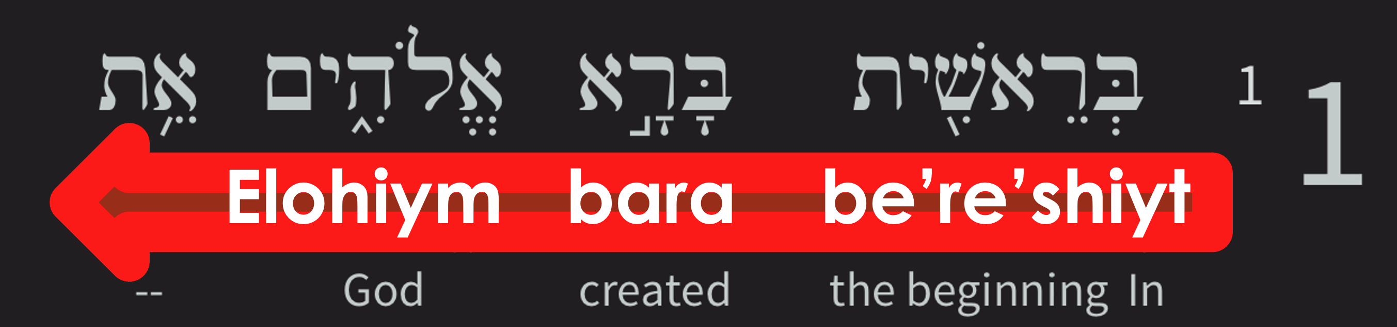
In the beginning God created the heavens and the earth.
If we can believe this verse, no other verse in the bible should be a problem
  If God created everything, then why should anything else recorded in the bible be hard to believe?
  The verb ‘bara” is only used of God’s creative works, not man’s
  A God, who is a plurality, singularly created

Slide 10
Verse 1 refutes all these false beliefs
Atheism- belief there is no God
Agnosticism- it is impossible to know God exists
Dualism- Good and evil are eternally co-existent
Finite-god- a god who is bound by the universe
Evolutionism- we evolved spontaneously from lower forms
Humanism- man is the measure of all things
Materialism/Naturalism- what we can see is all there is
Pantheism- ‘god is in everything’
Panentheism- ‘everything is what makes up God’
Polytheism- there is more than one god, many in fact
Unitarianism- God is an absolute Unity

Slide 11
How does it do that?
Atheism- God exists and was present at the beginning
Agnosticism- God has revealed himself in scripture
Dualism- God was alone when He created, evil came later
Finite-god- God created everything, so is limited by nothing
Evolutionism- God created man and woman, and all life
Humanism- God created us, so HE is the measure of all things
Materialism/Naturalism- God is master of his creation
Pantheism- God is distinct (separate) from His creation
Panentheism- God transcends what he has created
Polytheism- Only one God created all things
Unitarianism- Elohiym (a diverse God) singularly created

Slide 12
Creation of Time
Genesis 1:1 is the beginning of time itself
  Time was also created in verse 1
  John 1:3, All things were made through him, and without him was not any thing made that was made.
  Time is intimately connected to matter, energy, and space, as defined by Einstein’s Theory of General Relativity
  Time runs faster the farther a point is from the center of gravity
  So, when we say God is infinite, what we really mean God is beyond time, or outside of time. Time is part of the creation.

Slide 13
God stretched out the heavens
How far away is the “known” universe?
  What does science say?
  The universe is not 17 billion years old! (Time dilation)
Consider these verses:
  Job 9:5, 9:8, 22:14, “God is the one … who alone stretches out the heavens … and he walks on the vault of heaven.”
    Vault, a circle, or a horizon, or a ceiling
  Isa 40:22, It is he who sits above the circle of the earth, and its inhabitants are like grasshoppers, who stretches out the heavens like a curtain, and spreads them like a tent to dwell in;
  Isa 42:5, Thus says God, the Lord, who created the heavens and stretched them out, who spread out the earth and what comes from it, who gives breath to the people on it and spirit to those who walk in it:

Slide 14
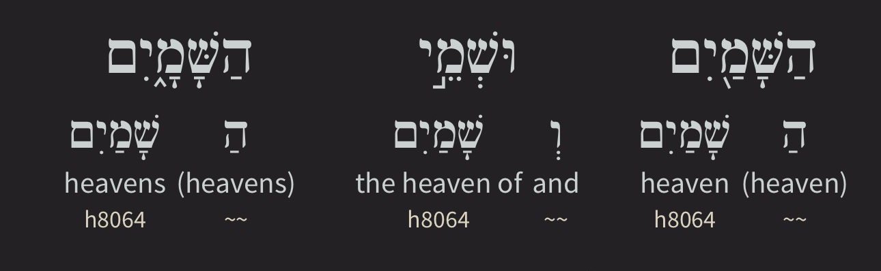
Question: Was heaven created in 1:1?
“the heavens (hashamayim) and the earth (ha’erets)”
Hashamayim is a plural word meaning “the heavens”
Shamayim is used for “heaven” without “ha”, God’s domain
  The root prefix “sha” is understood to mean ”lofty”
Deu 10:14, Behold, to the Lord your God belong heaven and the heaven of heavens, the earth with all that is in it.

Slide 15
Paul’s “Third heaven”
1st Heaven (Hebrew: hashamayim)
  Gen 1:30, ” And to every beast of the earth and to every bird of the heavens”
2nd Heaven (Hebrew: hashamayim)
  Gen 1:14, “Let there be lights in the expanse of the heavens to separate the day from the night. And let them be for signs and for seasons, and for days and years,”
3rd Heaven (Greek: ouranos)
  2 Cor 12:2-4, I know a man in Christ who fourteen years ago was caught up to the third heaven—whether in the body or out of the body I do not know, God knows. 3 And I know that this man was caught up into paradise—whether in the body or out of the body I do not know, God knows— 4 and he heard things that cannot be told, which man may not utter.

Slide 16
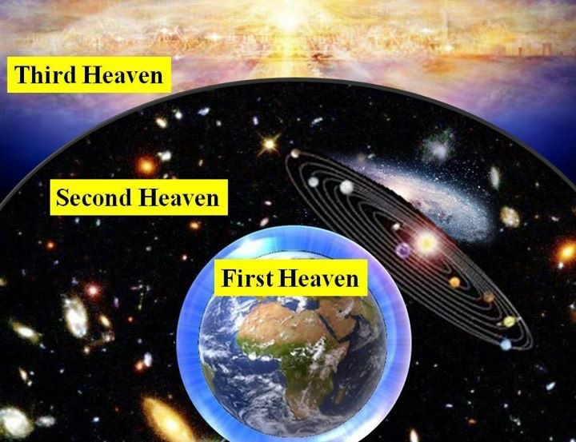
The Heavenly Realms
“But will God indeed dwell on the earth? Behold, heaven and the highest heaven cannot contain you; how much less this house that I have built! -1 Kings 8:27

Slide 17
And we know Jesus is Creator
John 1:1-3, In the beginning was the Word, and the Word was with God, and the Word was God. 2 He was in the beginning with God. All things were made through him, and without him was not any thing made that was made.
Colossians 1:15-17, He is the image of the invisible God, the firstborn of all creation. 16 For by him all things were created, in heaven and on earth, visible and invisible, whether thrones or dominions or rulers or authorities—all things were created through him and for him. 17 And he is before all things, and in him all things hold together.
Hebrews 1:1-2, Long ago, at many times and in many ways, God spoke to our fathers by the prophets, 2 but in these last days he has spoken to us by his Son, whom he appointed the heir of all things, through whom also he created the world.
Notes:
The WAY… “Jesus in not God”

Slide 18
Verse 2
Gen 1:2, The earth was without form and void, and darkness was over the face of the deep. And the Spirit of God was hovering over the face of the waters.
  formless = (tohu) without a finished shape, unorganized
  void = (bohu) empty, containing nothing, not filled
  darkness = Without any light whatsoever
  face = the surface
  deep = (tehom) an abyss, a deep place, implying water
  Spirit = (ruach), the breath, wind, or spirit
  God = (Elohiym) God in the plural
  hovering = moving, vibrating, fluttering, oscillating
  waters = (mayim) QUESTION: does this word sound familiar?
Notes:
The WAY… “Jesus in not God”

Slide 19
Verse 2, continued
Gen 1:2, The earth was without form and void, and darkness was over the face of the deep. And the Spirit of God was hovering over the face of the waters.
  The Semitic root for abyss, “tehom”, means ocean or sea, and the same word is also used in the following verses:
    Gen 7:11, “… on that day all the fountains of the great deep burst forth …”
    Gen 8:2, “The fountains of the deep and the windows of the heavens were closed, the rain from the heavens was restrained”
    Proverbs 8:28-29, “when he made firm the skies above, when he established the fountains of the deep”
    2 Peter 3:5, “… the heavens existed long ago, and the earth was formed out of water and through water by the word of God,”
  The primordial earth seems to have been a water world
Notes:
The WAY… “Jesus in not God”

Slide 20
Verse 3
Gen 1:3, And God said, “Let there be light,” and there was light.
God simply spoke light into existence
Before this there was only darkness over the face of the deep
QUESTION: What do we know about light?
QUESTION: Where did this light come from?
  1 Tim 6:16, the King of kings and Lord of lords, 16 who alone has immortality, who dwells in unapproachable light
QUESTION: How are light and darkness used metaphorically?
  1 John 1:5, This is the message we have heard from him and proclaim to you, that God is light, and in him is no darkness at all.
  John 1:4, In him was life, and the life was the light of men.
Notes:
The WAY… “Jesus in not God”

Slide 21
Verse 4
Gen 1:4, And God saw that the light was good. And God separated the light from the darkness.
QUESTION: Why is light good?
QUESTION: What is darkness?
QUESTION: Is darkness inherently bad?
QUESTION: Why does God make a distinction between light and darkness?
  Isa 45:7, I form light and create darkness; I make well-being and create calamity; I am the Lord, who does all these things.
QUESTION: What are the spiritual implications of light vs. darkness?
  Isa 9:2, The people who walked in darkness have seen a great light; those who dwelt in a land of deep darkness, on them has light shone.
Notes:
The WAY… “Jesus in not God”

Slide 22
Verse 5, “One Day”
Gen 1:5, God called the light Day (yom), and the darkness he called Night (laylah). And there was evening and there was morning, the first day (“one day” in the NASB).
QUESTION: God begins naming things (Day, Night). Why?
  Naming is a claim to ownership, authority
  Naming defines roles
Evening (ereb), means twilight, dusk, night
Morning (boqer), means dawn, first light, also morrow
God seems to be emphasizing the period between two days
A period of “laylah” between one “yom” and another
This phrase is repeated for each day of creation
  The first “yom”, the second “yom”, etc
Notes:
The WAY… “Jesus is not God”

Slide 23
Verse 5, continued
QUESTION: What two things are required for a day/night cycle?
QUESTION: How long was each day of creation?
  The bible doesn’t say!
    However, outside of Genesis 1, whenever “yom” is used with a number (410 times), it means an ordinary 24-hour day.
    Even in English, “day” means the light part of the cycle, and “night” means the dark part of the cycle
    And “a day”, or “one day” means the whole 24-hour period
”Yom” could also mean a period of time (in my dad’s day)
QUESTION: Could the yom in Genesis 1 be millions of years?
  Why or why not? We’ll look at this shortly
Notes:
The WAY… “Jesus is not God”

Slide 24
Verses 6-8, “A Second Day”
And God said, “Let there be an expanse in the midst of the waters (mayim), and let it separate the waters from the waters.” 7 And God made the expanse and separated the waters that were under the expanse from the waters that were above the expanse. And it was so. 8 And God called the expanse Heaven. And there was evening and there was morning, the second day.
  Expanse(raqiya) – the idea is a vaulted horizon moving outward
    Ezekiel 10:1, Then I looked, and behold, on the expanse that was over the heads of the cherubim there appeared above them something like a sapphire, in appearance like a throne
  The expanse separates the waters of the earth and forms an outer horizon, the “vault of heaven”.
  Firmament? What the ancients believed about the expanse
Notes:
The WAY… “Jesus is not God”

Slide 25
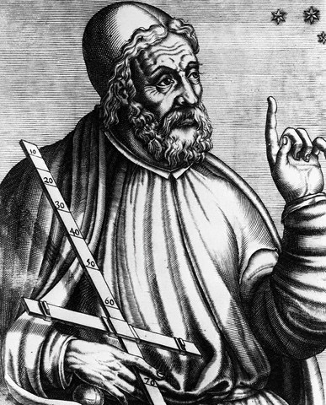
Verses 6-8, “A Second Day”, cont’d
Claudius Ptolemy, born 85 AD
  First postulated that the earth was the center of the universe
  That view stood for 1400 years!
  He wasn’t far off
  According to the bible, the entire universe was stretched out from a watery earth as the center-point
  Along came Copernicus, and Galileo to refute geocentricity
  QUESTION: Do science and faith sometimes conflict?
Notes:
The WAY… “Jesus is not God”

Slide 26
Verses 9-10, “A Third Day”
And God said, “Let the waters under the heavens be gathered together into one place, and let the dry land appear.” And it was so. 10 God called the dry land Earth, and the waters that were gathered together he called Seas. And God saw that it was good.
  Here God is focusing on the waters under the heavens
  He gathers them into “one place” to let dry land appear
  We don’t know if land was underneath the water and rose up
  Or, if some of the water was transformed and became land
    2 Peter 3:5, For they deliberately overlook this fact, that the heavens existed long ago, and the earth was formed out of water and through water by the word of God,
    Earth – the land, came from water and by means of water
Notes:
The WAY… “Jesus is not God”

Slide 27

Verses 11-12, “A Third Day”, cont’d
And God said, “Let the earth sprout vegetation, plants yielding seed, and fruit trees bearing fruit in which is their seed, each according to its kind, on the earth.” And it was so. 12 The earth brought forth vegetation, plants yielding seed according to their own kinds, and trees bearing fruit in which is their seed, each according to its kind. And God saw that it was good. 13 And there was evening and there was morning, the third day.
  ”Let the earth sprout”. QUESTION: why does He say it this way?
    Plants: Self-replicating, solar-powered food and oxygen factories
  God first introduces the idea of “according to [its] kind”
    Kinds produce their own kind, not a different kind
    James 3:12, Can a fig tree, my brothers, bear olives, or a grapevine produce figs? Neither can a salt pond yield fresh water.
Notes:
The WAY… “Jesus is not God”

Slide 28
First Three Days Summary
Day One
  He begins with a formless, empty, water-world
  God spoke light into existence, and separates it from darkness, and He names light and darkness.
  There must be rotation, since we see evening/morning
Day Two
  He separates waters and creates the expanse of heaven
Day Three
  He gathers the waters under heaven, dry land appears
  “Let the earth sprout vegetation” according to its kind
  Twice he proclaims, “God saw that it was good”
Notes:
The WAY… “Jesus is not God”

Slide 29
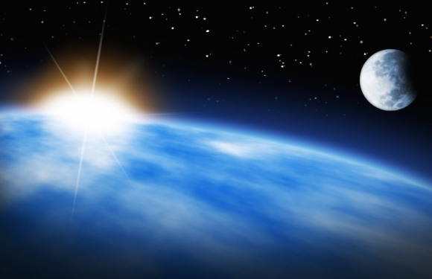
Verses 14-19, “A Fourth Day”
14 And God said, “Let there be lights in the expanse of the heavens to separate the day from the night. And let them be for signs and for seasons, and for days and years, 15 and let them be lights in the expanse of the heavens to give light upon the earth.” And it was so.
16 And God made the two great lights—the greater light to rule the day and the lesser light to rule the night—and the stars. ¹⁷ And God set them in the expanse of the heavens to give light on the earth,¹⁸ to rule over the day and over the night, and to separate the light from the darkness. And God saw that it was good. ¹⁹ And there was evening and there was morning, the fourth day.
  Lights: luminaries QUESTION: Where does God place the lights?
  QUESTION: What does the verse say is their purpose?
    For signs, and to mark times and seasons. QUESTION: what signs?
    To give light to the earth. QUESTION: What are the two great lights?
    To separate light from darkness (notice the common theme)
14 And God said, “Let there be lights in the expanse of the heavens to separate the day from the night. And let them be for signs and for seasons, and for days and years, 15 and let them be lights in the expanse of the heavens to give light upon the earth.” And it was so.
16 And God made the two great lights—the greater light to rule the day and the lesser light to rule the night—and the stars. ¹⁷ And God set them in the expanse of the heavens to give light on the earth,¹⁸ to rule over the day and over the night, and to separate the light from the darkness. And God saw that it was good. ¹⁹ And there was evening and there was morning, the fourth day.
  Lights: luminaries QUESTION: Where does God place the lights?
  QUESTION: What does the verse say is their purpose?
    For signs, and to mark times and seasons
    To give light to the earth. QUESTION: What are the two great lights?
    To separate light from darkness (notice the common theme)
Notes:
The WAY… “Jesuls is not God”

Slide 30
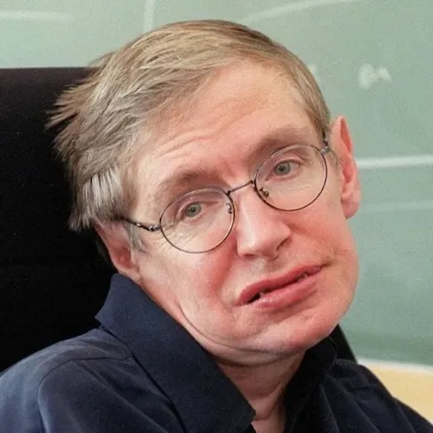
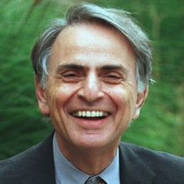
What are we in a vast universe?
Stephen Hawking said this:
  “We are such insignificant creatures on a minor planet of a very average star in the outer suburb of 100 billion galaxies. So, it is difficult to believe in a God who would care about us or even notice our existence.”
Carl Sagan said this:
  “Who are we? We find that we live on an insignificant planet of a humdrum star lost in a galaxy tucked away in some forgotten corner of a universe in which there are far more galaxies than people.”
  “Who is more humble? The scientist who looks at the universe with an open mind and accepts whatever the universe has to teach us, or somebody who says everything in this book must be considered the literal truth and never mind the fallibility of all the human beings involved?”
QUESTION: Are the human beings involved in science infallible?
Notes:
The WAY… “Jesus is not God”

Slide 31
What are we in a vast universe?
King David said this:
  Psalm 8:3-5, When I look at your heavens, the work of your fingers, the moon and the stars, which you have set in place, 4 what is man that you are mindful of him, and the son of man that you care for him? 5 Yet you have made him a little lower than the heavenly beings and crowned him with glory and honor.
  QUESTION: Does David see the same things, but come to a different conclusion than these secular scientists?
man (nos)- a mortal, not the common name for man - Adam
  From the Hebrew word anas, meaning frail, fragile
the son of man- an obvious reference to Jesus
QUESTION: Did Jesus have a mortal body when he was on earth?
Yet, QUESTION: considering all this, how does God view humanity?
Notes:
The WAY… “Jesus is not God”

Slide 32
Verses 20-21, “A Fifth Day”
20 And God said, “Let the waters swarm with swarms of living creatures, and let birds fly above the earth across the expanse of the heavens.” 21 So God created the great sea creatures and every living creature that moves, with which the waters swarm, according to their kinds, and every winged bird according to its kind. And God saw that it was good.
  God is speaking into existence again
  Swarm, to wriggle, creep or move
  Sea creatures and birds are created mature, the same as plants, and the sun, moon and stars
  This is not “creation with apparent age”, as if God is tricking us
  QUESTION: Which came first, the chicken or the egg?
Notes:
The WAY… “Jesus is not God”

Slide 33

Verses 22-23, “A Fifth Day”, cont’d
22 And God blessed them, saying, “Be fruitful and multiply and fill the waters in the seas, and let birds multiply on the earth.” 23 And there was evening and there was morning, the fifth day.
  God blesses them. This is an act of adoration and provision
  Notice the first inhabitants of the sea and of the earth
  Then He gives His first command
    Fruitful- to grow and bring forth
    Multiply- to increase in number
    Fill- to be complete, to finish, to satisfy
  QUESTION: How is this different from the tohu/bohu/dark earth?
  Another evening/morning cycle and day five is complete
Notes:
The WAY… “Jesus is not God”

Slide 34
Verses 24-25, “The Sixth Day”
24 And God said, “Let the earth bring forth living creatures according to their kinds—livestock and creeping things and beasts of the earth according to their kinds.” And it was so. 25 And God made the beasts of the earth according to their kinds and the livestock according to their kinds, and everything that creeps on the ground according to its kind. And God saw that it was good.
  God causes the living creatures to come forth from the earth
  Three broad categories:
    Livestock, “cattle”, Heb: “behema” suitable for domestication
    “Creeping things”, Heb: “remes”, reptiles, could also be insects
    Beasts of the earth Heb: “nephesh chayyah” (living things)
  Notice focus on “according to its kind”, and “that it was good”
Notes:
The WAY… “Jesus is not God”

Slide 35
A look at “Kinds”
The bible uses the word “kinds” (min) to describe creatures with similar features
  This is different from the scientific naming of “species” which focuses on behaviors and habitats
  Kind is more closely related the scientific “Genus”
    The Felis Genus includes all cats
    The Canis Genus includes all dogs
    Creatures in the same genus can typically interbreed, forming hybrids
  Through hybridization we get different species, which is defined as creatures in the same genus that have different behaviors
  However, hybrids are considered to be the same kind by the bible
  The Cat Kind: lions, tigers, ocelots, bobcats, house cats
  The Dog Kind: Wolves, foxes, coyotes, great danes and chihuahuas
Notes:
The WAY… “Jesus is not God”

Slide 36
Verses 26-27, “The Sixth Day” cont’d
26 Then God said, “Let us make man in our image (resemblance), after our likeness (model). And let them have dominion over the fish of the sea and over the birds of the heavens and over the livestock and over all the earth and over every creeping thing that creeps on the earth.” 27 So God created man in his own image, in the image of God he created him; male and female he created them.
God is speaking again, notice the words, “us” and “our”.
  Father, Son, and Holy Spirit all involved in creation
  We are created three-part creatures; body, soul and spirit
  Whose image and likeness do we bear?
  The animals belong to us. Who do we belong to?
Notes:
The WAY… “Jesus is not God”

Slide 37
Verses 26-27, “The Sixth Day” cont’d
26 Then God said, “Let us make man in our image (resemblance), after our likeness (model). And let them have dominion over the fish of the sea and over the birds of the heavens and over the livestock and over all the earth and over every creeping thing that creeps on the earth.” 27 So God created man in his own image, in the image of God he created him; male and female he created them.
QUESTION: In what other ways are we made in God’s image?
  Mental likeness (thinking, reasoning, creative thought)
  Moral likeness (morally self-aware, innate idea of right and wrong)
  Social likeness (walking with God in the Garden, relationship)
  Spiritual likeness (unlike any other creature, we are eternal)
This is the first use of the word “dominion”, to steward or manage
Notes:
The WAY… “Jesus is not God”

Slide 38
What about the dinosaurs?
QUESTION: When were the dinosaurs created?
QUESTION: Did dinosaurs live at the same time as man?
  Behemoth: A huge land creature. Job 40:15-24
    Behemoth is “behema” in plural form, speaking of a specific animal
    In other words, the “beast of beasts”
    God made behemoth, “which I made as I made you (v15)”. Day 6!
    We have huge sauropod fossils
  Leviathan: A huge water creature. Job 41:1-34
    20 Out of his nostrils comes forth smoke, as from a boiling pot and burning rushes. 21 His breath kindles coals, and a flame (flash or gleam) comes forth from his mouth.
    QUESTION: What common name might you use for this creature?
QUESTION: Are these only mythical beasts? Would God lie?
QUESTION: What happened to the dinosaurs? We’ll look at this later!
Notes:
The WAY… “Jesus is not God”

Slide 39
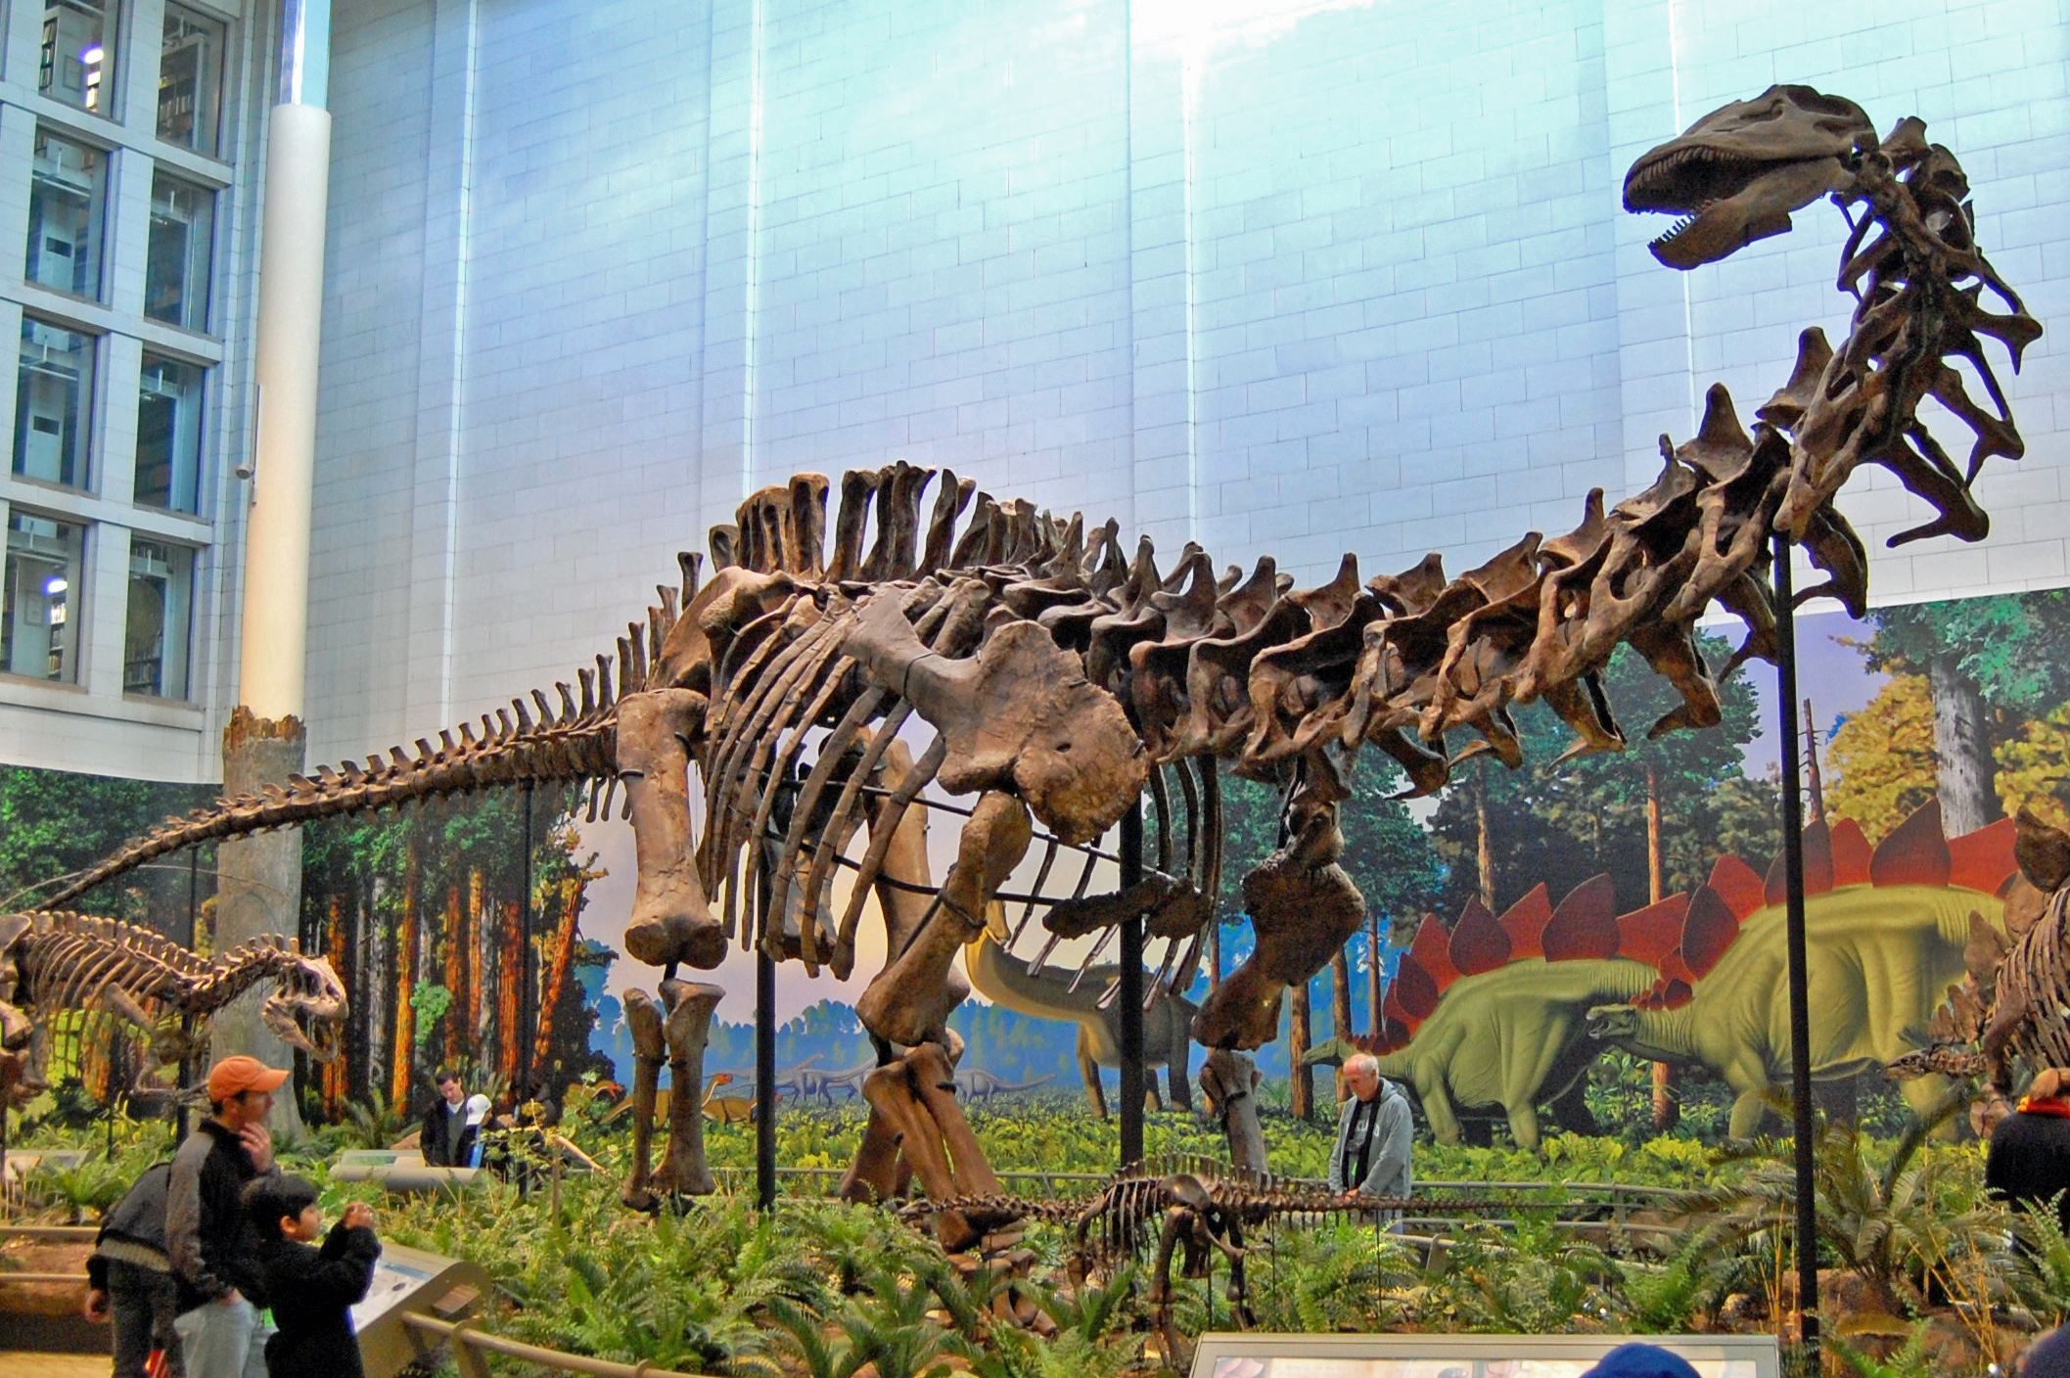
A Sauropod fossil skeleton
Notes:
The WAY… “Jesus is not God”

Slide 40
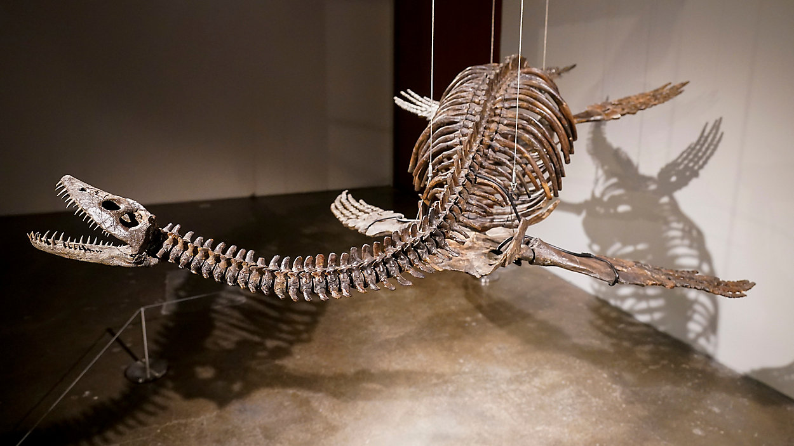
A Plesiosaur fossil skeleton
Notes:
The WAY… “Jesus is not God”

Slide 41
Verses 28, “The Blessing”
28 And God blessed them. And God said to them, “Be fruitful and multiply and fill the earth and subdue it, and have dominion over the fish of the sea and over the birds of the heavens and over every living thing that moves on the earth.”
God blesses his creation. An act of adoration and provision.
QUESTION: Then, what multipart commandments does God speak?
  Be fruitful (produce good works in abundance)
  Multiply (procreate)
  Fill the earth. QUESTION: Is the earth in danger of overpopulation?
  Subdue it. QUESTION: What does this mean?
  Have dominion over every living thing. We are his earthly administrators.
Notes:
The WAY… “Jesus is not God”

Slide 42
Verses 29-30, “The Provision”
29 And God said, “Behold, I have given you every plant yielding seed that is on the face of all the earth, and every tree with seed in its fruit. You shall have them for food. 30 And to every beast of the earth and to every bird of the heavens and to everything that creeps on the earth, everything that has the breath of life, I have given every green plant for food.” And it was so.
QUESTION: What was God’s original plan for man’s nourishment?
QUESTION: And what food was provided for the animals?
  What about carnivores, like lions and wild dogs?
Scientists say that the types of teeth reveal the diet.
  Consider this prophetic verse: The wolf and the lamb shall graze together; the lion shall eat straw like the ox, and dust shall be the serpent’s food. They shall not hurt or destroy in all my holy mountain,” says the LORD.(Isa 65:25)
Notes:
The WAY… “Jesus is not God”

Slide 43

Notes:
The WAY… “Jesus is not God”

Slide 44

Notes:
The WAY… “Jesus is not God”

Slide 45
Verse 31, “very good”
31 And God saw everything that he had made, and behold, it was very good. And there was evening and there was morning, the sixth day.
QUESTION: In what way does God describe the close of the sixth day that is different from all other days?
  Very good, Heb (tob meod) “good, exceedingly”
  His work is complete.
QUESTION: Until now, was anything God made not good?
  Moses also uses a different Hebrew construction for the 6th Day:
  “A DAY, THE SIXTH”. QUESTION: Why?
  He will also use the same emphatic construction for the 7th Day in the next chapter
Notes:
The WAY… “Jesus is not God”

Slide 46
Last Three Days Summary
Day Four (luminaries)
  God creates lights in the expanse of heaven
  Sun, Moon, and stars
Day Five (creatures of sea and air)
  God creates the swarms of creatures of the seas
  He also creates the birds of the sky
Day Six (land creatures, man and woman)
  God creates livestock, creeping things and beasts
  He makes man and woman
  He provides green plants for all to eat
  God saw that “it was very good”
Notes:
The WAY… “Jesus is not God”

Slide 47
Concluding…
In this chapter God created the heavens and the earth, and all that is in them.
QUESTION: When did God create the heavenly angels?
  It’s not 100% clear from the bible, however…
  Consider that angels inhabit God’s domain (heaven)
  God and his domain are outside of the created world
  Time is part of the created world, so they are outside of time
  Then, there is this verse from Job:
    Job 38:4-7, 4 Where were you when I laid the foundation of the earth? Tell me, if you have understanding. 5 Who determined its measurements—surely you know! Or who stretched the line upon it? 6 On what were its bases sunk, or who laid its cornerstone, 7 when the morning stars sang together and all the sons of God shouted for joy?
Notes:
The WAY… “Jesus is not God”

Slide 48
Concluding…
So, apparently, the angels in heaven were a witness to the creation of the heavens and the earth.
  When was it?
    Impossible to answer since time has no meaning in their realm
  The bible is a message to mankind
  Apparently, these details are not meant for us
  Angels probably had a beginning, and are eternal like us
    Mar 12:25, For when they (we) rise from the dead, they neither marry nor are given in marriage, but are like angels in heaven.
  Marriage is given for companionship and procreation
Notes:
The WAY… “Jesus is not God”

