Slide 1


Chapter 2
Chapter 2

Slide 2

WiFi Access
Campus WiFi is quite slow with so many people using it. So, we have set up a local hotspot. If you want faster Internet, scan this QR Code to connect to the hotspot network in this classroom.
Genesis PW: Adam&Eve

Slide 3

Class Registration
Register for this class (if you haven’t already) so that I can communicate with you by Email important information from time to time.

Slide 4

Class Website (http only!)
We have set up a website for this class that has calls materials, as well as excellent supplementary materials. If you want to learn even more, please visit the site. Click the Genesis Menu item.
http://sound-doctrine.us

Slide 5

Zoom Link
We realize some of you can’t make it every week (but please try!). We have arranged for a Zoom meeting for each class. Click the QR code here; or take a picture of it to send it to friends who may want to follow the class remotely.

Slide 6

Anonymous Questions?
Sometimes people are hesitant to ask questions in class. We have the solution. Anonymously ask any question by texting “Answers” to 877-324-4480 to register; and then text your question. Or scan this QR code, which also appears on the website.

Slide 7

DNA Replication

Slide 8

Genesis Chapter 2:1-3, God Rests
1 Thus the heavens and the earth were finished, and all the host of them. 2 And on the seventh day God finished his work that he had done, and he rested on the seventh day from all his work that he had done. 3 So God blessed the seventh day and made it holy, because on it God rested from all his work that he had done in creation.
Notes:
The WAY… “Jesus in not God”

Slide 9
God rests, Genesis 2:1-3
1 Thus the heavens and the earth were finished, and all the host of them. 2 And on the seventh day God finished his work that he had done, and he rested on the seventh day from all his work that he had done. 3 So God blessed the seventh day and made it holy, because on it God rested from all his work that he had done in creation.
  Many creation studies put this verse at the end of Chapter 1
    The MacArthur Bible Study book does this
  The original Hebrew text did not have chapter divisions
  The ones we use today were developed in the 13th century monk, Stephen Langton
  QUESTION: Why do you think he did it this way?
    Possibly to emphasize that creation took place in six days
  On the seventh day, God rested and admired His creation
Notes:
The WAY… “Jesus in not God”

Slide 10
God rests, page 2
1 Thus the heavens and the earth were finished, and all the host of them. 2 And on the seventh day God finished his work that he had done, and he rested on the seventh day from all his work that he had done. 3 So God blessed the seventh day and made it holy, because on it God rested from all his work that he had done in creation.
  “Rested”, Hebrew: Shabbath, means to cease, desist, rest
    QUESTION: What is a “rest” in music?
    It’s not our human understanding of rest. God does not need rest!
    Psalm 121:3-4, 3 He will not let your foot be moved; he who keeps you will not slumber. 4 Behold, he who keeps Israel will neither slumber nor sleep.
    Isa 40:28, Have you not known? Have you not heard? The Lord is the everlasting God, the Creator of the ends of the earth. He does not faint or grow weary; his understanding is unsearchable.
Notes:
The WAY… “Jesus in not God”

Slide 11
God rests, page 3
1 Thus the heavens and the earth were finished, and all the host of them. 2 And on the seventh day God finished his work that he had done, and he rested on the seventh day from all his work that he had done. 3 So God blessed the seventh day and made it holy, because on it God rested from all his work that he had done in creation.
  God blesses the day and makes it holy (sets it apart as special)
  QUESTION: And what did he rest from?
    Heb 4:3b, his works were finished from the foundation of the world
  QUESTION: Is God working now?
    John 5:17, But Jesus answered them, “My Father is working until now, and I am working.”
  QUESTION: Days, Months, Years! Where does our 7-day week come from?
  QUESTION: Do you ever wonder why God took so long to create? A model!
Notes:
The WAY… “Jesus in not God”

Slide 12
God rests, so we rest, page 4
Exodus 20:8-11, 8 “Remember the Sabbath day, to keep it holy. 9 Six days you shall labor, and do all your work, 10 but the seventh day is a Sabbath to the Lord your God. On it you shall not do any work, you, or your son, or your daughter, your male servant, or your female servant, or your livestock, or the sojourner who is within your gates. 11 For in six days the Lord made heaven and earth, the sea, and all that is in them, and rested on the seventh day. Therefore the Lord blessed the Sabbath day and made it holy.
  Creation week is the very basis for the working week
  How many days in a week?
  How long are the days?
Notes:
The WAY… “Jesus in not God”

Slide 13

Genesis 2:4, The First Toledot
4 These are the generations (toledot) of the heavens and the earth when they were created, in the day that the Lord God made the earth and the heavens.
Toledot (plural) “the procession of history as humans shape it”
This is the beginning of the human “story”
The record of generations
God says he made man
in Genesis 1:26.
  So, what’s this?
  Not a “second creation”
This is a deeper dive into
the creation of man and
the beginning of mankind.
Notes:
The WAY… “Jesus in not God”

Slide 14
Genesis 2:4, The First Toledot
4 These are the generations (toledot) of the heavens and the earth when they were created, in the day that the Lord God made the earth and the heavens.
Here we see the very first instance of “Lord God”
  Literally YHWY Elohiym. Occurring 20x in Genesis 2-3
  YHWY is considered to be the proper name for God
  QUESTION: Why does God start to use His proper name now (before it was just Elohiym)?
  NOTICE “in the day”, referring to all six creation days
  NOTICE now the switch in word order to “the earth and the heavens”. WHY?
Notes:
The WAY… “Jesus in not God”

Slide 15
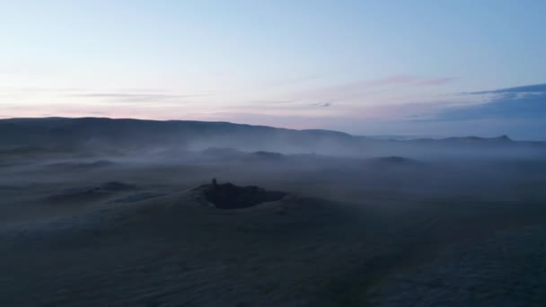
Genesis 2:5-6, State of the Earth Before Man
5 When no bush of the field was yet in the land and no small plant of the field had yet sprung up—for the Lord God had not caused it to rain on the land, and there was no man to work the ground, 6 and a mist was going up from the land and was watering the whole face of the ground.
Notes:
The WAY… “Jesus in not God”

Slide 16
Genesis 2:5-6, State of the Earth Before Man
5 When no bush of the field was yet in the land and no small plant of the field had yet sprung up—for the Lord God had not caused it to rain on the land, and there was no man to work the ground, 6 and a mist was going up from the land and was watering the whole face of the ground.
  QUESTION: What points do we see here?
    In Genesis 1:11, Did God himself bring forth plants?
      Or did He command the earth to do it?
  It says that plants for cultivation had not yet sprouted
  And there we no man to cultivate them
  And there not yet any rain (which these plants need)
Notes:
The WAY… “Jesus in not God”

Slide 17

Genesis 2:7, The Creation of Man (Adam)
7 then the Lord God formed the man of dust from the ground and breathed into his nostrils the breath of life, and the man became a living creature.
Man was created from the dust of the earth
He was alone, except for the creatures created on Day 6
The earth had not yet sprouted vegetation!
Notes:
The WAY… “Jesus in not God”

Slide 18
Genesis 2:7, The Creation of Man (Adam)
7 then the Lord God formed the man of dust from the ground and breathed into his nostrils the breath of life, and the man became a living creature.
  Man was “formed” from the dust of the earth (ground)
  Formed, Hebrew: yatsar, to shape or to fashion
    The imagery is that of a potter with clay
  Ground, Hebrew: adamah, from which we get “Adam”
  But then he does something not done with the animals
    He “breathed into his nostrils the breath of life”
    Hebrew: neshamah, breath, wind, or spirit of life
  So, man was made with non-living matter and made to live
  He was alone, except for the creatures created on Day 6
Notes:
The WAY… “Jesus in not God”

Slide 19
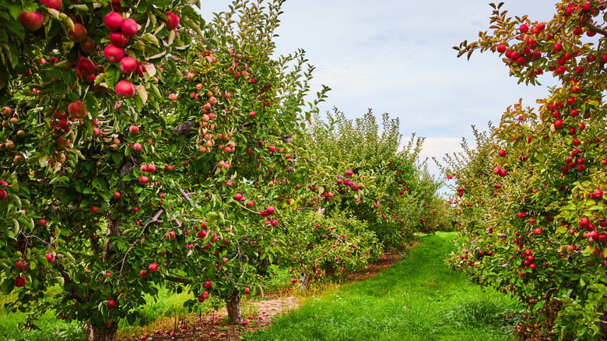
Genesis 2:8-9, The Garden and the Two Trees
8 And the Lord God planted a garden in Eden, in the east, and there he put the man whom he had formed. 9 And out of the ground the Lord God made to spring up every tree that is pleasant to the sight and good for food. The tree of life was in the midst of the garden, and the tree of the knowledge of good and evil.
Notes:
The WAY… “Jesus in not God”

Slide 20
Genesis 2:8-9, The Lord God Plants a Garden
8 And the Lord God planted a garden in Eden, in the east, and there he put the man whom he had formed. 9 And out of the ground the Lord God made to spring up every tree that is pleasant to the sight and good for food. The tree of life was in the midst of the garden, and the tree of the knowledge of good and evil.
God created a special place for Adam
  Eden means “delight” in Hebrew
  In the Greek OT (Septuagint) the word is “paradeisos”
QUESTION: Where else is the Tree of Life mentioned?
QUESTION: What is the purpose for the Tree of Life?
Notes:
The WAY… “Jesus in not God”

Slide 21
Genesis 2:8-9, The Lord God Plants a Garden
8 And the Lord God planted a garden in Eden, in the east, and there he put the man whom he had formed. 9 And out of the ground the Lord God made to spring up every tree that is pleasant to the sight and good for food. The tree of life was in the midst of the garden, and the tree of the knowledge of good and evil.
QUESTION: What is the purpose for the Tree of the knowledge of good and evil?
  Perhaps a test? Will they obey God?
  What would be the downside of taking from that tree?
  Sarfati says, “it gives man self-determination of right and wrong, a privilege that should belong only to God.”
Notes:
The WAY… “Jesus in not God”

Slide 22
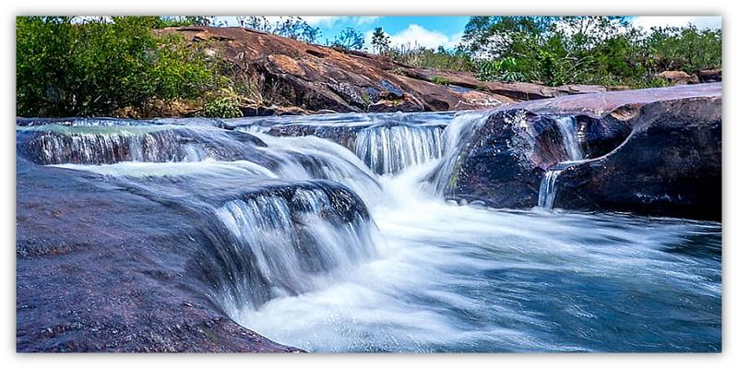
Genesis 2:10-14, Eden and the Four Rivers
10 A river flowed out of Eden to water the garden, and there it divided and became four rivers. 11 The name of the first is the Pishon. It is the one that flowed around the whole land of Havilah, where there is gold. 12 And the gold of that land is good; bdellium and onyx stone are there. 13 The name of the second river is the Gihon. It is the one that flowed around the whole land of Cush. 14 And the name of the third river is the Tigris, which flows east of Assyria. And the fourth river is the Euphrates.
Notes:
The WAY… “Jesus in not God”

Slide 23
Genesis 2:10-14, Eden and the Four Rivers
10 A river flowed out of Eden to water the garden, and there it divided and became four rivers. 11 The name of the first is the Pishon. It is the one that flowed around the whole land of Havilah, where there is gold. 12 And the gold of that land is good; bdellium and onyx stone are there. 13 The name of the second river is the Gihon. It is the one that flowed around the whole land of Cush. 14 And the name of the third river is the Tigris, which flows east of Assyria. And the fourth river is the Euphrates.
QUESTION: Where is Eden located?
Most rivers combine into one larger river
This river splits into four rivers, meaning it must be on a hill
And two of the rivers sound familiar
Notes:
The WAY… “Jesus in not God”

Slide 24
Genesis 2:10-14, Eden and the Four Rivers
10 A river flowed out of Eden to water the garden, and there it divided and became four rivers. 11 The name of the first is the Pishon. It is the one that flowed around the whole land of Havilah, where there is gold. 12 And the gold of that land is good; bdellium and onyx stone are there. 13 The name of the second river is the Gihon. It is the one that flowed around the whole land of Cush. 14 And the name of the third river is the Tigris, which flows east of Assyria. And the fourth river is the Euphrates.
Both the Tigris and Euphrates headwaters are in Turkey
Pishon, Havilah is thought to be on the Arabian Peninsula
Gihon; Flows around the land of Cush, which is Ethiopia
QUESTION: Did anything change on earth since creation?
Notes:
The WAY… “Jesus in not God”

Slide 25

Genesis 2:15-17, The Garden Commandment
15 The Lord God took the man and put him in the garden of Eden to work it and keep it.
16 And the Lord God commanded the man, saying, “You may surely eat of every tree of the garden,
17 but of the tree of the knowledge of good and evil you shall not eat, for in the day that you eat of it you shall surely die.”
Notes:
The WAY… “Jesus in not God”

Slide 26
Genesis 2:15-17, The Garden Commandment
15 The Lord God took the man and put him in the garden of Eden to work it and keep it. 16 And the Lord God commanded the man, saying, “You may surely eat of every tree of the garden, 17 but of the tree of the knowledge of good and evil you shall not eat, for in the day that you eat of it you shall surely die.”
QUESTION: What was the man’s purpose in the garden?
The man was given freedom to eat from any tree
QUESTION: What is the purpose of God’s commandment?
Hebrew: mut tamut. “dying you shall die”.
QUESTION: As God’s administrators are we expected to obey God’s commands?
Notes:
The WAY… “Jesus in not God”

Slide 27
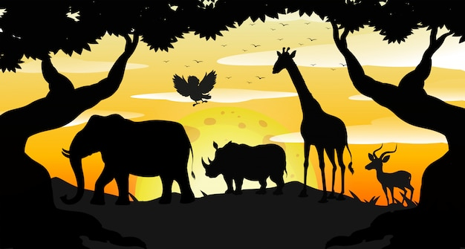
Genesis 2:18-20, The Man Names Creatures
18 Then the Lord God said, “It is not good that the man should be alone; I will make him a helper fit for him.” 19 Now out of the ground the Lord God had formed every beast of the field and every bird of the heavens and brought them to the man to see what he would call them. And whatever the man called every living creature, that was its name. 20 The man gave names to all livestock and to the birds of the heavens and to every beast of the field.
Notes:
The WAY… “Jesus in not God”

Slide 28
Genesis 2:18-20, The Man Names Creatures
18 Then the Lord God said, “It is not good that the man should be alone; I will make him a helper fit for him.” 19 Now out of the ground the Lord God had formed every beast of the field and every bird of the heavens and brought them to the man to see what he would call them. And whatever the man called every living creature, that was its name. 20 The man gave names to all livestock and to the birds of the heavens and to every beast of the field.
Here is the first thing that God declares “not good”
  “a suitable helper”, “a helper matchin or standing opposite him”
  Heb: ezer kenegdo. In Yiddish it means “aided by contrast”
  The idea is she the same, but actually quite opposite
  She is supplying what he lacks
Notes:
The WAY… “Jesus in not God”

Slide 29
Genesis 2:18-20a, The Man Names Creatures
18 Then the Lord God said, “It is not good that the man should be alone; I will make him a helper fit for him.” 19 Now out of the ground the Lord God had formed every beast of the field and every bird of the heavens and brought them to the man to see what he would call them. And whatever the man called every living creature, that was its name. 20 The man gave names to all livestock and to the birds of the heavens and to every beast of the field.
“had formed”, this is not a second creation, just a recap of the first!
God brought, and the man named, all livestock, birds and beasts
  A real time-saver! Perhaps about 2500 “kinds”
  5 seconds each, 5-minute break every hour, 4 hours total
Notes:
The WAY… “Jesus in not God”

Slide 30
Genesis 2:20b, Looking for Companionship
But for Adam there was not found a helper fit for him.
This is the first time “adam” is referred to without “the”
  Every other time it is “the man”. Now it is “Man”. Adam
Two purposes for naming the creatures
  To establish ownership over creation (dominion)
  To recognize his need for companionship
Helper fit: again, “ezer kenegdo”, same but different
  a partner made in the image of God like he was
  QUESTION: Is a dog man’s best friend?
Notes:
The WAY… “Jesus in not God”

Slide 31

Genesis 2:21-23, God creates Woman
21 So the Lord God caused a deep sleep to fall upon the man, and while he slept took one of his ribs and closed up its place with flesh. 22 And the rib that the Lord God had taken from the man he made into a woman and brought her to the man.
23 Then the man said, “This at last is bone of my bones and flesh of my flesh; she shall be called Woman, because she was taken out of Man.”
Notes:
The WAY… “Jesus in not God”

Slide 32
Genesis 2:21-23, God creates Woman
21 So the Lord God caused a deep sleep to fall upon the man (adam), and while he slept took one of his ribs (sela) and closed up its place with flesh. 22 And the rib that the Lord God had taken from the man (adam) he made into a woman and brought her to the man. 23 Then the man said, “This at last is bone of my bones and flesh of my flesh; she shall be called Woman (ishshah), because she was taken out of Man (ish).”
Here we se the very first surgery under anesthesia
Ribs, Heb: tsela, meaning the curved part of the side of the man
  Literally to build, or construct, or fashion from raw material, not molded
And now we see that the “man” refers to his wife as “ishshah”
And he refers to himself as “ish”. Something perhaps changed.
Ever wonder why the man carries both X and Y chromosomes?
Notes:
The WAY… “Jesus in not God”

Slide 33
Genesis 2:21-23, God creates Woman
21 So the Lord God caused a deep sleep to fall upon the man (adam), and while he slept took one of his ribs (sela) and closed up its place with flesh. 22 And the rib that the Lord God had taken from the man (adam) he made into a woman and brought her to the man. 23 Then the man said, “This at last is bone of my bones and flesh of my flesh; she shall be called Woman (ishshah), because she was taken out of Man (ish).”
QUESTION: Why would God take something from Adam’s own body, fashion it into a beautiful woman, and then present her to him as a wife?
Adam was taken for the ground, so, he has a natural affinity to the things of the earth. Eve has an has an affinity toward her husband.
QUESTION: So, is Eve descended from Adam?
QUESTION: On what day did all this happen?
Notes:
The WAY… “Jesus in not God”

Slide 34
Genesis 2:21-23, God creates Woman
21 So the Lord God caused a deep sleep to fall upon the man (adam), and while he slept took one of his ribs (sela) and closed up its place with flesh. 22 And the rib that the Lord God had taken from the man (adam) he made into a woman and brought her to the man. 23 Then the man said, “This at last is bone of my bones and flesh of my flesh; she shall be called Woman (ishshah, because she was taken out of Man (ish).”
Adam writes poetry! This at last!
  These are the first recorded words of Adam in the bible
Young’s Literal Translation renders it this way
  `This [is] the [proper] step! bone of my bone, and flesh of my flesh!' for this it is called Woman, for from a man hath this been taken;
  QUESTION: Is Adam excited?
Notes:
The WAY… “Jesus in not God”

Slide 35
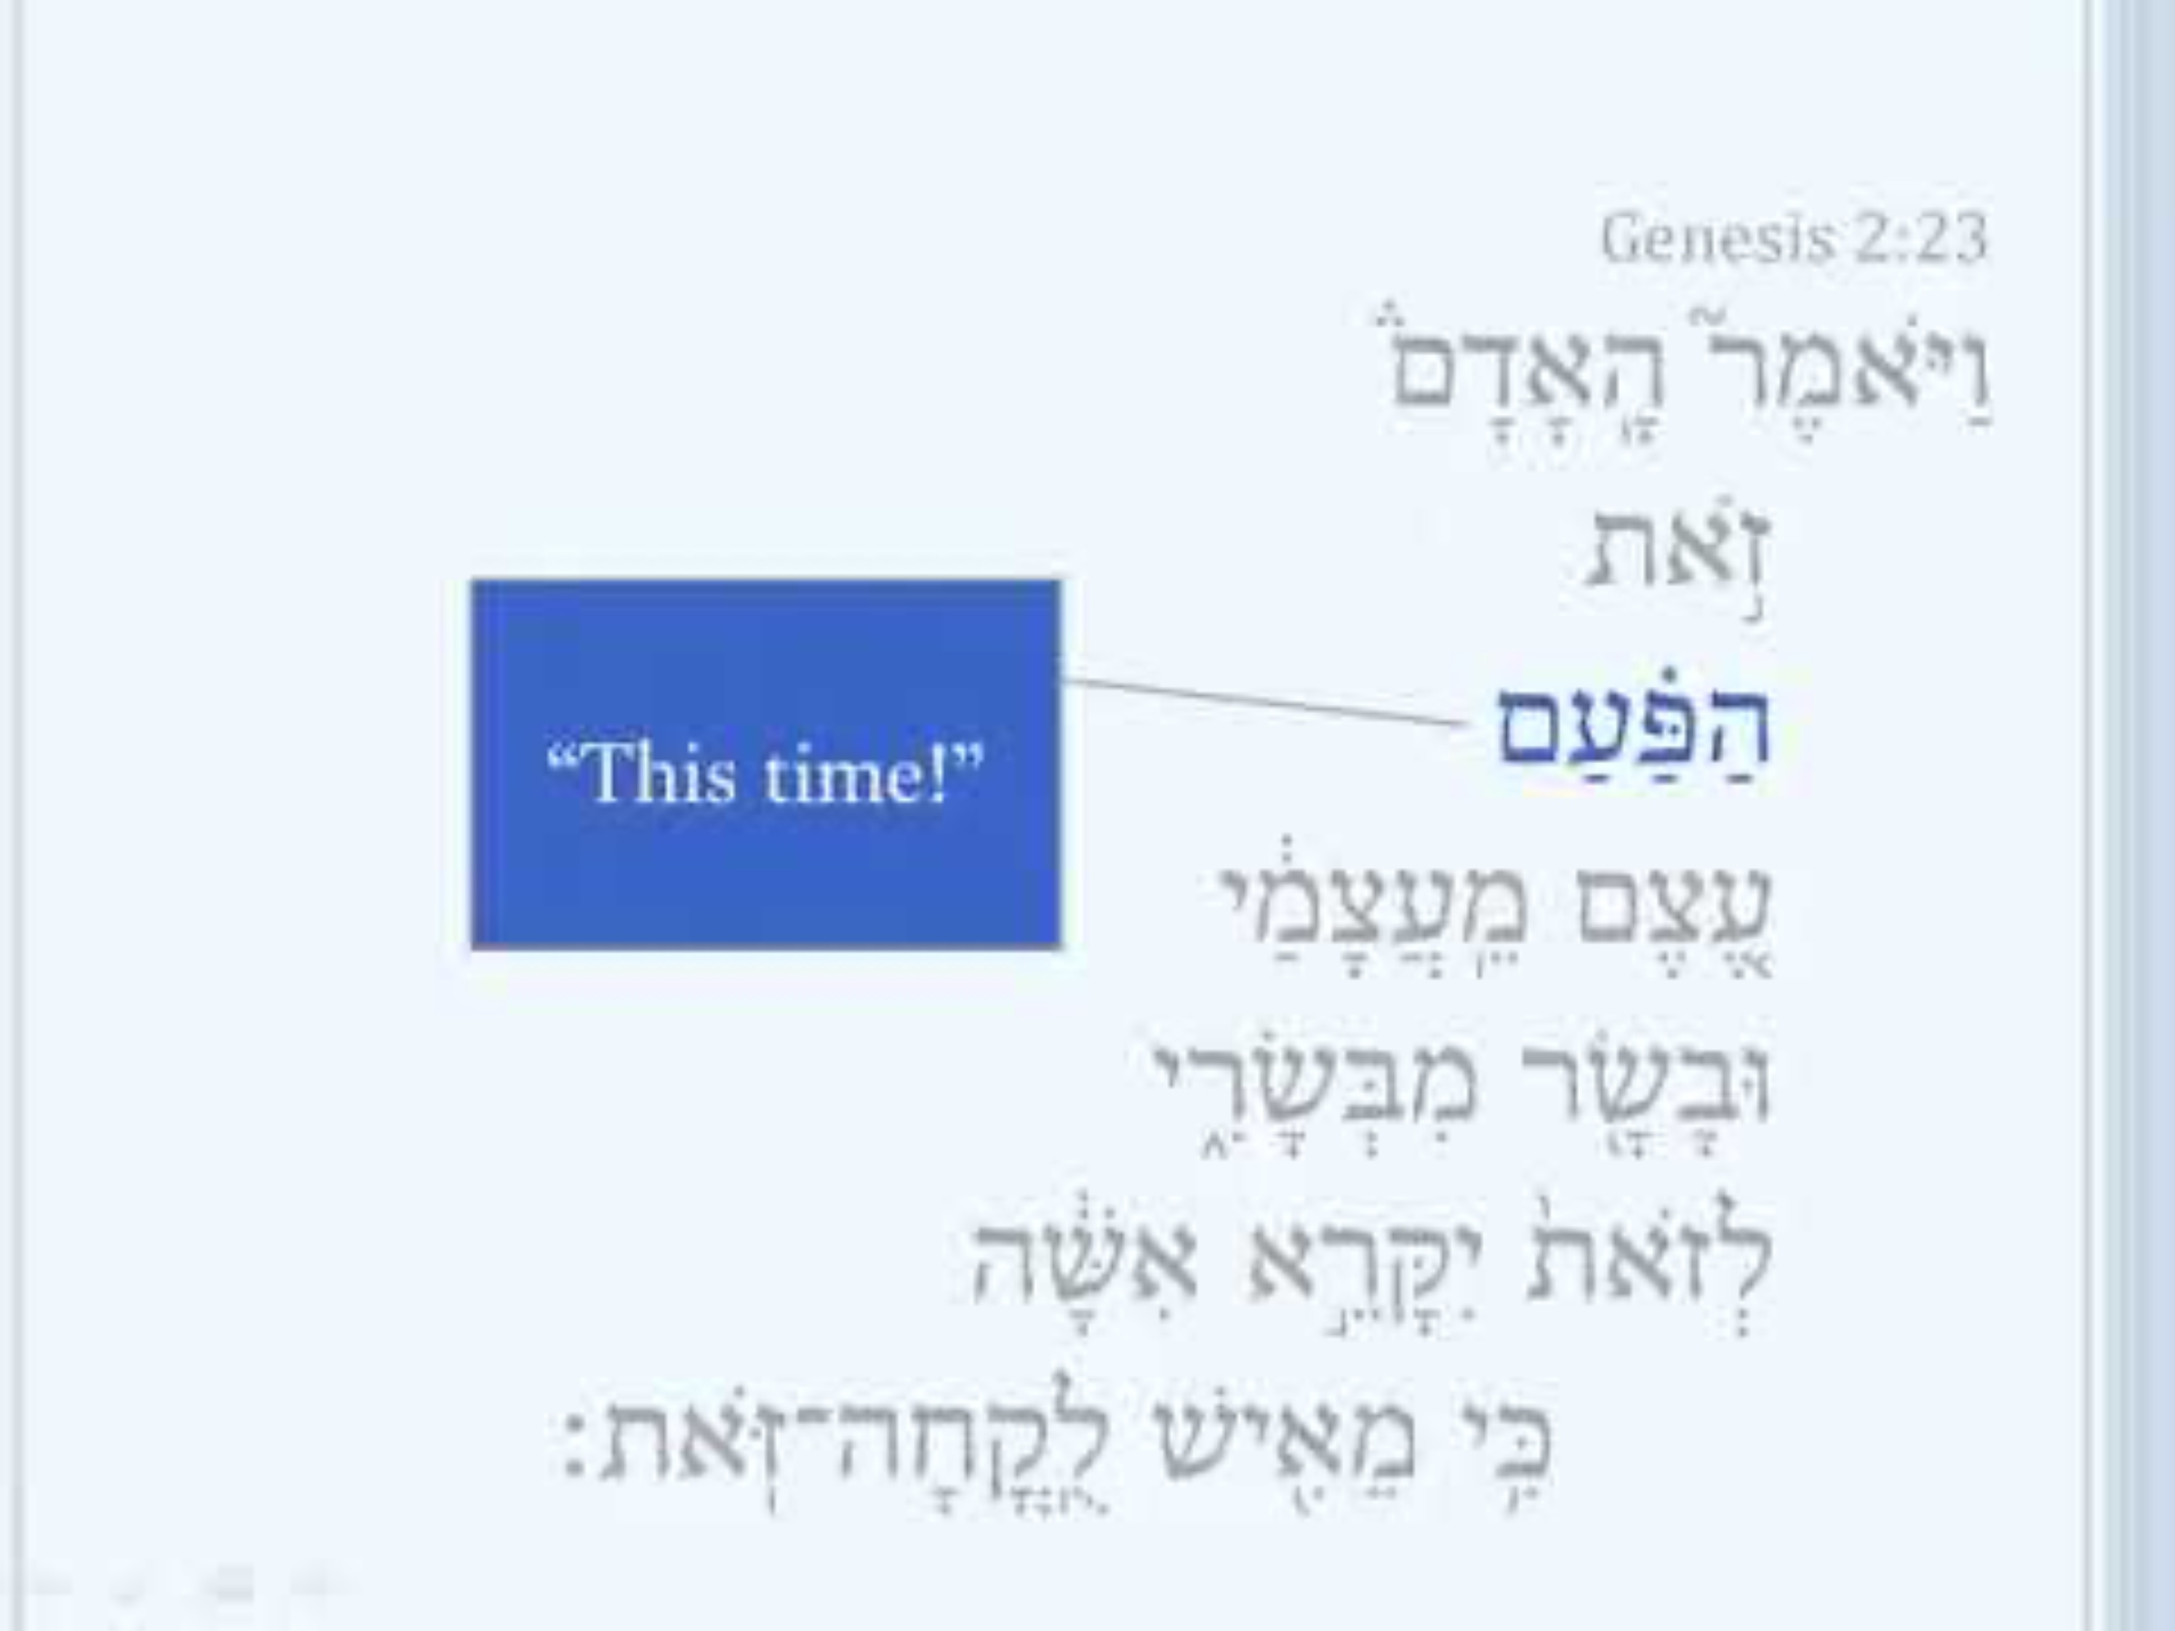
Genesis 2:23, Adam’s Love Poem in Hebrew
Notes:
The WAY… “Jesus in not God”

Slide 36
Genesis 2:24-25, God creates Marriage
24 Therefore a man shall leave his father and his mother and hold fast to his wife, and they shall become one flesh. 25 And the man and his wife were both naked and were not ashamed.
  QUESTION: Is this a heterosexual marriage?
  QUESTION: Is it monogamous?
  “hold fast”, to be metaphorically “glued” together
  “one flesh”, intimacy is ordained by God inside of this context
  QUESTION: Does this leave room for premarital or extra marital sex?
    Jesus on marriage: “But from the beginning of creation, ‘God made them male and female.’ 7 ‘Therefore a man shall leave his father and mother and hold fast to his wife, 8 and the two shall become one flesh.’ So they are no longer two but one flesh. 9 What therefore God has joined together, let not man separate.” Mat 19:4-6, Mark 10:6-9
Notes:
The WAY… “Jesus in not God”

Slide 37

Genesis 2:24-25, God creates Marriage
24 Therefore a man shall leave his father and his mother and hold fast to his wife, and they shall become one flesh.
25 And the man and his wife were both naked and were not ashamed.
Notes:
The WAY… “Jesus in not God”

