Slide 1


Chapter 2
Chapter 2

Slide 2
Genesis 23, Adam Writes Poetry
Then the man said, “This at last is bone of my bones and flesh of my flesh; she shall be called Woman (ishshah), because she was taken out of Man (ish).”
Adam writes poetry! This at last!
These are the first recorded words of Adam in the bible
Notes:
The WAY… “Jesus in not God”

Slide 3
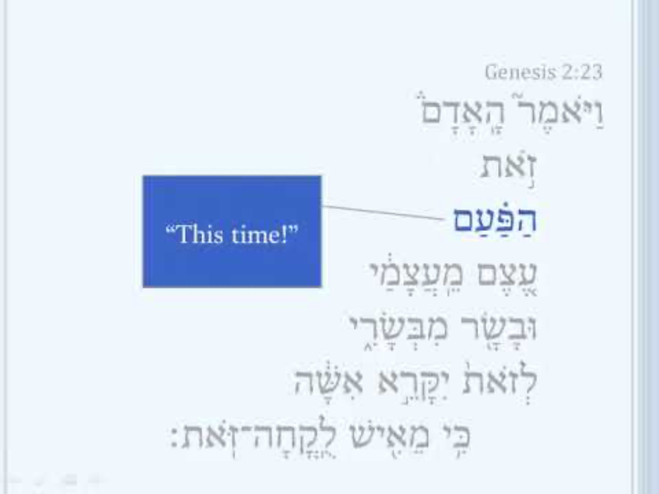
Genesis 2:23, Adam’s Love Poem in Hebrew
Notes:
The WAY… “Jesus in not God”

Slide 4

From Last Time, God creates Marriage
24 Therefore a man shall leave his father and his mother and hold fast to his wife, and they shall become one flesh.
25 And the man and his wife were both naked and were not ashamed.
Notes:
The WAY… “Jesus in not God”

Slide 5
From Last Time, God creates Marriage
God said his creation was very good (tob meod)
The only thing that God declared “not good” was for man to be alone.
God has said this right at the end of Chapter 2
Notes:
The WAY… “Jesus in not God”

Slide 6
Chapter 3
Chapter 3

Slide 7
QUESTION:
Does the New Testament support the literal, historic nature Genesis Account?
The genealogy in Mathew 1 traces the ancestry of Jesus (through Mary) back to Abraham (Genesis 12).
Luke 3:23-38, traces the ancestry of Jesus (through Joseph) all the way back to Adam!
John 8:44, [Jesus, talking with some unbelievers] You are of your father the devil, and you want to do the desires of your father. He was a murderer from the beginning, and does not stand in the truth because there is no truth in him. Whenever he tells a lie, he speaks from his own nature, because he is a liar and the father of lies.
1 Cor 11:8-9, For man [a]does not originate from woman, but woman from man; 9 for indeed man was not created for the woman’s sake, but woman for the man’s sake.

Slide 8
QUESTION:
Does the New Testament support the literal, historic nature Genesis Account?
2 Cor 11:3, But I am afraid that, as the serpent deceived Eve by his trickery, your minds will be led astray from sincere and pure devotion to Christ.
1 Tim 2:13-14, For it was Adam who was first [a]created, and then Eve. 14 And it was not Adam who was deceived, but the woman was deceived and became a wrongdoer.
2 Pet 3:5-6, it escapes their notice that by the word of God the heavens existed long ago and the earth was formed out of water and by water, 6 through which the world at that time was destroyed, being flooded with water.
Rev 12:9-10, And the great dragon was thrown down, the serpent of old who is called the devil and Satan, who deceives the whole world; he was thrown down to the earth, and his angels were thrown down with him.

Slide 9
Answer:
Absolutely!
Those who say the believe the New Testament but don’t believe parts of the Old Testament are self-contradictory.
Genesis is literal history
David L. Cooper’s Golden Rule of Interpretation
  “When the plain sense of scripture makes common sense, seek no other sense; therefore, take every word at its primary, ordinary, and usual meaning unless the facts of the immediate context, studied in light of related passages and axiomatic and fundamental truths, indicate clearly otherwise.”

Slide 10
Scoffers?
Genesis Chapter 3 is one of the most attacked passages in the bible
2 Pet 3:3, I want to remind you that in the last days scoffers will come, mocking the truth and following their own desires.
Jude 1:17-19, But you, beloved, ought to remember the words that were spoken beforehand by the apostles of our Lord Jesus Christ, 18 that they were saying to you, “In the last time there will be mockers, following after their own ungodly lusts.” 19 These are the ones who cause divisions, worldly-minded, devoid of the Spirit.
QUESTION: Why do they scoff, especially about Genesis 3?

Slide 11
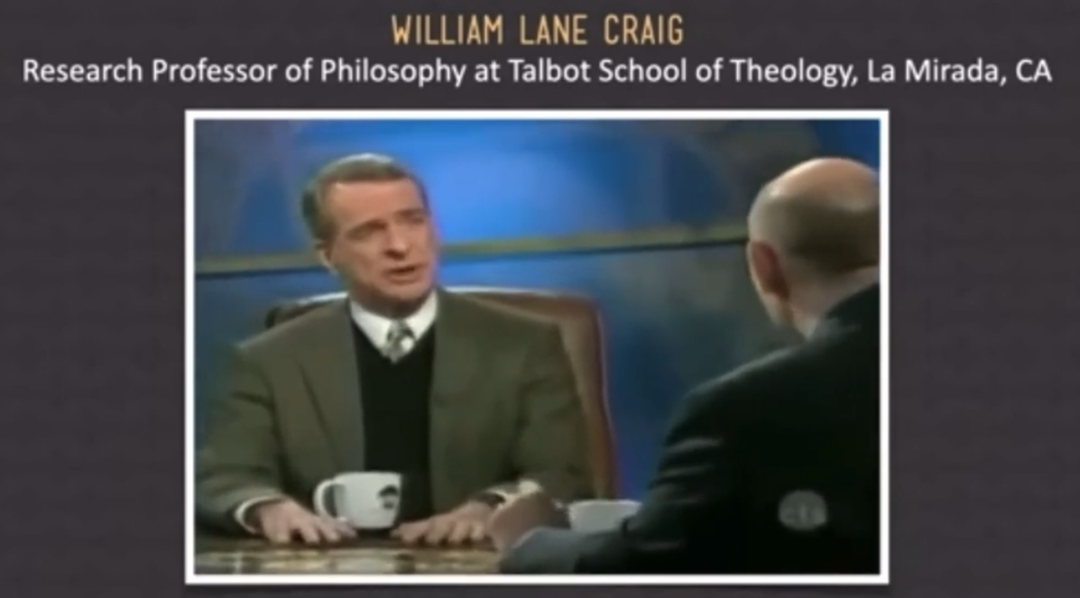


Slide 12
Genesis 3 explains the world in which we live!
Why is there evil and suffering and death?
Why are there wars, famines, diseases and pestilences?
Why is there rape and murder and adultery and abortion?
Why do we need a Savior?
  This last one is of particular concern to Satan
  Throw away, allegorize, or distort chapter 3 and…
    There is no understanding of the nature of universal sin
    No sin, no need for redemption
    No need for redemption, Jesus becomes unnecessary
    Without Jesus we are going to hell

Slide 13
An Introduction to Good and Evil, page 1
God is the source of all goodness
  When God created, He called His creation very good
  There was no actual evil
  Did God create any evil?
    He did not, nor can He
Good is an intrinsic quality of something
Evil is not a thing in itself
Rather, evil is the privation or corruption of some good that something ought to have (Augustine)
  murder is the removal of human life, an intrinsic good
  adultery is the privation of marriage, another intrinsic good
  hate destroys relationship, another intrinsic good

Slide 14
An Introduction to Good and Evil, page 2
QUESTION: So where does evil come from?
  God created everything “good”, including man and even the angels of heaven.
  But both men and angels were created with the power of “contrary choice”.
  We (and they) have the power to make a choice contrary to our good nature.
QUESTION: Is the power of contrary choice good?
  God himself does not have the power of contrary choice (he cannot go against his own nature)
  However, the power of contrary choice is good. God allowed it.
  Otherwise, we would be a race of robots. But it also brings with it the possibility of evil.

Slide 15
An Introduction to Good and Evil, page 3
QUESTION: what’s the good that can come out of our making a contrary choice?
  The opportunity to love God freely.
  Real love must be free
QUESTION: So why doesn’t God immediately destroy evil?
  He will do someday! He certainly could do it.
  Because he would have to destroy all of us as well!
  Revelation tells us the story, in God’s time!

Slide 16
Genesis 3:1a, Now the serpent was more crafty than any other beast of the field that the Lord God had made.
  The Hebrew word “Nachash” in the bible is literally a serpent (or snake) and is also used figuratively in the OT
  Nachash is synonymous with Hebrew Tannin, which means “dragon”
    Rev 20:2, uses both terms, And he laid hold of the dragon, the serpent of old, who is the devil and Satan, and bound him for a thousand years
Used Literally
  Ex 4:3, Moses throwing his staff on the ground and it became a serpent
  Num 21:7, “intercede with the Lord that he may remove the serpents from us”

Slide 17
Genesis 3:1a, Now the serpent was more crafty than any other beast of the field that the Lord God had made.
Used Figuratively
  Gen 49:17, “Dan shall be a serpent in the way, a horned snake in the path”
  Psa 58:5, “The wicked are estranged from the womb; These who speak lies go astray from birth. They have venom like the venom of a serpent;”
  Psa 140:2-3, Rescue me, O LORD, from evil men; Preserve me from violent men Who devise evil things in their hearts; They continually stir up wars. They sharpen their tongues as a serpent; Poison of a viper is under their lips.
QUESTION: Who is speaking in this first part of verse 1?

Slide 18
Genesis 3:1a, Now the serpent was more crafty than any other beast of the field that the Lord God had made.
  We can safely say that the Genesis 3 is both literal and figurative
    Probably Satan inhabited the body of serpent, and because of the nature of his activity in the garden (that of deception)
  “More crafty”, because snakes are crafty?
    But also, because Satan was behind the craftiness
    Means deceitful, shrewd. You could say snakes sneak up on their pray using stealth and then pounce!
    Mat 10:16, “Behold, I send you out as sheep in the midst of wolves; so be shrewd as serpents and innocent as doves.”

Slide 19
Genesis 3:1b, And he said to the woman, “indeed, has God said, ‘You shall not eat from any tree in the garden’?”
QUESTION: What word is missing from this quote from Satan?
Why would Satan leave that word out? What’s he doing here?
  Isa 14:13, [Speaking of Satan] “But you said in your heart, ‘I will ascend to heaven; I will raise my throne above the stars of God, And I will sit on the mount of assembly In the recesses of the north. 14 ‘I will ascend above the heights of the clouds; I will make myself like the Most High.’
QUESTION: Why did Satan attack the woman?
  Designed to be tender, compassionate, caring, under the protection of the husband
  The husband is the hunter, protector, provider, the one who loves, leads
  Perhaps he, as her covering and authority, wasn’t with her when she was being tempted

Slide 20
Genesis 3:1b, And he said to the woman, “indeed, has God said, ‘You shall not eat from any tree in the garden’?”
QUESTION: What was his tactic?
  Distorting what God had said, and turning it into a question
  He implied that God was restricting them from something good.
  This was disguised as a deceptive request for clarification of God’s word
  In other words, he intended to lead her in the “correct” interpretation of God’s word
  He wanted her to make a decision apart from Adam
The fact that she even engaged the serpent in a conversation is surprising, a tribute to his cunning
  Should we even entertain anything that desires to tempt us to do wrong?

Slide 21
Genesis 3:2-3, The woman said to the serpent, “From the fruit of the trees of the garden we may eat; 3 but from the fruit of the tree which is in the middle of the garden, God has said, ‘You shall not eat from it or touch it, or you will (may) die.’”
QUESTION: What two issues do you see with Eve’s response?
She demonstrated an incomplete understanding of God’s command
  Hebrew “pun mut” means “you may die” (subjunctive form)
  Gen 2:17, “you shall surely die” translates “mut tamut”, dying (absolutely) you will die!
  Using the word “mut” twice establishes certainty, and may also reference both physical AND spiritual death

Slide 22
Genesis 3:2-3, The woman said to the serpent, “From the fruit of the trees of the garden we may eat; 3 but from the fruit of the tree which is in the middle of the garden, God has said, ‘You shall not eat from it or touch it, or you will (may) die.’”
She also added a command to what God said, “or touch it”
  This may have been a prohibition given by Adam for her protection
  It’s a form of legalism that we know is ineffective in bringing forth righteousness
  Or, she added “or touch it” because she felt that God was harsh and restrictive
  Notice Eve does not refer to God as “Lord God”
  Perhaps only using the name Satan gave Him

Slide 23
Gen 3:4-5, But the serpent said to the woman, “You will not surely die. 5 For God knows that when you eat of it your eyes will be opened, and you will be like God, knowing good and evil.”
Satan outright lies, you surely will not die! You will “not mut tamut”, not die dying! (a lie)
This is why Satan is called by John a murder (bringing death), and a liar from the beginning
  John 8:44, 44 You are of your father the devil, and you want to do the desires of your father. He was a murderer from the beginning, and does not stand in the truth because there is no truth in him. Whenever he speaks a lie, he speaks from his own nature, for he is a liar and the father of lies.

Slide 24
Gen 3:4-5, But the serpent said to the woman, “You will not surely die. 5 For God knows that when you eat of it your eyes will be opened, and you will be like God, knowing good and evil.”
He gets her to doubt the character of God
  “God is withholding something good”
  He makes God’s Word subject to her own judgment
  Should we bring our own judgment to bear on the clear meaning of God’s Word?
He gets her to focus on the prohibition instead of the abundant freedom she was given by God
  This prohibition makes it seem like God is restrictive and Satan is for complete freedom
  QUESTION: What’s really happening here? Is God restrictive? Is Satan for freedom?

Slide 25
Gen 3:4-5, But the serpent said to the woman, “You will not surely die. 5 For God knows that when you eat of it your eyes will be opened, and you will be like God, knowing good and evil.”
He gets her to doubt the Word of God; “You shall not surely die”
He gets her to believe the lie of Satan; “You will be like God”
QUESTION: Is it OK to want to be like God? Does God want us to be like Him? In what ways?

Slide 26
Gen 3:6, So when the woman saw that the tree was good for food, and that it was a delight to the eyes, and that the tree was to be desired to make one wise,[b] she took of its fruit and ate, and she also gave some to her husband who was with her, and he ate.
What were the three things that tempted Eve to take and eat the fruit?
  Lust of the flesh – even though she could have chosen from all the other trees
  Desire of the eyes – beautiful, but the tree of life is also beautiful
    Rev 22:2, On either side of the river was the tree of life, bearing twelve kinds of fruit, yielding its fruit every month; and the leaves of the tree were for the healing of the nations.
  Pride of life – The desire to be like God. (Not in character, in position)
QUESTION: Why do we need to be like God if we really know and follow God?
QUESTION: Do we get more fulfilment out of disobeying God or obeying God

Slide 27
Gen 3:6, So when the woman saw that the tree was good for food, and that it was a delight to the eyes, and that the tree was to be desired to make one wise,[b] she took of its fruit and ate, and she also gave some to her husband who was with her, and he ate.
So, is there something “magical” about the fruit itself?
  Definitely something spiritual!
The real issue was one of trusting God and being obedient to God’s commandment!
So Eve was DECEIVED
Question: Was Adam deceived? No. He was DISOBEDIENT! Paul explains it like this:
  Rom 5:19, 19 For as through the one man’s disobedience the many were made sinners, even so through the obedience of the One the many will be made righteous.
Perhaps Adam saw that Eve did NOT die after eating the fruit, sight doesn’t reveal everything!
Anyone who says obedience doesn’t matter doesn’t get it!

Slide 28
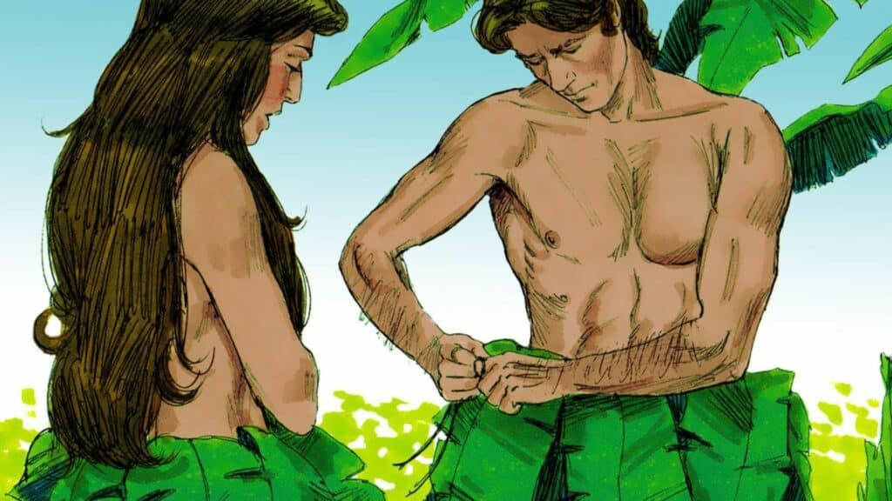
Gen 3:7, Then the eyes of both were opened, and they knew that they were naked. And they sewed fig leaves together and made themselves loincloths.
Their worldview had changed, and now they saw their whole world through sinful eyes
Sin can pervert even the most innocent things, and turn them evil
When they made loin coverings for themselves, was that the correct response? Yes, but inadequate!
Why do we wear clothes today, other than for fashion and warmth?
  To cover shame!
What about indigenous tribes that go without clothes, or nudists? Have they found freedom from shame?
  No! They trample over their own conscience.
What about pornographers? What do they do? What is the intent of their uncovering?

Slide 29
Gen 3:8-13, And they heard the sound of the Lord God walking in the garden in the cool[c] of the day, and the man and his wife hid themselves from the presence of the Lord God among the trees of the garden. 9 But the Lord God called to the man and said to him, “Where are you?”[d] 10 And he said, “I heard the sound of you in the garden, and I was afraid, because I was naked, and I hid myself.” 11 He said, “Who told you that you were naked? Have you eaten of the tree of which I commanded you not to eat?” 12 The man said, “The woman whom you gave to be with me, she gave me fruit of the tree, and I ate.” 13 Then the Lord God said to the woman, “What is this that you have done?” The woman said, “The serpent deceived me, and I ate.”

Slide 30
QUESTION? How can God, who is spirit, “walk” in the garden?
  Gen 18:1-2, Now the LORD appeared to [Abraham] by the [a]oaks of Mamre, while he was sitting at the tent door in the heat of the day. 2 When he lifted up his eyes and looked, behold, three men were standing opposite him; and when he saw them, he ran from the tent door to meet them and bowed himself to the earth.
  Gen 32:24–25, 28–30, Then Jacob was left alone; and a Man wrestled with him until the breaking of day. Now when He saw that He did not prevail against him, He touched the socket of his hip; and the socket of Jacob’s hip was out of joint as He wrestled with him. . . . And He said, “Your name shall no longer be called Jacob, but Israel; for you have struggled with God and with men, and have prevailed.” Then Jacob asked, saying, “Tell me Your name, I pray.”And He said, “Why is it that you ask about My name?” And He blessed him there. So Jacob called the name of the place Peniel: “For I have seen God face to face, and my life is preserved.”
  These are known as Theophanies, or Christophanies (God-appearances, or Christ appearances)
  How could Jacob see God and not die?
    Probably a “veiled” version of God in the form of Christ.

Slide 31
E.J. Young, a well-known Old Testament scholar, writes, “God is the infinite one. He is a spirit. In order to reveal Himself to man in an intimate way, He did appear during Old Testament times in human form. Such appearances were called theophanies and these theophanies found their culmination in the incarnation of the second person of the trinity. Pre-incarnate appearances of the Lord is what they were. In most loving and tender condescension, God appeared in the form of a man so that He might speak to man as friend to friend.”
QUESTION? How would they have responded to God walking in the garden before the transgression?
QUESTION? Why did they hide? What do we do when are ashamed over having done something wrong
QUESTION? How do people hide from God today?
QUESTION? Is it even possible to hide from God? (Psa 139:7-10)

Slide 32
QUESTION? When God’s asks Adam “where are you”, what information is He looking for?
  Confession!
QUESTION? Does Adam give God a confession, or an excuse? Why is Adam afraid of God now?
  Heb 2:14-15, Therefore, since the children share in [m]flesh and blood, He Himself likewise also partook of the same, that through death He might render powerless him who had the power of death, that is, the devil, 15 and might free those who through fear of death were subject to slavery all their lives.
QUESTION? Then what does Adam say when God asks him if he ate from the tree?
  He shifts blame!
QUESTION? Who told Adam and Eve that they were naked?
  They were always naked. Nobody! It came from sin within them.
  This was an opportunity to confess what was going on within them

Slide 33
Instead Adam shifted blame to “the woman”, and to God.
Adam is supposed to defend and protect his wife, instead he blamed her.
  Guilt-Blame balance!
Likewise, Eve did not accept blame for her transgression. She blamed it on the serpent!
  The devil made me do it!
Suddenly, Adam and Even went from praising God to blaming him for their own transgressions
In an instant, sin turned them from lovers of God into haters of God
They are void of any love for God, they now see him as their judge

Slide 34
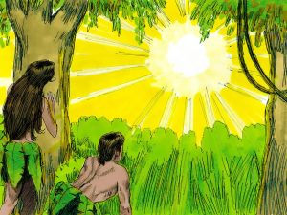
So now Satan, who wanted to become the sovereign of heaven, and now sees himself as the “sovereign” of earth.
  Adam and Eve are under his control
  all the generations of man that proceed from them (so he thinks)
  He is now the god of this age, and the ruler of this world.
QUESTION: Are they now bound by Satan?
QUESTION? How can they (we) solve their (our) problem without God making the first move?
2 Cor 4:4, the god of this world has blinded the minds of the unbelieving so that they might not see the light of the gospel of the glory of Christ, who is the image of God.
John 12:31, Now judgment is upon this world; now the ruler of this world will be cast out.

Slide 35
The Curse on the Serpent (the actual snake itself)
Gen 3:14, The Lord God said to the serpent, “Because you have done this, cursed are you above all livestock and above all beasts of the field; on your belly you shall go, and dust you shall eat all the days of your life.
The serpent was the instrument of Satan to lie and deceive, and as such is cursed
The serpent is punished as a symbol and lasting reminder of the punishment of Satan
The serpent was more cursed than the beasts of the field
Rabbinic Legend holds that the serpent was upright and had legs before the curse
The serpent was compared to the “beasts of the field” which are predominantly quadrupeds
After all, what’s the point of the curse, if the snake slithered on its belly before the fall?
Plus, there is the book of Revelation using the term serpent and dragon synonymously

Slide 36
The Curse on the Serpent (the actual snake itself)
Gen 3:14, The Lord God said to the serpent, “Because you have done this, cursed are you above all livestock and above all beasts of the field; on your belly you shall go, and dust you shall eat all the days of your life.
Eating dust is symbolic of the humiliation and defeat of a vanquished enemy
  Psa 72:9, Let the nomads of the desert bow before him, And his enemies lick the dust.
Snakes are associated with demon worship, and the occult.
The symbology of the snake: when we see one what should we be reminded of?
That Satan is defeated and humiliated, and even in the Millennial Earth, snakes are there!
  Isa 11:8, The nursing child will play by the hole of the cobra, and the weaned child will put his hand in the viper’s den. They will not hurt or destroy in all my holy mountain.
  Isa 65:25, The wolf and the lamb will graze together, and the lion will eat straw like the ox; and dust will be the serpent’s food. They will do no evil or harm in all My holy mountain,” says the LORD.

Slide 37
The Curse on Satan (the entity inside the serpent)
Gen 3:15, I will put enmity between you and the woman, and between your offspring and her offspring; he shall bruise your head, and you shall bruise his heel.”
This isn’t really about opposition and hostility between women and snakes
Rather God will make a way for Eve and her seed to oppose and be hostile toward Satan, and also Satan’s “seed”.
This is the introduction of God’s redemption plan for mankind
Satan may believe he has usurped God’s authority on earth by making Adam and Even his friends and God’s enemies, however, God is still sovereign!
Satan was cast out of heaven, taking 1/3 of the angels with him, which are now demons:
  Rev 12:3-4, Then another sign appeared in heaven: and behold, a great red dragon having seven heads and ten horns, and on his heads were seven diadems. 4 And his tail *swept away a third of the stars of heaven and threw them to the earth. And the dragon stood before the woman who was about to give birth, so that when she gave birth he might devour her child

Slide 38
Rev 12:3-4, Then another sign appeared in heaven: and behold, a great red dragon having seven heads and ten horns, and on his heads were seven diadems. 4 And his tail *swept away a third of the stars of heaven and threw them to the earth. And the dragon stood before the woman who was about to give birth, so that when she gave birth he might devour her child
Fallen angels have no redemption, and will be forever under the authority of Satan
Notice that Satan also wages war with the woman who was about to give birth
He’s been doing it throughout history!
  Mat 2:16, Then when Herod saw that he had been tricked by the magi, he became very enraged, and sent and slew all the male children who were in Bethlehem and all its vicinity, from two years old and under, according to the time which he had determined from the magi.
  Rev 12:9, And the great dragon was thrown down, the serpent of old who is called the devil and Satan, who deceives the whole world; he was thrown down to the earth, and his angels were thrown down with him.

Slide 39
The Curse on Satan (the entity inside the serpent)
Gen 3:15, I will put enmity between you and the woman, and between your offspring and her offspring; he shall bruise your head, and you shall bruise his heel.”
However, angels do not procreate as does mankind, and people can be redeemed and taken out from under the authority of Satan!
So, with the fulfillment of be fruitful and multiply, we see those who live by faith and those who don’t!
What does between you and the woman mean? Literally who is this referring to? Satan and Eve!
  Eve was deceived, but God can still make Eve his friend by faith, and the enemy of Satan
  Later in Genesis we will see evidence that this was actually the case in Eve’s life (more on this later)
  In this curse on Satan, God introduces his plan for election and salvation
    “So Satan, you can’t even keep this first couple in your Kingdom!”

Slide 40
The Curse on Satan (the entity inside the serpent)
Gen 3:15, I will put enmity between you and the woman, and between your offspring and her offspring; he shall bruise your head, and you shall bruise his heel.”
So who is the woman’s seed and who is Satan’s seed?
  The woman’s seed are the sons and daughters of Adam and Eve, but specifically the redeemed
  Satan’s seed are also sons and daughters of Adam and Eve, but specifically the wicked
  “So, the righteous seed of Eve will oppose your unrighteous seed throughout human history”
HE (Jesus-from Eve’s seed) shall bruise you (Satan) on the head
  A head-blow is a fatal, deadly blow. Satan will be judged and condemned!
And you (Satan) shall bruise him (Jesus) on the heel. Painful, but not a fatal blow. Jesus will rise!
From the beginning, 2 Kingdoms are being developed on earth;
  Read Thy Kingdom Come, pages 37-38
Satan thinks he’s got this, but God is still sovereign!

Slide 41
The Curse on the Woman
Gen 3:16, To the woman he said, “I will surely multiply your pain in childbearing; in pain you shall bring forth children. Your desire shall be contrary to your husband, but he shall rule over you.”
Her curse is in her realm, the family
So, the woman’s curse is in the two areas that should bring her the most joy in life:
  Giving birth to wonderful children
  Being the wife of a loving, caring, protective husband
Instead, at the risk of her own life she gives painful birth to little sinners and is married to a big sinner!
  Rebellious children can break a mother’s heart, or can be killed in senseless violence or a crash
  A husband can take advantage of her, rule over her, fail to love her, frustrate her

Slide 42
The Curse on the Woman
Gen 3:16, To the woman he said, “I will surely multiply your pain in childbearing; in pain you shall bring forth children. Your desire shall be contrary to your husband, but he shall rule over you.”
The curse has nothing to do with dishes or laundry or cooking or cleaning
  It comes with the difficulty of birthing and raising children, and dealing with a human husband
  Her greatest desires are for her children and her husband, and they can cause her the most grief
Yet, Godly women will derive satisfaction and praise by raising goldy offspring (Two Kingdoms)
  1 Tim 2:15, But women will be preserved (released from her *stigma) through the bearing of children if they continue in faith and love and sanctity with self-restraint. *stigma-falling into sin pursuing something she thought would bring joy
God’s blessing comes to the godly woman who pours herself into her family.

Slide 43
The Curse on the Woman
Gen 3:16, To the woman he said, “I will surely multiply your pain in childbearing; in pain you shall bring forth children. Your desire shall be contrary to your husband, but he shall rule over you.”
Pro 31:25-31, Strength and dignity are her clothing,
And she smiles at the future.
²⁶ She opens her mouth in wisdom,
And the teaching of kindness is on her tongue.
²⁷ She looks well to the ways of her household,
And does not eat the bread of idleness.
²⁸ Her children rise up and bless her;
Her husband also, and he praises her, saying:
²⁹ “Many daughters have done nobly,
But you excel them all.”
³⁰ Charm is deceitful and beauty is vain,
But a woman who fears the Lord, she shall be praised.
³¹ Give her the product of her hands,
And let her works praise her in the gates

Slide 44
The Curse on Adam and the Ground
Gen 3:17-19, And to Adam he said, “Because you have listened to the voice of your wife and have eaten of the tree of which I commanded you, ‘You shall not eat of it,’ cursed is the ground because of you; in pain you shall eat of it all the days of your life; 18 thorns and thistles it shall bring forth for you; and you shall eat the plants of the field. 19 By the sweat of your face you shall eat bread, till you return to the ground, for out of it you were taken; for you are dust, and to dust you shall return.”
Adam’s curse is not so much on him, but in his realm, the workplace
  Adam did what his wife told him to do (nothing wrong with that, unless…)
  She told him to do what she wanted, rather than what God wanted
  And he did it.

Slide 45
The creation was affected:
  Rom 8:19-23, For the anxious longing of the creation waits eagerly for the revealing of the sons of God. 20 For the creation was subjected to futility, not willingly, but because of Him who subjected it, [a]in hope 21 that the creation itself also will be set free from its slavery to corruption into the freedom of the glory of the children of God. 22 For we know that the whole creation groans and suffers the pains of childbirth together until now. 23 And not only this, but also we ourselves, having the first fruits of the Spirit, even we ourselves groan within ourselves, waiting eagerly for our adoption as sons, the redemption of our body.
The ground becomes his enemy and he has to subdue it to survive
  Ecc 2:18-23, 18 I came to hate all my hard work here on earth, for I must leave to others everything I have earned. 19 And who can tell whether my successors will be wise or foolish? Yet they will control everything I have gained by my skill and hard work under the sun. How meaningless! 20 So I gave up in despair, questioning the value of all my hard work in this world. 21 Some people work wisely with knowledge and skill, then must leave the fruit of their efforts to someone who hasn’t worked for it. This, too, is meaningless, a great tragedy. 22 So what do people get in this life for all their hard work and anxiety? 23 Their days of labor are filled with pain and grief; even at night their minds cannot rest. It is all meaningless. (NLT)

Slide 46
What’s the point? That every day a man works he is reminded of the curse that came through disobedience in the garden
And we have it good in the 21st century. I spend a lot of time in front of a computer. That’s work?
  In the middle ages, the birth rate the death rate were the same, and people lived to 40
  Men had to toil in the fields, and in the rain and snow, without power tools or shelter
  We work until we die and then return to the dust
QUESTION: Was man originally designed to return to dust?
How can a man be saved from this futility?
  By recognizing that God always has a greater purpose in all our toil

Slide 47
Each of us works for someone, and each has someone working for them
  Eph 6:5-8, Slaves, be obedient to those who are your masters according to the flesh, with fear and trembling, in the sincerity of your heart, as to Christ; ⁶ not by way of eyeservice, as men-pleasers, but as slaves of Christ, doing the will of God from the heart. ⁷ With good will render service, as to the Lord, and not to men, ⁸ knowing that whatever good thing each one does, this he will receive back from the Lord, whether slave or free. ⁹ And masters, do the same things to them, and give up threatening, knowing that both their Master and yours is in heaven, and there is no partiality with Him.

Slide 48
So, in a similar way that a woman is “restored” (not saved) through raising godly children, Man is restored by his faithful service to his superiors, and by treating subordinates with respect
  This is a living testimony in the workplace, and gives glory to God
  Rom 2:6-8, ⁶ [God] will render to each person according to his deeds: ⁷ to those who by perseverance in doing good seek for glory and honor and immortality, eternal life; ⁸ but to those who are selfishly ambitious and do not obey the truth, but obey unrighteousness, wrath and indignation.

Slide 49
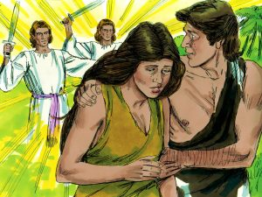
Conclusion
Genesis 3:20-24, The man called his wife's name Eve, because she was the mother of all living. 21 And the Lord God made for Adam and for his wife garments of skins and clothed them.
22 Then the Lord God said, “Behold, the man has become like one of us in knowing good and evil. Now, lest he reach out his hand and take also of the tree of life and eat, and live forever—” 23 therefore the Lord God sent him out from the garden of Eden to work the ground from which he was taken. 24 He drove out the man, and at the east of the garden of Eden he placed the cherubim and a flaming sword that turned every way to guard the way to the tree of life.

Slide 50
Eve (Chavvah) means life, or living one
  She would give life to all
What was the purpose of garments of skins?
  This is the first instance of the shedding of blood
  An example of the requirement for atonement for sin
“Like one of us in knowing good and evil”
  Man can now determine his own morality
  Yet, he is under the dominion of Satan’s Kingdom (not good)
  So he can not be allowed to live forever in a sinful state
They were judged immediately by removal from the garden.
  He might “send” his hand, so God “sent” him out
  QUESTION: Why did God need to remove them from the Garden?
He was ent out to “work the ground from which he was taken”

