Slide 1


Chapter 10
Chapter 10

Slide 2
The Sons of Shem, Genesis 10:21-32
To Shem also, the father of all the children of Eber, the elder brother of Japheth, children were born. 22 The sons of Shem: Elam, Asshur, Arpachshad, Lud, and Aram. 23 The sons of Aram: Uz, Hul, Gether, and Mash. 24 Arpachshad fathered Shelah; and Shelah fathered Eber. 25 To Eber were born two sons: the name of the one was Peleg, for in his days the earth was divided, and his brother's name was Joktan. 26 Joktan fathered Almodad, Sheleph, Hazarmaveth, Jerah, 27 Hadoram, Uzal, Diklah, 28 Obal, Abimael, Sheba, 29 Ophir, Havilah, and Jobab; all these were the sons of Joktan. 30 The territory in which they lived extended from Mesha in the direction of Sephar to the hill country of the east. 31 These are the sons of Shem, by their clans, their languages, their lands, and their nations. 32 These are the clans of the sons of Noah, according to their genealogies, in their nations, and from these the nations spread abroad on the earth after the flood.

Slide 3
The Sons of Shem, Part 1
QUESTION? Eber is the great grandson of Shem, but is mentioned right here in verse 21. WHY?
  This is the Patriarch from which we get the name “Hebrew”
    And his son, Peleg, means “divided”
  Eber was a contemporary of Nimrod and what happened at Babel
  Probably he named his son “divided” after what God did at Babel
Peleg is the branch of descendants down to Abraham, detailed in Chapter 11 (see your Table of Nations Chart)
All the sons of Shem settled in the Middle East from north to south

Slide 4
The Sons of Shem, Part 2
Elam is mentioned, who founded the Elamites
  The King of Elam conquered and enslaved the Canaanites in Gen 14
  The curse of Canaan didn’t have to wait for Israel to come out of Egypt
Notice Aram, the father of the Arameans (Ancient Syrians) from which we get Aramaic
  The books of Daniel and Ezra are written in Aramaic, because that was the language of the Babylonians, where Israel was held captive for 70 years
  Most Jews coming back from exile spoke Aramaic, and were still speaking Aramaic during the days of Jesus.
  Evidence strongly suggests that Aramaic was the language of Jesus and His disciples.

Slide 5
The Sons of Shem, Part 3
Side note: Aramaic is now considered a dead language, although some small groups still speak it.
When Mel Gibson produced the Passion of the Christ movie, he brought Aramaic back to life
  Some of the actors had to learn Aramaic to play their roles.
    Jesus and His disciples spoke in Aramaic
    The Jewish leaders spoke in Hebrew
    The Roman authorities spoke in Latin
  This was the linguistic environment in Israel at that time!
QUESTION? What language did Mary and Joseph Speak?
QUESTION? When the Magi came from the east to visit Jesus, what language did they speak?

Slide 6
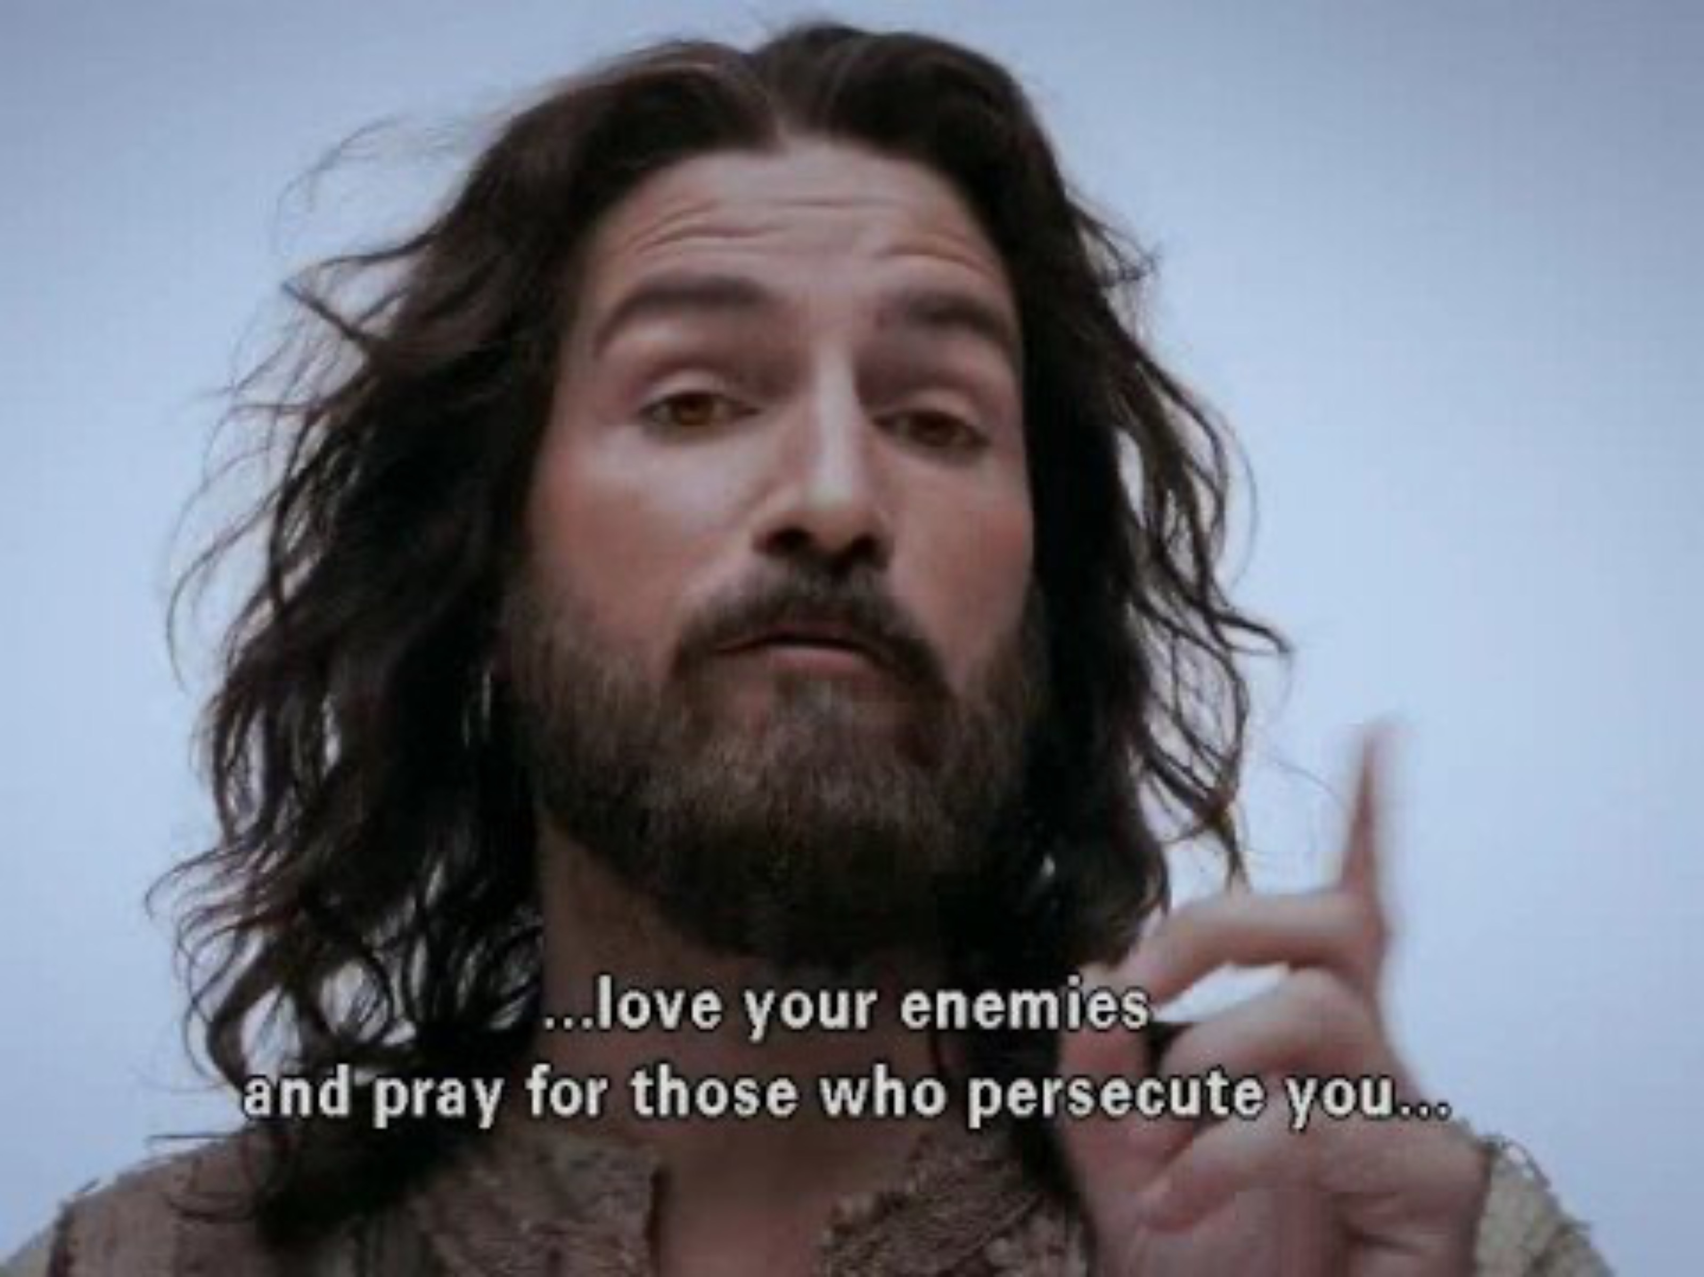
Love your enemy…

Slide 7
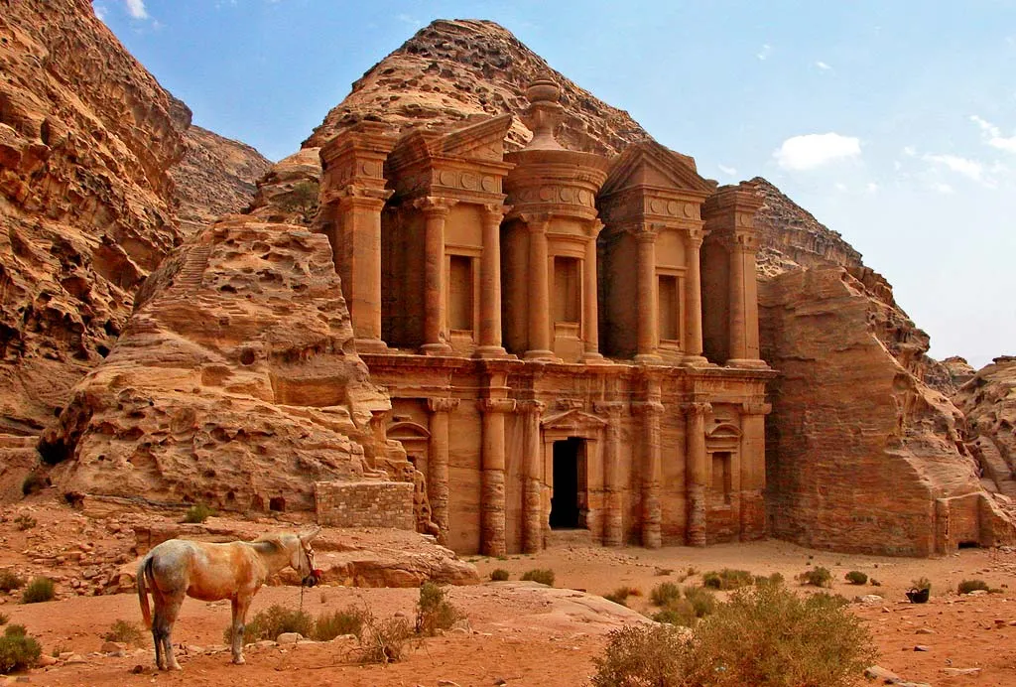

The Sons of Shem, Part 4
Notice also Uz, a son of Aram, who resided in the land of Uz
  QUESTION? Who was from the land of Uz?
  Job was from the land of Uz, probably
  near Petra, in Jordan
  Job 1:1, There was a man in the land of
  Uz whose name was Job, and that man
  was blameless and upright, one who
  feared God and turned away from evil.
  If we add up all the families listed in
  Genesis Chapter 10, we get 70 people
  groups!

Slide 8
The Sons of Shem, Part 5
QUESTION? Do these different people groups ever have issues with each other?
  A famous Japhethite decided he hated Shemites and used his army to kill 6 million of them
  Gomerites (from Japheth) enslaved Cushites (from Ham) for centuries (England, France)
  Iran and Iraq are next-door neighbors, but they hate each other. Why?
    Iran was settled by Japhethites.
    Iraq was settled by Shemites.
    Their distaste for each other stem from very different cultural, genetic, and language roots. Iranians speak Farsi, Iraqis speak Arabic.

Slide 9
The Sons of Shem, Part 6
Iranians are more like Europeans in culture and appearance, and Iraqis are more like Saudis!
  Arabic is in the Afro-Asiatic language family
  Farsi is in the Indo-European language family.
Last week I mentioned the Chinese and the Huns, and the Wall of Magog. (Ham/Japheth)
QUESTION? Does it take different people groups to create animosity toward one-another?
  This is why God came to earth in human form, to save us from ourselves!

Slide 10
The Sons of Shem, Part 7
Let me go back to the man who played Jesus in the Passion, Jim Caviezel
  Hollywood was so furious with him that he has been virtually shunned for the past 20 years.
  He is Catholic, and outspoken about his faith, and they hate that!
  They not only hate Jesus, but anyone who plays Jesus in a movie!

Slide 11
Chapter 11
Chapter 11

Slide 12
How Did Language Begin?
AI Overview
  The origin of language is a complex and debated topic, with several theories attempting to explain its development. One theory suggests that language may have evolved from gestures and sounds, like those used in sign language or to imitate natural sounds. Other theories propose that it started from emotional expressions or rhythmic sounds used during cooperative activities. Ultimately, the process likely involved a combination of these factors, with language evolving over time through a combination of vocalizations, gestures, and increasing cognitive abilities.

Slide 13
How Did Language Begin? Part 2
From thelinguisticsociety.org
In asking about the origins of human language, we first have to make clear what the question is. The question is not how languages gradually developed over time into the languages of the world today. Rather, it is how the human species developed over time so that we - and not our closest relatives, the chimpanzees and bonobos - became capable of using language.
And what an amazing development this was! No other natural communication system is like human language. Human language can express thoughts on an unlimited number of topics (the weather, the war, the past, the future, mathematics, gossip, fairy tales, how to fix the sink...). It can be used not just to convey information, but to solicit information (questions) and to give orders. Unlike any other animal communication system, it contains an expression for negation - what is not the case.

Slide 14
How Did Language Begin? Part 3
Every human language has a vocabulary of tens of thousands of words, built up from several dozen speech sounds. Speakers can build an unlimited number of phrases and sentences out of words plus a smallish collection of prefixes and suffixes, and the meanings of sentences are built from the meanings of the individual words. What is still more remarkable is that every normal child learns the whole system from hearing others use it.
Animal communication systems, in contrast, typically have at most a few dozen distinct calls, and they are used only to communicate immediate issues such as food, danger, threat, or reconciliation.
Many of the sorts of meanings conveyed by chimpanzee communication have counterparts in human 'body language'. And the attempts to teach apes some version of human language, while fascinating, have produced only rudimentary results. So, the properties of human language are unique in the natural world.

Slide 15
Evolutionists have no idea!
Along came Charles Darwin in 1871, who stated the following in the Descent of Man (an apt name):
  “I cannot doubt that language owes its origin to the imitation and modification, aided by signs and gestures, of various natural sounds, the voices of other animals, and man's own instinctive cries.”
Darwin said man learned his language by imitating nature and the “voices” of “other” animals.
  After Charles Darwin died, rumors spread that he had converted to Christianity on his deathbed. His children denied this occurred.
It’s all mere speculation! (together with ignoring God’s Word)

Slide 16
Evolutionists have no idea!
When did man “learn” language? (the Linguistic Institute)
  What changed in the species at that point?
  Did they just get smarter?
  Did they develop language all of a sudden?
  Did they become smarter because of the intellectual advantages that language affords?
  If this is when they developed language, were they changing from no language to modern language, or perhaps from 'protolanguage’ to modern language?
  And if the latter, when did 'protolanguage' emerge? Did our cousins the Neanderthals speak a protolanguage?
  At the moment, we don't know!

Slide 17
God speaks
Romans 1 has never been truer that when it comes to “speculation” on the origins of language:
Rom 1:18-19 NIV, The wrath of God is being revealed from heaven against all the godlessness and wickedness of people, who suppress the truth by their wickedness,19 since what may be known about God is plain to them, because God has made it plain to them.
Rom 1:25, They exchanged the truth about God for a lie, and worshiped and served created things rather than the Creator—who is forever praised. Amen.
“We learned our language skills from the animals” Really?

Slide 18
God speaks
Rom 1:28, Furthermore, just as they did not think it worthwhile to retain the knowledge of God, so God gave them over to a depraved mind, so that they do what ought not to be done.
  Depraved (adokinos): Adokinos is the negative of dokinos (tested, approved). So this is a mind that fails the test. Disqualified, rejected, non-functioning.
  King James uses the word reprobate (Re and probare). Disapproved, worthless, condemned

Slide 19
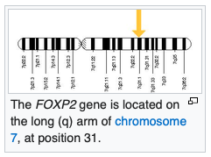
So, what determines our ability to speak?
From Wikipedia.org
In 1990, A gene (FOXP2) was discovered as a result of investigations on an English family known as the KE family, half of whom (15 individuals across three generations) had a speech and language disorder called developmental verbal dyspraxia.
Around this time, the researchers identified an individual who was unrelated to the KE family but had a similar type of speech and
language disorder. In this case, the child,
known as CS, carried a chromosomal
rearrangement (a translocation) in which
part of chromosome 7 had become
exchanged with part of chromosome 5.

Slide 20
What determines our ability to speak?
Then, in 2001, a team identified in CS that the mutation is in the middle of a protein-coding gene. Using a combination of bioinformatics and RNA analyses, they discovered that the gene codes for a novel protein belonging to the forkhead-box (FOX) group of transcription factors. As such, it was assigned with the official name of FOXP2.
When the researchers sequenced the FOXP2 gene in the KE family, they found a heterozygous point mutation shared by all the affected individuals, but not in unaffected members of the family and other people. This mutation is due to an amino-acid substitution that inhibits the DNA-binding domain of the FOXP2 protein.
Further screening of the gene identified multiple additional cases of FOXP2 disruption, including different point mutations and chromosomal rearrangements, providing evidence that damage to one copy of this gene is sufficient to derail speech and language development.

Slide 21
What about Chimpanzees? Can they talk?
Why can't chimps talk? It's more than just genes - By Reuters
November 11, 2009 2:14 PM EST WASHINGTON (Reuters)
Why can humans talk and chimps cannot? Researchers said on Wednesday they have another clue and it lies not simply in the genetic code, but in how the genes function. Humans and chimpanzees share most of their DNA. Estimates on the percentage range from 98.5 percent to 95 percent. Scientists study the differences to find the keys to what distinguishes humans.
The team used human and chimpanzee brain tissue to analyze what FOXP2 actually does. Although the DNA code itself is similar, they found subtle differences in two amino acids produced by the gene.
"We showed that the human and chimp versions of FOXP2 not only look different but function differently too," added Geschwind, who is currently a visiting professor at King's College London. "Our findings may shed light on why human brains are born with the circuitry for speech and language and chimp brains are not."

Slide 22
Questions
QUESTION? How did the entire creation come into being?
QUESTION? How is it that man can talk, and animals can’t talk?
QUESTION? Where did man’s first language come from?
QUESTION? What was the first language? In the Millenium…
  Zeph 3:9, “For at that time I will change the speech of the peoples to a pure speech, that all of them may call upon the name of the Lord and serve him with one accord.”
  Isa 19:189, In that day five cities in Egypt will speak the language of Canaan and swear allegiance to the Lord Almighty. One of them will be called the City of the Sun.
  Acts 26:14, We all fell to the ground, and I heard a voice saying to me in Aramaic, ‘Saul, Saul, why do you persecute me? It is hard for you to kick against the goads.’

Slide 23
Genesis 11:1
Now the whole earth had one language and the same words.
  Hebrew: “Now the whole world had one lip and one kind of words”
  According to Jonathan D. Sarfati, “the many word plays on the names [in Genesis] so far suggest that the original language was Hebrew, or something very close to it.”
Ask Google if Ancient Hebrew and Aramaic are similar:
  Ancient Hebrew and Aramaic are closely related languages, both belonging to the Semitic language family. While they are not mutually intelligible, they share many similarities in vocabulary, grammar, and sentence structure. Aramaic, in fact, is considered more closely related to Hebrew than to other Semitic languages like Arabic or Akkadian.

Slide 24
Genesis 11:1
QUESTION? What’s the difference between language and words?
  Compare American English with British, Australian, South African
    Same language, different words, different accents
  Our Liverpool experience! The accent was so strong we couldn’t understand them.
QUESTION? Does language change over time?
  Ancient Greek with Modern Greek – very different
  Ancient Hebrew with Modern Hebrew – also different
  The English Language Sheet – The Lord’s Prayer

Slide 25
Genesis 11:2
And as people migrated from the east, they found a plain in the land of Shinar and settled there.
They (who are they?)
  The descendants of Noah
  Gen 9:32, These are the families of the sons of Noah, according to their descendants, by their nations; and out of these the nations were separated on the earth after the flood.
Land of Shinar
  Mesopotamian Valley between the Tigris and Euphrates rivers
  The southern region of Iraq, the State of Kuwait and part of Iran
  Sumerian civilization first took form in southern Mesopotamia
  The first urban civilization in the region. Mesopotamians are noted for developing one of the first written scripts around 3000 BC.
  Cuneiform: wedge-shaped marks pressed into clay tablets.

Slide 26
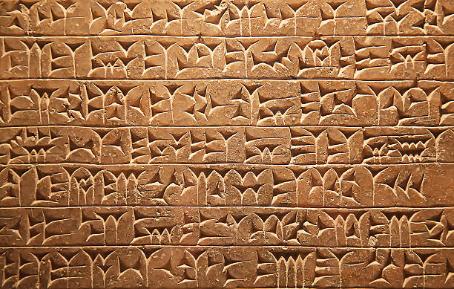

Slide 27
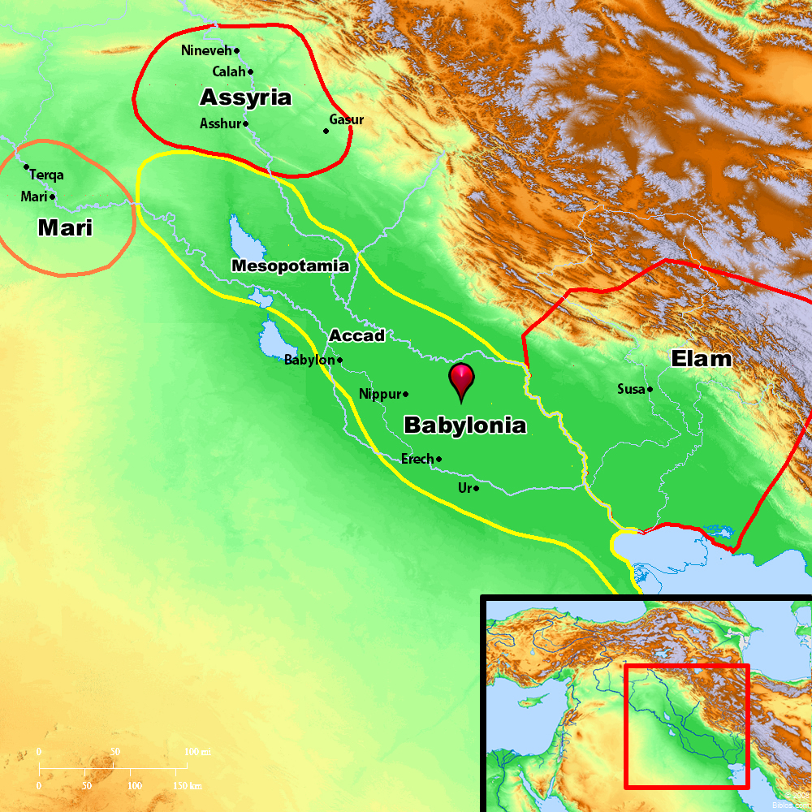

Slide 28
Genesis 11:2
Sargon, also known as Sargon of Akkad, (23rd century BC)
  Ancient Mesopotamian ruler (reigned c. 2334–2279 BC) who was one of the earliest of the world's great empire builders, conquering all of southern Mesopotamia as well as parts of Syria, Anatolia, and Elam (western Iran).
The ancient Jewish writers Philo of Alexandria and Flavius Josephus suggested Nimrod was a giant who opposed God and the tyrant behind the construction of the Tower of Babel.
  Genesis 10:10–12, The beginning of his [Nimrod’s] kingdom was Babel, Erech, Accad, and Calneh, in the land of Shinar. 11 From that land he went into Assyria and built Nineveh, Rehoboth-Ir, Calah, and 12 Resen between Nineveh and Calah; that is the great city.
Archaeology has also identified Nimrod with these cities

Slide 29
Genesis 11:2
The Old Testament mentions Nimrod four times, calling him “a mighty one on the earth” (Genb10:8; 1 Chr. 1:10); “a mighty hunter before the LORD” (Gen. 10:9); and the founder of thebAssyrian Empire (Mic. 5:6).
  Nimrod’s origin in Cush matches Sargon’s origin in Sumerian Kish
  The Hebrew name Nimrod is the same person as Assyrian name Sargon! Nimrod means “rebel”
Settled there
QUESTION? Didn’t God say to fill the earth?
  Gen 9:1, Then God blessed Noah and his sons, and said to them, “Be fruitful and multiply, and fill the earth.”
  In an act of disobedience, they all settled in one place, the Land of Shinar

Slide 30
Genesis 11:3-4
And they said to one another, “Come, let us make bricks, and burn them thoroughly.” And they had brick for stone, and bitumen for mortar. 4 Then they said, “Come, let us build ourselves a city and a tower with its top in the heavens, and let us make a name for ourselves, lest we be dispersed over the face of the whole earth.”
Bottom line, they didn’t want to be scattered, QUESTION? WHY
  They wanted a one-world civilization!
Bricks are made from clay and hardened by firing. This is easier than making cut stones.
The land of Shinar has very few stones. It’s mostly clay
  The same word is used for bricks for the pyramids by the Israelites.
  In that case, they also mixed their clay with straw.

Slide 31
Genesis 11:3-4
The word for bitumen really means asphalt, a petroleum product used for making our roads.
  Noah coated the ark with “pitch” which is more like what we call “tar”
    This is made from heating wood or plants or from distilled petroleum.
  Moses’ mother used both bitumen and pitch on the basket
Let us build – WE are doing this.
  To make a name – so WE will “make a name”.
  For ourselves – for US, it’s all about us!
  And somehow building a tower will keep us from being scattered as God commanded?

Slide 32
Genesis 11:3-4
Build a city, Babel, the original BABYLON
  And a tower to reach to “heaven”
  They probably didn’t think it would go all the way to “heaven”.
  This was not to get closer to the true God.
These people worshipped the moon and stars, instead of God.
They would place a temple or altar at the top, sometimes for human sacrifice.
  One language
  One government
  One religion
This is not like the Washington Monument, this is a Ziggurat

Slide 33
Ziggurats Worldwide
Why are these structures found all over the World?

Slide 34
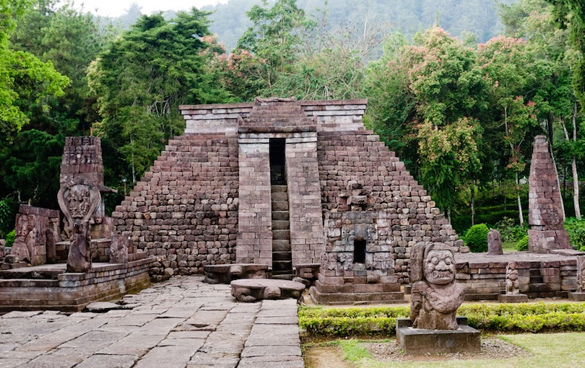
Candi Sukuh is a 15th century Hindu temple that is located on Mount Lawu in Central Java, Indonesia

Slide 35
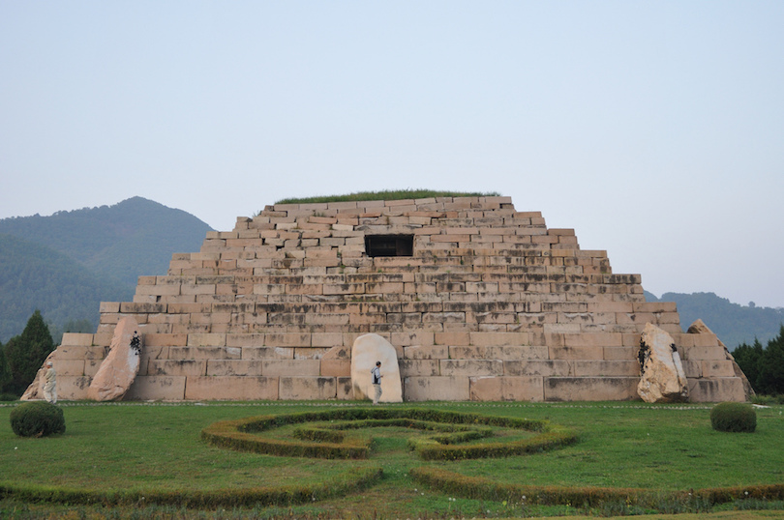
Tomb of the General is the burial tomb of King Jangsu, the 20th monarch of Goguryeo, of Korea

Slide 36
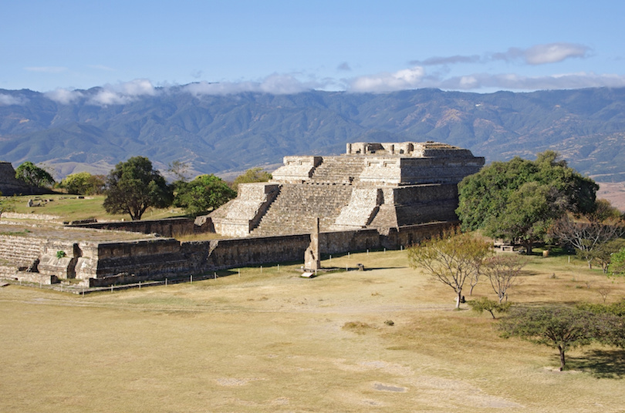
Monte Alban located on a hilltop in the center of the Valley of Oaxaca in Mexico

Slide 37
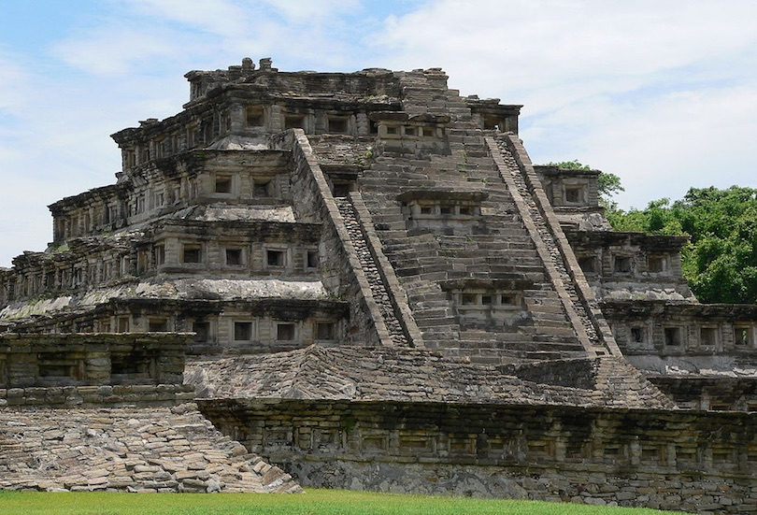
El Tajín was an important gulf coast city in present-day Mexico, founded by the Classic Veracruz culture.

Slide 38
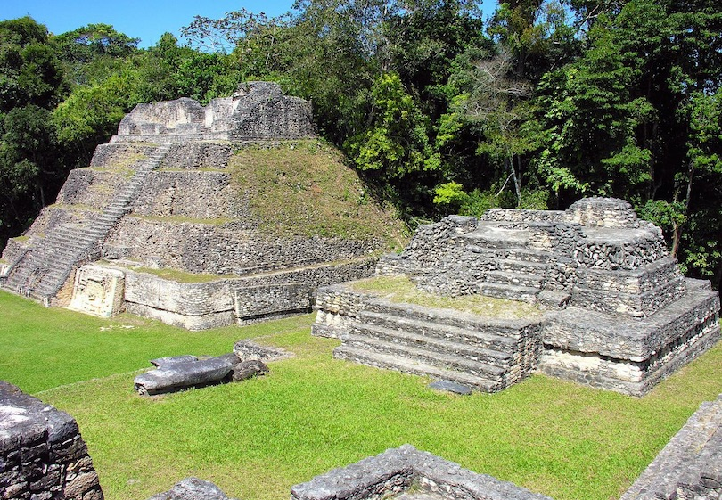
Sitting high on the Vaca Plateau, 500 meters (1650 ft) above sea level, Caracol is the largest Maya site in Belize

Slide 39
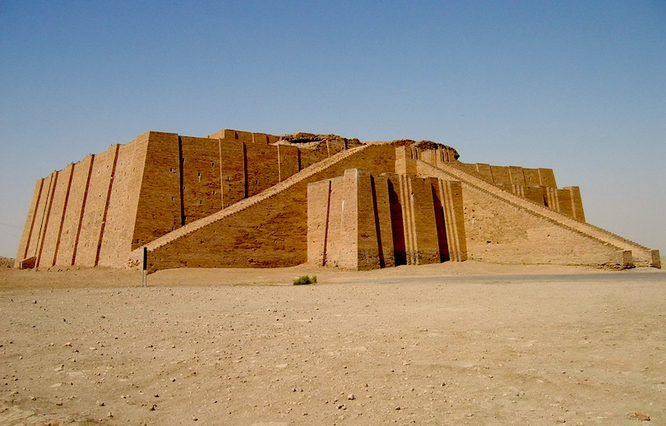
The Ziggurat of Ur, a massive step pyramid about 64 by 46 meters (210×150 ft) in size in modern-day Iraq.

Slide 40
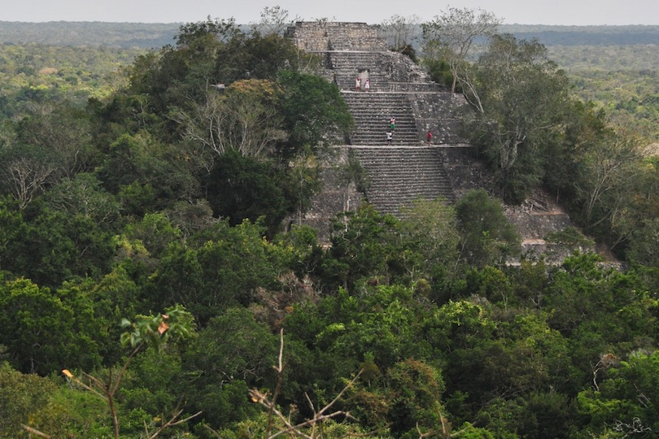
Calakmul is a Mayan site in the Mexican state of Campeche. It is one of the largest Mayan cities..

Slide 41
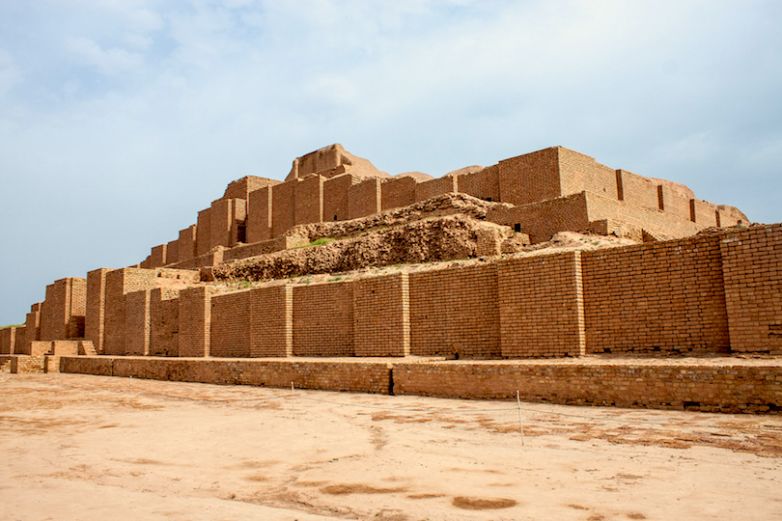
The Chogha Zanbil in Iran was built by the Elamites around 1250 BC to honor the god Inshushinak.

Slide 42
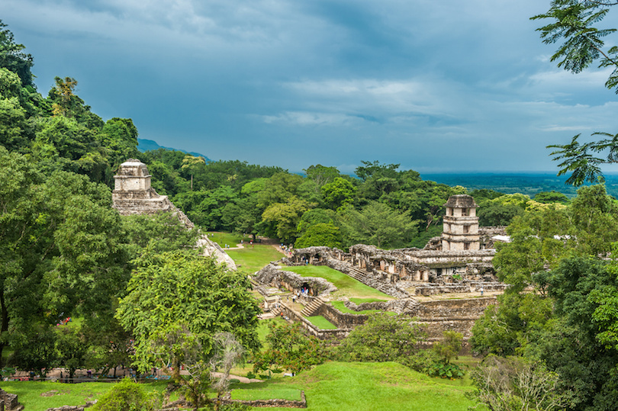
Palenque is an archaeological site that is located on the western edge of the Maya empire in Chiapas, Mexico.

Slide 43
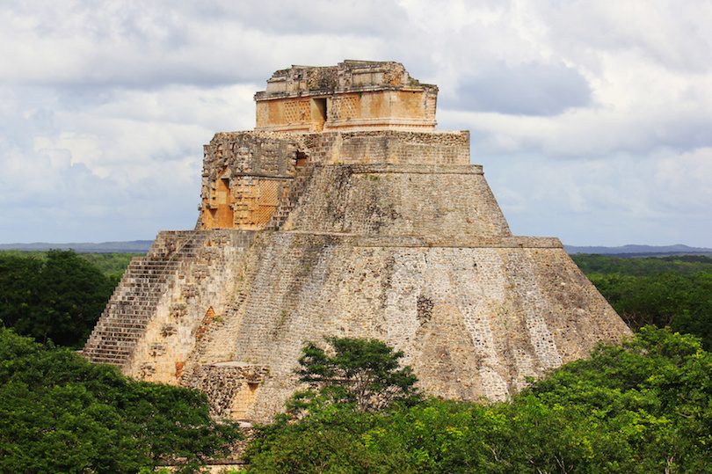
Uxmal, meaning “built three times” in Mayan, is one of the best preserved Pre-Columbian sites in Mexico

Slide 44
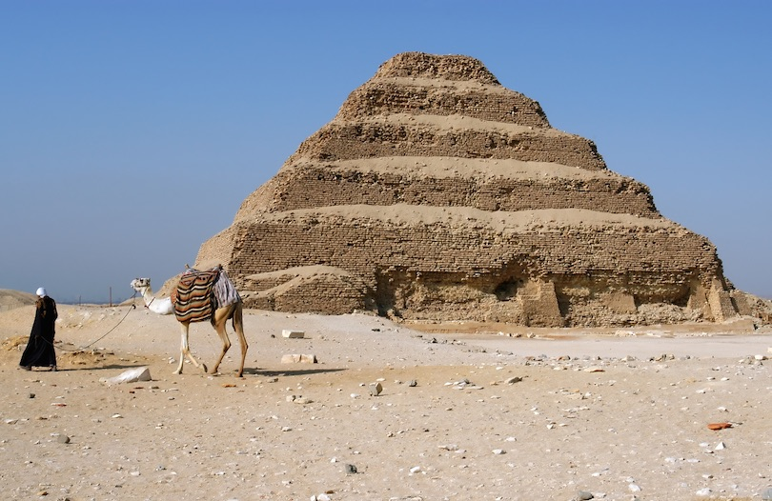
Step Pyramid of Djoser at the Saqqara necropolis was the very first pyramid built by the ancient Egyptians

Slide 45
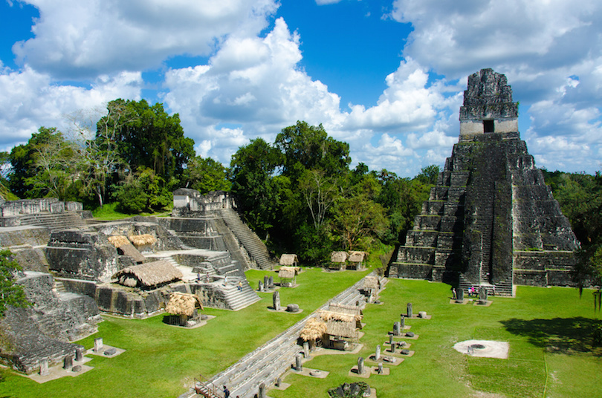
Situated in the lowland rainforest of northern Guatemala, Tikal is perhaps the most breathtaking of Mayan sites.

Slide 46
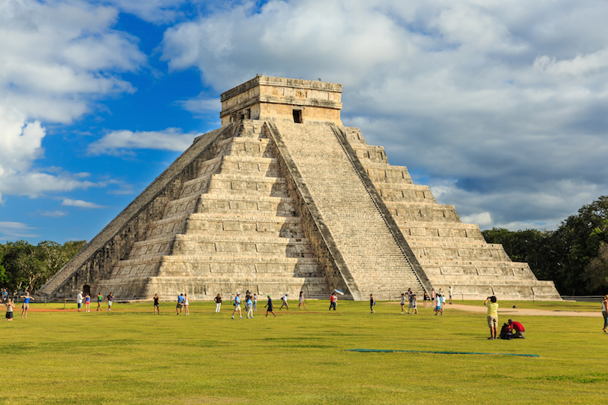
Chichen Itza, a most spectacular Mayan temple that dominates the archaeological site in Yucatan, Mexico

Slide 47
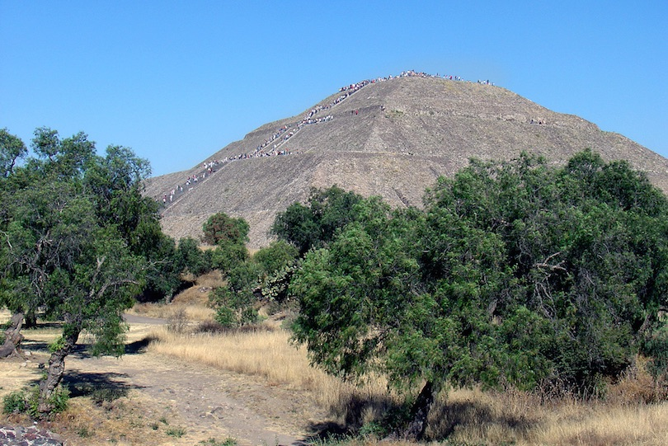
The Pyramid of the Sun, a 246 ft high step pyramid, is the largest building in Teotihuacán, Mexico.

Slide 48
Genesis 11:5-6
And the Lord came down to see the city and the tower, which the children of man had built. 6 And the Lord said, “Behold, they are one people, and they have all one language, and this is only the beginning of what they will do. And nothing that they propose to do will now be impossible for them.
  The Lord “came down”. I guess the tower wasn’t high enough.
QUESTION? What is the concern here?
  One world civilization, one government, one language sounds like a great idea
QUESTION? What’s wrong with this?
  Nations are needed to police other nations.
  Twice, a nation tried to take over the world, and twice they were stopped!
  Most love the idea of a world without borders, without nations, without war.
  With possible global unity among sinners, who on earth can stop them?

Slide 49
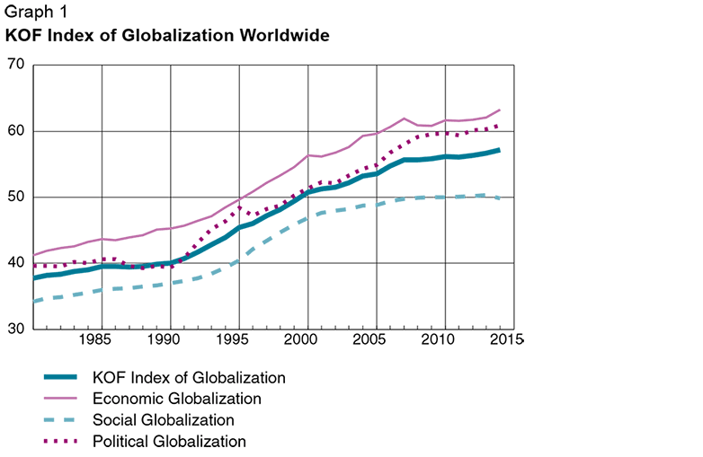

Slide 50
Genesis 11:5-6
QUESTIONS? In what direction is our world moving today?
What about languages? Languages are disappearing!
  National Review article from 2001 - “Thousands of human languages head toward extinction. The 15 most common languages are now on the lips of over half the world’s people.”
  Half the world’s people speak one of only 15 languages.
  “Ninety percent of humanity speaks only a hundred languages.”
  “Half of the world’s 6800 languages are spoken by only 2,500 people.”
  “Only 600 are being taught to children. The rest can’t survive because there’s not another generation to speak them.”

Slide 51
Genesis 11:5-6
Which language?
  Probably English. Why?
  Because of technology and the Internet.
God made us a rich and powerful nation because of the faith of our founders.
  Now we have turned away from God and lead the world in sin and decadence.
  Judgment is coming. The US doesn’t seem to appear in any end-times prophecies.
What nation and government?
  National boundaries are disappearing through GLOBALIZATION
  Look at the EU
  Look at the disaster our southern border has been for four years

Slide 52
Genesis 11:5-6
Russia is attempting to annex Ukraine
Iran, Hamas and Hezbollah want to destroy Israel
China wants Hong Kong and Taiwan
Why do the Washington elites hate “America First”?
  America First is anti-globalization!
  The want a one-world government!
  Also sometimes known as the New World Order

Slide 53
Genesis 11:5-6
What currency will be used?
  Digital, block-chain, it tracks every transaction.
  The US dollar is devaluing and quickly going out of use. It can’t be tracked.
  Story about the bank giving me trouble over buying the camper!
  Federal regulations require banks to report larger deposits/withdrawals
  Our inflation is intentional
    So are the many crises we are experiencing (COVID anyone?).
  It’s not just the US. Inflation is worldwide!

Slide 54
Genesis 11:5-6
What religion?
  Worship of Antichrist
  He will promise to bring peace and order in the world.
  What happens to those who choose not to be a part of this world system?
  What do you think Nimrod did to those who didn’t go along?
QUESTION? This is gradually happening. What must happen for globalization to become a reality?
  A world-wide crisis
    Perhaps the Rapture
    Or Nuclear war

Slide 55
Genesis 11:5-6
This is why the kingdom that Antichrist sets up is called Babylon.
  It is a false kingdom built on lies, and promising peace (a false peace)
  But after 3 ½ years, the peace agreement is broken, and war breaks out.
  At the end of 7 years, Christ returns, destroying the false kingdom and all unbelievers.
  Christ establishes His Millennial Kingdom on earth.
QUESTION? Now how is Christ’s one world government different from what they started in Babel?

Slide 56
Genesis 11:7-9
Come, let us go down and there confuse their language, so that they may not understand one another's speech.” 8 So the Lord dispersed them from there over the face of all the earth, and they left off building the city. 9 Therefore its name was called Babel, because there the Lord confused the language of all the earth. And from there the Lord dispersed them over the face of all the earth.
“Let Us” go down and there confuse their language is the antithesis of “Let us” make bricks and build.
  In an instant, God frustrates their puny efforts to make themselves a city and a name.
QUESTION? Who scattered them?
  You can’t build a city if you can’t talk to the person next to you.

Slide 57
Genesis 11:7-9
God’s scattering was a judgment, and also a blessing
QUESTION? Can you imagine a world run by Nimrod, the rebel?
  Nations hold other nations accountable, and keep them in check
  Even with the languages and cultural differences, look what mankind has achieved
Gen 11:10-32, refer to the chart next

Slide 58
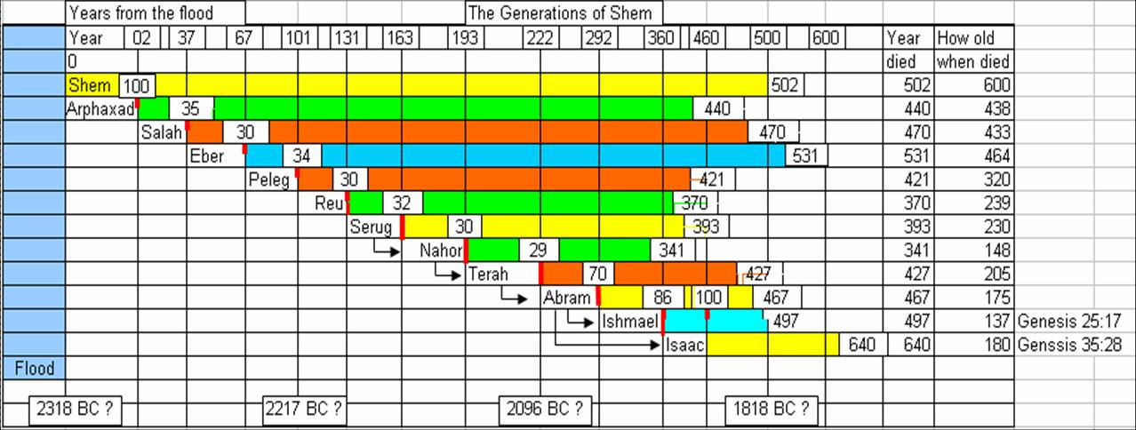

Slide 59
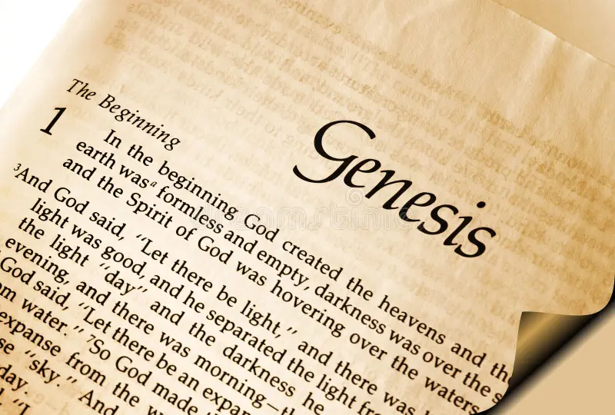
A Final Challenge!
Continue reading Genesis.

