Slide 1


Chapter 4
Chapter 4

Slide 2
Genesis 4:23-24, Lamech’s Poem
Lamech said to his wives:
  “Adah and Zillah, hear my voice;
  you wives of Lamech, listen to what I say:
  I have killed a man for wounding me,
  a young man for striking me.
  If Cain's revenge is sevenfold,
  then Lamech's is seventy-sevenfold.”
QUESTION? What does this tell you about Lamech?
  He was a proud, hateful man. What a long empty life (no timelines given)!
  Eph 2:12, remember that you were at that time separated from Christ, alienated from the commonwealth of Israel and strangers to the covenants of promise, having no hope and without God in the world.

Slide 3
Genesis 4:25-26, Abel’s Replacement
And Adam knew his wife again, and she bore a son and called his name Seth, for she said, “God has appointed for me another offspring instead of Abel, for Cain killed him.” 26 To Seth also a son was born, and he called his name Enosh. At that time people began to call upon the name of the Lord.
God’s plan is never thwarted by man’s sin
He keeps alive the godly seed through Seth
  Seth means “substitute” or “compensation”
Enosh “man”
  “at that time [people] began to call upon the name of the Lord”
  It seems that Enosh himself (not people) began to call upon the name of YaHWeH
  This is in remarkable contrast with Cain’s line, particularly Lamech!
What the bible says about the pre-flood life is the only record we have!

Slide 4
Next Time!
Genesis 5
  The toledot of Adam
  The Origin of Godly Society
  The Purpose for Geneologies
  The Timeline from Creation
Genesis 6
  The Corruption of Mankind and the Nephilim
  Events leading up to the Flood
  Noah and the Building of the Ark

Slide 5
Chapter 5
Chapter 5

Slide 6
Genesis 5
This is the book of the generations of Adam. When God created man, he made him in the likeness of God. 2 Male and female he created them, and he blessed them and named them Man when they were created. 3 When Adam had lived 130 years, he fathered a son in his own likeness, after his image, and named him Seth. 4 The days of Adam after he fathered Seth were 800 years; and he had other sons and daughters. 5 Thus all the days that Adam lived were 930 years, and he died…
  In Chapter 5, we are given the genealogies of the sons of Seth.
    Dates are meticulously recorded! (years, not days or months)
  QUESTION? Why are genealogies important?
    They lead us to Christ.
    This pre-flood record is the only historical record we have
    It also shows us how much vitality existed in people during those times
    It also gives an EXACT number of years from creation to flood, 1656 years

Slide 7
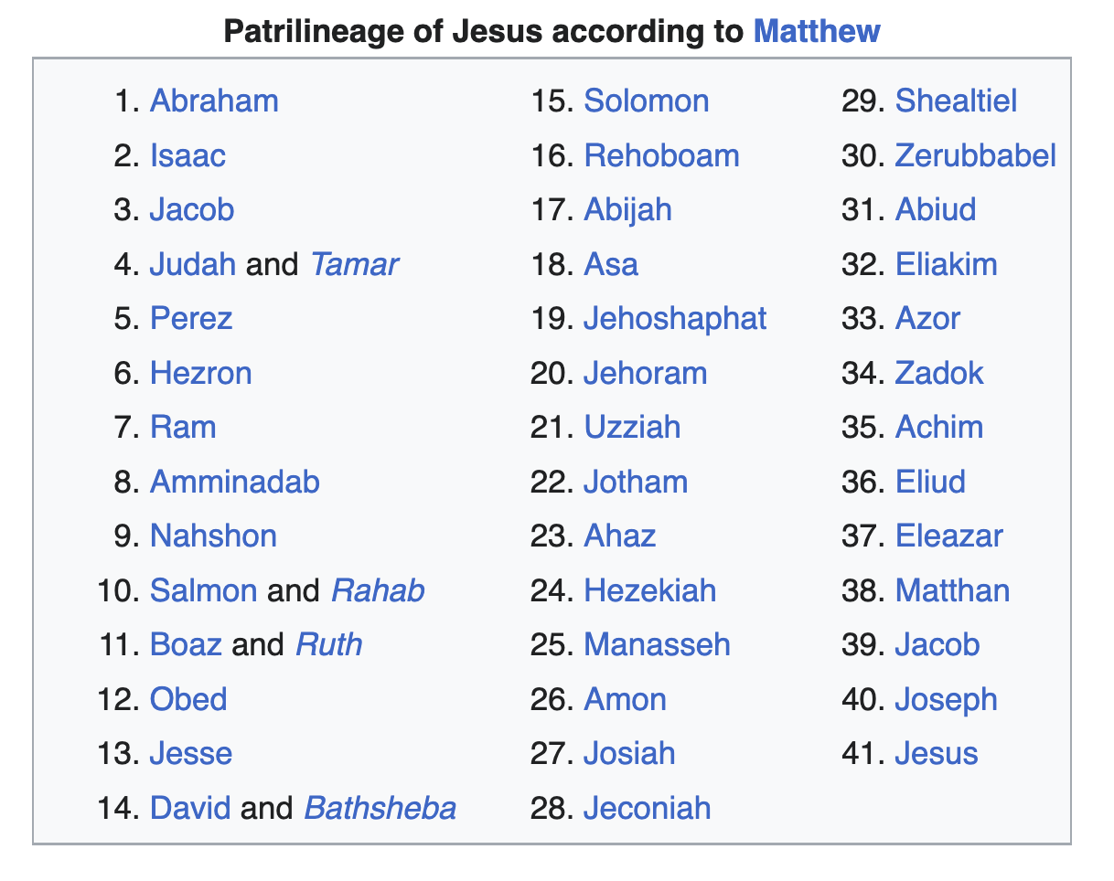
Genesis 5
Matthew points to Christ from Abraham to Joseph

Slide 8
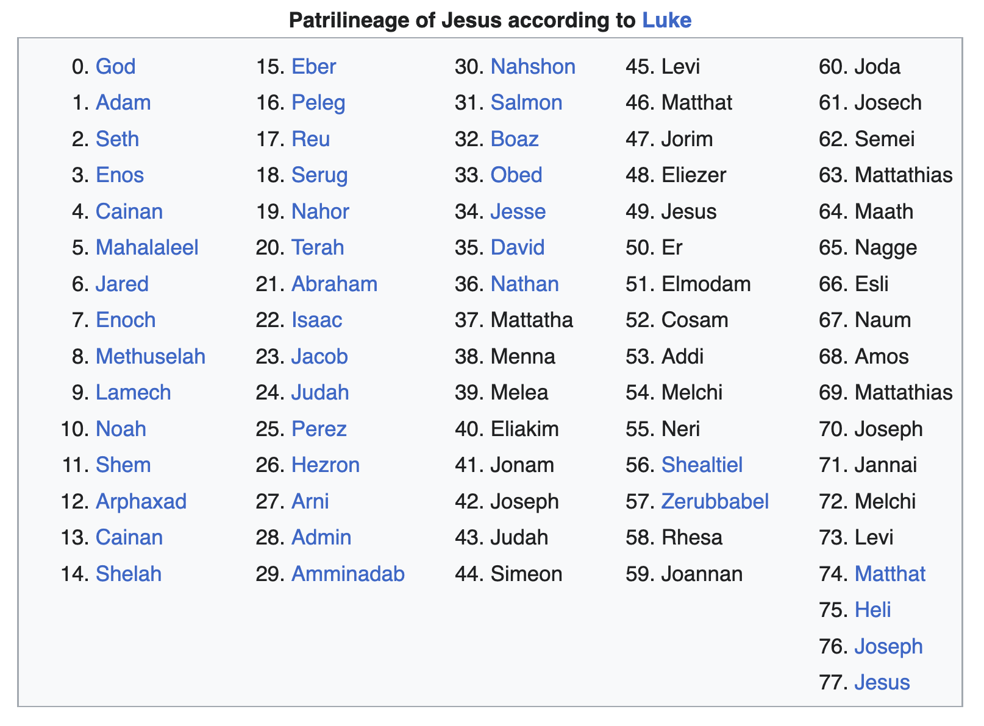

Genesis 5
Luke points to Christ from Adam to Mary, the wife of Joseph

Slide 9
Genesis 5 – Pre-Flood Patriarchs
Adam’s Toldedot – the Godly seed
  Adam (Man)
  Seth (Appointed)
  Enosh (Frail)
  Kenan (Acquired or “Smith”)
  Mahalalel (Praise of Elohim)
  Jared (Descent)
  Enoch (Dedication) – ”Walked with God”, and was no more
  Methuselah (he dies it shall be sent) – oldest living man on record 969
    The flood came in the same year he died!
  Lamech (Warrior or Conqueror) – not the same Lamech as Cain’s son
  Noah (Comfort, or Rest)

Slide 10
Genesis 5 – Pseudepigraphic Books
We don’t know much about these patriarchs except…
Some passages from extra-biblical, unsubstantiated books:
  The Book of Jubilees
    Jewish text from 100 BC that gives some detail about:
    The names of wives and mothers of the pre-flood patriarchs
    That Noah was a preacher of righteousness (see also 2 Pet 2:5)
    Some more information about the Nephilim (the Watchers)
  The Book of Enoch
    More about “the Watchers”
    Divine judgement and Cosmic order, (see Jude 1:14-15)
    The Messiah and the coming Kingdom
  The Book of Noah
    A psychedelic read – no hallucinogens needed

Slide 11
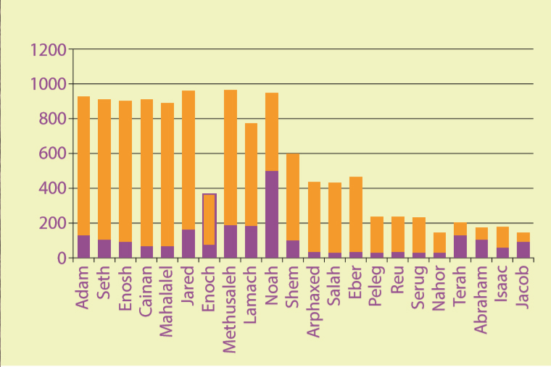
Genesis 5 – Longevity of the Patriarchs

Slide 12
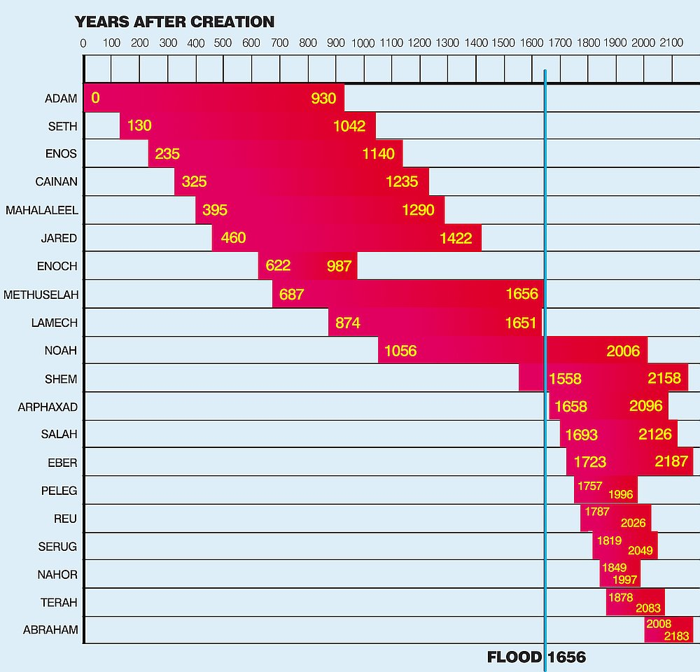
Genesis 5 –
Change in
Longevity
Post-Flood

Slide 13
Genesis 5 – Why such longevity pre-flood?
These are some of the unproven reasons suggested
  Higher atmospheric oxygen – due to abundance of forests
  Higher atmospheric pressure – due to a “vapor canopy”
  Genetics
A better question may be why are our lives so short?
  We live less than 10% as long as the pre-flood patriarchs
  QUESTION? What causes aging?
    All our cells replace themselves many times throughout our lifespan
    We age because the replacements are not as robust as the originals
    And, humans add 30 new genetic mutations every generation
    All mutations are harmful. No beneficial mutations have ever been seen
    Each successive generation has more DNA damage. Evolution?

Slide 14
Genesis 5 – What happened at the flood?
First, Adam and Eve began with perfect genes
There were only 10 generations from Adam to the flood
Then, there was a “population bottleneck” at the flood
  We are all descendants of Noah, (inbreeding vs outbreeding)
    Inbreeding results in a decline in survival and reproductive fitness
  Aged fathers are a major source of genetic disorders (Noah was 500)
    Sperm cells come from division of stem cells (840 replications by age 50)
  We each inherit our parents’ genetics as our starting point in life
  Our chromosomes have telomeres at the end of each one
    Telomeres serve as a type of “hash” to protect the genetic code
    Telomeres shorten at every cell replication until there are no more
    Without telomeres, a cell cannot properly divide, and so it dies

Slide 15
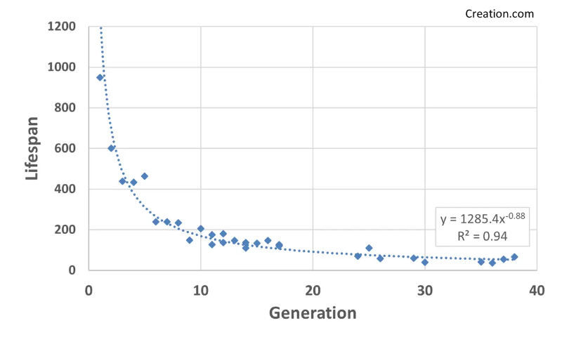
Genesis 5 – The expected actually happened!
Noah
Shem
Abraham

Slide 16
Genesis 5 – How did God use longevity?
Methuselah, the oldest recorded man, lived to be 969 years old
He lived while Adam was alive and could share everything with Noah
Noah had three sons when he was 500 years old!
  Shem, Ham, Japheth
The flood came when he was 600, and he was still alive when Abraham was born
  Noah’s son Shem lived longer than Abraham, Isaac, and possibly even Jacob, and could recount firsthand everything about the flood because he went through it!
Potentially, pre-flood records were preserved by Noah, passed down trough Seth, and incorporated into Genesis by Moses.

Slide 17
Genesis 5 – How did God use longevity?
Most of us lose track of our heritage and family stories
Why? because usually our great-grandparents, or even our grandparents die when we are quite young
  These people knew their great, great, great, great, great, great (six times) grandparents
We can see the curse in action, “and he died … and he died …”
QUESTION? Can we take the recorded genealogies literally?
  The genealogies in Matthew, Luke, Jude, Chronicles all correspond! They are precise!
  The genealogies both of Joseph and of Mary are in Judah’s line and separate only at Judah’s great-grandsons

Slide 18
Chapter 6
Chapter 6

Slide 19
Genesis 6:1-4, The Preflood Earth
When man began to multiply on the face of the land and daughters were born to them, 2 the sons of God saw that the daughters of man were attractive. And they took as their wives any they chose. 3 Then the Lord said, “My Spirit shall not abide in man forever, for he is flesh: his days shall be 120 years.” 4 The Nephilim were on the earth in those days, and also afterward, when the sons of God came in to the daughters of man and they bore children to them. These were the mighty men who were of old, the men of renown.
This passage has been the source of much controversy throughout biblical history. What does it mean?
QUESTION? What are some of the possible explanations?

Slide 20
Genesis 6:1-4, Sons of God, Daughters of Men
“Sons of God” refers to the line of Seth intermarrying with Cain’s line (the daughters of men)
  This is a modern interpretation but an unlikely one for these reasons
    “Sons of God” is never used in the Old Testament to refer to righteous humans
    In the NT, yes, but only in the context of believing Christians
  Daughters of men is too general a term to be limited only to Cain’s line
Sons of God refers to fallen angels procreating with human women
This is the traditional view, that fallen spirit beings procreated with humans creating a “hybrid” half-demon, half-human creature

Slide 21
Genesis 6:1-4, Sons of God, Daughters of Men
John Calvin called this view absurd.
  Apart from immaculate conception, there is no other biblical support for spirit beings procreating with fleshly beings!
The most likely view is Sons of God refers to fallen angels possessing the bodies of men
  Then marrying and procreating with human women
  Not necessarily rape, but would likely require concession of both
  We know that demons interfere in human affairs on earth
  We know that demons can possess a human body
  “sons of God” is a phrase contrasted with the phrase “daughters of men”

Slide 22
Genesis 6:1-4, Sons of God, Daughters of Men
Anytime “sons of God” is used in the bible it refers to angels:
  Job 2:1, Again there was a day when the sons of God came to present themselves before the LORD, and Satan also came among them to present himself before the LORD.
  Job 38:4-7, 4 “Where were you when I laid the foundation of the earth? Tell Me, if you [a]have understanding, 5 Who set its measurements? Since you know. Or who stretched the line on it? 6 “On what were its bases sunk? Or who laid its cornerstone, 7 When the morning stars sang together And all the sons of God shouted for joy?
Everywhere in the Old Testament, sons of God are the direct creation of God
  the term is never used to describe mere men

Slide 23
Genesis 6:1-4, Sons of God, Daughters of Men
Trying to make son‘s of God mere men is not supported biblically
  These are undoubtedly fallen angels leaving their realm and interfering in the realm of men.
  Satan did this in the garden. Demons did it throughout the NT
What’s the reason?
  To turn men away from God and make them worshipers of Satan.
  The original lie of Satan, “you will be like God”.
It is a huge stretch to support the view that demon spirits could “marry” and procreate with human women
Also, the resulting progeny was described as human (flesh).
  A human male must be involved, giving birth to human children.

Slide 24
Genesis 6:1-4, the Nephilim
The name given to them is Nephilim, used only here and in Numbers 13:33
  The Hebrew root is naphal, meaning to fall, to come down, to be cast down.
  In other words, the fallen ones, but Nephilim is translated “giants”
  This could be a reference to their physical stature, or their power, or both
Gen 6:4 describes them as “mighty men of old, men of renown”.
  The idea is great, powerful, perhaps conquerors, warriors

Slide 25
Numbers 13:3, Post Flood Giants
In Numbers 13:3, the Hebrew spies brought back a report of Nephilim (giants) living in the Promised Land (Sons of Anak (long-neck) in the Old Testament)
  They were known by different local names, including Rephaim, Zuzim, Emim, and Anakim
  QUESTION? How could Nephilim live both before and after the flood?
  The flood destroyed all but Noah and his family (8 people)
  The spies could have used the pre-flood name for what they described as giants in Canaan
QUESTION? Were there giants?
  We know there were giants in Canaan!

Slide 26
Other Post Flood Giants
Og, King of Bashan, was left of the remnant of the Rephaim
  from rapha, Hebrew word for giant)
  Deu 3:11, For only Og king of Bashan was left of the remnant of the Rephaim. Behold, his [a]bedstead was an iron [b]bedstead; it is in Rabbah of the sons of Ammon. Its length was nine cubits and its width four cubits by ordinary cubit (14 feet by 6 feet).
Goliath was over 9 feet tall
And in Gath there were the four sons of “the giant” (probably Goliath, since he was the most famous giant)
David and his men defeated all four sons of the “giant from Gath” in 2 Sam 21: Sippai, Lahmi, Goliath (son of Goliath), and the six- fingered giant whose name isn’t given

Slide 27
Other Post Flood Giants
2 Sam 21:20-22, There was war at Gath again, where there was a man of great stature who had six fingers on each hand and six toes on each foot, twenty-four in number; and he also had been born to the giant. 21 When he defied Israel, Jonathan the son of Shimei, David’s brother, struck him down. 22 These four were born to the giant in Gath, and they fell by the hand of David and by the hand of his servants.

Slide 28
Other Post Flood Giants
gotquestions.org puts it this way:
  Is it possible that the Rephaim were literal giants? The Septuagint uses the Greek words gigas and titanes (the source of the English titan) to translate these and other verses, so the ancient Jews certainly considered them to be giants. They are described generally as being between 7 and 10 feet tall and are called “mighty men.” The Egyptians wrote about giants who lived in the land of Canaan, and the folklore of other nations is full of such references. The people of the ancient world accepted the presence of giants as a fact of history, and the Bible presents them as enemies who were destroyed either by the judgment of God or in battle with men. So where did these giants come from? One theory, based on Genesis 6:1– is that fallen angels (the sons of God) had sexual relations with women, resulting in the birth of giants.
                Continued…

Slide 29
Other Post Flood Giants
  This is remarkably similar to Greek and Roman myths about demi-gods, but the theory has some theological and biological obstacles. Another theory, also based on Genesis 6, is that the fallen angels, having knowledge of human genetics, indwelt certain men and women who would have the right traits to produce a race of giants and induced them to cohabit with each other. A third theory is that the giants were simply the result of normal genetic variability within a society. Whatever the origin of the Rephaim, it is certain that a race of “giants”—strong, tall people—did exist at one time, and many cultures had dealings with them. Even today, there are people who grow to extreme sizes, whether through genetic disorders like gigantism or through normal heredity.

Slide 30
What was the sin of the preflood world?
Back to pre-flood: The bottom line:
  Men and women were inviting fallen angels into relationship with them. Why?
  Presumably to foster a race of evil superhumans “to be like God”.
  We don’t know if the same kinds of things were happening post-flood to produce a race of giants (the bible doesn’t say).
  We do know that it was all rebellion against God
Jude describes exactly what is happening here:
  Jude 6-7, And angels who did not keep their own domain, but abandoned their proper abode, He has kept in eternal bonds under darkness for the judgment of the great day, 7 just as Sodom and Gomorrah and the cities around them, since they in the same way as these indulged in gross immorality and went after strange flesh, are exhibited as an example in undergoing the punishment of eternal fire.

Slide 31
What was the sin of the preflood world?
What was the sin of Genesis 6?
  Going after strange flesh.
  Destruction by water
What was the sin of Sodom?
  Going after strange flesh.
  Destruction by fire.
When a society condones and celebrates gross immorality, the time is short
  God only puts up with so much, and then passes judgment
  Anyone who claims sexual sin is no big deal doesn’t know God

Slide 32
The downward spiral into a depraved mind
  Rom 1:24-32, Therefore God gave them over in the lusts of their hearts to impurity, so that their bodies would be dishonored among them. 25 For they exchanged the truth of God for a lie, and worshiped and served the creature rather than the Creator, who is blessed forever. Amen. 26 For this reason God gave them over to degrading passions; for their women exchanged the natural function for that which is unnatural, 27 and in the same way also the men abandoned the natural function of the woman and burned in their desire toward one another, men with men committing indecent acts and receiving in their own persons the due penalty of their error. 28 And just as they did not see fit to acknowledge God any longer, God gave them over to a depraved mind, to do those things which are not proper, 29 being filled with all unrighteousness, wickedness, greed, evil; full of envy, murder, strife, deceit, malice; they are gossips, 30 slanderers, haters of God, insolent, arrogant, boastful, inventors of evil, disobedient to parents, 31 without understanding, untrustworthy, unloving, unmerciful; 32 and although they know the ordinance of God, that those who practice such things are worthy of death, they not only do the same, but also give hearty approval to those who practice them.

Slide 33
What do we see today?
QUESTION? What’s the symbol of the gay pride movement?
QUESTION? Why has the movement chosen the rainbow?
  This is sinful man being defiant in the face of God!
  The symbol God uses to promise he will never again flood the earth has been coopted by the very people that God will one day punish with fire.
  Not only have they adopted God’s covenant symbol of His grace to represent blatant immorality, but they also want everyone else to participate and approve of their sin as well.
  Notice God passes judgment on men, and not on the demons that came down to men
QUESTION? Why is God judging man for something fallen angels did?

Slide 34
Why did (will) God judge mankind?
Genesis is the story of man, and God already has judgment planned for fallen angels
  Men and women had a choice and chose wickedness.
Gen 6:3, My Spirit shall not abide in man forever, for he is flesh: his days shall be 120 years.”
What is the meaning of 120 years? Two views:
  The number of years between Gods decree to Noah and the flood
    It was at least 100 years
  How long God decreed man’s lifespan would become after the flood
    After the flood there is no biblical record of anyone living past 120 years after Moses
    Moses was exactly 120 years old when he died! Deu 34:7

Slide 35
We see God’s grace and judgement together
2 Pet 2:4-10, For if God did not spare angels when they sinned, but cast them into hell and committed them to pits of darkness, reserved for judgment; 5 and did not spare the ancient world, but preserved Noah, a preacher of righteousness, with seven others, when He brought a flood upon the world of the ungodly; 6 and if He condemned the cities of Sodom and Gomorrah to destruction by reducing them to ashes, having made them an example to those who would live ungodly lives thereafter; 7 and if He rescued righteous Lot, oppressed by the sensual conduct of unprincipled men 8 (for by what he saw and heard that righteous man, while living among them, felt his righteous soul tormented day after day by their lawless deeds), 9 then the Lord knows how to rescue the godly from temptation (actually trials, or testing), and to keep the unrighteous under punishment for the day of judgment, 10 and especially those who indulge the flesh in its corrupt desires and despise authority.
This verse is also compelling support for a pre-Tribulation rapture

Slide 36
Genesis 6:5-7
The Lord saw that the wickedness of man was great in the earth, and that every intention of the thoughts of his heart was only evil continually. 6 And the Lord regretted that he had made man on the earth, and it grieved him to his heart. 7 So the Lord said, “I will blot out man whom I have created from the face of the land, man and animals and creeping things and birds of the heavens, for I am sorry that I have made them.”
  God FELT sorry and was grieved
    Wickedness-Raah: Evil, misery, distress, violence, disaster
  QUESTION? Did God just now happen to notice?
  Heb 4:13 (NLT), 13 Nothing in all creation is hidden from God. Everything is naked and exposed before his eyes, and he is the one to whom we are accountable.

Slide 37
Genesis 6:5-7
Sin compounded by intentional demonic involvement
  Man’s “every intent of the thoughts” were nothing but evil continually
    Every-(kol) all
    Intention-construction, framework, purpose
    Thoughts-inventions, designs, schemes
    Heart-inner man, mind, will, emotions
    Only-altogether without exception, nothing but Evil
    Continually-(kol-yom) all, always, “all day long”, “every day”, 24/7
  Gen 6:6, The Lord regretted that he had made man on the earth, and it grieved him to his heart
    QUESTION? Why would God feel sadness? What is God’s heart about this?
  The NLT renders it this way: “It broke his heart”.

Slide 38
What is God’s heart about wickedness?
Ez 33:11, 11 As surely as I live, says the Sovereign LORD, I take no pleasure in the death of wicked people. I only want them to turn from their wicked ways so they can live. Turn! Turn from your wickedness, O people of Israel! Why should you die?
Mat 23:37, “Jerusalem, Jerusalem, who kills the prophets and stones those who are sent to her! How often I wanted to gather your children together, the way a hen gathers her chicks under her wings, and you were unwilling.
Gen 6:7, The LORD said, “I will blot out man whom I have created from the face of the land, from man to animals to creeping things and to birds of the [a]sky; for I am sorry that I have made them.”
God DECIDED to do something
QUESTION? Why does God have to do something?

Slide 39
Why a flood?
It says God will “blot out” (Heb. “maha”)
  means to completely erase without a trace
  to abolish, destroy, to rub off any evidence of what was
QUESTION? How would a global flood accomplish this purpose?
QUESTION? Why aren’t there billions of people fossilized in the geologic record?
Fossils only form under a very specific set of conditions
  Instant burial in water
  High pressure
  Lack of oxygen (oxygen quickly destroys organic matter)
  Mineralization of organic materials

Slide 40
What does the fossil record reveal?
Scientific studies of the fossil record have shown the following:
  95% of all fossils are marine shellfish, oysters, clams, trilobites,
  95% of the remaining 5% are algae and plants (oil and coal)
  95% of the remaining 5% are other invertebrates, insects
  95% of the remaining 5% are mostly fish, and a few dinosaurs
  The remaining 5% or so are mammals (mammoths, sabretooth tigers)
    about 0.000625% - six ten-thousandths of a percent
Of that six-ten-thousandths of a percent, human fossils are virtually non-existent, and are usually pieced together from single scattered bones or bone fragments
Ever heard of “Lucy”?
She’s considered a fossilized “transitional form” or “missing link”

Slide 41
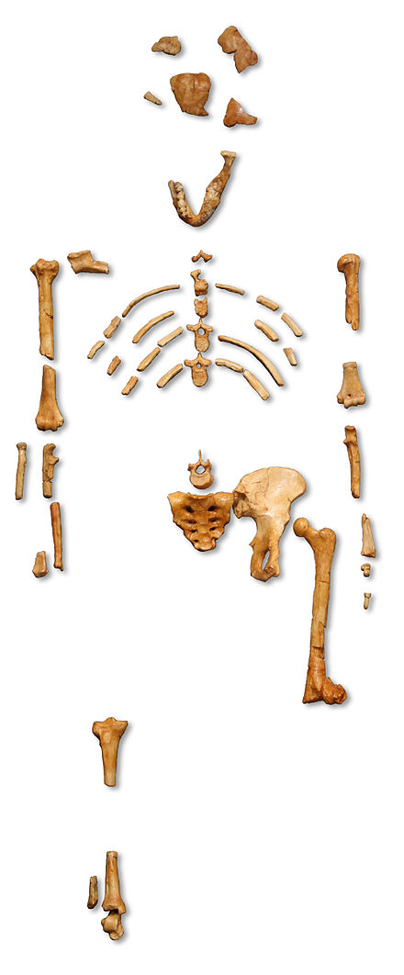
The Lucy Fossil
“Lucy was found by Donald Johanson and Tom Gray on November 24, 1974, at the site of Hadar in Ethiopia. They had taken a Land Rover out that day to map in another locality. After a long, hot morning of mapping and surveying for fossils, they decided to head back to the vehicle. Johanson suggested taking an alternate route back to the Land Rover, through a nearby gully. Within moments, he spotted a right proximal ulna (forearm bone) and quickly identified it as a hominid. Shortly thereafter, he saw an occipital (skull) bone, then a femur, some ribs, a pelvis, and the lower jaw. Two weeks later, after many hours of excavation, screening, and sorting, several hundred fragments of bone had been recovered, representing 40 percent of a single hominid skeleton.” – The Institute of Human Origins

Slide 42
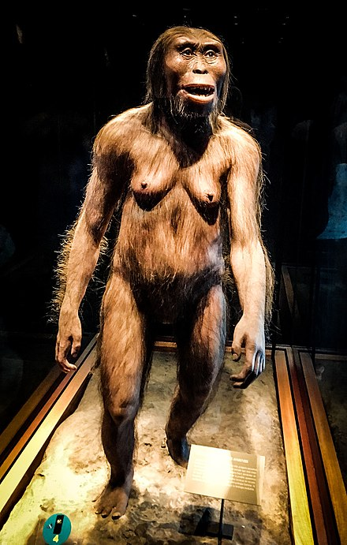
The Lucy “Reconstruction”
“Lucy, discovered almost half a century ago, was the most complete skeleton of the earliest hominid ever found at the time. She changed our understanding of human evolution. There’s little doubt Lucy walked on two feet like a modern human, or that she climbed trees to sleep, avoid predators or gather food.”
-The New York Times

Slide 43
So why a flood?
God said he would wipe humans off the face of the earth
  The tendency of dead mammals to “bloat and float”
  Mammals would try to swim on the surface
  Humans would look for higher ground or jump in a boat to survive
Mammals and humans would have ended up near the surface
After the flood, exposed to oxygen, they would quickly decompose

Slide 44
Genesis 6:8-12
But Noah found favor in the eyes of the Lord. 9 These are the generations of Noah. Noah was a righteous man, blameless in his generation. Noah walked with God. 10 And Noah had three sons, Shem, Ham, and Japheth. 11 Now the earth was corrupt in God's sight, and the earth was filled with violence. 12 And God saw the earth, and behold, it was corrupt, for all flesh had corrupted their way on the earth.
QUESTION? What do we notice about these verses?
  Noah was righteous, blameless, and walked with God
QUESTION? Does the bible say Noah was sinless?
  No. Gen 9:21 says Noah planted a vineyard and got drunk!

Slide 45
Genesis 6:8-12
QUESTION? How is Noah made righteous?
  By faith!
Heb 11:7, By faith Noah, being warned by God about things not yet seen, in reverence prepared an ark for the salvation of his household, by which he condemned the world, and became an heir of the righteousness which is according to faith.

Slide 46
Genesis 6:13-22
And God said to Noah, “I have determined to make an end of all flesh, for the earth is filled with violence through them. Behold, I will destroy them with the earth. 14 Make yourself an ark of gopher wood. Make rooms in the ark, and cover it inside and out with pitch. 15 This is how you are to make it: the length of the ark 300 cubits, its breadth 50 cubits, and its height 30 cubits. 16 Make a roof for the ark, and finish it to a cubit above, and set the door of the ark in its side. Make it with lower, second, and third decks. 17 For behold, I will bring a flood of waters upon the earth to destroy all flesh in which is the breath of life under heaven. Everything that is on the earth shall die. 18 But I will establish my covenant with you, and you shall come into the ark, you, your sons, your wife, and your sons' wives with you.

Slide 47
Genesis 6:13-22
19 And of every living thing of all flesh, you shall bring two of every sort into the ark to keep them alive with you. They shall be male and female. 20 Of the birds according to their kinds, and of the animals according to their kinds, of every creeping thing of the ground, according to its kind, two of every sort shall come in to you to keep them alive. 21 Also take with you every sort of food that is eaten, and store it up. It shall serve as food for you and for them.” 22 Noah did this; he did all that God commanded him.
QUESTION? Did this really happen?
  Those who don’t believe in Noah’s flood also don’t believe the words of Jesus.
    Luke 17:26, And just as it happened in the days of Noah, so it will be also in the days of the Son of Man:

Slide 48
Genesis 6:13-22
The end of all flesh is before me, an expression, the matter is decided.
Ark (tebah) – A box! Or a basket
  The only other usage is the reed basket that saved Moses
  It’s designed to “float”, not to “boat”
  Most artist renditions of the ark look like boats
Different from Ark of the Covenant (aron), a chest, as opposed to a box -Ex 25:10
  The ark was about 45-50 feet tall, 75-80 feet wide, and 450-500 feet long

Slide 49
Genesis 6:13-22
QUESTION? Were these dimensions important?
  Yes, for the sheer size that was needed to hold all the animals
  This ratio of L x W x H has been proved over the centuries to lead to the most stable vessels
  This design could tip more than 90 degrees and still not capsize
  Length x Width of all modern freighters is between 6:1 and 8:1
  The volume is the equivalent of 522 boxcars
    Estimates are that it could hold over 125,000 mid-sized animals (sheep sized)
    But the average animal is smaller than this
    Plus we didn’t have so much variation in the species back then
    Large enough to carry two of every species of air-breathing land creatures on the earth today, with room to spare!

Slide 50
Genesis 6:13-22
The rest of the space was for housing the family and for food.
  QUESTION? How did Noah collect all those creatures?
  QUESTION? How many decks did the ark have?
  QUESTION? Did Noah speak at all during this passage?
  QUESTION? What does the bible say that Noah did?
Next time, Genesis Chapters 7-8, The Great Flood!

