Slide 1


Chapter 6
Chapter 6

Slide 2
Genesis 6:5-7
The Lord saw that the wickedness of man was great in the earth, and that every intention of the thoughts of his heart was only evil continually. 6 And the Lord regretted that he had made man on the earth, and it grieved him to his heart. 7 So the Lord said, “I will blot out man whom I have created from the face of the land, man and animals and creeping things and birds of the heavens, for I am sorry that I have made them.”
  God FELT sorry and was grieved
    Wickedness-Raah: Evil, misery, distress, violence, disaster
  QUESTION? Did God just now happen to notice?
  Heb 4:13 (NLT), 13 Nothing in all creation is hidden from God. Everything is naked and exposed before his eyes, and he is the one to whom we are accountable.

Slide 3
Genesis 6:5-7
Sin compounded by intentional demonic involvement
  Man’s “every intent of the thoughts” were nothing but evil continually
    Every-(kol) all
    Intention-construction, framework, purpose
    Thoughts-inventions, designs, schemes
    Heart-inner man, mind, will, emotions
    Only-altogether without exception, nothing but Evil
    Continually-(kol-yom) all, always, “all day long”, “every day”, 24/7
  Gen 6:6, The Lord regretted that he had made man on the earth, and it grieved him to his heart
    QUESTION? Why would God feel sadness? What is God’s heart about this?
  The NLT renders it this way: “It broke his heart”.

Slide 4
What is God’s heart about wickedness?
Ez 33:11, 11 As surely as I live, says the Sovereign LORD, I take no pleasure in the death of wicked people. I only want them to turn from their wicked ways so they can live. Turn! Turn from your wickedness, O people of Israel! Why should you die?
Mat 23:37, “Jerusalem, Jerusalem, who kills the prophets and stones those who are sent to her! How often I wanted to gather your children together, the way a hen gathers her chicks under her wings, and you were unwilling.
Gen 6:7, The LORD said, “I will blot out man whom I have created from the face of the land, from man to animals to creeping things and to birds of the [a]sky; for I am sorry that I have made them.”
God DECIDED to do something
QUESTION? Why does God have to do something?

Slide 5
Why a flood?
It says God will “blot out” (Heb. “maha”)
  means to completely erase without a trace
  to abolish, destroy, to rub off any evidence of what was
QUESTION? How would a global flood accomplish this purpose?
QUESTION? Why aren’t there billions of people fossilized in the geologic record?
Fossils only form under a very specific set of conditions
  Instant burial in water
  High pressure
  Lack of oxygen (oxygen quickly destroys organic matter)
  Mineralization of organic materials

Slide 6
What does the fossil record reveal?
Scientific studies of the fossil record have shown the following:
  95% of all fossils are marine shellfish, oysters, clams, trilobites,
  95% of the remaining 5% are algae and plants (oil and coal)
  95% of the remaining 5% are other invertebrates, insects
  95% of the remaining 5% are mostly fish, and a few dinosaurs
  The remaining 5% or so are mammals (mammoths, sabretooth tigers)
    about 0.000625% - six ten-thousandths of a percent
Of that six-ten-thousandths of a percent, human fossils are virtually non-existent, and are usually pieced together from single scattered bones or bone fragments
Ever heard of “Lucy”?
She’s considered a fossilized “transitional form” or “missing link”

Slide 7
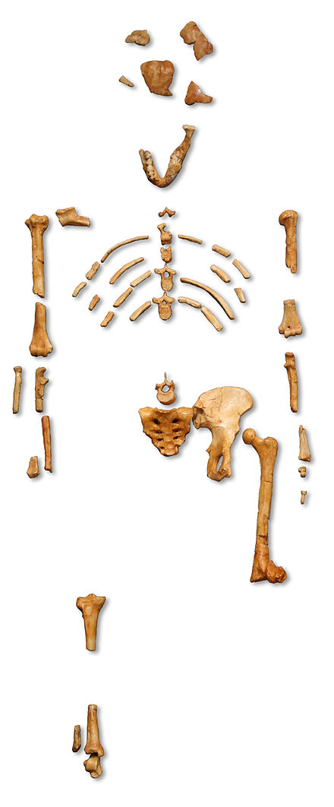
The Lucy Fossil
“Lucy was found by Donald Johanson and Tom Gray on November 24, 1974, at the site of Hadar in Ethiopia. They had taken a Land Rover out that day to map in another locality. After a long, hot morning of mapping and surveying for fossils, they decided to head back to the vehicle. Johanson suggested taking an alternate route back to the Land Rover, through a nearby gully. Within moments, he spotted a right proximal ulna (forearm bone) and quickly identified it as a hominid. Shortly thereafter, he saw an occipital (skull) bone, then a femur, some ribs, a pelvis, and the lower jaw. Two weeks later, after many hours of excavation, screening, and sorting, several hundred fragments of bone had been recovered, representing 40 percent of a single hominid skeleton.” – The Institute of Human Origins

Slide 8
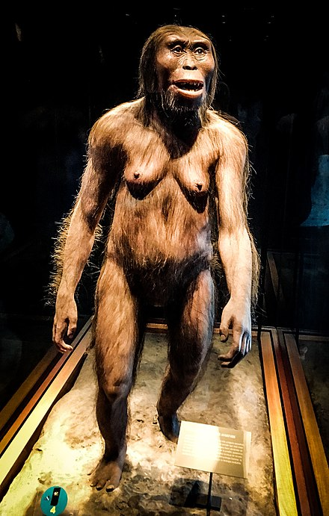
The Lucy “Reconstruction”
“Lucy, discovered almost half a century ago, was the most complete skeleton of the earliest hominid ever found at the time. She changed our understanding of human evolution. There’s little doubt Lucy walked on two feet like a modern human, or that she climbed trees to sleep, avoid predators or gather food.”
-The New York Times

Slide 9
So why a flood?
God said he would wipe humans off the face of the earth
  The tendency of dead mammals to “bloat and float”
  Mammals would try to swim on the surface
  Humans would look for higher ground or jump in a boat to survive
Mammals and humans would have ended up near the surface
After the flood, exposed to oxygen, they would quickly decompose

Slide 10
Genesis 6:8-12
But Noah found favor in the eyes of the Lord. 9 These are the generations of Noah. Noah was a righteous man, blameless in his generation. Noah walked with God. 10 And Noah had three sons, Shem, Ham, and Japheth. 11 Now the earth was corrupt in God's sight, and the earth was filled with violence. 12 And God saw the earth, and behold, it was corrupt, for all flesh had corrupted their way on the earth.
QUESTION? What do we notice about these verses?
  Noah was righteous, blameless, and walked with God
QUESTION? Does the bible say Noah was sinless?
  No. Gen 9:21 says Noah planted a vineyard and got drunk!

Slide 11
Genesis 6:8-12
QUESTION? How is Noah made righteous?
  By faith!
Heb 11:7, By faith Noah, being warned by God about things not yet seen, in reverence prepared an ark for the salvation of his household, by which he condemned the world, and became an heir of the righteousness which is according to faith.

Slide 12
Genesis 6:13-22
And God said to Noah, “I have determined to make an end of all flesh, for the earth is filled with violence through them. Behold, I will destroy them with the earth. 14 Make yourself an ark of gopher wood. Make rooms in the ark, and cover it inside and out with pitch. 15 This is how you are to make it: the length of the ark 300 cubits, its breadth 50 cubits, and its height 30 cubits. 16 Make a roof for the ark, and finish it to a cubit above, and set the door of the ark in its side. Make it with lower, second, and third decks. 17 For behold, I will bring a flood of waters upon the earth to destroy all flesh in which is the breath of life under heaven. Everything that is on the earth shall die. 18 But I will establish my covenant with you, and you shall come into the ark, you, your sons, your wife, and your sons' wives with you.

Slide 13
Genesis 6:19-22
19 And of every living thing of all flesh, you shall bring two of every sort into the ark to keep them alive with you. They shall be male and female. 20 Of the birds according to their kinds, and of the animals according to their kinds, of every creeping thing of the ground, according to its kind, two of every sort shall come in to you to keep them alive. 21 Also take with you every sort of food that is eaten, and store it up. It shall serve as food for you and for them.” 22 Noah did this; he did all that God commanded him.
QUESTION? Did this really happen?
  Those who don’t believe in Noah’s flood also don’t believe the words of Jesus.
    Luke 17:26, And just as it happened in the days of Noah, so it will be also in the days of the Son of Man:
QUESTION? Did Noah need to gather all the the animals?

Slide 14
Genesis 6:19-22
The end of all flesh is before me, an expression, the matter is decided.
Ark (tebah) – A box! Or a basket
  The only other usage is the reed basket that saved Moses
  It’s designed to “float”, not to “boat”
  Most artist renditions of the ark look like boats
Different from Ark of the Covenant (aron), a chest, as opposed to a box -Ex 25:10
  The ark was about 45-50 feet tall, 75-80 feet wide, and 450-500 feet long

Slide 15
Genesis 6:19-22
QUESTION? Were these dimensions important?
  Yes, for the sheer size that was needed to hold all the animals
  This ratio of L x W x H has been proved over the centuries to lead to the most stable vessels
  This design could tip more than 90 degrees and still not capsize
  Length x Width of all modern freighters is between 6:1 and 8:1
  The volume is the equivalent of 522 boxcars
    Estimates are that it could hold over 125,000 mid-sized animals (sheep sized)
    But the average animal is smaller than this
    Plus we didn’t have so much variation in the species back then
    Large enough to carry two of every species of air-breathing land creatures on the earth today, with room to spare!

Slide 16
Genesis 6:19-22
The rest of the space was for housing the family and for food.
  QUESTION? How did Noah collect all those creatures?
  QUESTION? How many decks did the ark have?
  QUESTION? Did Noah speak at all during this passage?
  QUESTION? What does the bible say that Noah did?

Slide 17
Chapter 7
Chapter 7

Slide 18
Genesis 7:1-5, Then the Lord said to Noah, “Go into the ark, you and all your household, for I have seen that you are righteous before me in this generation. 2 Take with you seven pairs of all clean animals, the male and his mate, and a pair of the animals that are not clean, the male and his mate, 3 and seven pairs of the birds of the heavens also, male and female, to keep their offspring alive on the face of all the earth. 4 For in seven days I will send rain on the earth forty days and forty nights, and every living thing that I have made I will blot out from the face of the ground.” 5 And Noah did all that the Lord had commanded him.

Slide 19
Genesis 7:1, Then the Lord said to Noah, “Go into the ark, you and all your household, for I have seen that you are righteous before me in this generation.
Noah has been building this ark for up to 100 years. There’s no record of God speaking to him during that whole time until now.
  QUESTION? How is this a demonstration of Noah’s faithfulness?
  QUESTION? Of the billions of people living on earth at that time, how many did God find righteous?
  QUESTION? Who is God speaking to in this verse?
  NCV renders it, “I have seen that you are the best person among the people of this time, so you and your family can go into the boat”
QUESTION? Does God’s favor to Noah overflow to his family?
  Noah is declared righteous, and his family receives the benefit

Slide 20
Genesis 7:2, Take with you seven pairs of all clean animals, the male and his mate, and a pair of the animals that are not clean, the male and his mate, 3 and seven pairs of the birds of the heavens also, male and female, to keep their offspring alive on the face of all the earth.
QUESTION? Why is God making a distinction here? Clean/Unclean
QUESTION? Why seven pairs of clean animals?
QUESTION? What makes an animal holy or unholy?
QUESTION? Can God declare holy something that is unholy?
Acts 10:12-15, In it were all kinds of animals and reptiles and birds of the air. 13 And there came a voice to him: “Rise, Peter; kill and eat.” 14 But Peter said, “By no means, Lord; for I have never eaten anything that is common or unclean.” 15 And the voice came to him again a second time, “What God has made clean, do not call common.”

Slide 21
The Jews had become separationists
Not associating with Samaritans or Gentiles
And the Roman Centurion knew this
  Acts 10:25-28, When Peter entered, Cornelius met him, and fell at his feet and worshiped him. 26 But Peter raised him up, saying, “Stand up; I too am just a man.” 27 As he talked with him, he entered and found many people assembled. 28 And he said to them, “You yourselves know how unlawful it is for a man who is a Jew to associate with a foreigner or to visit him; and yet God has shown me that I should not call any man unholy or unclean.
QUESTION? Do we look down on others who are not believers?
QUESTION? What about us? Were we once unholy?
  God declares us holy!

Slide 22
Genesis 7:4, For in seven days I will send rain on the earth forty days and forty nights, and every living thing that I have made I will blot out from the face of the ground.”
QUESTION? God already asked Noah and family to enter the ark. Why wait seven days?
  Perhaps waiting to give people opportunity to repent?
  One last chance for anyone else to enter!
  The movie Noah, with Russell Crow, 2014, had a stowaway
QUESTION? How long will it rain?
QUESTION? Do you think the rain was local or global?
  And there again is the term “blot out” … Erase everything!

Slide 23
Genesis 7:5, And Noah did all that the Lord had commanded him.
QUESTION? Did Noah ask God any questions?
  Look back to Gen 6:22, Thus Noah did; according to all that God had commanded him, so he did.
QUESTION? What does this tell us about Noah’s character?
QUESTION? Have we ever said to our kids, “Because I said so”?
  Why do we have to say that?
  Did God have to explain himself to Noah? Do we have to explain ourselves to our children?

Slide 24
Genesis 7:6-9, Noah was six hundred years old when the flood of waters came upon the earth. 7 Then Noah and his sons and his wife and his sons’ wives with him entered the ark because of the water of the flood. 8 Of clean animals, and of animals that are not clean, and of birds, and of everything that creeps on the ground, 9 two and two, male and female, went into the ark with Noah, as God had commanded Noah.
Noah gave birth to his sons when he was 500 (Gen 5:32). One hundred years have passed!
Noah and his family entered the ark.
The animals went into the ark as well
QUESTION? Kangaroos, elephants, alligators, pandas? How?
  These are typically considered to be isolated to certain geography

Slide 25
Genesis 7:10, And after seven days the waters of the flood came upon the earth.
QUESTION? Did the rain start right away?
  God repeats the seven-day delay from Gen 7:4
  Some say these seven days correspond to the seven-year tribulation, which is God’s final warning before he brings total destruction to all the unrighteous.
QUESTION? Are people saved during the tribulation?
QUESTION? Is anyone else saved here on the Ark?

Slide 26
Genesis 7:11 In the six hundredth year of Noah's life, in the second month, on the seventeenth day of the month, on that day all the fountains of the great deep burst forth, and the windows of the heavens were opened. 12 And rain fell upon the earth forty days and forty nights.
Notice the story line is very repetitive
  Noah’s age when the flood began
  Animals two by two
  The seven day wait before destruction
QUESTION? Why do it the bible so specific about the exact time?
  In 7:4 the Hebrew word for rain matar is used. It means normal rain
  In 7:12, the Hebrew word for rain geshem is used. It means a torrent
  40 days of torrential rain would be impossible on today’s earth

Slide 27
Fountains of the Great Deep
Gen 1:6-7, Then God said, “Let there be an expanse in the midst of the waters, and let it separate the waters from the waters.” 7 God made the expanse, and separated the waters which were below the expanse from the waters which were above the expanse; and it was so.
  There was water below the earth and water above it
  Something catastrophic occurred to break up the super-continent and release the fountains of the abyss
  Psa 104:5-7, He set the earth on its foundations, so that it should never be moved. 6 You covered it with the deep as with a garment; the waters stood above the mountains 7 At your rebuke they fled; at the sound of your thunder they took to flight.

Slide 28
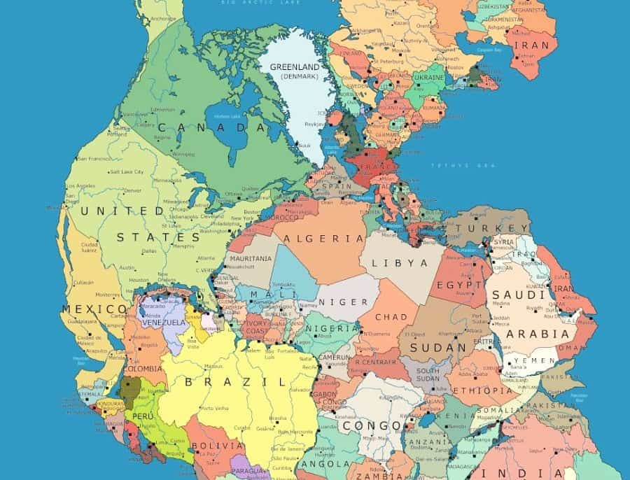

Pangea?

Slide 29
Fountains of the Great Deep
QUESTION? So where did all the water go?
  Psalm 104:8-9, The mountains rose; the valleys sank down to the place which you established for them. 9 You set a boundary that they may not pass over, So that they will not return to cover the earth.”
  The mountains rose up and the valleys sank down to contain all the water after the flood.
THERE ARE FOSSILS in the limestone on the top of Mount Everest!
  Jacques Cousteau calculated that if the mountains were brought low and the valleys raised up, water would cover every continent up to two miles deep
    Gen 7:20 says 15 cubits (22.5 feet) above the highest mountain
  Isa 24:1, Behold, the LORD lays the earth waste, devastates it, distorts its surface and scatters its inhabitants.

Slide 30
The Floodgates of Heaven
Sluice gates: Opening up a dam and letting the water out all at once!
For six weeks the water poured out of the earth and the heavens
How did this happen?
  A water canopy was bound up as ice encircling the planet?
  Plate tectonics and the continent breaking apart?
  Intense global volcanic activity sent ash and dust 50,000 feet into the air?
  The ice canopy melted, and it came pouring down?
Isa 24:18b-20, For the windows of heaven are opened, and the foundations of the earth tremble. 19 The earth is utterly broken, the earth is split apart, the earth is violently shaken. 20 The earth staggers like a drunken man; it sways like a hut; its transgression lies heavy upon it, and it falls, and will not rise again.

Slide 31
Floodgates of Heaven
QUESTION? Intense volcanic activity combined with water makes:
  Steam vents. Massive mudslides. Entire continents washed into the ocean.
  Jer 4:23-27, I looked on the earth, and behold, it was formless and void; And to the heavens, and they had no light. 24 I looked on the mountains, and behold, they were quaking, And all the hills moved to and fro. 25 I looked, and behold, there was no man, And all the birds of the heavens had fled. 26 I looked, and behold, the fruitful land was a wilderness, And all its cities were pulled down Before the LORD, before His fierce anger. 27 For thus says the LORD, “The whole land shall be a desolation, Yet I will not execute a complete destruction.
In the midst of devastation, there was preservation!
  Psalm 36:5-7, Your lovingkindness, O LORD, extends to the heavens, Your faithfulness reaches to the skies. 6 Your righteousness is like the mountains of God; Your judgments are like a great deep. O LORD, You preserve man and beast.7 How precious is Your lovingkindness, O God! And the children of men take refuge in the shadow of Your wings.

Slide 32
Gen 7:13-16, On the very same day Noah and his sons, Shem and Ham and Japheth, and Noah's wife and the three wives of his sons with them entered the ark, 14 they and every beast, according to its kind, and all the livestock according to their kinds, and every creeping thing that creeps on the earth, according to its kind, and every bird, according to its kind, every winged creature. 15 They went into the ark with Noah, two and two of all flesh in which there was the breath of life. 16 And those that entered, male and female of all flesh, went in as God had commanded him. And the Lord shut him in.
Again, God repeats many things here
Notice “according to its kind”
Who, what was saved in the Ark?
  Noah and his family
  Every beast, livestock, creeping things, every bird and winged creatuire
  What about fish? Insects?

Slide 33
What?
This was a global cataclysmic event
  What was wiped out?
The earth was shaken to its core
The landscape forever changed
Did the climate change?
Who, what was saved in the Ark?
  Noah and his family
  beasts, livestock, creeping things, birds and winged creatures
  What about fish? Insects?
QUESTION? Does earth today look like pre-flood earth?

Slide 34
Why?
QUESTION? Why would God do such a thing?
  Job 22:15-18, [Eliphaz Speaks] “Will you keep to the ancient path Which wicked men have trod,16 Who were snatched away before their time, Whose foundations were washed away by a flood?17 “They said to God, ‘Depart from us!’ And ‘What can the Almighty do to them?’ “Yet He filled their houses with good things; But the counsel of the wicked is far from me.
QUESTION? What was the attitude of pre-flood people?
QUESTION? Are there any people like that in our world today?

Slide 35
Gen 7:17-24, The flood continued forty days on the earth. The waters increased and bore up the ark, and it rose high above the earth. 18 The waters prevailed and increased greatly on the earth, and the ark floated on the face of the waters. 19 And the waters prevailed so mightily on the earth that all the high mountains under the whole heaven were covered. 20 The waters prevailed above the mountains, covering them fifteen cubits deep. 21 And all flesh died that moved on the earth, birds, livestock, beasts, all swarming creatures that swarm on the earth, and all mankind. 22 Everything on the dry land in whose nostrils was the breath of life died. 23 He blotted out every living thing that was on the face of the ground, man and animals and creeping things and birds of the heavens. They were blotted out from the earth. Only Noah was left, and those who were with him in the ark. 24 And the waters prevailed on the earth 150 days.
QUESTION? Was this flood local or global?

Slide 36
What is the main lesson of Noah’s Flood?
Why did God do this?
As a warning to those who ignore and disobey God!
2 Pet 3:3b-7, scoffers will come in the last days with scoffing, following their own sinful desires. 4 They will say, “Where is the promise of his coming? For ever since the fathers fell asleep, all things are continuing as they were from the beginning of creation.” 5 For they deliberately overlook this fact, that the heavens existed long ago, and the earth was formed out of water and through water by the word of God, 6 and that by means of these the world that then existed was deluged with water and perished. 7 But by the same word the heavens and earth that now exist are stored up for fire, being kept until the day of judgment and destruction of the ungodly.

Slide 37
What is the main lesson of Noah’s Flood?
Heb 11:7, By faith Noah, being warned by God concerning events as yet unseen, in reverent fear constructed an ark (a wooden box)for the saving of his household. By this he condemned the world and became an heir of the righteousness that comes by faith.
Deu 32:39, “‘See now that I, even I, am he, and there is no god beside me; I kill and I make alive; I wound and I heal; and there is none that can deliver out of my hand.
Ezk 33:29, Then they will know that I am the Lord, when I have made the land a desolation and a waste because of all their abominations that they have committed.
Psa 34:16, The face of the Lord is against those who do evil, to cut off the memory of them from the earth.
GOD TAKES FULL RESPONSIBILITY FOR THE DESTRUCTION OF EVIL MEN

Slide 38
Next Time! Chapter 8-9
The flood ends
The ark lands
The water subsides
God speaks
Noah and his family leave the ark
The world is changed
God makes a covenant with Noah
What’s a rainbow?

