Slide 1


Chapter 7
Chapter 7

Slide 2
Gen 7:17-24, The flood continued forty days on the earth. The waters increased and bore up the ark, and it rose high above the earth. 18 The waters prevailed and increased greatly on the earth, and the ark floated on the face of the waters. 19 And the waters prevailed so mightily on the earth that all the high mountains under the whole heaven were covered. 20 The waters prevailed above the mountains, covering them fifteen cubits deep. 21 And all flesh died that moved on the earth, birds, livestock, beasts, all swarming creatures that swarm on the earth, and all mankind. 22 Everything on the dry land in whose nostrils was the breath of life died. 23 He blotted out every living thing that was on the face of the ground, man and animals and creeping things and birds of the heavens. They were blotted out from the earth. Only Noah was left, and those who were with him in the ark. 24 And the waters prevailed on the earth 150 days.

Slide 3
Gen 7:17-24, Fact check questions
How long did the flood waters prevail?
What was covered by the flood?
How deep was the water?
What flesh died?
  “In whose nostrils was the breath of life”
The flood came due to man’s sin. Why did animals have to die?
Was creation subjected to corruption because of man’s sin?
Was creation subjected to judgement because of man’s sin?
Why does creation also have to pay for man’s sin?
  Interesting the ark was as much about saving animals as humans.
Because of “dominion” we are intimately connected to creation.

Slide 4
What is the main lesson of Noah’s Flood?
Why did God destroy the world?
  As a warning to those who ignore and disobey God!
2 Pet 3:3b-7, scoffers will come in the last days with scoffing, following their own sinful desires. 4 They will say, “Where is the promise of his coming? For ever since the fathers fell asleep, all things are continuing as they were from the beginning of creation.” 5 For they deliberately overlook this fact, that the heavens existed long ago, and the earth was formed out of water and through water by the word of God, 6 and that by means of these the world that then existed was deluged with water and perished. 7 But by the same word the heavens and earth that now exist are stored up for fire, being kept until the day of judgment and destruction of the ungodly.

Slide 5
What is the main lesson of Noah’s Flood?
A lesson in faith in God: Heb 11:7, By faith Noah, being warned by God concerning events as yet unseen, in reverent fear constructed an ark (a wooden box) for the saving of his household. By this he condemned the world and became an heir of the righteousness that comes by faith.
A lesson in the nature of God: Deu 32:39, “‘See now that I, even I, am he, and there is no god beside me; I kill and I make alive; I wound and I heal; and there is none that can deliver out of my hand.
A lesson in reverent fear of God: Ezk 33:29, Then they will know that I am the Lord, when I have made the land a desolation and a waste because of all their abominations that they have committed.
A lesson in the judgement of God: Psa 34:16, The face of the Lord is against those who do evil, to cut off the memory of them from the earth.
GOD TAKES FULL RESPONSIBILITY FOR THE DESTRUCTION OF EVIL MEN

Slide 6
Coming up! Chapter 8
The flood ends
The ark lands
The water subsides
God speaks
Noah and his family leave the ark
The world is changed
God makes a covenant with Noah
What’s a rainbow?

Slide 7
Chapter 8
Chapter 8

Slide 8
Genesis 8:1
But God remembered Noah and all the beasts and all the livestock that were with him in the ark. And God made a wind blow over the earth, and the waters subsided.
God remembered, a Hebrew idiom, to be mindful, thinking of
  Gen 19:29, So it was that, when God destroyed the cities of the valley, God remembered Abraham and sent Lot out of the midst of the overthrow when he overthrew the cities in which Lot had lived.
  Jer 31:20, Is Ephraim my dear son? Is he my darling child? For as often as I speak against him, I do remember him still. Therefore my heart yearns for him; I will surely have mercy on him, declares the Lord.
God made a wind to blow…
  God uses natural means to make the waters subside
  QUESTION? Did God use natural means to destroy the earth?

Slide 9
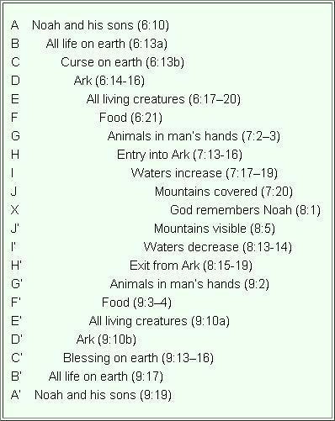
The Flood Story is a Chiasm
A chiasm (or chiasmus) is a literary device where a sequence of ideas or words is repeated in reverse order, creating a "mirror" or "X" effect, often used for emphasis and rhythm.
We are at the mid-point

Slide 10
Genesis 8:2-3
The fountains of the deep and the windows of the heavens were closed, the rain from the heavens was restrained, 3 and the waters receded from the earth continually. At the end of 150 days the waters had abated
When God “remembers”, it is followed by action
  He causes a wind to blow
  He closes the fountains of the deep
  He restrains the windows of heaven
And history records how long, 150 days
“abated”, began to decrease, this was the peak of the flood

Slide 11
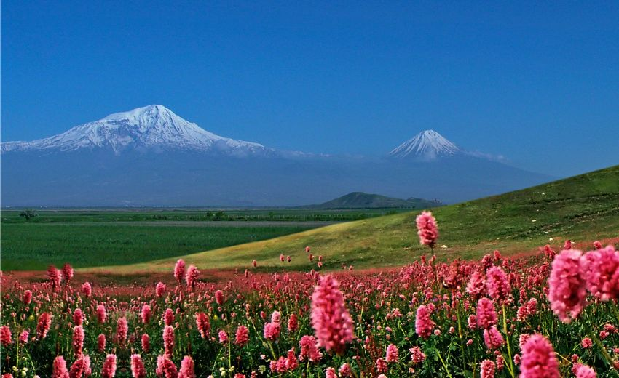
Genesis 8:4-5
and in the seventh month, on the seventeenth day of the month, the ark came to rest on the mountains of Ararat. 5 And the waters continued to abate until the tenth month; in the tenth month, on the first day of the month, the tops of the mountains were seen.
This is history! Notice the attention to detail.
So, at the peak of the flood the ark came to rest
“on the mountains of Ararat”
  A mountain range traversing
  Turkey, Armenia, and Iran
74 days later the tops of the
mountains could be seen
Many have failed trying to find
Noah’s Ark

Slide 12
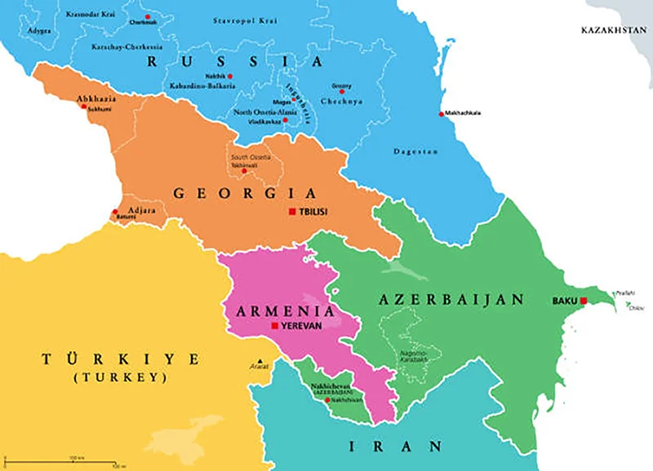

Genesis 8:4-5

Slide 13
So, is the Ark still there?
From Flavius Josephus in Antiquities (94 AD, about 2400 yrs later)
  The ark rested on the top of a certain mountain in Armenia. However, Armenians call this place [apobaterion] ‘The Place of Descent’, for the ark being saved in that place, its remains are shown there by the inhabitant to this day. Now all the writers of barbarian histories make mention of this flood, and of this ark, among whom is Berossus [a Chaldean Priest of Babylon]. For when he is describing the circumstances of the flood he goes on thus: “It is said there is still some part of the ship in Armenia, at the mountain of the Cordyaeans; and that some people carry off pieces of the bitumen, which they take away, and use chiefly as amulets for the averting of mischiefs.”
Noah may have also used pieces of the ark for firewood!
QUESTION? Would finding the ark change anything?

Slide 14
Genesis 8:6-9
At the end of forty days Noah opened the window of the ark that he had made 7 and sent forth a raven. It went to and fro until the waters were dried up from the earth. 8 Then he sent forth a dove from him, to see if the waters had subsided from the face of the ground. 9 But the dove found no place to set her foot, and she returned to him to the ark, for the waters were still on the face of the whole earth. So he put out his hand and took her and brought her into the ark with him.
40 days after the mountaintops became visible
The raven never came back (plenty of carrion out there?)
The first dove came back without finding a place to land

Slide 15
Genesis 8:10-12
10 He waited another seven days, and again he sent forth the dove out of the ark. 11 And the dove came back to him in the evening, and behold, in her mouth was a freshly plucked olive leaf. So Noah knew that the waters had subsided from the earth. 12 Then he waited another seven days and sent forth the dove, and she did not return to him anymore.
The second flight of the dove returned with an Olive leaf
The third flight of the dove, she never came back
QUESTION? How is a dove different from a Raven?
  Ravens eat carrion, Doves eat vegetation
  Doves can cover long distances
    They prefer valleys to mountains and like clean dry places for nesting

Slide 16
Genesis 8:13-15
In the six hundred and first year, in the first month, the first day of the month, the waters were dried from off the earth. And Noah removed the covering of the ark and looked, and behold, the face of the ground was dry. 14 In the second month, on the twenty-seventh day of the month, the earth had dried out. 15 Then God said to Noah, 16 “Go out from the ark, you and your wife, and your sons and your sons' wives with you.
Removed the covering, he actually removed the roof
But he stayed in the ark another 26, days! Why?
God spoke!
Noah was again obedient to God’s Word

Slide 17
Genesis 8:17-19
Bring out with you every living thing that is with you of all flesh—birds and animals and every creeping thing that creeps on the earth—that they may swarm on the earth, and be fruitful and multiply on the earth.” 18 So Noah went out, and his sons and his wife and his sons' wives with him. 19 Every beast, every creeping thing, and every bird, everything that moves on the earth, went out by families from the ark.
Hebrew for “family” is mishpachah
It seems God wanted the animals to depart by kinds

Slide 18
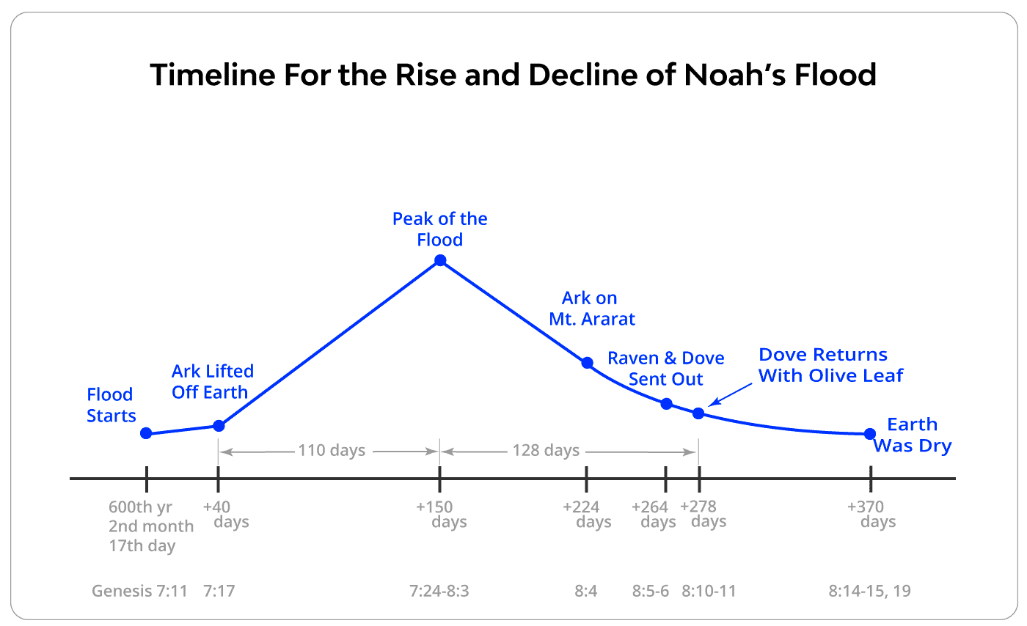


The Flood itself is a type of Chiasm
Using Noah’s age as the year, and 30-day months
7/17/600
10/01/600
Mountaintops
visible
Noah enters the ark
2/10/600
Noah leaves the ark
2/27/601
3/27/600
11/14/600
10/25/600
2/17/600
01/01/601

Slide 19
Is the Bible the only “flood story”?
There are 270 cultures around the world with flood stories
  88% say that a favored family was spared
  70% say their survival was because they built a boat
  66% say the flood came because of man’s wickedness
  67% say that animals were also saved from the flood
  57% say the boat came to rest on a mountain
The water grew higher and higher until all the earth was covered . . . A single family remained alive. —the Chimila tribe of northern Colombia
Then the waters went up, up and up, flooding all the mountains and highest hills and killing all that had life on the earth. Only one house had been raised over the waters, which had covered all the species of animals. —Mayan ancestors of the Jakalteks of northwestern Guatemala

Slide 20

Other evidence for the validity of the bible?
A Chinese word for CREATE, zào, unmistakably shows the creation of man. It is a combination of WALK and TALK. Adam was created a full grown man, able both to walk and talk. But the word TALK (gào) breaks down further, with compelling details that leave no doubt it is Adam being pictured. He is revealed to be the LIVING DUST MAN!
And the Lord God formed man of the dust of the ground and breathed into his nostrils the breath of life, and man became a living being.

Slide 21

Other evidence for the validity of the bible?
The image for GARDEN in the Chinese is yuán. This image has amazing detail in it.

Slide 22
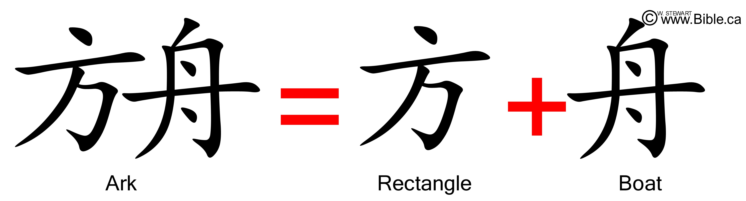
Other evidence for the validity of the flood?
The word for ARK in Chinese is fangzhou. This is a combination of two words, fang which means RECTANGLE and zhou meaning BOAT. That is basically what the ark was; a rectangular boat. There was nothing fancy about its construction, it was essentially a huge floating box. It is interesting to note that the word fang can also mean UPRIGHT or HONEST, which describes the character of those who were permitted onboard.
Make yourself an ark ... I will establish My covenant with you, and you shall go into the ark, you, your sons, your wife, and your sons wives with you. (Genesis 6:14, 18, NKJV)

Slide 23
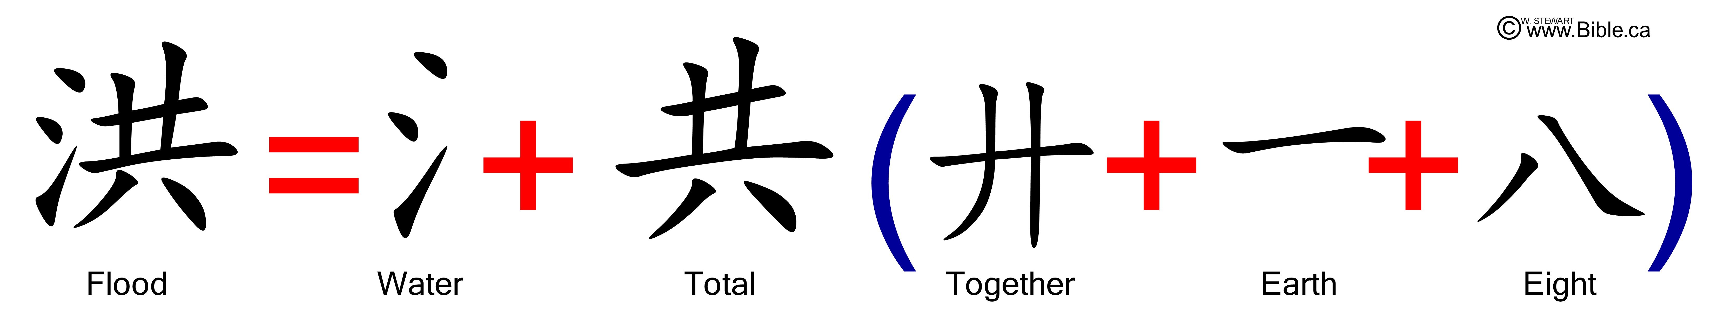
Other evidence for the validity of the flood?
Hóng, meaning FLOOD, reveals the extent of the flood. It was not a localized flood; God would bring TOTAL WATER upon the land. The word for TOTAL here is significant also. It is a record of what would be left after the flood was finished. There would remain EIGHT TOGETHER upon the EARTH. Only Noah, his wife, their three sons, and their wives would survive.

Slide 24

Other evidence for the validity of the flood?
This boat which Noah constructed was massive. It was a three-level vessel, with over 100,000 square feet of floor space. It would be rightly called a SHIP (chuán). What ship has only eight people onboard? Cruiseliners are built to carry thousands of people and have dozens of personnel onboard. Surely this pictures the ark Noah was commanded to build. God said that eight people would be saved in the ark.
the ark was being prepared, in which a few, that is, eight souls, were saved through water. (1 Peter 3:20-21, NKJV)

Slide 25
What is the aftermath of the global flood?
Speciation
  People and animals separate
  Genetic characteristics become inbred
Natural Selection (sounds like Darwin)
  Works by removing unfit genes from the population
  Log-haired dogs survive in northern climates
  Short-haired dogs do better in warm climates
The Ice Age
  Global cooling leads to faster migration and natural selection
Mass Extinctions
  Some kinds do not survive the global change in climate

Slide 26

Speciation
Genetic bottleneck at Noah’s lineage
Genetic disposition and errors quickly multiply
Each offspring inherits half their genes from each parent
As populations expand, they move away, limiting local diversity

Slide 27
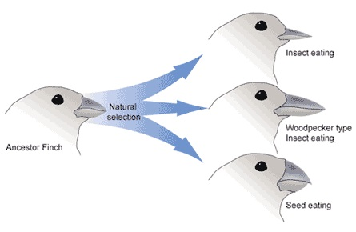
Natural Selection
Darwin had this part right
  Natural Selection occurs when a creature has some inheritable trait that gives it a better chance of passing this trait to the next generation
Different from Speciation in that it removes unfit genes
Natural selection cannot
create anything new
It only selects from what
is available
Information is removed,
and no new information
can ever be added

Slide 28
Ice Age
Tectonic activity and volcanism warmed the oceans
Water evaporation increased
But dust and volcanic ash blocked the sun, cooling the continents
Snow falling faster than it melted created huge glacial surfaces
The Great Lakes and finger lakes are remnants of the Ice Age
This probably lasted for several hundred years after the flood
Eventually oceans cooled and continent warmed
We have been in a gradual warming trend ever since

Slide 29
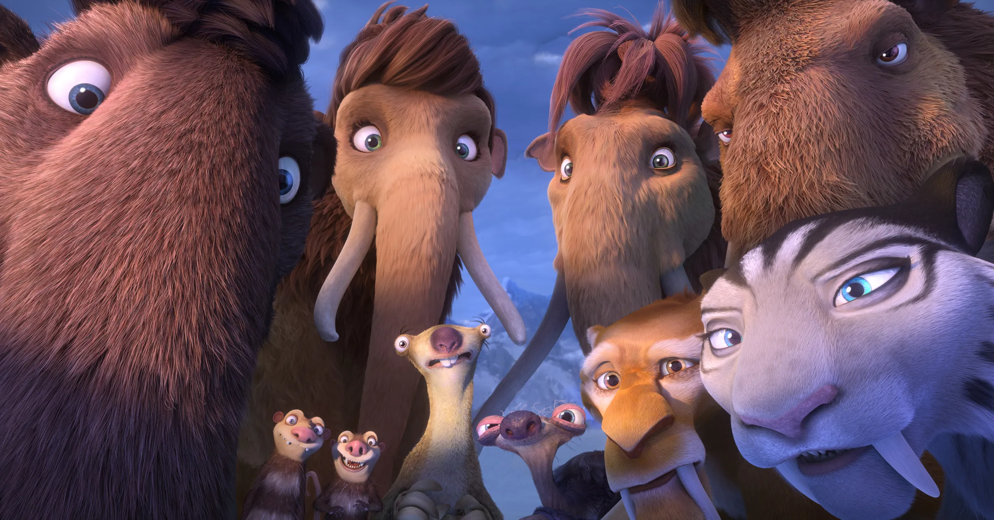
Mass Extinctions
A rapid, drastic climate change probably killed the dinosaurs
Other species also failed to survive in a now more hostile earth

Slide 30
Next Time! Genesis 8-9
Noah builds an altar
God makes a covenant with Noah
God promises to never again flood the earth
The sign of the rainbow
Noah’s indiscretion
Ham’s sin
Noah’s curse, and blessings to his sons

