Slide 1
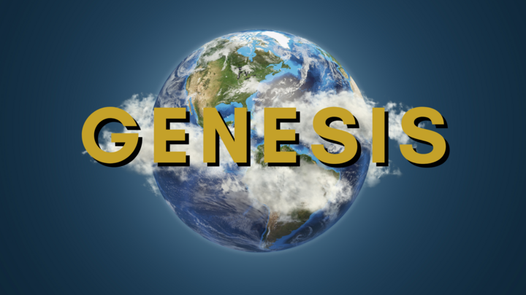

Chapter 8
Chapter 8

Slide 2
Genesis 8:20
Then Noah built an altar to the Lord and took some of every clean animal and some of every clean bird and offered burnt offerings on the altar.
First mention of an “altar”. Was it the first offering?
Cain and Abel had “brought to the Lord” an offering
Some commentators say it was brought to the gate of Eden
But now Eden is washed away!
QUESTION? How many animals were sacrificed?
“offered burnt offerings” is a play on words in the Hebrew
  He went up to offer that which goes up (smoke from the offering)
  So the emphasis is on the smoke that rises to God

Slide 3
Genesis 8:21
And when the Lord smelled the pleasing aroma, the Lord said in his heart, “I will never again curse the ground because of man, for the intention of man's heart is evil from his youth. Neither will I ever again strike down every living creature as I have done.
Noah’s sacrifice is pleasing to God
Here, the Lord commits to himself two things, what are they?
  “I will never again curse the ground”
    QUESTION? When was the first time He cursed the ground?
    The first curse was because of the disobedience of Adam and Eve
    The flood was a curse because of the evil intentions of man’s heart
  “Neither will I ever again strike down every living creature.”

Slide 4
Genesis 8:22
While the earth remains, seedtime and harvest, cold and heat, summer and winter, day and night, shall not cease.”
  God makes a third promise here!
  The cycles of life will continue
While the earth remains, these shall not cease:
  Planting and growing seasons
  Cold and heat
  Summer and winter, day and night
Do we need to move to the planet Mars?

Slide 5
The cycles of the earth endure
The regular cycles we are used to will not cease until the end of the world
  Will “Climate Change” stop this?
  Will Nuclear War stop this?
  Will the Tribulation stop this?
  We will continue to have all this even into the Millennial Kingdom of Christ (1000-year reign of Christ on earth)

Slide 6
The cycles of the earth endure
QUESTION: How long will the earth endure?
Until the new heavens and new earth!
  After the Rapture
  After the Tribulation
  After the Millennial Kingdom
  At the Great White Throne, where Satan and all the unrighteous are judged.
Rev 20:11, Then I saw a great white throne and him who was seated on it. From his presence earth and sky fled away, and no place was found for them.

Slide 7
Looking forward
God is looking forward to new Earth and new Heavens!
Isaiah 65:17-19 - “See, I will create new heavens and a new earth. The former things will not be remembered, nor will they come to mind. But be glad and rejoice forever in what I will create, for I will create Jerusalem to be a delight and its people a joy. I will rejoice over Jerusalem and take delight in my people; the sound of weeping and of crying will be heard in it no more.”
Isaiah 66:22 - “‘As the new heavens and the new earth that I make will endure before me,’ declares the Lord, ‘so will your name and descendants endure.’”
2 Peter 3:13 – “But in keeping with his promise we are looking forward to a new heaven and a new earth, where righteousness dwells.”
Revelation 21:1 – “Then I saw ‘a new heaven and a new earth,’ for the first heaven and the first earth had passed away, and there was no longer any sea.”

Slide 8
Looking forward
So, Noah and his family have been on the ark for a little over a year
  We believe it was a rough ride (as we discussed last week)
  The earth has been devastated
  All the humans and all the animals are dead
    There may even be dead creatures everywhere
The face of the land has changed
  Mountains have lifted up and valleys have formed
  The forests are gone, plants are beginning to regrow
  The continents are splitting up and drifting apart
  Even the earth’s axis may have changed!

Slide 9
Looking at a changed world
The climate has changed drastically
  There is no more vapor canopy protecting the earth
  Lots of volcanic dust in the atmosphere remains for years
  Oceans are warmer leading to evaporation
  Temperatures in the atmosphere are lower
QUESTION? What does low pressure mean?
  Rain, wind, and snow are now regular occurrences
  This is the beginning of the hydrological cycle
What ramifications do warmer oceans have?
  Hurricanes
What if the oceans in the upper (cooler) latitudes are also warm?
  Snow

Slide 10
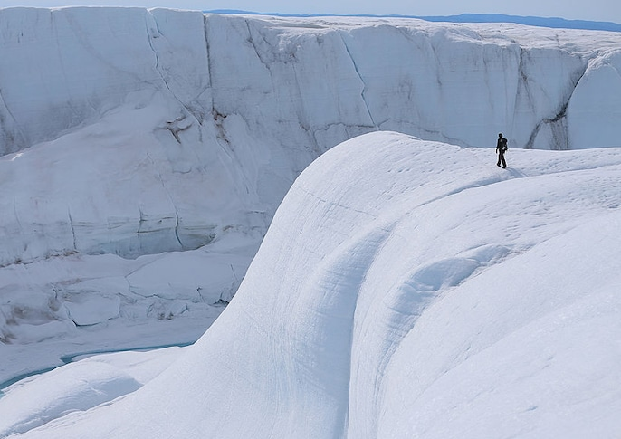

Slide 11
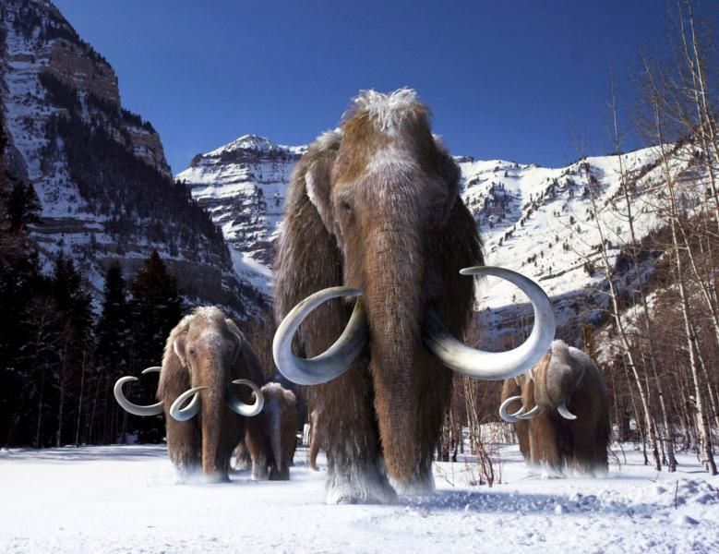

Slide 12
Chapter 9
Chapter 9

Slide 13
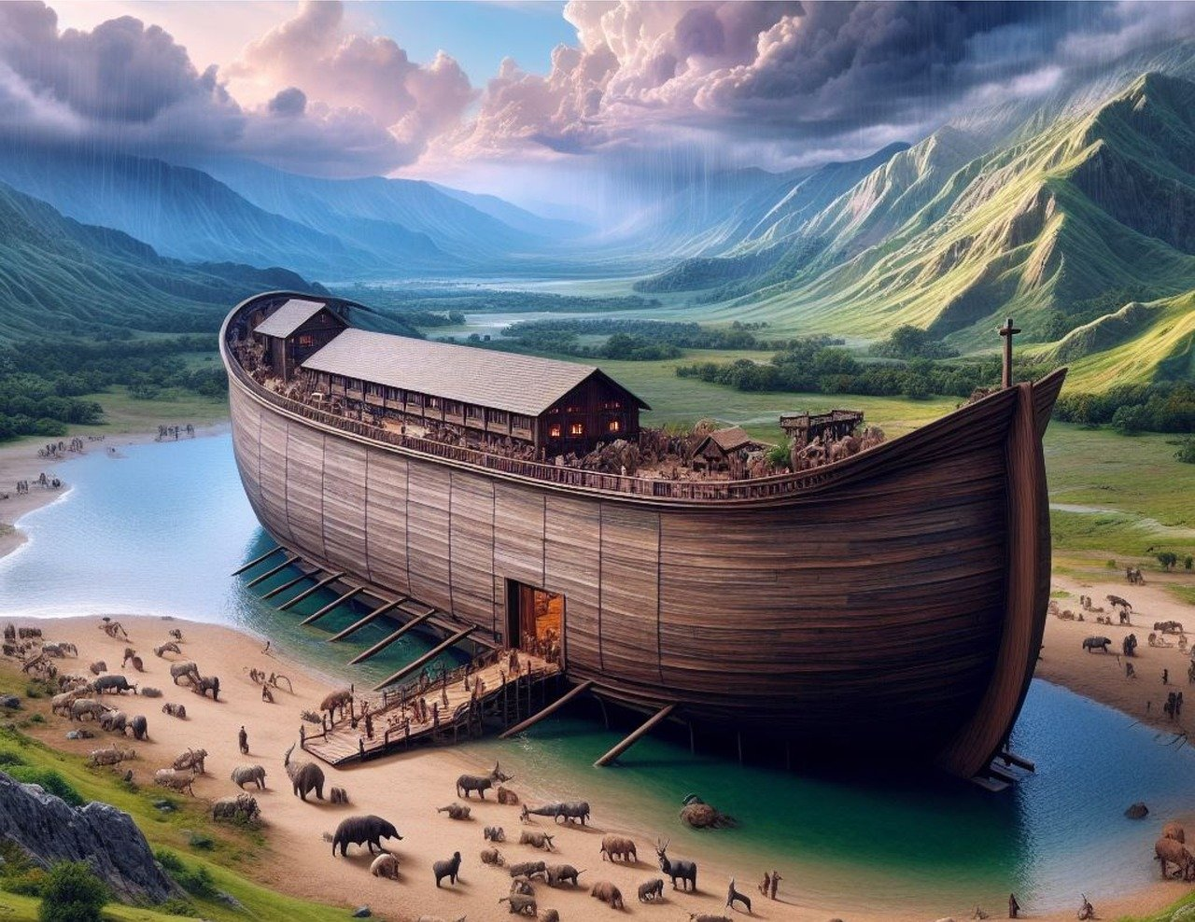

Slide 14
Genesis 9:1
God gives Noah some commands in 1-7
And He promises to do some things in 8-17
Verse 1, And God blessed Noah and his sons and said to them, “Be fruitful and multiply and fill the earth.
  God repeats the blessing of Gen 1:28, and 8:17
  This time it is also extended to Noah’s sons who are the representative heads of the human family
  God is “Elohim”, the name He uses during the creation
  He is the creator and sustainer of all life
This is a blessing, but it is also a _____________.
  How does this correspond to what we see today?

Slide 15
Be Fruitful and Multiply
God’s plan still for his creatures is “be fruitful and multiply”
  Gen 1:22, 1:28:8:17, 9:1, 9:7, Chapters 17, 26, 28, 35
Why is God continually promoting procreation?
  Ex 19:5, Now if you obey me fully and keep my covenant, then out of all nations you will be my treasured possession.
  Isa 43:21, “The people whom I formed for Myself will declare my praise.
  Mal 3:17-18, “They will be Mine,” says the LORD of hosts, “on the day that I prepare My own possession, and I will spare them as a man spares his own son who serves him.” 18 So you will again distinguish between the righteous and the wicked, between one who serves God and one who does not serve Him.

Slide 16
Genesis 9:1
  Tit 2:13-14, Christ Jesus, 14 who gave Himself for us to redeem us from every lawless deed, and to purify for Himself a people for His own possession, zealous for good deeds.
  1 Pet 2:9, But you are a chosen race, A royal priesthood, A holy nation, a people for God’s own possession, so that you may proclaim the excellencies of Him who has called you out of darkness into His marvelous light;

Slide 17
Genesis 9:1
Right after destroying everything, God pronounces a blessing!
  Man is sinful, contrasted with the graciousness and forbearance of God
  Now, 4500 years since the flood, God has been pouring out His grace
  He is forming a people for himself
But another judgment is coming for those who reject Him!
  Act 17:30-31, Therefore having overlooked the times of ignorance, God is now declaring to men that all people everywhere should repent, 31 because He has fixed a day in which He will judge the world in righteousness through a Man whom He has appointed, having furnished proof to all men by raising Him from the dead.”
The day is FIXED!

Slide 18
Genesis 9:2
The fear of you and the dread of you shall be upon every beast of the earth and upon every bird of the heavens, upon everything that creeps on the ground and all the fish of the sea. Into your hand they are delivered.
A fascinating verse! “delivered” = “given to”, “handed over”
Are animals now generally afraid of us?
Was it that way from the beginning? We can assume harmony!
  Isa 65:25, The wolf and the lamb shall graze together; the lion shall eat straw like the ox, and dust shall be the serpent's food. They shall not hurt or destroy in all my holy mountain,” says the Lord.
Things have changed due to the fall and the flood
Why does God now instill a fear into the animals?

Slide 19
Genesis 9:3
Every moving thing that lives shall be food for you. And as I gave you the green plants, I give you everything.
QUESTION? According to God, what is one purpose for animals?
QUESTION? Is eating animals morally wrong?
  People were probably eating animals soon after the fall
  But here is God’s official permission to do so
QUESTION? What are other purposes for animals?
  To serve man. We have dominion.
  The animals are here for us! But not to be abused.
  Pro 12:10, Whoever is righteous has regard for the life of his beast, but the mercy of the wicked is cruel.
QUESTION? Was there no eating of animals in the Garden? Why?

Slide 20
Genesis 9:4
4 But you shall not eat flesh with its life, that is, its blood
  A Dietary Law
  Blood is “alive”
    Gen 4:10, Cain rose up and killed Abel and God said, “What have you done? The voice of your brother’s blood is crying to me from the ground”.
    Lev 17:10-11, “If any one of the house of Israel or of the strangers who sojourn among them eats any blood, I will set my face against that person who eats blood and will cut him off from among his people. 11 For the life of the flesh is in the blood, and I have given it for you on the altar to make atonement for your souls, for it is the blood that makes atonement by the life.

Slide 21
Genesis 9:4
4 But you shall not eat flesh with its life, that is, its blood
  A Dietary Law
  But blood also has a corrupting nature
    Num 35:33, You shall not pollute the land in which you live, for blood pollutes the land, and no atonement can be made for the land for the blood that is shed in it, except by the blood of the one who shed it.
  What does the embalming process consist of?
  Is Adam’s blood tainted?

Slide 22
Genesis 9:5-6
5 And for your lifeblood I will require a reckoning: from every beast I will require it and from man. From his fellow man I will require a reckoning for the life of man. 6 Whoever sheds the blood of man, by man shall his blood be shed, for God made man in his own image.
  Now a Societal Law
  This known as a chiastic parallelism
    English: “Shed the blood of man, by man your blood will shed”
    Hebrew: “Sapak dam adam, adam dam sapak”
  This is the first mention of and support for capital punishment
  QUESTION? What is the reason for this commandment?
  QUESTION? Are beasts subject to this command as well?

Slide 23
Capital Punishment
One of the most debated topics in modern society
Liberal studies ”prove” it is not a deterrent to crime
Conservative studies “prove” it is a deterrent to crime
QUESTION? Is Capital Punishment a deterrent to crime?
  How is it a deterrent?
  IF you kill a killer, will he ever kill again?
Alex Murdaugh (55) sentenced to 40 years in prison
  South Carolina annual cost per prisoner $35,000
  California annual cost per prisoner $135,000
What would God have us do?

Slide 24
Genesis 9:7-11
7 And you, be fruitful and multiply, increase greatly on the earth and multiply in it.” 8 Then God said to Noah and to his sons with him, 9 “Behold, I establish my covenant with you and your offspring after you, 10 and with every living creature that is with you, the birds, the livestock, and every beast of the earth with you, as many as came out of the ark; it is for every beast of the earth. 11 I establish my covenant with you, that never again shall all flesh be cut off by the waters of the flood, and never again shall there be a flood to destroy the earth.”
Again, the commandment to be fruitful, and “greatly” increase
And God makes a covenant. What is a covenant?
Is it conditional or unconditional? Any current examples?

Slide 25
Genesis 9:12-17
And God said, “This is the sign of the covenant that I make between me and you and every living creature that is with you, for all future generations: 13 I have set my bow in the cloud, and it shall be a sign of the covenant between me and the earth. 14 When I bring clouds over the earth and the bow is seen in the clouds, 15 I will remember my covenant that is between me and you and every living creature of all flesh. And the waters shall never again become a flood to destroy all flesh. 16 When the bow is in the clouds, I will see it and remember the everlasting covenant between God and every living creature of all flesh that is on the earth.” 17 God said to Noah, “This is the sign of the covenant that I have established between me and all flesh that is on the earth.”

Slide 26
A Bow in the Cloud
What’s a bow?
  It’s the most common weapon of antiquity!
72 occurrences of the Hebrew “qesheth” in the OT
  3 of them are in our passage
A bow without arrows typically signifies peace
  The Greek for bow “toxon” appears only once in the NT here:
    Rev 6:2, I looked, and behold, a white horse, and he who sat on it had a bow; and a crown was given to him, and he went out conquering and to conquer.
  No arrows! This is not Jesus, but one who promises peace
  It’s a false peace, because the following is the red horse of war

Slide 27
A Bow in the Cloud
God says, “I set My bow in the cloud”
  “To set” means to give up or to place
  The sense is that God is hanging up his bow for all to see
  Isa 54:7-9, 7 “For a brief moment I forsook you, But with great compassion I will gather you.8 “In an outburst of anger I hid My face from you for a moment, But with everlasting lovingkindness I will have compassion on you,” Says the LORD your Redeemer. 9 “For this is like the days of Noah to Me, When I swore that the waters of Noah Would not flood the earth again; So I have sworn that I will not be angry with you Nor will I rebuke you.
Here you can see the victory of grace over judgment
This is our opportunity to tell the world of God’s grace

Slide 28
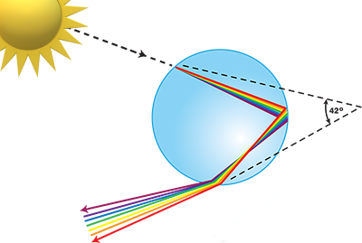
What Makes a Rainbow?
Rainbows are caused by both refraction and reflection inside of raindrops. Sunlight enters the raindrop at about 48 degrees. Inside the drop it hits the back of the drop at about 21 degrees to the perpendicular, so instead of refracting, it reflects, creating an optimal 42 degree angle, and then exits the drop refracting again. Red light travels the fastest so is bent the least when it crosses the refractive interface. Violet bends the most.

Slide 29
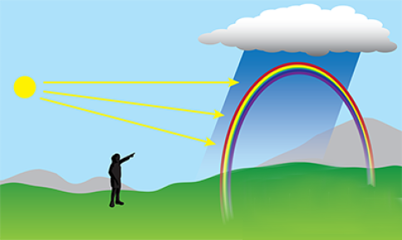
What Makes a Rainbow?
To see a rainbow, the sun must be behind you. The colors you see are reflected off the back side of millions of raindrops. As an observer looking up, the drops lower in the sky display violet to you, and the drops higher in the sky display red to you. The curve of the bow is created based on the sun's position relative to the raindrops and the observer, and the fact that violet bends more than red, and hence appears as the color on the inside of the rainbow.

Slide 30
Next Time!
Genesis 9:18-29
  The Toldoth of Noah
  Drunkenness
  Nakedness
  Taking advantage of and gloating over another’s shame
  A national curse
Issues
  Why does righteous Noah lose his self-control and uncover himself?
  Why does Ham tell his brothers, but Canaan is the one cursed?
  Why does the birth order of Noah’s sons seem wrong in different translations (Gen 10:21)
  How can such a seemingly minor incident lead to God’s cursing an entire people group?

