Slide 1


Chapter 9
Chapter 9

Slide 2
Genesis 9:18-21
The sons of Noah who came out of the ark were Shem, Ham and Japheth. (Ham was the father of Canaan.) 19 These were the three sons of Noah, and from them came the people who were scattered over the whole earth. Noah, a man of the soil, proceeded to plant a vineyard. 21 When he drank some of its wine, he became drunk and lay uncovered inside his tent.
  QUESTION? When Noah’s family left the ark, what else left with him?
  QUESTION? Why would Noah overindulge after the flood?
    Some of men’s biggest failures come right after their greatest victories
      Noah
      Elijah
      Peter

Slide 3
Noah’s Excess
Noah planted a vineyard.
  QUESTION? Did he plant anything else?
Noah lived for 600 years before the flood, probably he knew about wine before
  The bible doesn’t record any event where Noah overindulged before the flood
  This probably wasn’t a problem for him before
One of the characteristics of a fallen world is fermentation
  Almost any juice will ferment in time, creating alcohol
  Juice is delicious and nutritious, but leave it for a while and something happens (apple cider)
  Ethanol is produced when yeast breaks down sugars

Slide 4
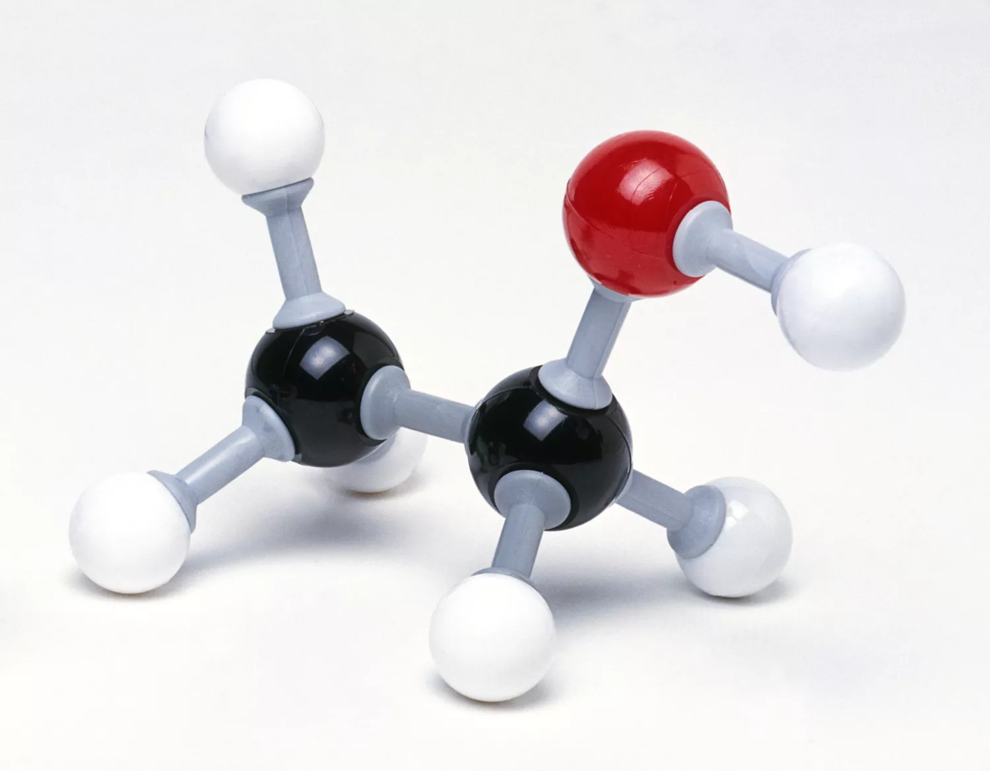
QUESTION? What is alcohol?
Ethanol: CH3−CH2−OH
It binds to the receptors
of nerves and changes
the way they work
An enzyme in the body
adds an atom oxygen
This forms acetaldehyde
and H₂O
A different enzyme adds
another oygen forming
Acetic acid and CO₂
Notice both processes
require an oxygen atom

Slide 5
The role of oxygen in alcohol metabolism
The more available oxygen in the body the faster this occurs
People get drunk faster and stay drunk longer at high altitudes
QUESTION? How could Noah’s experience with alcohol before the flood be different from his experience with alcohol after the flood?
Consider:
  Post flood altitude
  Pre-flood air pressure
  Pre-flood oxygen levels

Slide 6
QUESTION? Is alcohol bad?
Judges 9:13, my new wine, which cheers God and men
Psalm 104:15, And wine which makes man’s heart glad
Isa 25:6, The LORD of hosts will prepare a lavish banquet for all peoples on this mountain; A banquet of aged wine, choice pieces with marrow, And refined, aged wine.
Deu 14:26, Use the silver to buy whatever you like: cattle, sheep, wine or other fermented drink, or anything you wish. Then you and your household shall eat there in the presence of the Lord your God and rejoice.
1 Tim 5:23, No longer drink water exclusively, but use a little wine for the sake of your stomach and your frequent ailments
Ecc 9:7, Go then, eat your bread in happiness and drink your wine with a cheerful heart; for God has already approved your works.

Slide 7
However…
Pro 20:1, Wine is a mocker, strong drink a brawler, And whoever is intoxicated by it is not wise
Eph 5:18, And do not get drunk with wine, [a]for that is dissipation, but be filled with the Spirit
Isa 5:11, Woe to those who rise early in the morning that they may pursue strong drink, Who stay up late in the evening that wine may inflame them!
Isa 5:22, Woe to those who are heroes at drinking wine, and valiant men in mixing strong drink
Pro 23:31-32, Do not look on the wine when it is red, When it sparkles in the cup, When it goes down smoothly; 32 At the last it bites like a serpent And stings like a viper.

Slide 8
Nakedness…
Hab 2:15, “Woe to you who make your neighbors drink, Who mix in your venom even to make them drunk So as to look on their nakedness!
Lam 4:21, Are you rejoicing in the land of Uz, O people of Edom? But you, too, must drink from the cup of the Lord’s anger. You, too, will be stripped naked in your drunkenness.
Drinking is very often associated with nakedness, even today
  This is what happened to Noah when, “he uncovered himself inside his tent”.
  Drunkenness causes us to lose our inhibitions, and our sense of shame

Slide 9
Gen 9:22-23, The shame!
And Ham, the father of Canaan, saw the nakedness of his father and told his two brothers outside. 23 Then Shem and Japheth took a garment, laid it on both their shoulders, and walked backward and covered the nakedness of their father. Their faces were turned backward, and they did not see their father's nakedness.
The word “saw” (raah) indicates a pondering look
This is the second reference to Ham as the father of Canaan
  See Genesis 9:18
and “told” (nagad) his brothers
  This is to “declare to them conspicuously”.
  He described to them what he saw with an air of satisfaction

Slide 10
The transgression!
What he did was wrong!
  Pro 10:12, Hatred stirs up strife, But love covers all transgressions.
  Pro 17:9, He who conceals a transgression seeks love, But he who repeats a matter separates intimate friends.
  1 Pet 4:8, Keep fervent in your love for one another, because love covers a multitude of sins.
Shem and Japheth do the right thing and cover their father, walking backward
  QUESTION? Where does this shame of nakedness come from?
  From the fall.
  Sin takes advantage of our fallen minds and puts inappropriate thoughts in our head. Adam and Eve recognized this.

Slide 11
Gen 9:24-29
When Noah awoke from his wine, he knew what his youngest son had done to him. 25 So he said,
“Cursed be Canaan;
A servant of servants
He shall be to his brothers.”
26 He also said,
“Blessed be the LORD,
The God of Shem;
And let Canaan be [b]his servant.
27 “May God enlarge Japheth,
And let him dwell in the tents of Shem;
And let Canaan be [c]his servant.”
28 Noah lived three hundred and fifty years after the flood. 29 So all the days of Noah were nine hundred and fifty years, and he died.

Slide 12
Noah Speaks!
This is the first time in Scripture that Noah ever says anything! And the last!
Noah pronounces curses and blessings in Hebrew poetic form
  Curses on Canaan, who will be servant to his brothers
  God will later use Israel to bring judgment on Canaan
Blessings on Shem (Father of the Jews), and Japheth who will “dwell” with Shem
  These people groups will “get along”, and Japheth will be enlarged
  He curses Canaan, his grandson
    We believe that Canaan was involved, because
  He (Noah) knew what his (Ham’s) youngest son had done to him
  QUESTION? What was done to him? Conspiracy theorists?

Slide 13
The Curse on Canaan
QUESTION? Was Ham guilty? Yes, of course
  But it may be that Ham was justified by his faith, whereas Canaan was not
God does not curse his own
  Num 23:8, “How shall I curse whom God has not cursed?
And how can I denounce whom the LORD has not denounced?
  Psa 32:1-2, How blessed is he whose transgression is forgiven, Whose sin is covered! 2 How blessed is the man to whom the LORD does not impute iniquity, And in whose spirit there is no deceit!

Slide 14
The Curse of Ham?
Many call this “the curse of Ham”
  Ham was not cursed. There’s no biblical basis for “the curse of Ham”
  “The curse of Ham” was used to justify the slave trade
Since descendants of Ham occupied Egypt, Libya, and Southern Nile
  And, Cush, which means “black” settled in and around Ethiopia
    “A servant of servants He shall be to his brothers”
Abraham, from Shem, came from Ur of the Chaldees, Southern Iraq
  Descendants of Japheth, north to Turkey, west toward Europe

Slide 15
The Curse on Canaan
Canaan is Ham’s youngest son (Gen 10:6)
The descendants of Canaan occupied Palestine
  He is cursed by his grandfather, perhaps because he was already a rejector of God
  His descendants later occupied the Holy Land before the Jews conquered it
  Genesis was probably written by Moses during the 40-year wilderness wandering
    Was this read to Israel? Why were they entitled to the land?
    Deu 9:5, 5 Not because of your righteousness or the uprightness of your heart are you going in to possess their land, but because of the wickedness of these nations the Lord your God is driving them out from before you.

Slide 16
Who are the Canaanites? Part 1
They are mentioned starting in Genesis 11, and appear throughout the OT
  They were idolatrous, adulterous, lascivious, wicked people
  Abraham forbids Isaac from taking a Canaanite wife
  Gen 24:3-4, I will make you swear by the LORD, the God of heaven and the God of earth, that you shall not take a wife for my son from the daughters of the Canaanites, among whom I live, 4 but you will go to my country and to my relatives, and take a wife for my son Isaac.
Jacob’s daughter Dinah was raped by a Canaanite in Genesis 34.
  Her brothers Simeon and Levi then killed every male and looted the city

Slide 17
Who are the Canaanites? Part 2
A couple of famous Canaanite cities are Sodom and …
  We know what happened there!
  Also, Jericho and Ai
A famous Canaanite was a giant Philistine named…
Another famous Canaanite was a harlot named…
  Even cursed people can be redeemed!
In the Exodus, God promises to completely destroy them
  Exo 23:23, My angel will go before you and bring you in to the land of the Amorites, the Hittites, the Perizzites, the Canaanites, the Hivites and the Jebusites; and I will completely destroy them.

Slide 18
Who are the Canaanites? Part 3
  Num 21:3, The LORD heard the voice of Israel and delivered up the Canaanites;vthen they utterly destroyed them and their cities. Thus the name of the place was called Hormah (devoted to destruction).
  Deu 7:1-2, “When the LORD your God brings you into the land where you are entering to possess it, and clears away many nations before you, the Hittites and the Girgashites and the Amorites and the Canaanites and the Perizzites and the Hivites and the Jebusites, seven nations greater and stronger than you, 2 and when the LORD your God delivers them before you and you defeat them, then you shall utterly destroy them. You shall make no covenant with them and show no favor to them.

Slide 19
Who are the Canaanites? Part 4
But Israel did not completely drive them out
  So they became slaves of Israel
    Josh 16:10, But they did not drive out the Canaanites who lived in Gezer, so the Canaanites live in the midst of Ephraim to this day, and they became forced laborers.
Judges is filled with references to skirmishes with Canaanites,
    Ezra recounts problems with intermarriages, and calls for national repentance
    Then, the CANAANITES DISAPPEAR from biblical history around 500 BC
About 1,800 years after Noah’s curse on Canaan God wiped out the entire culture!

Slide 20
Who are the Canaanites? Part 5
Modern genetic studies claim to have found a close correlation between supposed Canaanite skeletal remains, with people living in modern-day Lebanon
  But as a people-group and culture the Canaanites are gone.
    As are, “the Hittites and the Girgashites and the Amorites and the Canaanites and the Perizzites and the Hivites and the Jebusites, seven nations greater and stronger than you”
  All of them ethnic groups descended from Canaan
Then Noah lived 350 years after the flood and the days of Noah were?
  950
Noah knew Methuselah, who knew Adam!
Noah was still alive when Abraham was born!

Slide 21
Chapter 10
Chapter 10

Slide 22
Ancestry
QUESTION? Why are people so interested in knowing their genealogy?
  Ancestry.com, has been around over 40 years
    Over 1 billion in revenue
    23 million customers
  23andMe.com, been around almost 20 years
    280 million revenue
    12.8 million customers
    Just last week they filed Chapter 11. Should we delete our data?
These services also use heuristics to determine your genetic risk for certain diseases

Slide 23
Do we really want to know our ancestors?
Studying our ancestors can be interesting, but it can also be scary
  My mom used to say we were related to Annie Oakley
  My great-great grandparents arrived New York at Ellis Island
  My brother did his 23andme and found out he is small percentage Ashkenazi Jew
QUESTION? What’s an Ashkenazi Jew?
  Jews who fled to the land of Ashkenaz from the Holy Land during the Muslim invasion
  Where is Ashkenaz? Mostly Germany, but also Europe
What if we do the research and find out we are related to a famous serial killer? Does our ancestry really matter?

Slide 24
The Table of Nations, Part 1
For certain, all of us come from Shem, Ham or Japheth, from Noah, and from Adam
  Chapter 10 can be fascinating or boring
    It really depends on how we look at it
A read through Genesis 10, without knowing what all the names mean is BORING!
  This chapter is known as the Table of Nations
  There is NO record, other than the bible, for these early generations
God put this chapter in Genesis for a reason!
  He wants us to know something!

Slide 25
The Table of Nations, Part 2
Knowing the offspring of these patriarchs, we can:
  Understand early human history
  Trace to spread of mankind by relating names to places and nations
  Understand God’s sovereign involvement with mankind
  See ancestry of the Nation of Israel, and the promised Messiah
The main point of this chapter is to explain the origin of peoples and nations (70 in total)
  God said, be fruitful and multiply
  But it is also to explain Abraham, his ancestry, and the pathway to Messiah
  For this reason, the sons of Noah are addressed in reverse order, leaving Shem LAST

Slide 26
The Table of Nations, Part 3
All of the nations descended from the three sons of Noah were wicked and idolatrous, not knowing or recognizing the true God.
Even though their parents and great-grandparents could explain to them first-hand the account of the flood, the reason for the flood, the result of the flood. No one cared.
Every once-in-a-while a righteous man pops up here and there:
  Enoch
  Noah
  Job
  Zacharias, in the NT
Apart from these rare instances what we see is the general decline of the human race.
  Even the religious elite in Israel were “a brood of vipers”

Slide 27
The Promise to Israel
It was only when God chose Abraham (chapter 12), from the line of Shem, and began working with him, that eventually the nation of Israel was born
QUESTION? What was God’s promise for the nation of Israel?
  Deu 7:7-9, “The LORD did not set His love on you nor choose you because you were more in number than any of the peoples, for you were the fewest of all peoples, 8 but because the LORD loved you and kept the oath which He swore to your forefathers, the LORD brought you out by a mighty hand and redeemed you from the house of [a]slavery, from the hand of Pharaoh king of Egypt. 9 Know therefore that the LORD your God, He is God, the faithful God, who keeps [b]His covenant and [c]His lovingkindness to a thousandth generation with those who love Him and keep His commandments;

Slide 28
The Purpose for Israel
QUESTION? But what was Israel’s purpose?
God’s missionary nation!
Isa 49:6, “I will make you a light to the Gentiles, and you will bring my salvation to the ends of the earth.”
How did they do?

Slide 29
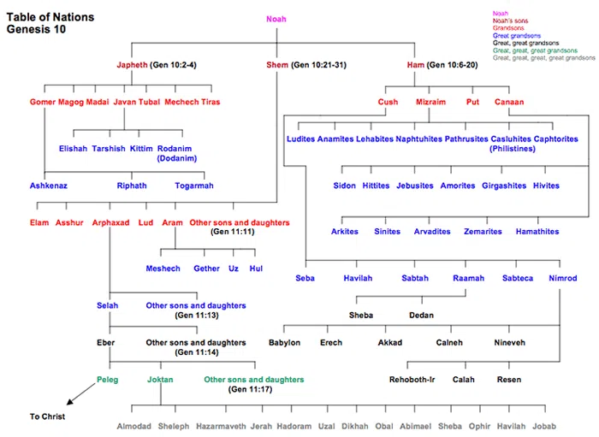

Slide 30
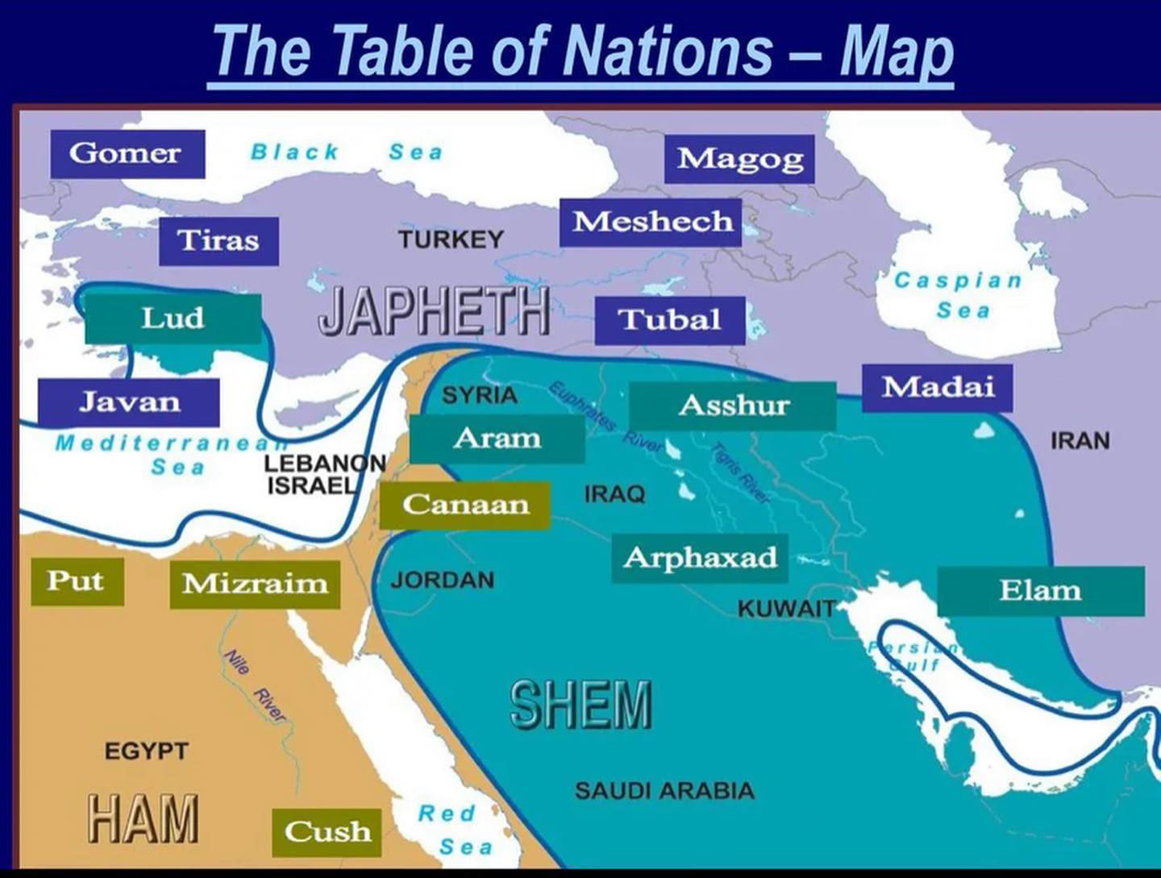

Slide 31
Genesis 10:1-4
Pull out your two sheets for reference!
1 These are the generations of the sons of Noah, Shem, Ham, and Japheth. Sons were born to them after the flood. 2 The sons of Japheth: Gomer, Magog, Madai, Javan, Tubal, Meshech, and Tiras. 3 The sons of Gomer: Ashkenaz, Riphath, and Togarmah. 4 The sons of Javan: Elishah, Tarshish, Kittim, and Dodanim. 5 From these the coastland peoples spread in their lands, each with his own language, by their clans, in their nations.
Verse 5 refers to the scattering from Babel
Japheth is the father of the Indo-European nations, North of the Mid-East, going from East to West, basically from India across to Europe.
We know this by studying the names which became nations, and also the roots and structure of language, which are related to Sanskrit

Slide 32
Japheth
The Greeks: Claim to have descended from Japetos
  A form of Japheth
The Persians: Trace themselves back to a flood account with a man named Japeti as their father.
  Also, a word related to Japheth
The Japheth descendants can be traced by their names and language groups
The major language groups are:
  Indo-European (583 languages)
  Sino-Tibetan (501 languages)
  Afro-Asiatic (379 languages)

Slide 33
The sons of Japheth, Part 1
Gomer
  North to the Black Sea area, and spreading west into Europe, France, England
The sons of Gomer
  Ashkenaz – North to Turkey in the area of Lake Ascanius
    Later many moved to Germany and west into Europe
    Ashkenazi Jews are not Japhethites, they are Jews living in the land of Ashkenaz (Germany and Europe)
    And then many fled to the USA during the German purge in WWII
  Riphath – Josephus associates them with the Paphligonians (Northern Turkey-on the south shore of the black sea)
  Togarmah – The House of Targum – today’s Armenians

Slide 34
The sons of Japheth, Part 2
Magog
  Also known as Gog. Migrated north of the Caspian Sea
  Ez 38:1-3, And the word of the LORD came to me saying, 2 “Son of man, set your face toward Gog of the land of Magog, the [a]prince of Rosh, Meshech and Tubal, and prophesy against him 3 and say, ‘Thus says the Lord GOD, “Behold, I am against you, O Gog, prince of Rosh, Meshech and Tubal.
  Note Meshech (Mushku River-Moscow) and Tubal (Tobol River and Tobolsk, Russia) are also sons of Japheth
“Prince of Rosh” (Russia)

Slide 35
The sons of Japheth, Part 3
Madai – The Medes in the area of Persia.
  The Magi who visited Jesus were from Persia
Javan – The Greeks, the Ionians
  The sons of Javan
    Elishah, a derivative of the Hellenists (Greeks)
    Acts 6:1, Now in these days when the disciples were increasing in number, a complaint by the Hellenists arose against the Hebrews because their widows were being neglected in the daily distribution.
Tarshish, believed to be a city in Spain called Tartessos
  Jonah tried sailing there when called to preach to Ninevah
Kittim and Rodanim – went to the Med. islands of Cyprus and Rhodes

Slide 36
The sons of Japheth, Part 4
So, the descendants of Japheth populated Europe, North Asia (Russia), Persia and India.
They may have even moved across Siberia, crossed the land (or ice) bridge to North America and populated the Americas
Noah’s prophecy was true, “May God extend Japheth’s territory” (Gen 9:27)

Slide 37
Genesis 10:6-14
The sons of Ham: Cush, Egypt, Put, and Canaan. 7 The sons of Cush: Seba, Havilah, Sabtah, Raamah, and Sabteca. The sons of Raamah: Sheba and Dedan. 8 Cush fathered Nimrod; he was the first on earth to be a mighty man. 9 He was a mighty hunter before the Lord. Therefore it is said, “Like Nimrod a mighty hunter before the Lord.” 10 The beginning of his kingdom was Babel, Erech, Accad, and Calneh, in the land of Shinar. 11 From that land he went into Assyria and built Nineveh, Rehoboth-Ir, Calah, and 12 Resen between Nineveh and Calah; that is the great city. 13 Egypt fathered Ludim, Anamim, Lehabim, Naphtuhim, 14 Pathrusim, Casluhim (from whom the Philistines came), and Caphtorim.

Slide 38
The Sons of Ham
Cush is Ethiopia
  The name Cush also appears in Saudi Arabia
  Jer 13:23, Can the Ethiopian (Kushi) change his skin or the leopard his spots?
Looking forward to the Messianic kingdom age:
  Isa 45:14, Thus says the LORD, “The products of Egypt (Mizraim) and the merchandise of Cush And the Sabeans (descendants of Saba, son of Cush), men of stature, Will come over to you and will be yours; They will walk behind you, they will come over in chains And will bow down to you; They will make supplication to you: ‘Surely, God is with you, and there is none else, No other God.’”

Slide 39
The Sons of Ham, Part 2
Cush also fathered Nimrod, a mighty hunter (or warrior)
Nimrod was also the founder of Babel which we will see next time
  Bab-el means “gateway” to God in Babylonian
  But in Hebrew Babel means “confusion”
  One represents the view of man, the other the view of God
“A mighty hunter “before the Lord” Actually “against” the Lord.
Not hunting animals, but hunting the souls of men, like AntiChrist
Nimrod means “rebel”

Slide 40
The Sons of Ham, Part 3
But Nimrod also built many cities listed in verses 10-12
  Nineveh was one of the cities, so sinful that God sent a prophet
His kingdom was enormous!
  He was the ruler of Babylon, and also Nineveh, a city in Assyria
Interestingly, God used the Assyrians in 722 BC to take captive the 10 northern tribes of Israel back to Assyria
Then, God sent the Babylonians, under Nebuchadnezzar in 605 and 586 BC (two separate exiles)
  to take the remaining two southern tribes away to Babylon
Put is Lybia (northern Africa)
Mizraim is Egypt and the Nile valley

Slide 41
The Sons of Ham, Canaan, Genesis 15-20
Canaan fathered Sidon his firstborn and Heth, 16 and the Jebusites, the Amorites, the Girgashites, 17 the Hivites, the Arkites, the Sinites, 18 the Arvadites, the Zemarites, and the Hamathites. Afterward the clans of the Canaanites dispersed. 19 And the territory of the Canaanites extended from Sidon in the direction of Gerar as far as Gaza, and in the direction of Sodom, Gomorrah, Admah, and Zeboiim, as far as Lasha. 20 These are the sons of Ham, by their clans, their languages, their lands, and their nations.
Canaan occupied the land of Palestine
  Remember the curse of Canaan?
Canaanites were so conquered and subjugated, not just by Israel, that many of them fled abroad.

Slide 42
The Sons of Ham, Canaan, Part 2
Of all the clans of Canaan, possibly the Hittites or the Sinites populated the Far East
Hittites- Hittites and the Mongols have very similar features: shoes which had toes that turned up, hair in a pigtail, pioneer work in smelting and casting iron, and the domestication of horses
Sinites, the word Sin is very prevalent in China. Sin means “purebred”, and we see that many Chinese have very similar features
  The prefix Sin as in Sino indicates China
  Many Chinese emperors prefix their name with “Sin”

Slide 43
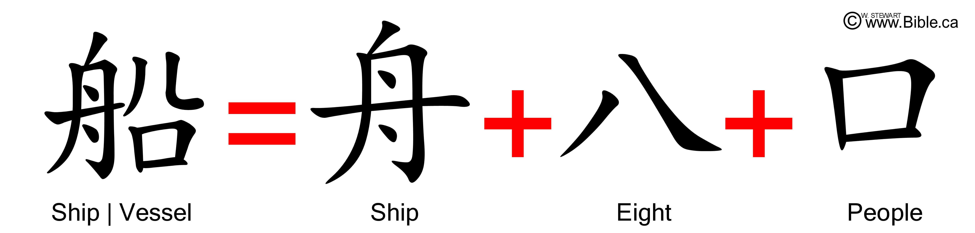
The Sons of Ham, Canaan, Part 3
The Great Wall of China was started by Alexander the Great and was called the Wall of Magog, because it was designed to protect them from the Huns (also known as Scythians (Russian) peoples of the north (Magog)
  For certain, the Far East Asians came from Noah
  Remember the Chinese character for ship or vessel…

Slide 44
Next Time!
The Sons of Shem
Men want to “make a name” for themselves
The Tower of Babel
The Origin of Languages
  Biblical explanation
  Secular explanation

