Slide 1

Chapters 1-11
Introduction
Chapters 1-11

Slide 2

WiFi Access
Campus WiFi is quite slow with so many people using it. So, we have set up a local hotspot. If you want faster Internet, scan this QR Code to connect to the hotspot network in this classroom.
Genesis PW: Adam&Eve

Slide 3

Class Registration
Register for this class (if you haven’t already) so that I can communicate with you by Email important information from time to time.

Slide 4

Class Website (http only!)
We have set up a website for this class that has calls materials, as well as excellent supplementary materials. If you want to learn even more, please visit the site. Click the Genesis Menu item.
http://sound-doctrine.us

Slide 5

Zoom Link
We realize some of you can’t make it every week (but please try!). We have arranged for a Zoom meeting for each class. Click the QR code here; or take a picture of it to send it to friends who may want to follow the class remotely.

Slide 6

Anonymous Questions?
Sometimes people are hesitant to ask questions in class. We have the solution. Anonymously ask any question by texting “Answers” to 877-324-4480 to register; and then text your question. Or scan this QR code, which also appears on the website.

Slide 7
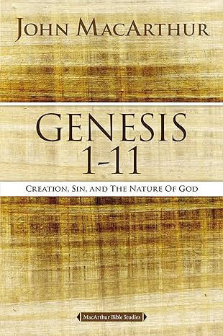
Book for Personal Study
This book guides you to spend a few minutes each week working through the material on your own. Class is strongly encouraged to work through each chapter BEFORE each week’s session. The class doesn’t exactly follow the book. It is meant for personal study!

Slide 8
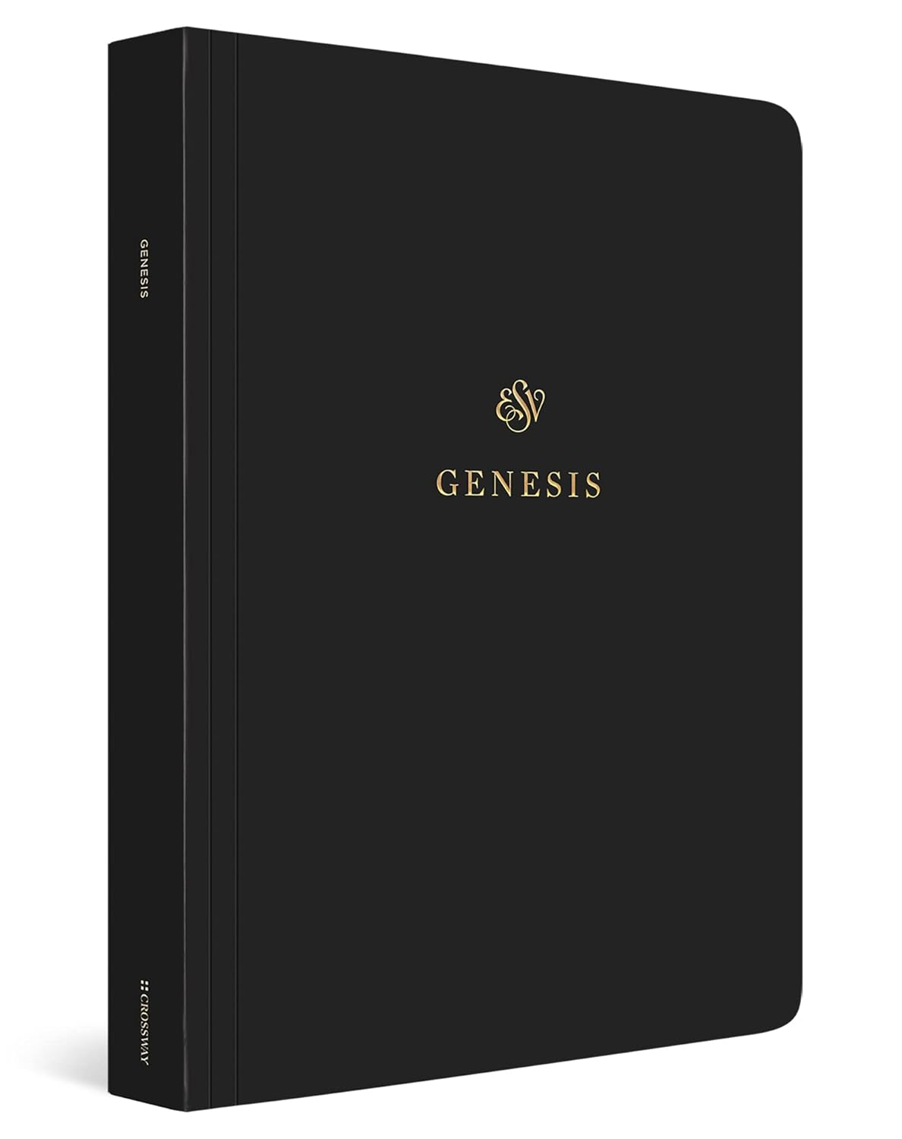
THE Book we use in class
We have taken the liberty of providing the book of Genesis in the English Standard Version (ESV) with adjacent blank pages so you may take copious notes! Please bring it to class with you!

Slide 9
Class Schedule
Wednesday Evenings, 6:30pm to 7:45pm
January 15 – Introduction
January 22 – Chapter 1
January 29 – Chapter 2
February 5 – Chapter 3
February 12 – Chapter 4
February 19 – Chapter 5
February 26 – Chapter 6
March 5 – Chapter 7
March 12 – Chapter 8
March 19 – Chapter 9
March 26 – No class
April 2 – Chapter 10
April 9 – Spring Break
April 16 – Chapter 11

Slide 10
Why Genesis?
Genesis is THE foundational book to the entire bible
Society’s attacks on the bible are most vehement toward the book of beginnings, and for good reason
  If Genesis is dismissed as myth
    It makes God out to be a liar (or non-existent)
    Our origins can’t be logically explained
    There is no reason to adopt a moral worldview
    The gospel is rendered unnecessary
2/3 of teens raised in Christian homes say they plan to leave the church when they leave home
Of the 1/3 who retain the faith, the vast majority were taught Genesis as actual history, and given reasons to take it that way

Slide 11
Why Chapters 1-11?
Chapters 1-11 are the foundational chapters of Genesis
They set the stage for the rest of the book
We plan to do an expositional deep-dive into these 11 chapters
  We only have 13 weeks to do it!
We will learn many amazing things about the world God created
  The origin of the universe.
  The origin of life on earth.
  The origin of sin and our need for salvation.
  Where did the fossils come from?
  Where did languages come from?

Slide 12

Pop Quiz!
Let’s have some fun anonymously learning about the perspectives of people in this class about the book of Genesis.
Register your participation by scanning this QR code.

Slide 13
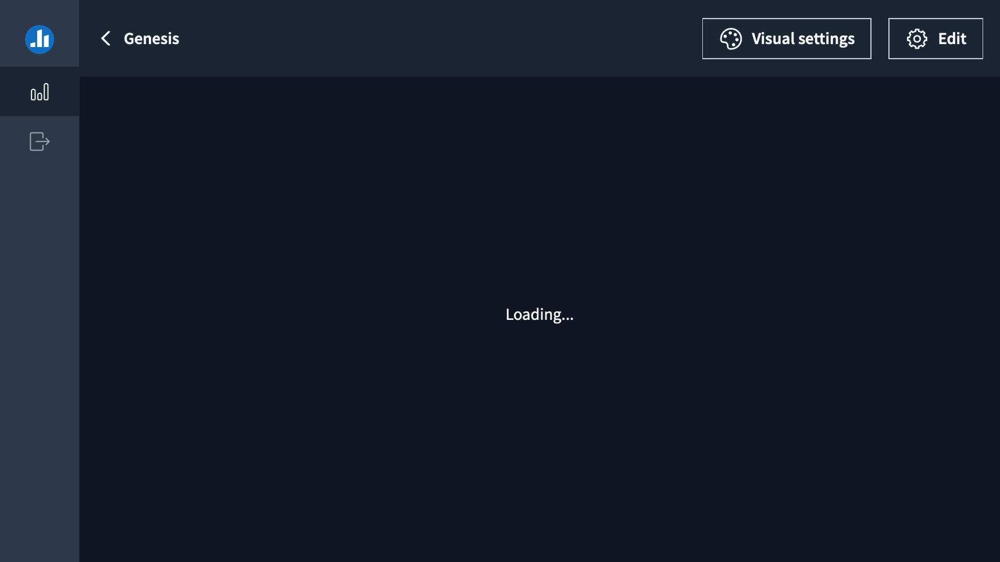

Slide 14
2 Timothy 3:16-17
All Scripture is breathed out by God and profitable for teaching, for reproof, for correction, and for training in righteousness, 17 that the man of God[a] may be complete, equipped for every good work.

Slide 15
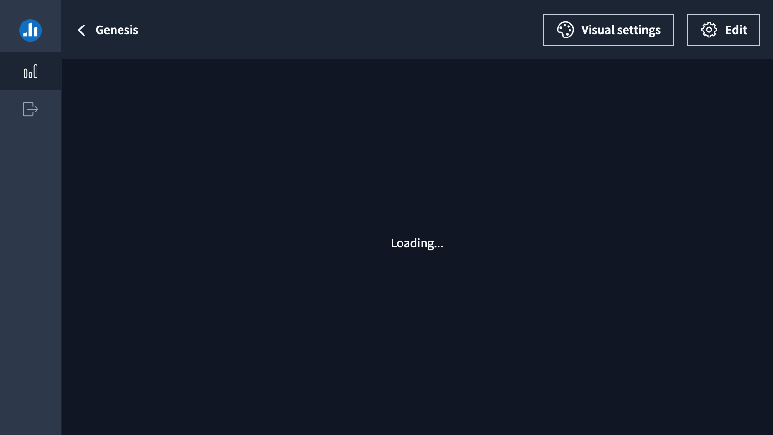

Slide 16
Titus 1:1-2, Heb 6:18
Paul, a servant[a] of God and an apostle of Jesus Christ, for the sake of the faith of God's elect and their knowledge of the truth, which accords with godliness, 2 in hope of eternal life, which God, who never lies, promised before the ages began…
so that by two unchangeable things, it is impossible for God to lie, we who have fled for refuge might have strong encouragement to hold fast to the hope set before us.

Slide 18
Jeremiah 33:25-26
Thus says the Lord: If I have not established my covenant with day and night and the fixed order of heaven and earth, ²⁶ then I will reject the offspring of Jacob and David my servant and will not choose one of his offspring to rule over the offspring of Abraham, Isaac, and Jacob. For I will restore their fortunes and will have mercy on them.”

Slide 20
Luke 1:34-35
And Mary said to the angel, “How will this be, since I am a virgin?”
“The Holy Spirit will come upon you, and the power of the Most High will overshadow you; therefore the child to be born will be called holy—the Son of God.

Slide 22
Heb 11:3
By faith we understand that the universe was created by the word of God, so that what is seen was not made out of things that are visible.

Slide 24
John 5:46-47
For if you believed Moses, you would believe me; for he wrote of me. 47 But if you do not believe his writings, how will you believe my words?”

Slide 25
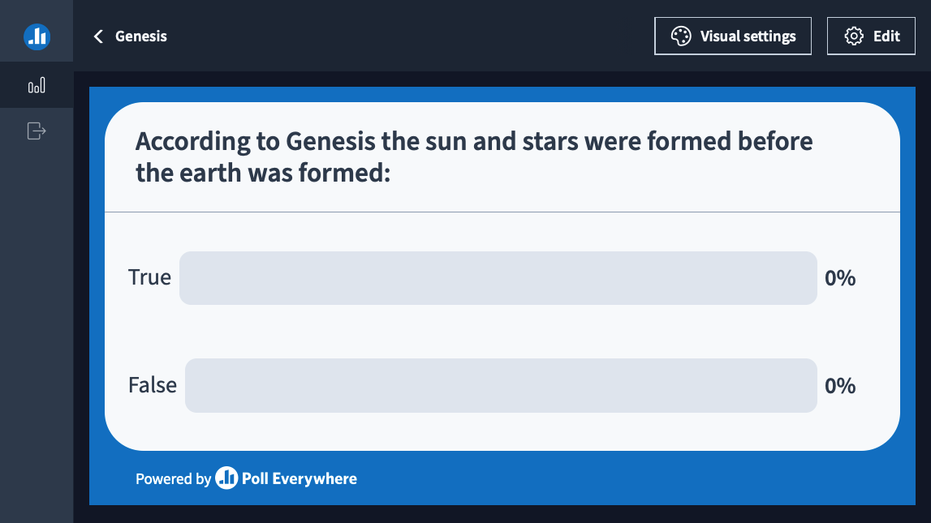

Slide 26
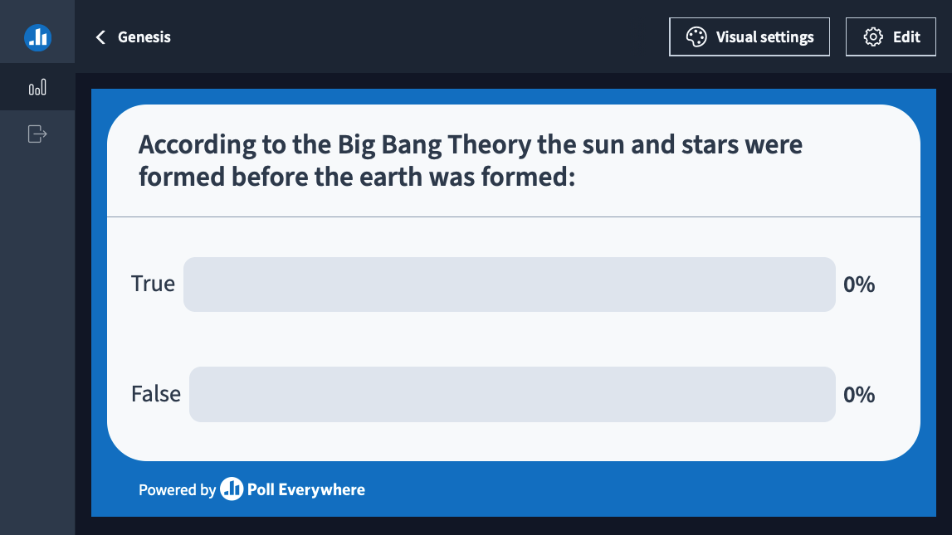

Slide 27
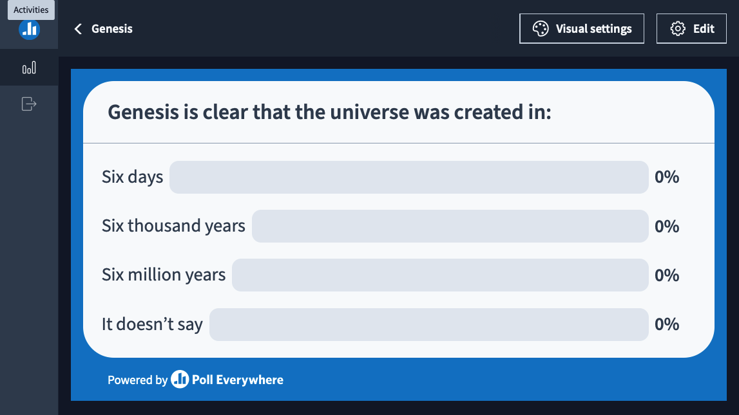

Slide 28
Genesis 1:31
And God saw everything that he had made, and behold, it was very good. And there was evening and there was morning, the sixth day.

Slide 29


Slide 30
Genesis 2:7
the Lord God formed the man of dust from the ground and breathed into his nostrils the breath of life, and the man became a living creature.

Slide 31


Slide 32
Genesis is History
Jesus himself affirmed the historical nature of Genesis
Genesis 1-11 is quoted as history 60 times by New Testament authors
Genesis 1-11 contains events, genealogies, lifespans, places of residence
Genesis 1-11 explains who built specific known and historical places

Slide 33
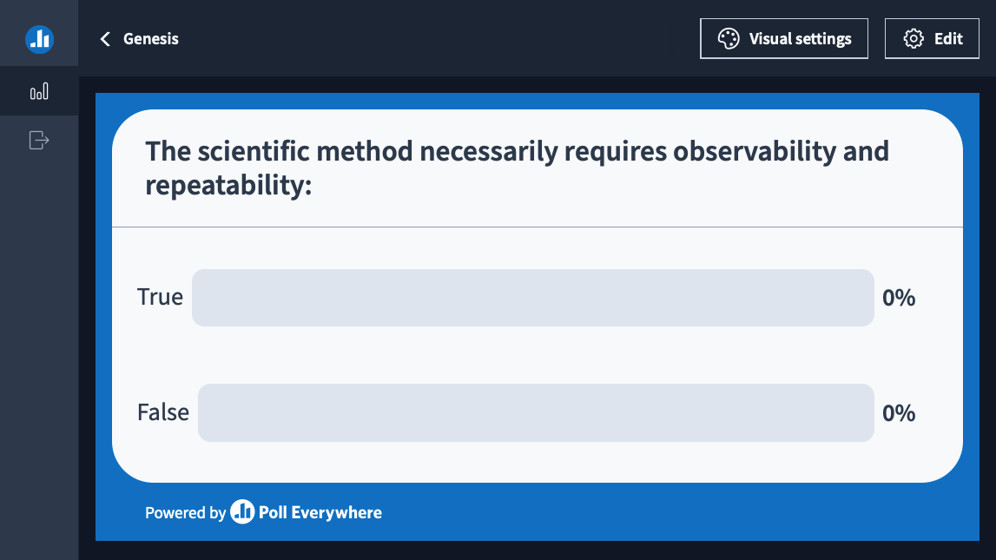

Slide 34
The Scientific Method
Google AI Overview: “Repeatability is crucial to the scientific method because it allows scientists to validate their findings and build confidence in their results.”

Slide 35
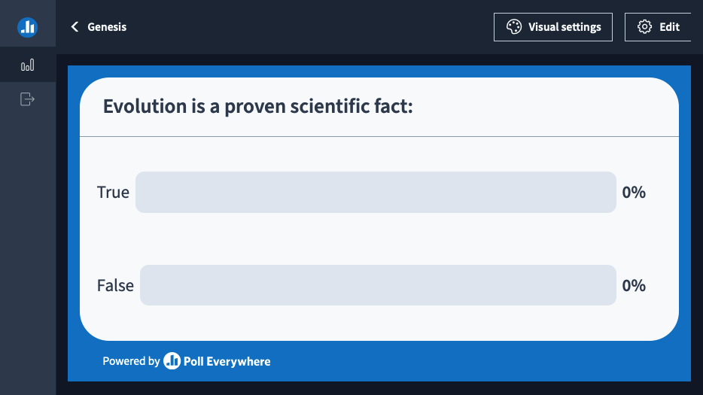

Slide 36
Evolution as science?
Evolution has not been observed
  We do see variations within kinds
    Dog breeds for example. Still a dog.
  But no evolving between kinds
Evolution could not be repeated
  Who can wait millions of years?

Slide 37
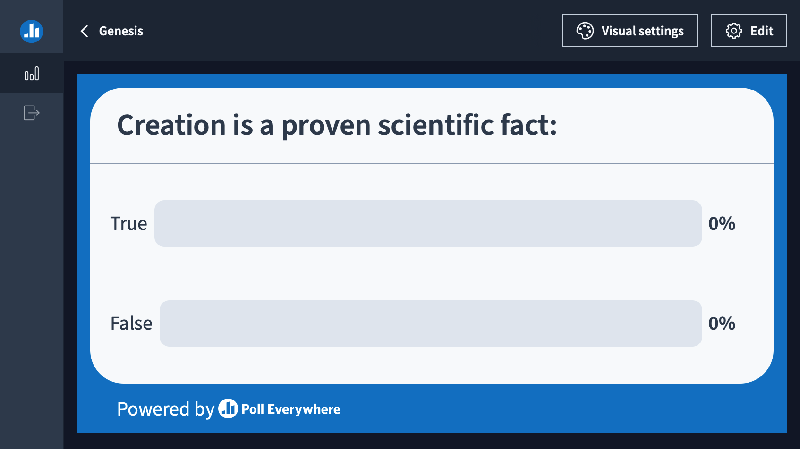

Slide 38
Creation as science?
Creation has been observed
  Romans 19-20, “what can be known about God is plain to them, because God has shown it to them. For his invisible attributes, namely, his eternal power and divine nature, have been clearly perceived, ever since the creation of the world, in the things that have been made. So they are without excuse.” Also see Psalm 19
But Creation cannot be repeated by man (God, yes)
However, science supports the existence of a Creator
  Take the example of the DNA molecule

Slide 39
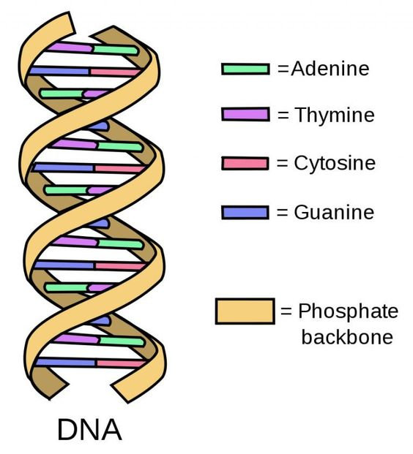
DNA Molecule
Digital computers are mathematically “base 2”. DNA is considered a "base 4" digital system, meaning it uses four different bases to encode information: adenine (A), cytosine (C), guanine (G), and thymine (T). DNA information is unbelievably dense!

Slide 40
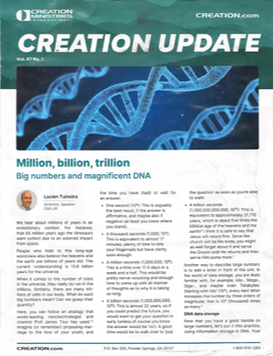
How dense is DNA Info?
“One cubic millimeter of DNA contains about 470 petabytes of data. This is equivalent to 470,000 laptop 1TB hard drives.”
Stacked on top of each other this pile of hard drives is half the height of Mount Everest.

Slide 41
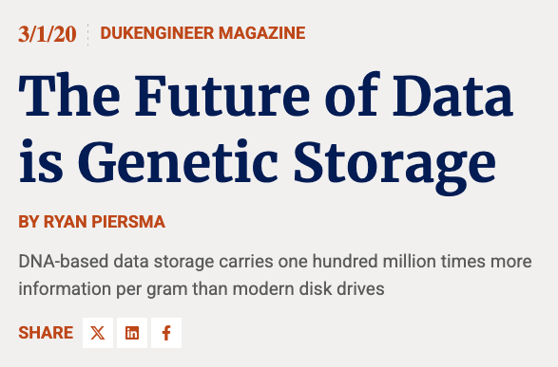

Slide 42
The Future of Data is Genetic Storage
“Top research scientists in the fields of genetics and computer science have realized DNA’s potential as an efficient storage mechanism.”
“Today, researchers at Microsoft and the University of Washington have built the world’s first automated system that can read and write to DNA. The MIT-based startup CATALOG has reportedly been able to store the entire repository of English-language Wikipedia pages in a small vial of DNA.”
Questions:
  Where did the Wikipedia data come from?
  Who is putting that data in there?

Slide 43
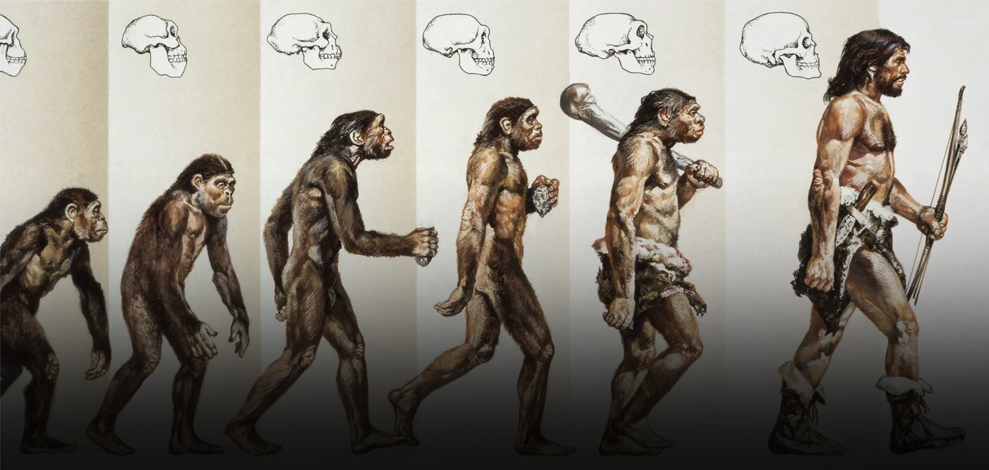
Where does the information in DNA come from?
From Google AI Overview:
  “The information in DNA comes from an organism's parents.”
  Why is a giraffe’s
  neck so long?

Slide 44

Ever copied a computer file?

Slide 45
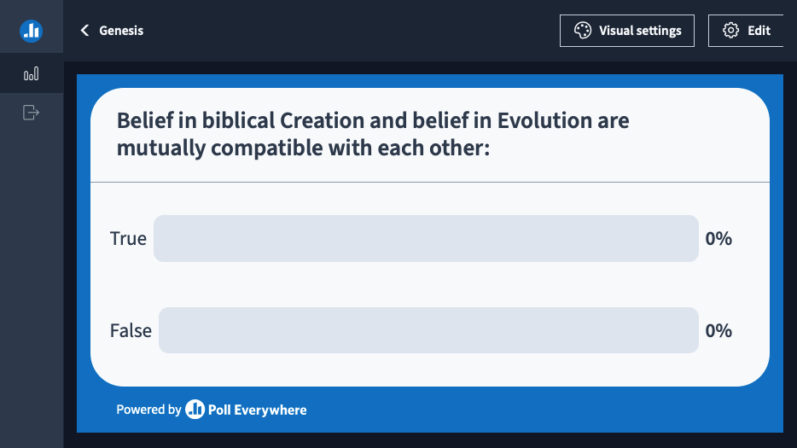

Slide 46


Slide 47
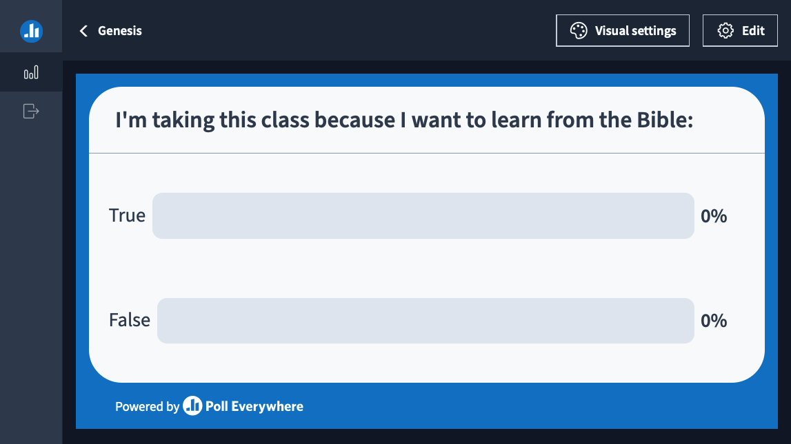

Slide 48
Genesis Introduction
Why is Genesis Foundational?
Who created God?
Who wrote Genesis?
When was Genesis Written?
What type of literature is Genesis?
The Unity of Genesis
The Unity of Scripture

Slide 49
Genesis is Foundational
Genesis 1:1, In the beginning God created the heavens and the earth.
  The bible presumes the existence of God
  It also indicates that God was already there before the creation
  The Universe was formed by God’s creative act, it didn’t “just happen”
  The Universe has not existed forever

Slide 50
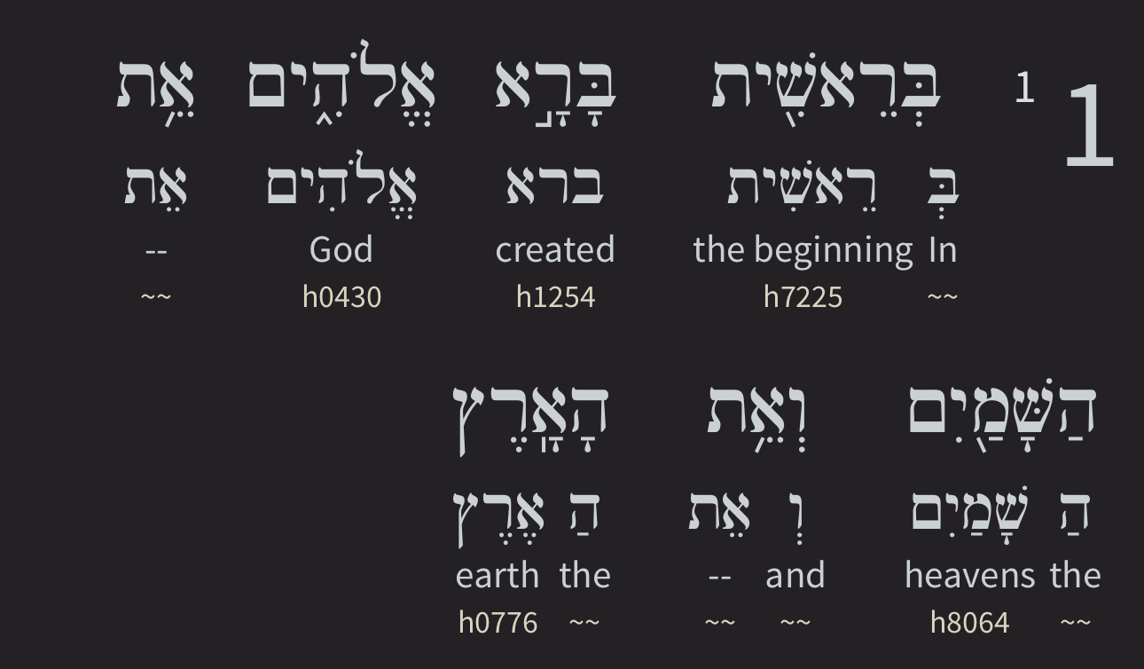
Genesis is Foundational
Re’siyt bara Elohiym

Slide 51
Genesis is Foundational
Re’siyt bara Elohiym
  Bara = singular form of the verb “created”
  Elohiym = plural form of “God”
  “One God, who is many, singularly created”
This refutes the idea of polytheism *Hindu
It also refutes the idea of God being an absolute unity *Muslim, Judaism, JWs

Slide 52
Who Created God?
“Everything which has a beginning has a cause” –William Lane Craig
  God has no beginning, so He has no cause
The Universe has a beginning
  So, it must have a cause
  We know the universe has a beginning because of the Laws of Thermodynamics

Slide 53
What About the Universe?
1st Law of Thermodynamics
  The total amount of mass-energy in the Universe is constant. The total amount of Mass-Energy is fixed.
  Mass and energy are interchangeable, Einstein: E = mc²
  No more Mass-Energy is being added to the Universe.
2nd Law of Thermodynamics (probably a result of the curse)
  Mass is being converted to energy, but the amount of energy available for work (energy used) is being used up.
  The Universe trends toward disorder (AKA “heat death”).
If the Universe had no beginning, then it wouldn’t exist today. Its energy would have already been totally used up.

Slide 54
Who wrote Genesis?
Other Bible authors point to Moses as the author of the first 5 books of the bible.
  Moses is named as recording historic events in Exodus, Numbers, Ezra, Nehemiah
  New Testament authors also cite Moses’ writings
  Phrase “Moses and the prophets” occurs throughout the bible
  Genesis is written from the perspective of Egypt (Gen 13:10)
  However, Moses was born nearly 300 years after the events described in Genesis!
  This leads many to believe that Moses is probably the “editor” of Genesis, relying on documents perhaps written by pre-flood patriarchs, such as Adam, Enoch, then Noah, and Abraham

Slide 55
When was it written?
Theologians and historians disagree, but it was most likely written (or edited) when Moses was resident in Egypt.
Although, some say it was written after, or during the Exodus
I prefer the first conclusion for the following:
  It is written from the perspective of someone living in Egypt
  Egyptian animals are mentioned
  Jerusalem is never mentioned in Genesis
  The tabernacle and the temple are never mentioned in Genesis

Slide 56
What type of Literature?
It is not poetry because it does not resemble at all any poetic books, such as Job, Psalms, Proverbs, Songs
It can’t be myth or legend, because Jesus himself refers to the historicity of Genesis.
The Apostle Paul builds the whole case for Jesus as the “Second Adam” as the basis for our need for salvation.
Genesis contains many “toledots”, meaning genealogies of actual people and their lifespans in years.
Genesis describes actual events, such as the Flood, Babel
Genesis uses many consecutive phrases (using “and”) “Evening and morning”, “And God said”, ”and there was”, “and God saw”

Slide 57
The Unity of Genesis
Genesis, as the Foundational book for the entire bible
The New Testament references Genesis more than 100 times
60 of those are in the first 11 chapters
The bible has over 300 references just to Creation itself
The bible has 63,779 cross references (see next diagram)
Genesis and Revelation are intimately related
  Genesis: The Creation Revelation: The Re-creation
  Genesis: First Wedding Revelation: The Last Wedding
  Genesis: Birth of Sin Revelation: Death of Sin
  Genesis: Eden Lost Revelation: Eden Restored
  Genesis: Redeemer Promised Revelation: Redeemer Reigns

Slide 58
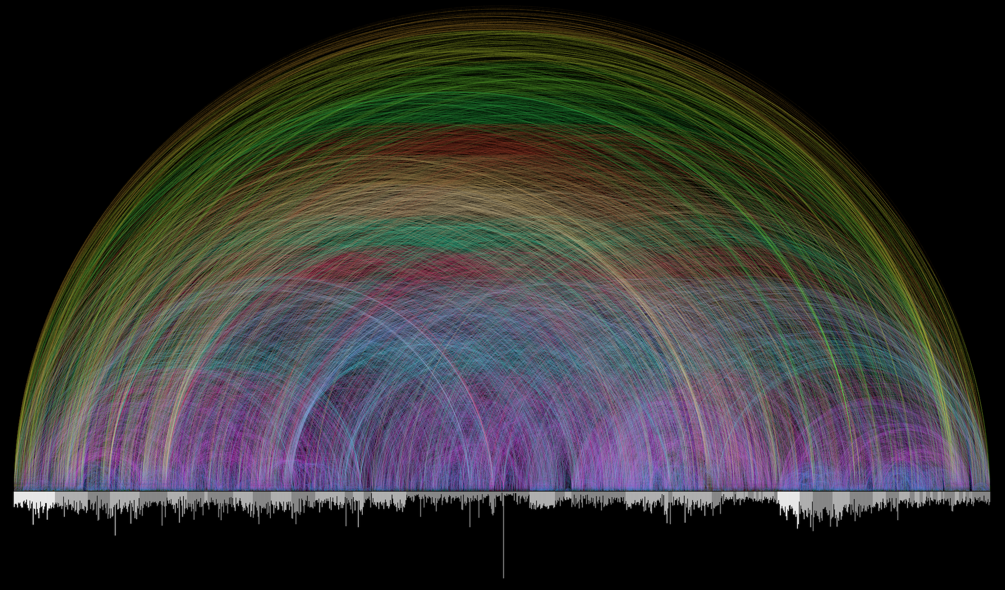
The Unity of Scripture
https://www.chrisharrison.net/index.php/Visualizations/BibleViz

