Slide 1

The Rapture of the Church
What does it mean?

Slide 2
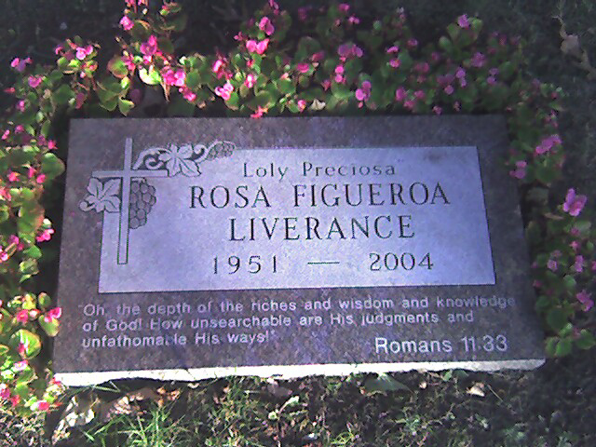
Marker in a Cemetery

Slide 3
Questions
What will happen to these saints of God?
What about all of us here in this room? What will happen to us?
What do we all have in common with the dead saints?

Slide 4
More Questions
How do we know that the resurrection from the dead is even a thing?
Did Jesus die? Did he rise from the dead?
How do we know the rapture of the living is even a thing?

Slide 5
Even More Questions
When will it happen?
What is God waiting for?
What will we be like when we are raptured?
What does the term “rapture” mean?

Slide 6
Rough Outline of Future Biblical Events
Church on Earth (Rev 1-3)
Rapture (John 14:1-4, 1 Cor 15:51-54, 1 Thes 4:13-17)
Tribulation on Earth (Rev 6-19)
Millennial Kingdom (Rev 20:1-6)
Final Rebellion and Judgment (Rev 20:7-15)
Eternal State Rev (21-22)

Slide 7
The Letters to the Churches
There is a remnant of true believers in the churches
That remnant is called to be faithful, even through trials and persecution, and even if your “church” is lacking in zeal
The faithful will be kept from the “hour” of testing.
Those who are not faithful are called to repent.

Slide 8
The Faithful Church Promise
Philadelphia – The Faithful Church. Little power (small in number) but have kept the Word and affirmed Christ.
  Commendation: “Rev 3:10, Because you have kept the word of My perseverance, I will also keep (tereo - to keep, to guard) you from (ek – “from”, rather than en – “in”, or dia – “through”) the hour (season) of testing, that hour which is about to come upon the whole world, to test those who dwell on the face of the earth. I am coming quickly.”
  Command: Hold fast to what you have, so that no one will take your crown.

Slide 9
A time of testing is coming!
Those who don’t repent will endure a time of testing that will come upon the whole world.
The test is in the future
The test is for a limited time
The test is designed to expose people for what they really are
The test is worldwide in scope

Slide 10
A time of testing is coming!
Its purpose is to test “those who dwell on the face of the earth”
This phrase is used throughout Revelation for unbelievers (6:10, 8:13, 11:10, 13:8)
Unbelievers will either pass the test by repenting (6:9-11, 7:9-10, 14:4, 17:14)
Or they will fail the test by refusing to repent (6:15-17, 9:20, 16:11,

Slide 11
Rapture/Translation 2nd Coming/ The Earthly Kingdom
1 Translation of all believers (dead and alive) 1 No translation at all
2 Translated saints go to heaven 2 Translated saints return to earth
3 Earth is not judged 3 Earth is judged & righteousness rules
4 Imminent, any-moment, signless 4 Predicted signs including tribulation
5 Revealed to us in the New Testament 5 Predicted often in the Old Testament
6 Affects believers only 6 Affects all men
7 Preceding the day of wrath 7 Concluding the day of wrath
8 No reference to Satan 8 Satan is bound for 1,000 years
9 Christ comes for His bride (the Church) 9 Christ comes with His bride
10 Christ comes in the air only 10 Christ comes down to the earth
11 Only His own see Him 11 Every eye shall see Him
12 Tribulation begins 12 Millennial Kingdom begins

Slide 12
What actually happens at the Rapture?
First, the spirits of the dead in Christ are reunited with transformed earthly bodies and are “caught up”
Then, those that are alive in Christ are simply transformed wherever they are, and are also “caught up”

