Slide 1
The Second Coming of Christ
The Antichrist is defeated

Slide 2
Chapters 1-3, The Church
  The Revelation of Jesus Christ, which God gave Him to show to His bond-servants, the things which must soon take place;
    This is a message to true Christians (his bond-servants)
  3 Blessed is he who reads and those who hear the words of the prophecy, and [b]heed the things which are written in it; for the time is near.
  Behold [Jesus] is coming with the clouds, and every eye will see Him, even those who pierced Him; and all the tribes of the earth will mourn over Him. So it is to be, Amen”
  I, John was on the island called Patmos, and was in the Spirit on the Lord’s day, and I heard behind me a loud voice like the sound of a trumpet, 11 saying, “Write in a book what you see, and send it to the seven churches”
    So the entire book is written to all the seven churches, not just each individual part. This is how we know all of Revelation is written to us.
  The specific letter to each church identifies characteristics of each that requires attention.

Slide 3
Chapters 4-5, The Scroll
  I looked, and behold, a door standing open in heaven, and the first voice … speaking with me, said, “Come up here, and I will show you what must take place after these things.”
    In other words, at the end of the church age
  I saw in the right hand of Him who sat on the throne a book written inside and on the back, sealed up with seven seals. 2 And I saw a strong angel proclaiming with a loud voice, “Who is worthy to open the book and to break its seals?”
    The scroll is representative of what? The title deed to earth (the universe)
  “The Lion that is from the tribe of Judah, the Root of David, has overcome so as to open the book and its seven seals.”

Slide 4
Chapters 6-7, the Seal Judgements
  The Lamb broke one of the seven seals, I looked, and behold, a white horse (peace)
  When He broke the second seal, a red horse, went out (war)
  When He broke the third seal, behold, a black horse (famine)
  When the Lamb broke the fourth seal, behold, an ashen horse (death)
  When the Lamb broke the fifth seal, I saw the souls … of those who had been slain …and they cried out with a loud voice (what do they say?) (why they need to wait?)
  I looked when He broke the sixth seal, and there was a great earthquake; and the sun became black … the whole moon became like blood; 13 and the stars of the sky fell to the earth.
  After this I saw another angel saying ... "do not harm the earth or the sea or the trees until we have sealed the bond-servants of our God on their foreheads.” 4 And I heard the number of those who were sealed, one hundred and forty-four thousand
  After these things I looked, and behold, a great multitude which no one could count, from every nation and all tribes and peoples and tongues, standing before the throne and before the Lamb.
  When the Lamb broke the seventh seal, there was silence in heaven for about half an hour.

Slide 5
Chapters 8-11
  The Seven Trumpet Judgements
  The Two Witnesses in Jerusalem
Chapters 12-18
  The allegory of the woman (Israel) clothed in the sun about to give birth to a son
  The war in heaven and the Dragon is thrown down to earth.
  The two beasts, one from the sea (Antichrist), one from the earth (False Prophet)
  The earth is reaped by Jesus and an Angel, taking out the withered and dried up:
    The reaping introduces the Bowl Judgements
  The Dragon calls all the kings of the earth to gather at Har-Magedon for a battle!
  The harlot Babylon (the wicked world system) is revealed and destroyed by fire.
And that leads us to Chapter 19

Slide 6
Rev 12:11, And they overcame him (Satan) because of the blood of the Lamb and because of the word of their testimony, and they did not love their life even when faced with death.
  QUESTION: According to Rev 12:11, What are the three weapons we need to overcome the enemy?
    Blood of the Lamb
      QUESTION: What does the blood of the Lamb do? (sinless blood)
        Rev 1:5, He released us from our sins by his blood. Truly saved.
    Word of their testimony
      QUESTION: What it the word of our testimony?
        Rom 10:9, confess with your mouth Jesus as Lord (supreme)
    They did not love their life even when faced with death.
      QUESTION: What does this mean to love not our life?
        Mat 16:25, For whoever wishes to save his life will lose it; but whoever loses his life for My sake will find it.
  QUESTION: How did Jesus live? Exactly the same way!

Slide 7
Chapter 19
Rev 19:1-3, After these things I heard something like a loud voice of a great multitude in heaven, saying, “Hallelujah! Salvation and glory and power belong to our God; 2 because His judgments are true and righteous; for He has judged the great harlot who was corrupting the earth with her immorality, and He has avenged the blood of His bond-servants on her.”
QUESTION: After what things?
QUESTION: What are the specific reasons for the praise?
QUESTION: Does the harlot use seduction and deception (lies) to achieve her goals?
QUESTION: Can you think of any lies that are being told to us today?

Slide 8
Rev 19:3-4, And a second time they said, “Hallelujah! Her smoke rises up forever and ever.” 4 And the twenty-four elders and the four living creatures fell down and worshiped God who sits on the throne saying, “Amen. Hallelujah!”
QUESTION: Why is all heaven rejoicing at the downfall of Babylon?
  It’s the destruction entire world political and religious system that opposes God.
  What kind of system is that?
    It opposes God, it promotes human achievement, it rewards greed.
    “Man is lawless; he will do what you let him do if not restrained. And in order to try to restrain him we have countless laws, millions of litigating cases, a million police, spend trillions of dollars, and at the top of the pile is a justice department that we don’t trust because it’s full of the same kind of mentality as the criminals at the other end of the system. So just a little hint: if you’re trying to get justice in the world, that is a fool’s errand. We do the best we can.” - John MacArthur

Slide 9
Rev 19:5-6, And a voice came from the throne, saying, “Give praise to our God, all you His bond-servants, you who fear Him, the small and the great.” 6 Then I heard something like the voice of a great multitude and like the sound of many waters and like the sound of mighty peals of thunder, saying, “Hallelujah! For the Lord our God, the Almighty, reigns.
Psa 96:10-13, Say among the nations, “The Lord reigns; Indeed, the world is firmly established, it will not be moved; He will judge the peoples with equity.” 11 Let the heavens be glad, and let the earth rejoice; Let the sea roar, and all it contains; 12 Let the field exult, and all that is in it. Then all the trees of the forest will sing for joy 13 Before the Lord, for He is coming, For He is coming to judge the earth. He will judge the world in righteousness And the peoples in His faithfulness.
Psa 97:1-6, The Lord reigns, let the earth rejoice; Let the many islands be glad. 2 Clouds and thick darkness surround Him; Righteousness and justice are the foundation of His throne. 3 Fire goes before Him and burns up His adversaries round about. 4 His lightnings lit up the world; The earth saw and trembled. 5 The mountains melted like wax at the presence of the Lord, At the presence of the Lord of the whole earth. 6 The heavens declare His righteousness, And all the peoples have seen His glory.

Slide 10
Rev 19:7-10, Let us rejoice and be glad and give the glory to Him, for the marriage of the Lamb has come and His bride has made herself ready.” 8 It was given to her to clothe herself in fine linen, bright and clean; for the fine linen is the righteous acts of the saints.
QUESTION: Who is the bride?
QUESTION: What does this mean, has made herself ready? How does a bride get ready?
QUESTION: And the clothing metaphor? What is the linen made from?
QUESTION: Who chose the bride, and the bride said yes, right?
QUESTION: Who dresses the bride and makes her ready for the wedding?

Slide 11
9 Then he said to me, “Write, ‘Blessed are those who are invited to the marriage supper of the Lamb.’” And he said to me, “These are true words of God.” 10 Then I fell at his feet to worship him. But he said to me, “Do not do that; I am a fellow servant of yours and your brethren who hold the testimony of Jesus; worship God. For the testimony of Jesus is the spirit of prophecy.”
QUESTION: Who are the guests of the bride? The bride is not a guest. She invites the guests!
QUESTION: If Jesus is the only way to heaven, what about Old Testament Saints, and even those who never witnessed or fully understood the cross of Christ? How are they saved?
  Parable of the Wedding Feast, Mat 22:1-10
  Parable of the Ten Virgins (bridesmaids), Mat 25:1-13

Slide 12
Rev 19:11-16, And I saw heaven opened, and behold, a white horse, and He who sat on it is called Faithful and True, and in righteousness He judges and wages war. 12 His eyes are a flame of fire, and on His head are many diadems; and He has a name written on Him which no one knows except Himself. 13 He is clothed with a robe dipped in blood, and His name is called The Word of God. 14 And the armies which are in heaven, clothed in fine linen, white and clean, were following Him on white horses. 15 From His mouth comes a sharp sword, so that with it He may strike down the nations, and He will rule them with a rod of iron; and He treads the wine press of the fierce wrath of God, the Almighty. 16 And on His robe and on His thigh He has a name written, “KING OF KINGS, AND LORD OF LORDS.”

Slide 13
Rev 19:17-18, Then I saw an angel standing in the sun, and he cried out with a loud voice, saying to all the birds which fly in midheaven, “Come, assemble for the great supper of God, 18 so that you may eat the flesh of kings and the flesh of commanders and the flesh of mighty men and the flesh of horses and of those who sit on them and the flesh of all men, both free men and slaves, and small and great.”

Slide 14
Rev 19:19-21, And I saw the beast and the kings of the earth and their armies assembled to make war against Him who sat on the horse and against His army. 20 And the beast was seized, and with him the false prophet who performed the signs in his presence, by which he deceived those who had received the mark of the beast and those who worshiped his image; these two were thrown alive into the lake of fire which burns with brimstone. 21 And the rest were killed with the sword which came from the mouth of Him who sat on the horse, and all the birds were filled with their flesh.

Slide 15
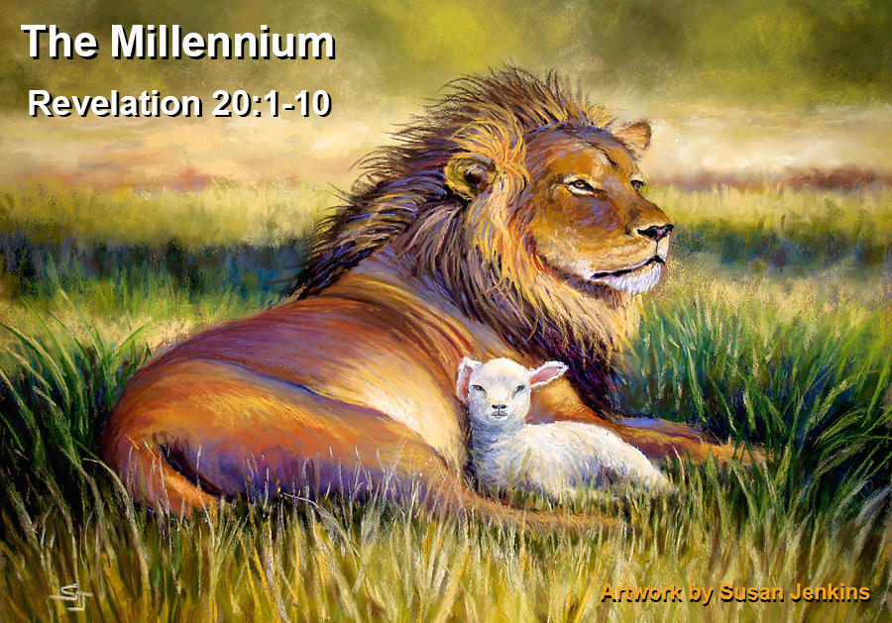
This final slaughter marks the beginning of the Millennial Kingdom, which we will talk about in more detail next week.

