Slide 1
The Millennium
Jesus Establishes His Kingdom on Earth

Slide 2
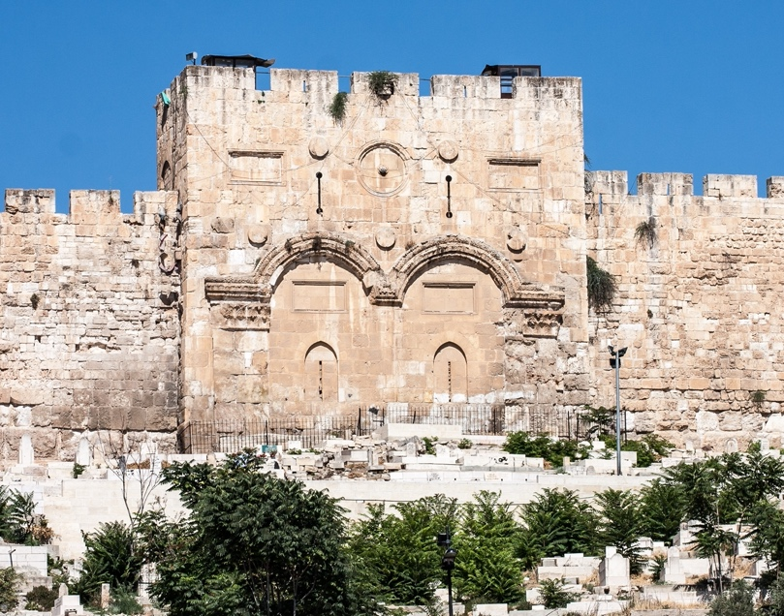

Slide 3
What is the Millennium?
o It is an earthly Kingdom of Jesus Christ, centered in Jerusalem, that lasts for 1000 years.
o A literal, chronological view of Revelation leads to Pre-Millennialism. Christ precedes!
  Millennials: Christ brings the Kingdom, and we join him
  Post-Millennials: The Church brings the Kingdom and offers it to Christ.
  A-millennials: We are in the Kingdom now
o The first phase on earth of God’s eternal heavenly Kingdom, also promised in the bible
o Jesus told Pilate, “my Kingdom is not of this world”, NOT “my Kingdom is not of this earth”
  Gr: kosmos, means a system of order, structure, an arrangement, an administration
  This is the “world system” that will be completely burned up in Rev 18:8.

Slide 4
Review from last week
An angel announces to the birds of the air to “assemble” for the great supper of God (19:17)
The Antichrist and the False Prophet are thrown “alive” into the Lake of Fire (19:20)
The “rest” were killed with the sword that comes from the mouth of the Lord (19:21)
And the birds were filled with their flesh.
QUESTION: What happens to the faithful believers who survive the tribulation?

Slide 5
What is the Lake of Fire?
The term “Lake of Fire” occurs only in Revelation.
Its introduction brings clarity to the meaning of the place of eternal fire referenced everywhere.
Jesus says, “Depart from Me, accursed ones, into the eternal fire which has been prepared for the devil and his angels”
It is called “unquenchable fire” in Mark 9:43
The Lake of Fire seems to be a place of final, permanent, eternal torment from which no one ever leaves.
The Antichrist and the False prophet are never coming out of that place!

Slide 6
Rev 20:1-3, Then I saw an angel coming down from heaven, holding the key of the abyss and a great chain in his hand. 2 And he laid hold of the dragon, the serpent of old, who is the devil and Satan, and bound him for a thousand years; 3 and he threw him into the abyss, and shut it and sealed it over him, so that he would not deceive the nations any longer, until the thousand years were completed; after these things he must be released for a short time.

Slide 7
So, what is the Abyss?
Abyss, Gr: Abussos, literally means the “bottomless place”
Also, the word Hell is a translation of Gr: Tartarus, which can be thought of as the “deepest pit”.
1 Pet 3:19, Jesus “went and preached to the spirits in prison".
Hades is the Greek god of the dead. The word is used in Luke 16 and other places
  It also seems to be a temporary “holding place”, and also one in which there is torment.
Then there is Gehenna, translated “hell” in the NT, a word used by Jesus 11 times in the gospels, and James also uses it in his epistle.

Slide 8
Places of Punishment
Probably The Abyss, Tartarus, Hades, and “prison” can all be considered temporary places of punishment.
The Lake of Fire is eternal and permanent and may equate to Gehenna translated as “hell”.
In the end, these are all semantics (word games), but there is a definite distinction between temporary and permanent places of torment.

Slide 9
Anabaptist Belief Statements
THE INTERMEDIATE STATE: We believe that in the interval between death and resurrection, the righteous will be with Christ in a state of conscious bliss and comfort, but that the wicked will be in a place of torment, in a state of conscious suffering and despair.
THE FINAL STATE: We believe that hell is the place of torment, prepared for the devil and his angels, where with them the wicked will suffer the vengeance of eternal fire forever and ever and that heaven is the final abode of the righteous, where they will dwell in the fullness of joy forever and ever.

Slide 10
What About purgatory?
Oxford says this: (in Roman Catholic doctrine) a place or state of suffering inhabited by the souls of sinners who are expiating their sins before going to heaven.
  Expiating means “atoning for”.
  Heb 9:27, it is appointed for men to die once and after this comes judgment.
  Luke 16:24 “between us and you there is a great chasm fixed, so that those who wish to come over from here to you will not be able, and that none may cross over from there to us.”

Slide 11
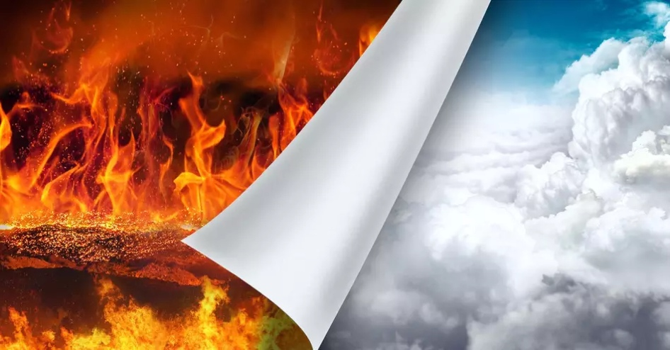
Two Destinations

Slide 12
The Names of Satan
2 And he laid hold of the dragon, the serpent of old, who is the devil and Satan
Dragon – Gr: Drakon (a huge serpent) symbolically: ferocious, wicked
Serpent – Gr: Ophis, from: Optanomai (Ophthalmology). Eying its prey. Crafty, shrewd, cunning (sneaky).
Devil – Gr: Diabolos, Slanderer (the Father of Lies)
Satan – Transliterated from Aramaic: Accuser, Adversary, Enemy

Slide 13
SATAN is BOUND
… and bound him for a thousand years; 3 and he threw him into the abyss, and shut it and sealed it over him, so that he would not deceive the nations any longer, until the thousand years were completed; after these things he must be released for a short time.
Where else have we seen “bound angels”?
  Then “sons of God” in Gen 6, as referenced by Peter and Jude
  The locust demons released from the “pit” (Rev 9:3)
  The four angels by the river Euphrates (Rev 9:14)

Slide 14
Angelology
ALL Angels
  Holy Angels (2/3)
  Fallen Angels (1/3)
    Unbound
    Bound
      Temporarily Bound – Abyss
      Permanently Bound – Lake of Fire
After the Millennium ALL Fallen Angels and ALL unredeemed humanity will be sent into the Lake of Fire

Slide 15
Rev 20:1-3, Then I saw an angel coming down from heaven, holding the key of the abyss and a great chain in his hand. 2 And he laid hold of the dragon, the serpent of old, who is the devil and Satan, and bound him for a thousand years; 3 and he threw him into the abyss, and shut it and sealed it over him, so that he would not deceive the nations any longer, until the thousand years were completed; after these things he must be released for a short time.

Slide 16
Rev 20:4, Then I saw thrones, and they sat on them, and judgment was given to them. And I saw the souls of those who had been beheaded because of their testimony of Jesus and because of the word of God, and those who had not worshiped the beast or his image, and had not received the mark on their forehead and on their hand; and they came to life and reigned with Christ for a thousand years.
Who are those John sees seated on thrones? “They” will judge the world.

Slide 17
  Daniel 7:18, 22, 27, the saints of the Highest One will receive the kingdom and possess the kingdom forever, for all ages to come.’ the Ancient of Days came and judgment was passed in favor of the saints of the Highest One, and the time arrived when the saints took possession of the kingdom. Then the sovereignty, the dominion and the greatness of all the kingdoms under the whole heaven will be given to the people of the saints of the Highest One; His kingdom will be an everlasting kingdom, and all the dominions will serve and obey Him.’
  Daniel 12:1-4, “Now at that time Michael, the great prince who stands guard over the sons of your people, will arise. And there will be a time of distress such as never occurred since there was a nation until that time; and at that time your people, everyone who is found written in the book, will be rescued. 2 Many of those who sleep in the dust of the ground will awake, these to everlasting life, but the others to disgrace and everlasting contempt. 3 Those who have insight will shine brightly like the brightness of the expanse of heaven, and those who lead the many to righteousness, like the stars forever and ever. 4 But as for you, Daniel, conceal these words and seal up the book until the end of time; many will go back and forth, and knowledge will increase.”

Slide 18
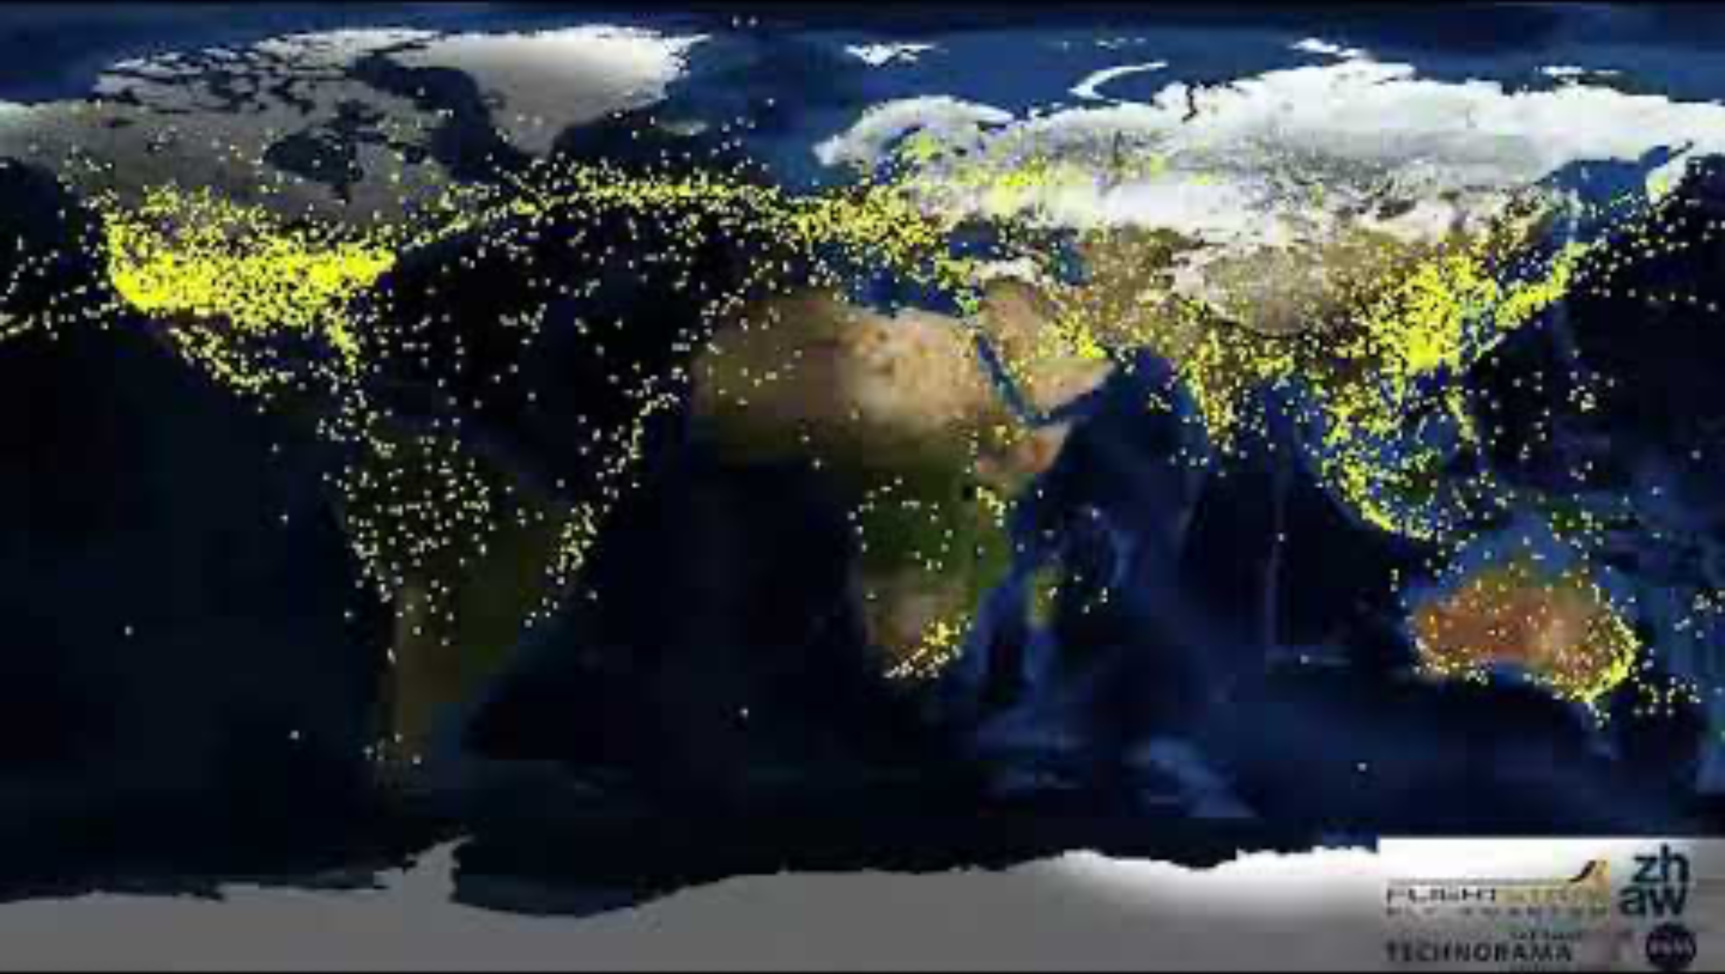
  In 1982, futurist and inventor R. Buckminster Fuller estimated that up until 1900, human knowledge doubled approximately every century, but by 1945 it was doubling every 25 years. And by 1982, it was doubling every 12-13 months. It is now estimated that human knowledge is doubling every 12 hours.

Slide 19
  Mat 19:28-29, And Jesus said to them, “Truly I say to you, that you who have followed Me, in the regeneration* when the Son of Man will sit on His glorious throne, you also shall sit upon twelve thrones, judging the twelve tribes of Israel. 29 And everyone who has left houses or brothers or sisters or father or mother or children or farms for My name’s sake, will receive many times as much, and will inherit eternal life.
  1 Cor 6:2-3, do you not know that the saints will judge the world? If the world is judged by you, are you not competent to constitute the smallest law courts? 3 Do you not know that we will judge angels? How much more matters of this life?
  *Gr: paliggenesia, another (or new) Genesis

Slide 20
What is the purpose of a 1000 year earthly Kingdom?
Most theologians believe this is a “Sabbath Rest” for a “tired” planet.
Let’s look at Genesis to get a glimpse of what the “regeneration” is like.
Then judgement came in the form of a worldwide flood.
So, how will the Millennium be similar to the original garden?

Slide 21
prophecies describing the time of the Millennium
Jesus brings justice and righteousness to earth, Jer 23:25
Jerusalem as capital city, Zech 14:9
Jerusalem becomes the highest mountain on earth, Micah 4:1-2
Isa 11:6-9
  No enmity between animals,
  Carnivores revert to grazing
  Natural dangers are removed
  Animals respect human life
  All on the earth will know who the Lord is
Earth will become fruitful and productive, Ez 34:26-27
Abundant fresh water, Joel 3:18
The desert will bloom, Isaiah 35:1-2
Isa 65:19-20
  Crying will be eliminated
  People will live to an old age
No deafness or blindness, Isa 29:18
Isaiah 65:23
  Our work will be productive
  No children will be stillborn

Slide 22
Rev 20:5-6, The rest of the dead did not come to life until the thousand years were completed. This is the first resurrection. 6 Blessed and holy is the one who has a part in the first resurrection; over these the second death has no power, but they will be priests of God and of Christ and will reign with Him for a thousand years.
Who are “the rest of the dead”?
What is the “first resurrection”
What is the “second death”?
What is our function in the Millennium?

Slide 23
Luke 19:17-19, Master, your mina has made ten minas more.’ 17 And he said to him, ‘Well done, good slave, because you have been faithful in a very little thing, you are to be in authority over ten cities.’ 18 The second came, saying, ‘Your mina, master, has made five minas.’ 19 And he said to him also, ‘And you are to be over five cities.’

Slide 24
Appearances of the resurrected Jesus
Mat 16:28, “Truly I say to you, there are some of those who are standing here who will not taste death until they see the Son of Man coming in His kingdom.”
Mat 17:1-3, Six days later Jesus took with Him Peter and James and John his brother, and led them up on a high mountain by themselves. 2 And He was transfigured before them; and His face shone like the sun, and His garments became as white as light. 3 And behold, Moses and Elijah appeared to them, talking with Him.

Slide 25
Appearances of the resurrected Jesus
John 20:19, So when it was evening on that day, the first day of the week, and when the doors were shut where the disciples were, for fear of the Jews, Jesus came and stood in their midst and *said to them, “Peace be with you.”
Luke 24:30-31, [Road to Emmaus], When He had reclined at the table with them, He took the bread and blessed it, and breaking it, He began giving it to them. 31 Then their eyes were opened and they recognized Him; and He vanished from their sight.

Slide 26

Question
So, does Jesus need to enter Jerusalem through the Eastern gate?

