Slide 1
A Visit to Heaven & the Title Deed of The Earth
Heaven-Your personal Tour
http://sound-doctrine.us

Slide 2
Rev 4:1-2, After these things I looked, and behold, a door standing open in heaven, and the first voice which I had heard, like the sound of a trumpet speaking with me, said, “Come up here, and I will show you what must take place after these things.” 2 Immediately I was in the Spirit; and behold, a throne was standing in heaven, and One sitting on the throne.
After what things?
What does “behold” mean? What did John really see?
Where have we heard about this before? (see Rev 1:10)
Come up where? What is Christ going to show John?
What is our idea of a throne?
Who is on the throne?

Slide 3
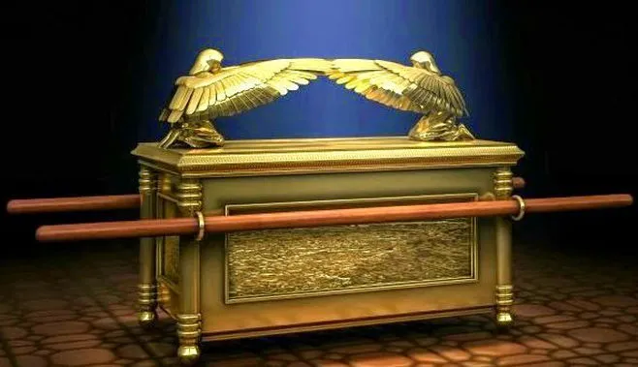

Slide 4
Rev 4:3-4, And He who was sitting was like a jasper stone and a sardius in appearance; and there was a rainbow around the throne, like an emerald in appearance. 4 Around the throne were twenty-four thrones; and upon the thrones I saw twenty-four elders sitting, clothed in white garments, and golden crowns on their heads.
What does a jasper stone look like?

Slide 5
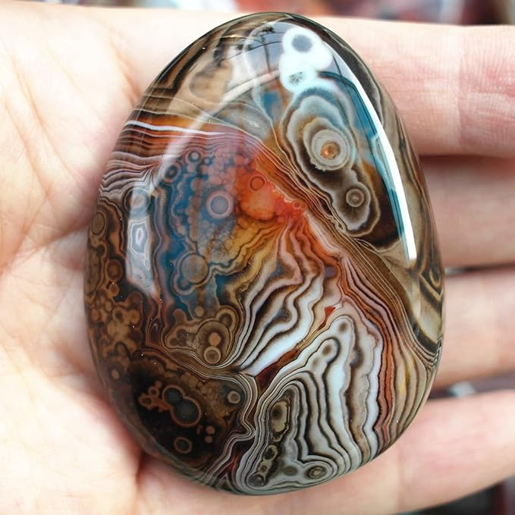
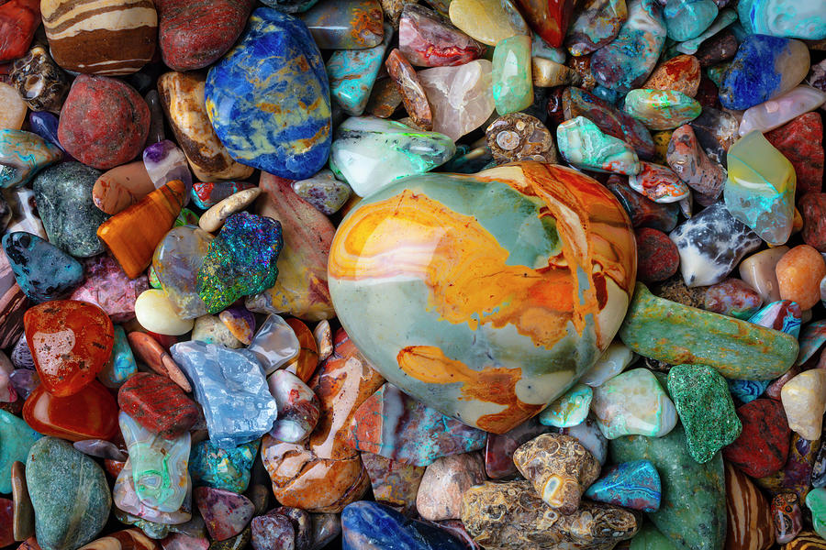
Jasper

Slide 6
Rev 4:3-4, And He who was sitting was like a jasper stone and a sardius in appearance; and there was a rainbow around the throne, like an emerald in appearance. 4 Around the throne were twenty-four thrones; and upon the thrones I saw twenty-four elders sitting, clothed in white garments, and golden crowns on their heads.
What does a jasper stone look like?
What does a sardius look like?

Slide 7
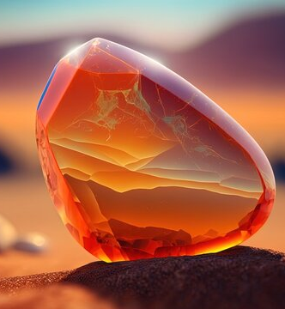
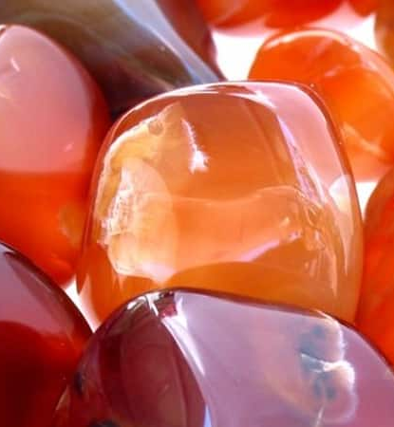

Slide 8
Rev 4:3-4, And He who was sitting was like a jasper stone and a sardius in appearance; and there was a rainbow around the throne, like an emerald in appearance. 4 Around the throne were twenty-four thrones; and upon the thrones I saw twenty-four elders sitting, clothed in white garments, and golden crowns on their heads.
What does a jasper stone look like?
What does a sardius look like?
What does an emerald look like?

Slide 9
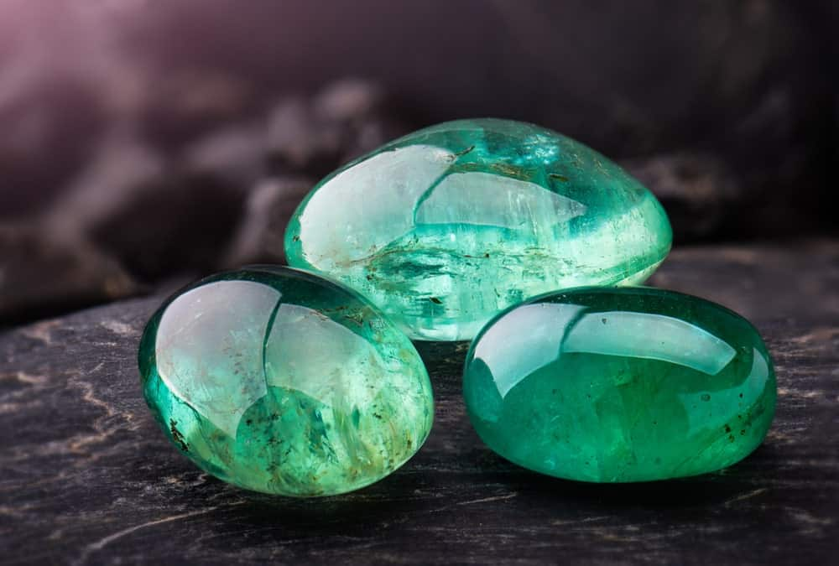
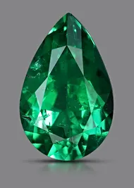
Emerald

Slide 10
Rev 4:3-4, And He who was sitting was like a jasper stone and a sardius in appearance; and there was a rainbow around the throne, like an emerald in appearance. 4 Around the throne were twenty-four thrones; and upon the thrones I saw twenty-four elders sitting, clothed in white garments, and golden crowns on their heads.
What does a jasper stone look like?
What does a sardius look like?
What does an emerald look like?
Twenty-four thrones
Twenty-four elders
White garments, and golden crowns

Slide 11
Rev 4:5-6, Out from the throne come flashes of lightning and sounds and peals of thunder. And there were seven lamps of fire burning before the throne, which are the seven Spirits of God; 6 and before the throne there was something like a sea of glass, like crystal; and in the center and around the throne, four living creatures full of eyes in front and behind.
What do lightning and thunder represent in the bible?

Slide 12
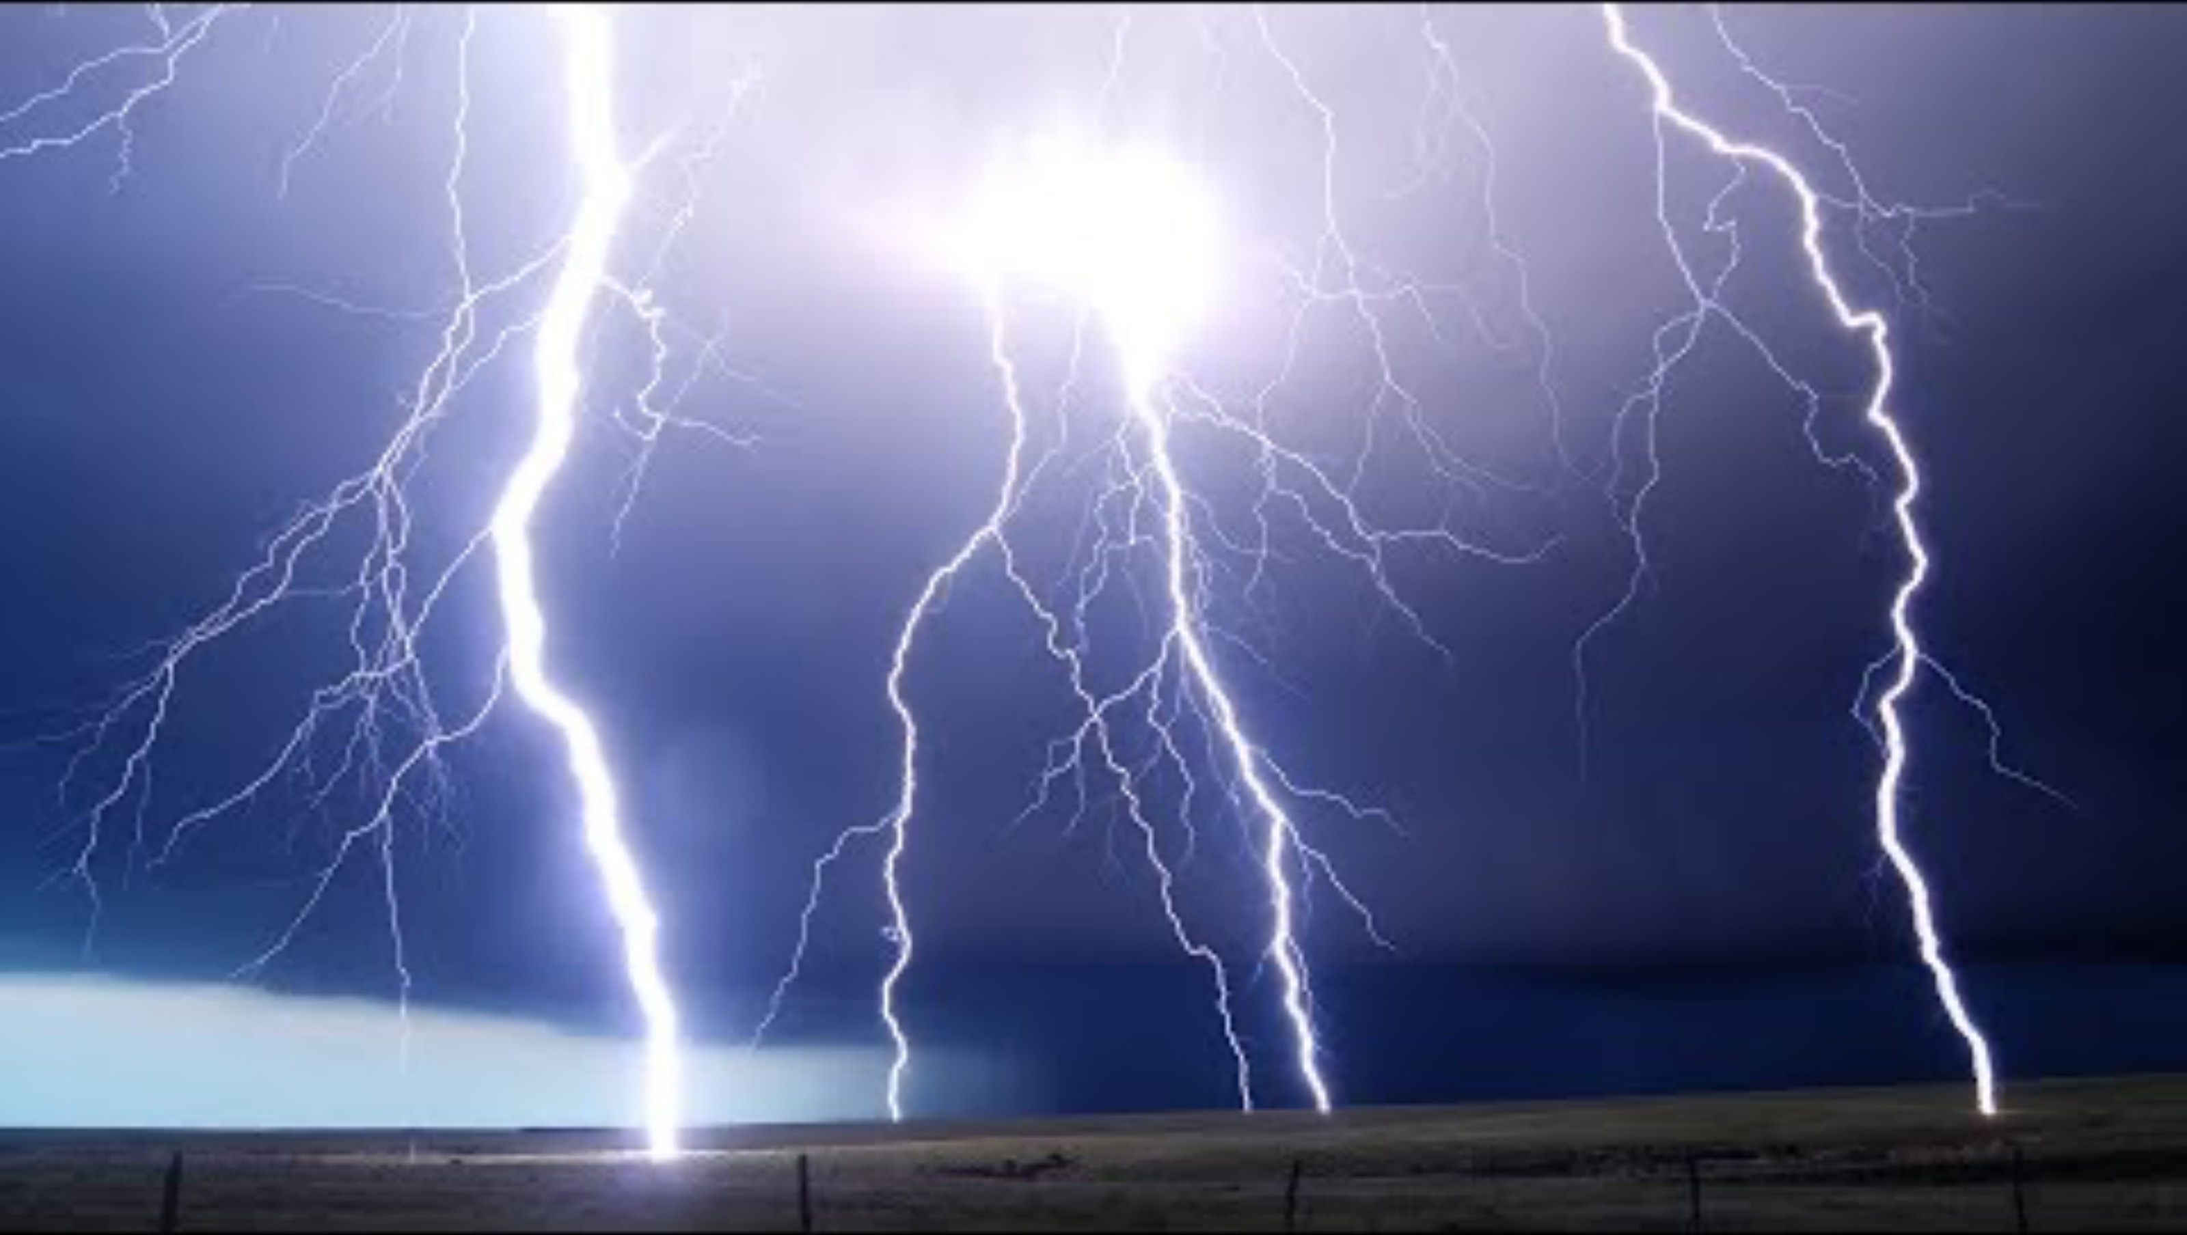

Slide 13
Rev 4:5-6, Out from the throne come flashes of lightning and sounds and peals of thunder. And there were seven lamps of fire burning before the throne, which are the seven Spirits of God; 6 and before the throne there was something like a sea of glass, like crystal; and in the center and around the throne, four living creatures full of eyes in front and behind.
What do lightning and thunder represent?
Seven lamps of fire burning before the throne
A sea of glass, like crystal
In the center and around the throne
Four living creatures full of eyes in front and behind

Slide 14
Rev 4:7-8, The first creature was like a lion, and the second creature like a calf, and the third creature had a face like that of a man, and the fourth creature was like a flying eagle. 8 And the four living creatures, each one of them having six wings, are full of eyes around and within; and day and night they do not cease to say, “Holy, holy, holy is the Lord God, the Almighty, who was and who is and who is to come.”
What do these different faces possibly represent?
What do they continually say?

Slide 15
Rev 4:9-11, And when the living creatures give glory and honor and thanks to Him who sits on the throne, to Him who lives forever and ever, the twenty-four elders will fall down before Him who sits on the throne, and will worship Him who lives forever and ever, and will cast their crowns before the throne, saying, “Worthy are You, our Lord and our God, to receive glory and honor and power; for You created all things, and because of Your will they existed, and were created.”
Who is casting their crowns before the throne?
You created all things, why mention this here?

Slide 16
Rev 5:1, I saw in the right hand of Him who sat on the throne a book written inside and on the back, sealed up with seven seals.
Right hand of Him who sat on the throne
  Who is this?
A book written inside and on the back
  Usually a summary of contents was on the outside, with the legal details on the inside
Sealed up with seven seals
  It is a legal document

Slide 17
Rev 5:2-4, And I saw a strong angel proclaiming with a loud voice, “Who is worthy to open the [c]book and to break its seals?” 3 And no one in heaven or on the earth or under the earth was able to open the [d]book or to look into it. 4 Then I began to weep greatly because no one was found worthy to open the [e]book or to look into it;
Strong angel
  A loud enough voice to penetrate the entire universe
Break its seals
  Who is allowed to open the seals on a legal document?
No one in heaven or on the earth or under the earth was able
  No human or angel can redeem the Universe
  Where will we find someone who is authorized to open this scroll?

Slide 18
Rev 5:5-7, and one of the elders *said to me, “Stop weeping; behold, the Lion that is from the tribe of Judah, the Root of David, has overcome so as to open the book and its seven seals.” 6 And I saw between the throne (with the four living creatures) and the elders a Lamb standing, as if slain, having seven horns and seven eyes, which are the seven Spirits of God, sent out into all the earth. 7 And He came and took the book out of the right hand of Him who sat on the throne.
Lion that is from the tribe of Judah
  is Jesus a Lion or a Lamb?
a Lamb standing, as if slain
  With the marks of having been killed, yet alive!
having seven horns, absolute power and authority
seven eyes, fullness of the Spirit, seeing and knowing everything
He came and took the book, The title deed to earth has been given to Jesus (Shiloh)

Slide 19
Rev 5:10-14, When He had taken the [a]book, the four living creatures and the twenty-four elders fell down before the Lamb, each one holding a harp and golden bowls full of incense, which are the prayers of the [b]saints. 9 And they *sang a new song, saying,
“Worthy are You to take the [c]book and to break its seals; for You were slain, and purchased for God with Your blood men from every tribe and tongue and people and nation.
10 “You have made them to be a kingdom and priests to our God; and they will reign upon the earth.”
11 Then I looked, and I heard the voice of many angels around the throne and the living creatures and the elders; and the number of them was myriads of myriads, and thousands of thousands, 12 saying with a loud voice,
“Worthy is the Lamb that was slain to receive power and riches and wisdom and might and honor and glory and blessing.”
13 And every created thing which is in heaven and on the earth and under the earth and on the sea, and all things in them, I heard saying,
“To Him who sits on the throne, and to the Lamb, be blessing and honor and glory and dominion forever and ever.”
14 And the four living creatures kept saying, “Amen.” And the elders fell down and worshiped.

