Slide 1
Tribulation: The Seal Judgements
Revelation Chapters 6-7

Slide 2
What are some of the reasons world leaders want a New World Order?
Equity, redistribution of wealth, with the elites controlling the flow of money
Currency control, elimination of cash, all transactions tracked, no one “off-grid”
Environmental control, using “climate change” to influence people’s behavior
Global taxation, no company can move to a country with lower taxes
Global crisis response. The Covid pandemic was a “pre-test” of this
Open migration free of borders, no national identity
Elimination of “unsanctioned” religion
No nations and religious homogeny, so no more wars, “world peace” would result

Slide 3
First a few words about what we are looking at in these chapters:
Tonight, we’re going to see six of the seven seals opened.
The opening of these seals represents an outline of consecutive future events.
  These future events come in more details throughout the rest of Revelation
  These events can be seen as epochs during which certain characteristics prevail on earth.
According to Daniel, Mathew, 1 & 2 Thessalonians, the Antichrist comes to power at the start of the tribulation, promising peace and safety.
The first six seals are in Chap 6, and they parallel Jesus’ “Olivet Discourse” in Mat 24:4-37

Slide 4
What are the Judgments of the Seven Seals?
|----------------- The Beginning of Birth Pangs ----------------------|--------- The Great Tribulation -----------|
|-----------First three and a half years of Tribulation----------------|-----Second three and a half years-----|
First Second Third Fourth Fifth Sixth Seventh
First Seal: Antichrist, False Peace – Mat 24:4-5 White horse, a world leader bringing unity
Second Seal: Worldwide War – Mat 24:6-7 Red Horse, the false peace fails, bringing war
Third Seal: Famine – Mat 24:7 Black horse, worldwide food shortages
Fourth Seal: Death-Mat 24:7 Pale horse, a fourth of the people are killed
Fifth Seal: The martyrs cry out-Mat 24:9 Divine judgment proclaimed on the evil ones
Sixth Seal: Earthquake, darkness-Mat 24:29 Rulers hide underground in fear of Christ
  Now, a pause in judgment while 144,000 Jewish evangelists are “sealed” on their foreheads for protection, Rev 7
Seventh Seal Trumpet/Bowl judgments-Mat 24:37 Cataclysmic Events, earth is essentially ransacked.

Slide 5
Rev 6:1-2, Then I saw when the Lamb broke one of the seven seals, and I heard one of the four living creatures saying as with a voice of thunder, “Come^{[a]}.” ² I looked, and behold, a white horse, and he who sat on it had a bow; and a crown was given to him, and he went out conquering and to conquer.

Slide 6
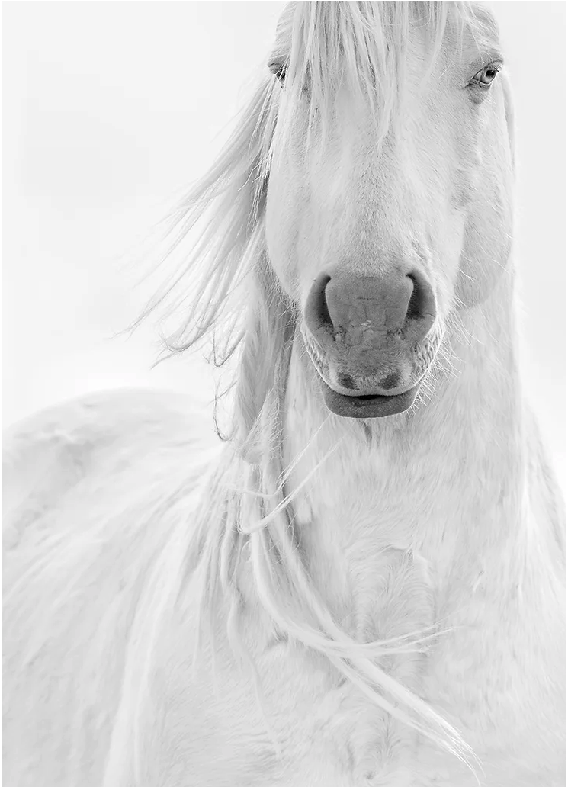
White Horse
The Legend of the White Stallion is an ancient story that has been passed down through generations. According to the legend, if one were to (against all odds) find and ride this mythical creature, they would be granted great power and success. In some re-tellings, the white stallion is believed to be a symbol of freedom, courage, strength, and purity - as well as a sign of hope in times of difficulty. This legend has been a part of human history for centuries and the white horse has been featured in mythology, folklore and literature around the world. From the Celtic legend of the white stallion to the Native American story of White Horse, this creature has become a powerful symbol and has inspired large bodies of work.
-Maria Mariott Photography

Slide 7
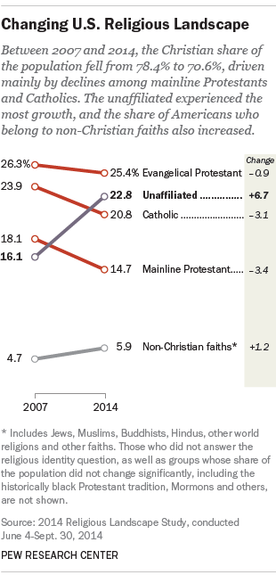
What is apostasy?
The Christian share of the U.S. population is declining, while the number of U.S. adults who do not identify with any organized religion is growing, according to an extensive new survey by the Pew Research Center. (Pew Research May 12, 2015)

Slide 8
Rev 6:1-2, Then I saw when the Lamb broke one of the seven seals, and I heard one of the four living creatures saying as with a voice of thunder, “Come.” I looked, and behold, a white horse, and he who sat on it had a bow; and a crown was given to him, and he went out conquering and to conquer.

Slide 9
he who sat on it had a bow
  This is someone with political power, but who doesn’t engage militarily.
  This cannot be Christ. Christ is never pictured with a bow, but rather a sword.
a crown was given to him
  The Greek word for crown here is “stephanos” which is not a kingly crown, but a crown given as a crown of victory in games, or for military valor. It is presented as an award.
  Diadems (Gr diadema), a crown signifying royalty
he went out conquering and to conquer
  The sense here is that the rider conquered perhaps through diplomacy,
  This Rider on the White horse represents a false Christ (the Antichrist

Slide 10
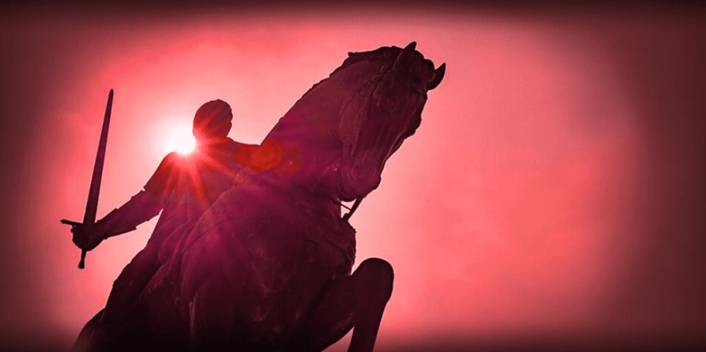
Rev 6:3-4, When He broke the second seal, I heard the second living creature saying, “Come.” 4 And another, a red horse, went out; and to him who sat on it, it was granted to take peace from the earth, and that men would slay one another; and a great sword was given to him.

Slide 11
a red horse
  Red for war and blood, which follows a time of initial false peace
it was granted to take peace from the earth
  This emphasizes that there is peace for a time and that it is taken away
that men would slay one another
  This is seems to be more than just killing in war, but an increase in murder, because…
a great sword was given to him
  sword, Gr. machaira, a dagger, not a long sword used in war, but for assassination

Slide 12
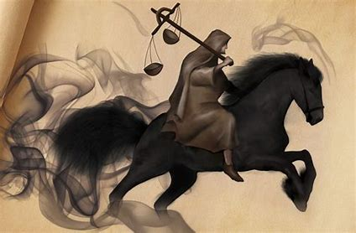
Rev 6:5-6, When He broke the third seal, I heard the third living creature saying, “Come.” I looked, and behold, a black horse; and he who sat on it had a pair of scales in his hand. 6 And I heard something like a voice in the center of the four living creatures saying, “A quart of wheat for a denarius, and three quarts of barley for a denarius; and do not damage the oil and the wine.”

Slide 13
A black horse
  The meaning is not readily apparent without the verses that follow
pair of scales in his hand
  Something is being measured out, rationed
a voice in the center of the four living creatures saying
  Who is at the center of the four living creatures?
“A quart of wheat for a denarius”
  A quart of wheat is considered to be enough to feed one person per day.
  A denarius is a day’s wage.
  Today’s average daily wage is about $220
  The idea here is that you would have to work for a whole day just to eat that day
  This is severe famine
    Mat 24:7b-8, in various places there will be famines and earthquakes. 8 But all these things are merely the beginning of birth pangs.

Slide 14
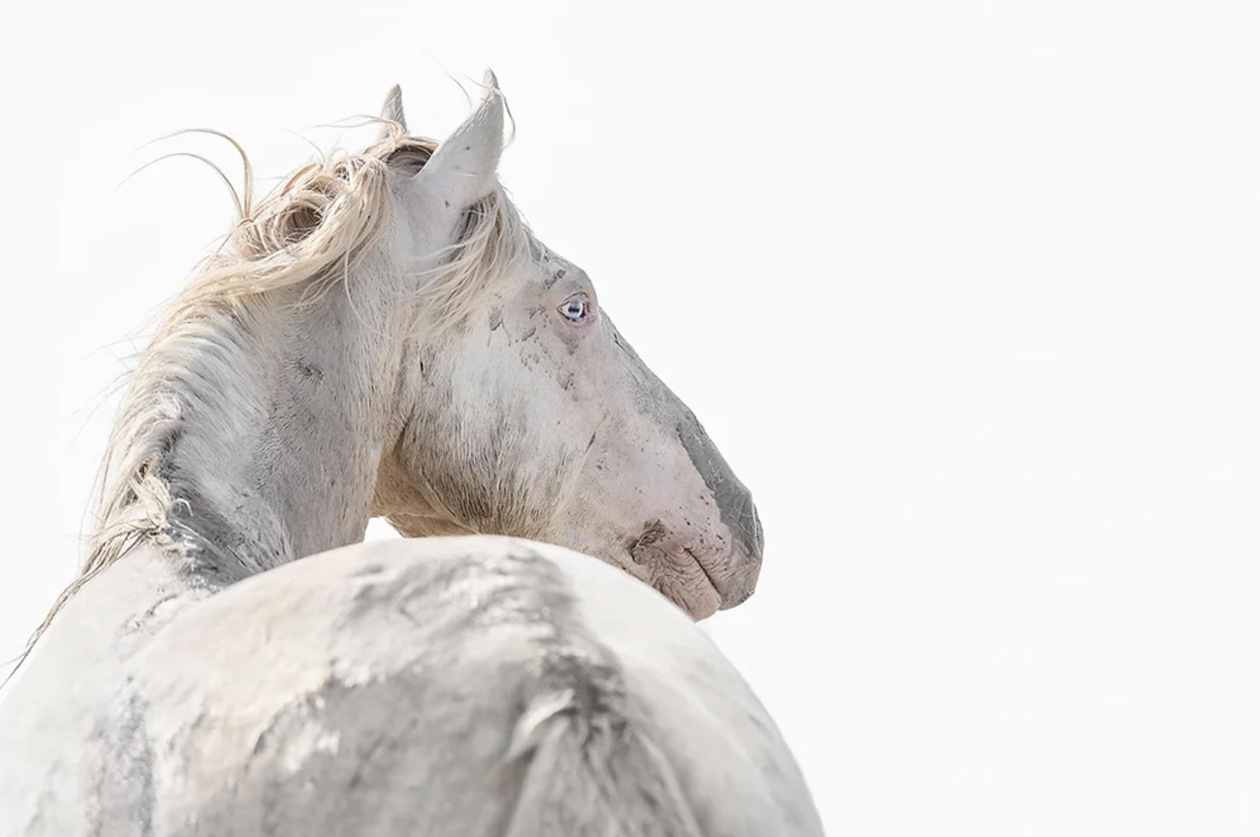
Rev 6:7-8, When the Lamb broke the fourth seal, I heard the voice of the fourth living creature saying, “Come.” 8 I looked, and behold, an ashen horse; and he who sat on it had the name Death; and Hades was following with him. Authority was given to them over a fourth of the earth, to kill with sword and with famine and with pestilence and by the wild beasts of the earth.

Slide 15
An ashen horse
  ashen is a sickly pale green color, the color of a decomposing body
Authority was given to them over a fourth of the earth
  To kill with the sword, war and murder
    Mat 24:9, See also Luke 21:8-28
To kill with famine
  lack of food will kill many
To kill with pestilence
  a disease, plague or other disaster of some kind
To kill with the “wild beasts” of the earth
  Untamed creatures.
  Earth has over 8 billion people, so more than 2 billion people will die when this fourth seal is opened.

Slide 16
Rev 6:9-11, When the Lamb broke the fifth seal, I saw underneath the altar the souls of those who had been slain because of the word of God, and because of the testimony which they had maintained; 10 and they cried out with a loud voice, saying, “How long, O Lord, holy and true, will You refrain from judging and avenging our blood on those who dwell on the earth?” 11 And there was given to each of them a white robe; and they were told that they should rest for a little while longer, until the number of their fellow servants and their brethren who were to be killed even as they had been, would be completed also.

Slide 17
I saw underneath the altar the souls of those who had been slain because of the word of God
  These seem to be those who were martyred through persecutions during the tribulation
How long, O Lord, holy and true, will You refrain from judging and avenging our blood?
  The are crying out for justice, which is coming, they just have a to wait a bit longer
  Notice souls, they do not yet have bodies, even though they were provided with robes, presumably so John could see them.
there was given to each of them a white robe
  Gr: Stole, a robe reaching to the feet, worn by kings, priests and people of rank
    This type of robe is given to the redeemed saints throughout Revelation
they should rest for a little while longer, why?
  Until the rest of the martyrs come in… we will see even more martyrs in 7:9

Slide 18
Rev 6:12-17, I looked when He broke the sixth seal, and there was a great earthquake; and the sun became black as sackcloth made of hair, and the whole moon became like blood; 13 and the stars of the sky fell to the earth, as a fig tree casts its unripe figs when shaken by a great wind. 14 The sky was split apart like a scroll when it is rolled up, and every mountain and island were moved out of their places. 15 Then the kings of the earth and the great men and the [m]commanders and the rich and the strong and every slave and free man hid themselves in the caves and among the rocks of the mountains; 16 and they *said to the mountains and to the rocks, “Fall on us and hide us from the presence of Him who sits on the throne, and from the wrath of the Lamb; 17 for the great day of their wrath has come, and who is able to stand?”

Slide 19
Signs and catastrophic events on earth and in the heavens
  Mat 24:29, “But immediately after the tribulation of those days the sun will be darkened, and the moon will not give its light, and the stars will fall from the sky, and the powers of the heavens will be shaken.
A great earthquake
  Gr. “mega”. This is unlike any earthquake the earth has ever experienced.
The sun became black
  Perhaps due to ash from tectonic and volcanic activity
the whole moon became like blood
  “blood moon” is caused by a lunar eclipse, but it’s probably more than this

Slide 20
the stars of the sky fell to the earth
  Comets, meteors
The sky was split apart like a scroll
  Some kind of rift in heaven, like an old scroll that breaks when you roll/unroll it
  Isa 40:22
every mountain and island were moved out of their places
  Unprecedented continental “drift”. The earth is reeling.
  Isa 34:2-4
Fall on us and hide us from the presence of Him who sits on the throne
  The unrighteous inhabitants of the earth now know that God is involved here and they want nothing to do with Him. Until now is was like life was normal!
    Mat 24:37-41
    Note this taking is in the context of judgement, not the Rapture!
  Who is able to stand? Chapter 7 will answer this question.

Slide 21
What do we know about the Antichrist?
  The Antichrist is the “little horn” in Daniel 7:8
  He forms part of the “unholy trinity”
    Satan, the Antichrist, and the False Prophet
  He is a mere man, empowered by Satan
  He appears to have died and is resurrected in Rev 13:3
  He speaks against God
  He persecutes the saints of God
  He attempts to make changes to Jewish calendars and feast dates
  He will remain in power for about 3 ½ years
  He signs a treaty with Israel then breaks the agreement after 3 ½ years
  He desecrates the Jewish temple with idolatry
  He does whatever he wants
  He makes himself a god
  He will prosper in all he does until God’s wrath is completed
  He has “no desire for women”. The Hebrew is ambiguous.

Slide 22
Rev 7:1-3, After this I saw four angels standing at the four corners of the earth, holding back the four winds of the earth, so that no wind would blow on the earth or on the sea or on any tree. 2 And I saw another angel ascending from the rising of the sun, having the seal of the living God; and he cried out with a loud voice to the four angels to whom it was granted to harm the earth and the sea, 3 saying, “Do not harm the earth or the sea or the trees until we have sealed the bond-servants of our God on their foreheads.”

Slide 23
5 from the tribe of Judah, twelve thousand were sealed,
from the tribe of Reuben twelve thousand,
from the tribe of Gad twelve thousand,
6 from the tribe of Asher twelve thousand,
from the tribe of Naphtali twelve thousand,
from the tribe of Manasseh twelve thousand,
7 from the tribe of Simeon twelve thousand,
from the tribe of Levi twelve thousand,
from the tribe of Issachar twelve thousand,
8 from the tribe of Zebulun twelve thousand,
from the tribe of Joseph twelve thousand,
from the tribe of Benjamin, twelve thousand were sealed.

Slide 24
After this
  the scene changes from judgement of the ungodly to protection for the godly.
  the angels are holding back winds that would otherwise be unleashed on earth.
sealed the bond-servants of our God on their foreheads.
  This is God’s seal for these saints, as opposed to the “mark of the Beast”, the Antichrist’s seal.
  Rev 14:1 identifies the seal,
    Then I looked, and behold, the Lamb was standing on Mount Zion, and with Him one hundred and forty-four thousand, having His name and the name of His Father written on their foreheads
12,000 from each tribe
  electively chosen by God, He knows which Jews are in which tribe!

Slide 25
Rev 7:9-12, After these things I looked, and behold, a great multitude which no one could count, from every nation and all tribes and peoples and tongues, standing before the throne and before the Lamb, clothed in white robes, and palm branches were in their hands; 10 and they cry out with a loud voice, saying,
“Salvation to our God who sits on the throne, and to the Lamb.” 11 And all the angels were standing around the throne and around the elders and the four living creatures; and they fell on their faces before the throne and worshiped God, 12 saying,
“Amen, blessing and glory and wisdom and thanksgiving and honor and power and might, be to our God forever and ever. Amen.”

Slide 26
Rev 7:13-17, Then one of the elders answered, saying to me, “These who are clothed in the white robes, who are they, and where have they come from?” 14 I said to him, “My lord, you know.” And he said to me, “These are the ones who come out of the great tribulation, and they have washed their robes and made them white in the blood of the Lamb. 15 For this reason, they are before the throne of God; and they serve Him day and night in His temple; and He who sits on the throne will spread His tabernacle over them. 16 They will hunger no longer, nor thirst anymore; nor will the sun beat down on them, nor any heat; 17 for the Lamb in the center of the throne will be their shepherd, and will guide them to springs of the water of life; and God will wipe every tear from their eyes.”

Slide 27
The ones who have come out of the great tribulation
  Gr: erchomai is in the “middle voice”, rather than a “passive voice”
    indicating a process of coming out in which they are involved
    rather than a sudden, “passive” event such as the Rapture which is out of their control
    Some refer to this verse to place the rapture near the end of the tribulation
  These are martyred saints (plus many more since), whose souls were under the altar in 6:9
    They “lived into it, were redeemed during it, and came out over time through death”
The blood of Jesus “cleansing and whitening” property
  How can blood, which is typically red, cleanse robes (think about it)?
  Spread his tabernacle over them
    Loving relief from the torment they have experienced during the Tribulation

