Slide 1
Tribulation: Trumpet Judgements and the Two Witnesses
Revelation Chapters 8-12

Slide 2
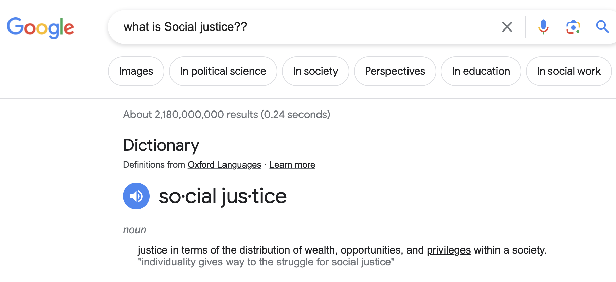

Slide 3
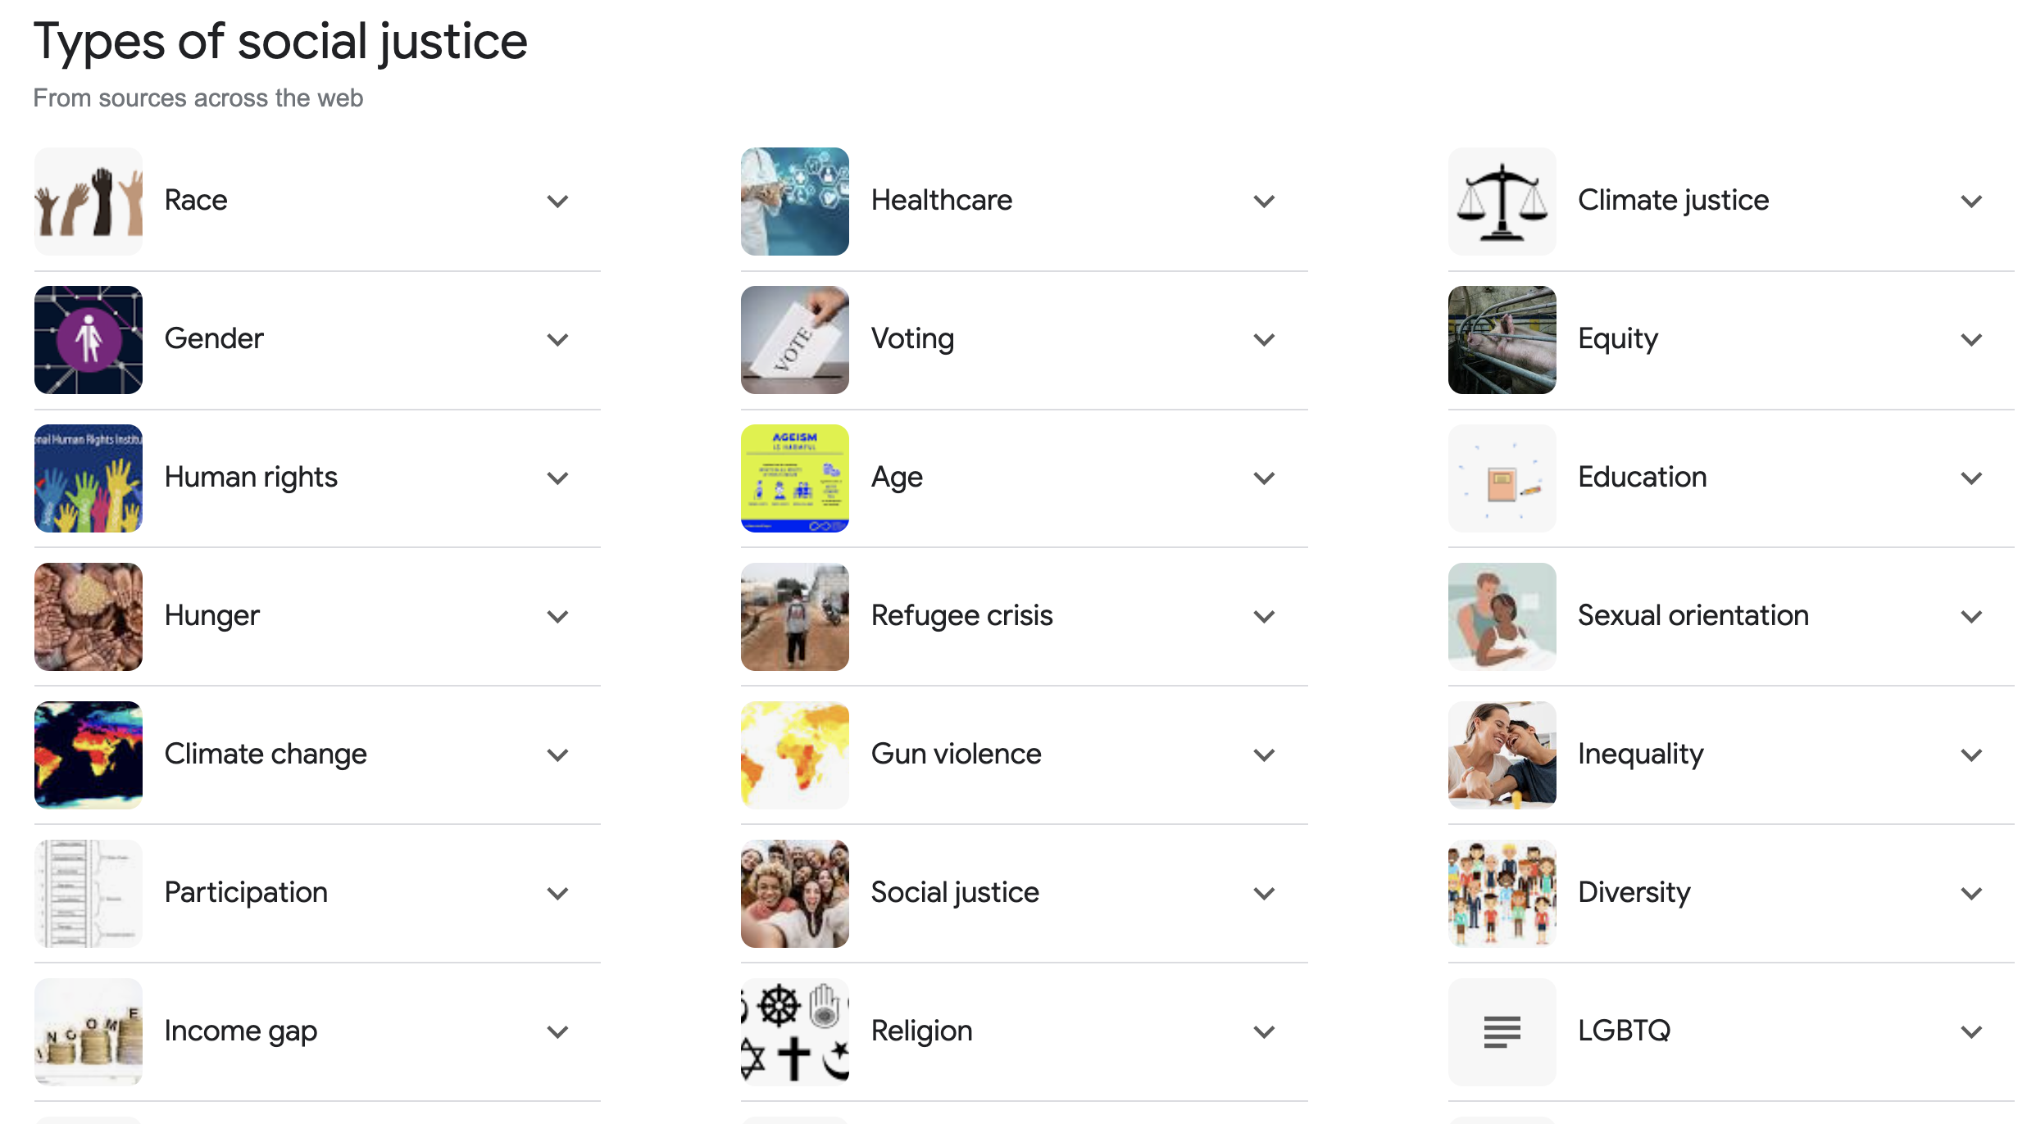

Slide 4
What is God up to?
Heb 9:27-28 (NLT), just as each person is destined to die once and after that comes judgment, 28 so also Christ was offered once for all time as a sacrifice to take away the sins of many people. He will come again, not to deal with our sins, but to bring salvation to all who are eagerly waiting for him.
What will He bring to those who have rejected him?
The Lord’s Prayer
Mat 6:10, ‘Your kingdom come. Your will be done, on earth as it is in heaven.
  “What heaven decrees, its effect is upon earth. What is decided in the spiritual realm will manifest in the physical realm.” – Pastor Jack Hibbs, Calvary Chapel Chino Hills
James 5:16b-17 (NLT), The earnest prayer of a righteous person has great power and produces wonderful results. 17 Elijah was as human as we are, and yet when he prayed earnestly that no rain would fall, none fell for three and a half years!

Slide 5
Equity and Justice are coming!
  Divine Equity is absolutely equitable
  Divine Justice is absolutely just
    Psalm 99:1-4,
      The Lord reigns, let the peoples tremble;
      He is enthroned above the cherubim, let the earth shake!
      2 The Lord is great in Zion,
      And He is exalted above all the peoples.
      3 Let them praise Your great and awesome name;
      Holy is He.
      4 The strength of the King loves justice;
      You have established equity;
      You have executed justice and righteousness in Jacob.

Slide 6
Rev 8:1-2, When the Lamb broke the seventh seal, there was silence in heaven for about half an hour.
QUESTION: Until now, heaven has been noisy. Why the silence in heaven?
Inside the seventh Seal are all the Trumpet Judgements!
Inside the seventh Trumpet are all the Bowl judgements! We’ll see this next time.
  These all take place over an indefinite amount of time but are most likely within the last 3 ½ years of the Tribulation, ending after the seventh year.
So, these are exponentially increasing judgements poured out on those who dwell on the earth.
  Mat 24:21-22,
    For then there will be a great tribulation, such as has not occurred since the beginning of the world until now, nor ever will. 22 Unless those days had been cut short, no life would have been saved; but for the sake of the elect those days will be cut short.

Slide 7
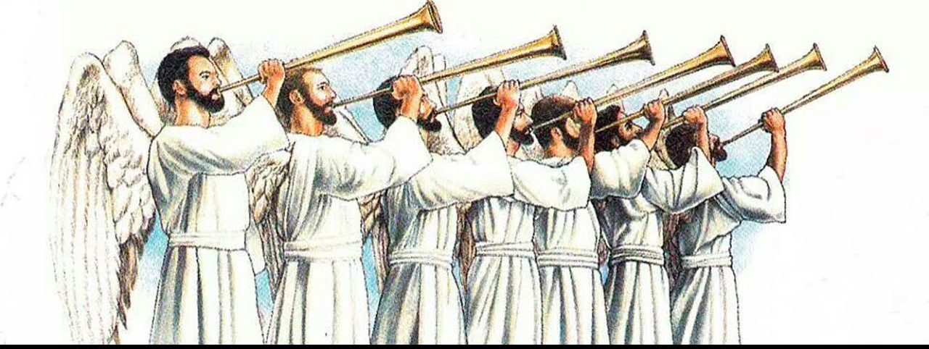
Rev 8:2, And I saw the seven angels who stand before God, and seven trumpets were given to them.
Each time a trumpet is blown the judgments become progressively more severe.
  The first three trumpets destroy the earth’s ecology.
  The fourth trumpet affects the luminaries in the sky.
  The next two trumpets release demonic destruction on humanity.
  The last trumpet unleashes the bowl judgements which are far worse than the trumpets.

Slide 8
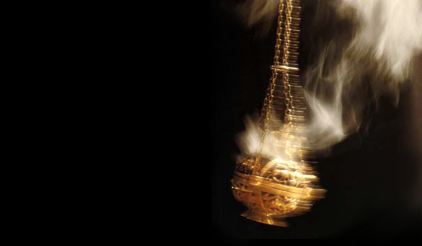
Rev 8:3-5 Another angel came and stood at the altar, holding a golden censer; and much incense was given to him, so that he might add it to the prayers of all the saints on the golden altar which was before the throne. 4 And the smoke of the incense, with the prayers of the saints, went up before God out of the angel’s hand. 5 Then the angel took the censer and filled it with the fire of the altar, and threw it to the earth; and there followed peals of thunder and sounds and flashes of lightning and an earthquake.

Slide 9
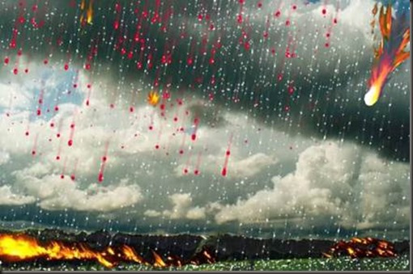
The First Trumpet – Judgement on the Land
Rev 8:6-7, And the seven angels who had the seven trumpets prepared themselves to sound them. 7 The first sounded, and there came hail and fire, mixed with blood, and they were thrown to the earth; and a third of the earth was burned up, and a third of the trees were burned up, and all the green grass was burned up.

Slide 10
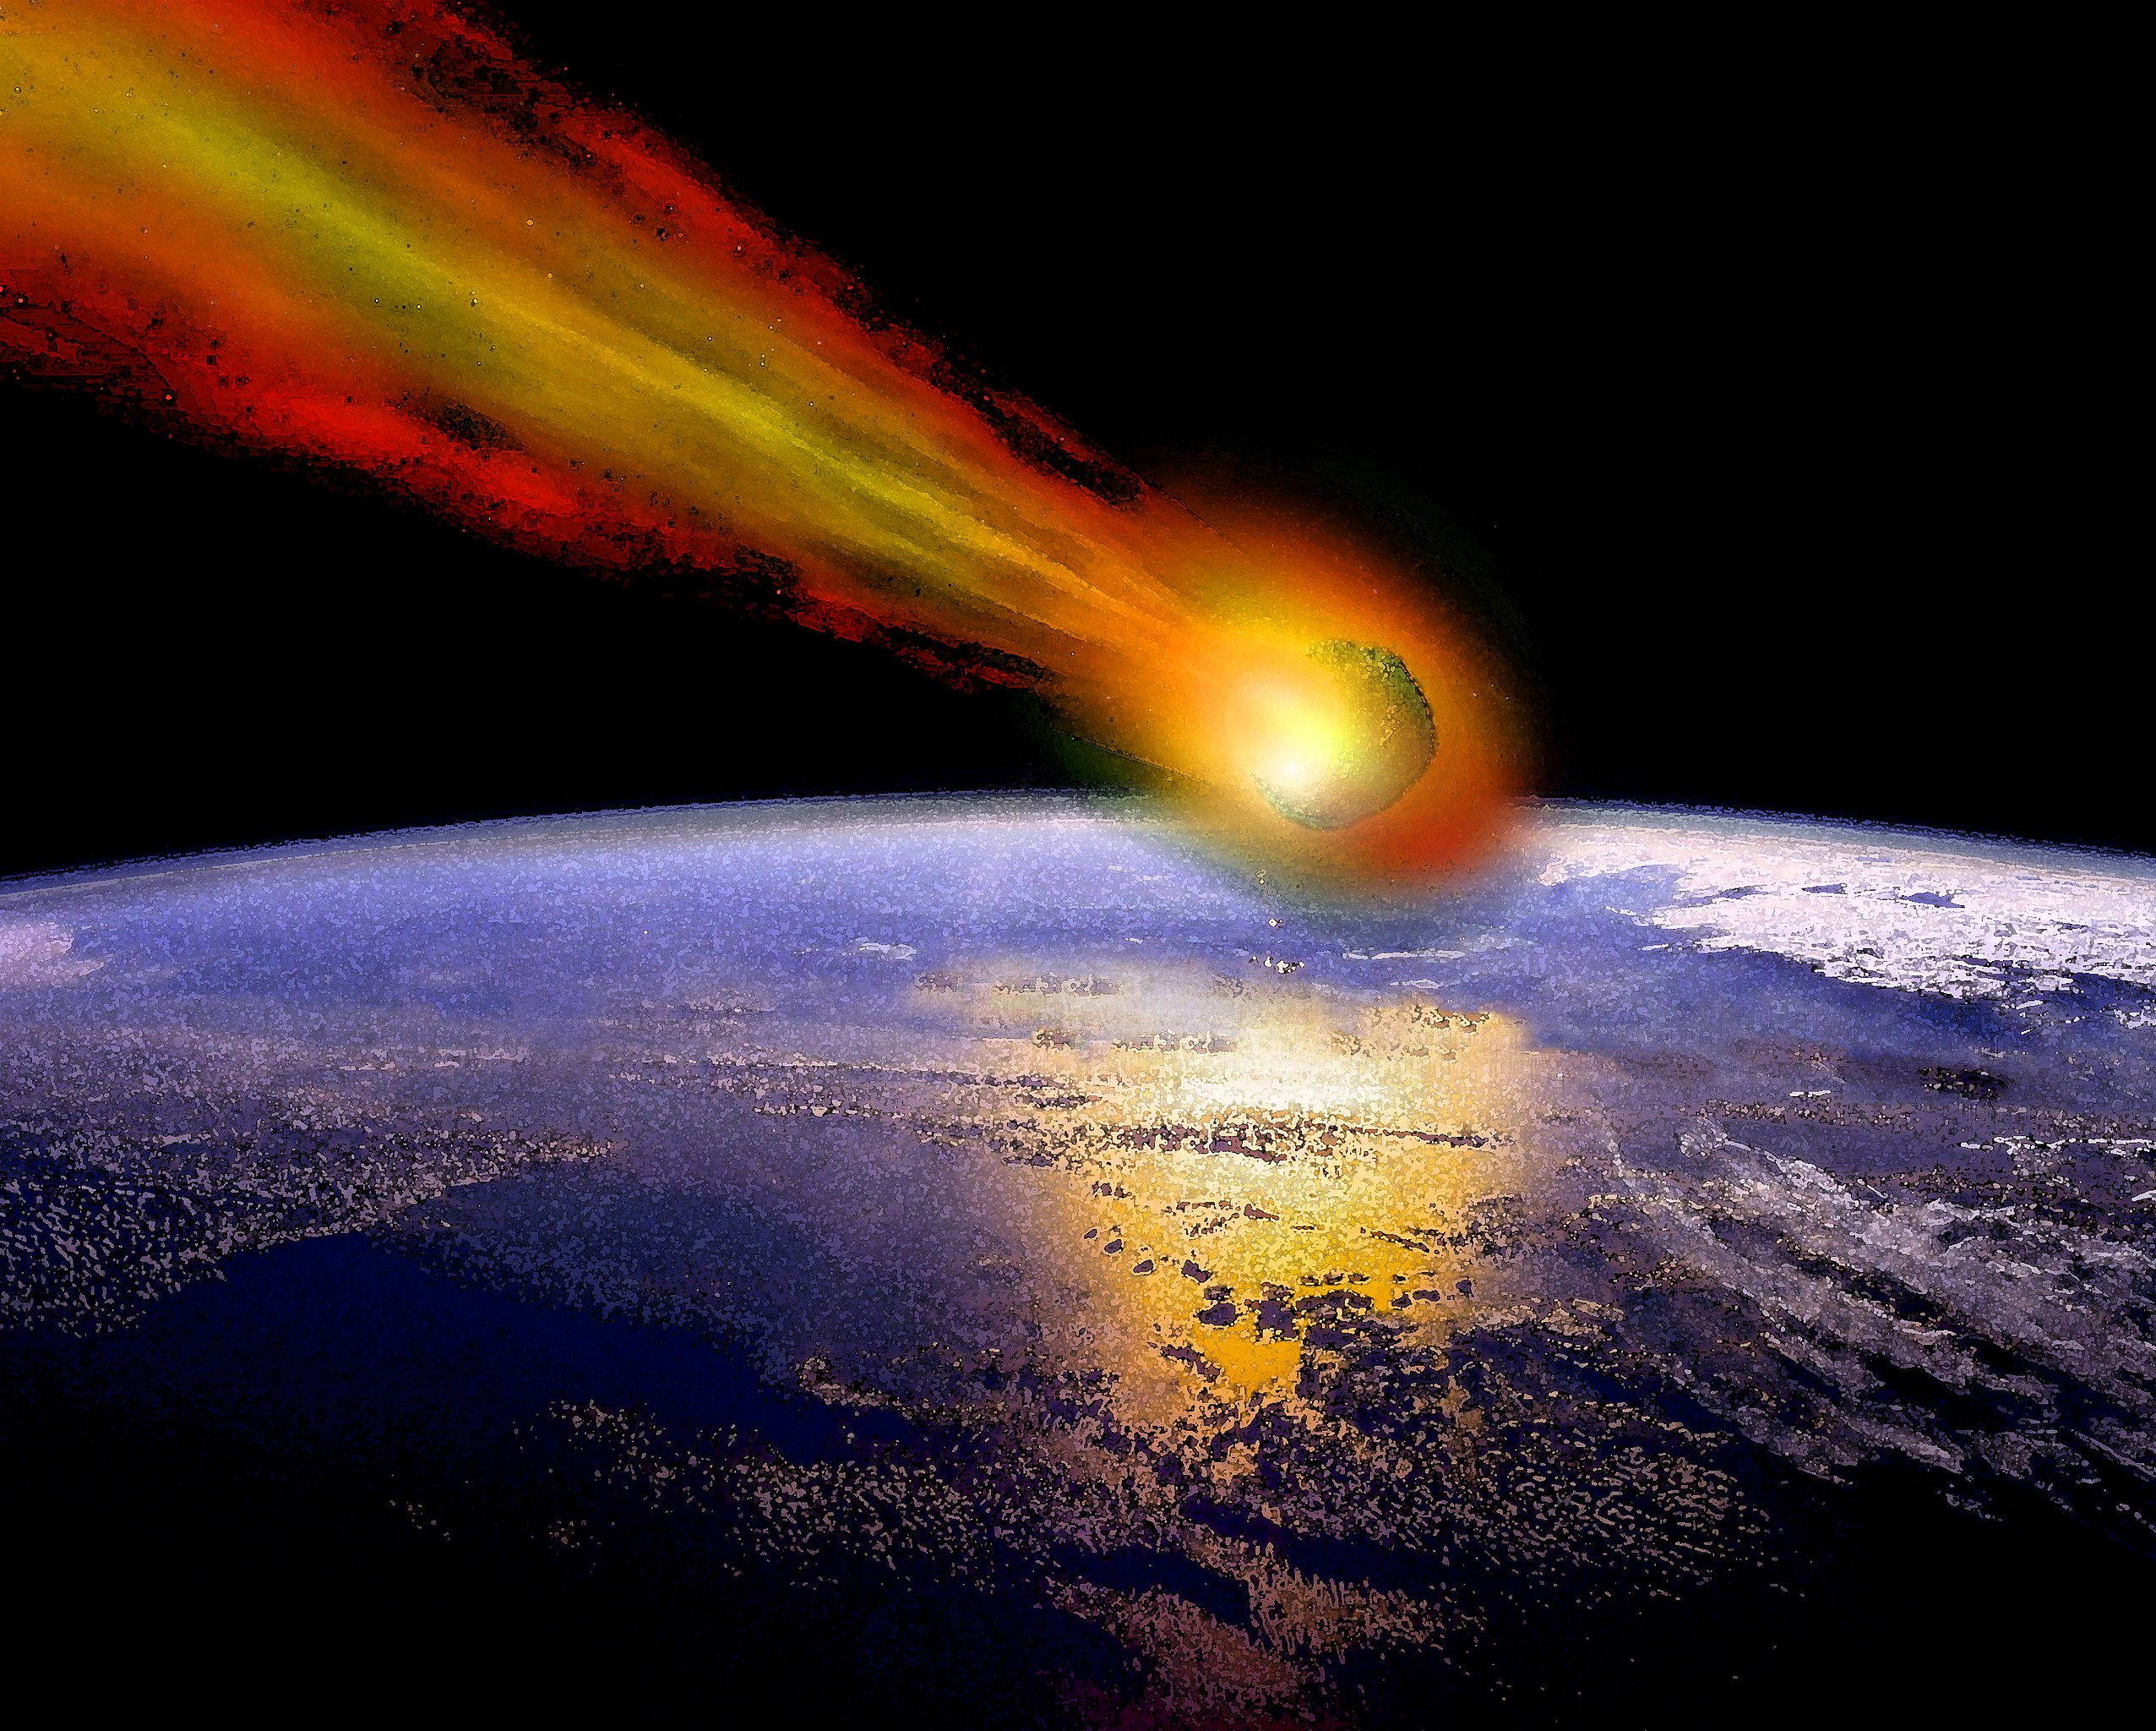
The Second Trumpet – Judgement on the Seas
Rev 8:8-9, The second angel sounded, and something like a great mountain burning with fire was thrown into the sea; and a third of the sea became blood, 9 and a third of the creatures which were in the sea and had life, died; and a third of the ships were destroyed.

Slide 11
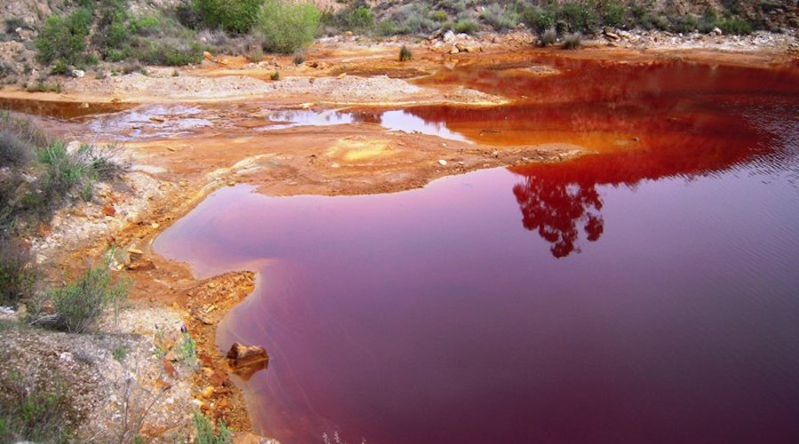
The Third Trumpet – Judgement on the Fresh Water
Rev 8:10-11, The third angel sounded, and a great star fell from heaven, burning like a torch, and it fell on a third of the rivers and on the springs of waters. 11 The name of the star is called Wormwood; and a third of the waters became wormwood, and many men died from the waters, because they were made bitter.

Slide 12

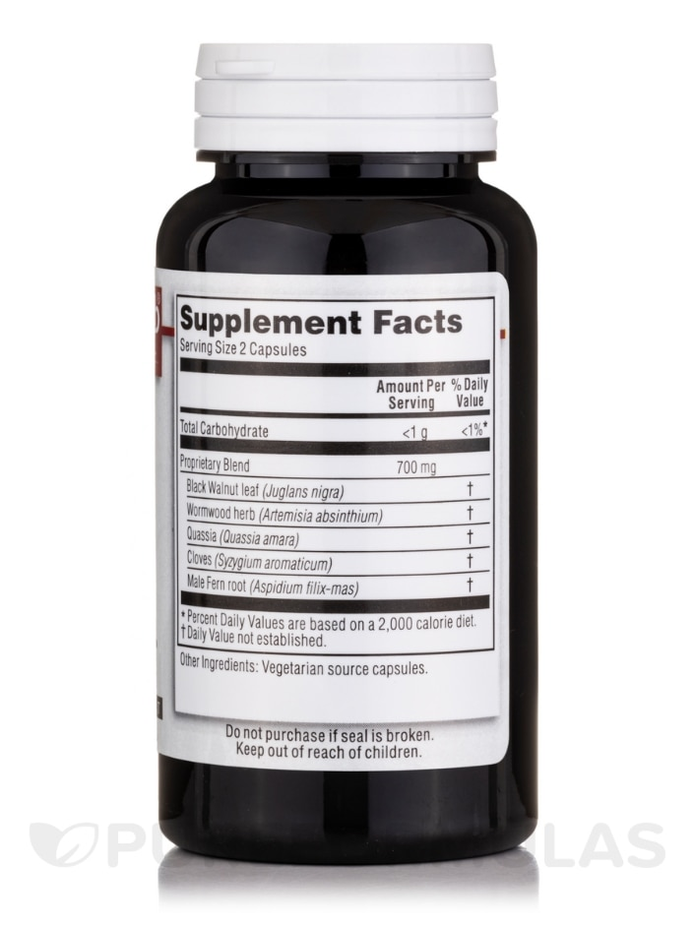

Slide 13
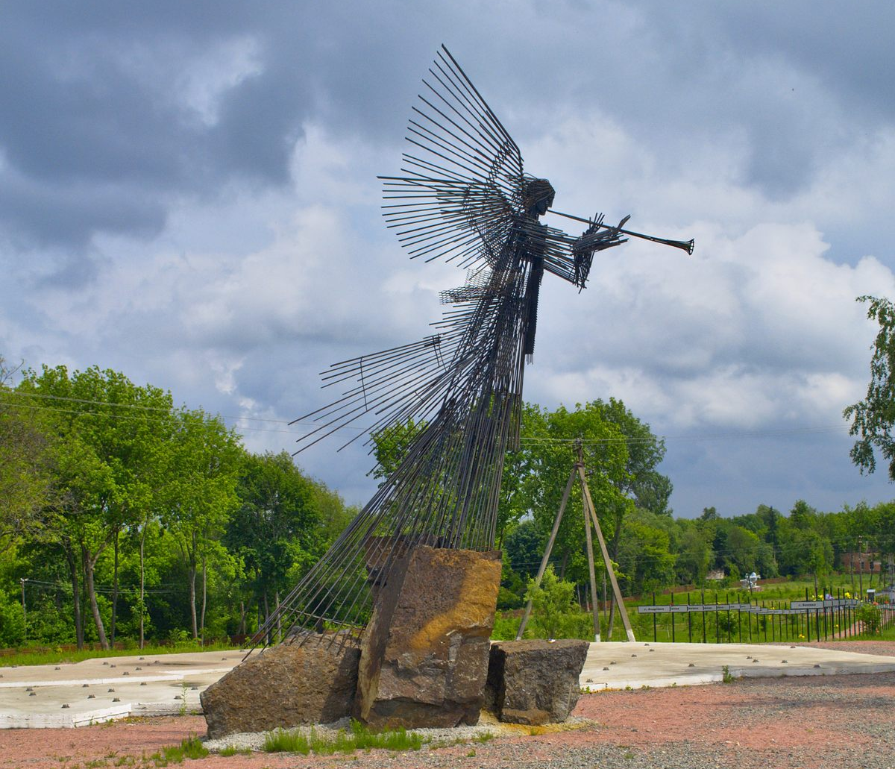
Wormwood Star Memorial Complex
The Monument of the Third Angel was installed as part of the new memorial park in Chernobyl on April 26, 2011 – the 25th anniversary of the Chernobyl disaster.

Slide 14
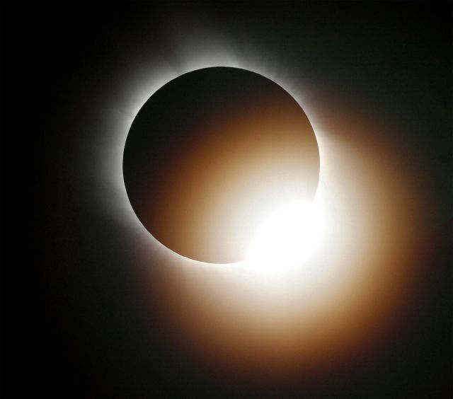
The Fourth Trumpet – Judgement on the Luminaries
Rev 8:12-13, The fourth angel sounded, and a third of the sun and a third of the moon and a third of the stars were struck, so that a third of them would be darkened and the day would not shine for a third of it, and the night in the same way. 13 Then I looked, and I heard an eagle flying in midheaven, saying with a loud voice, “Woe, woe, woe to those who dwell on the earth, because of the remaining blasts of the trumpet of the three angels who are about to sound!”

Slide 15
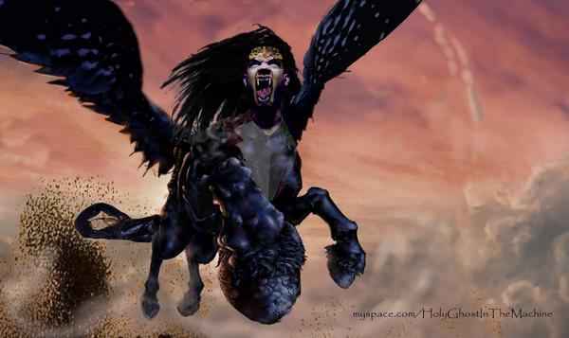
The Fifth Trumpet – The Demon Locust Swarm Sent to Torment Unbelievers
Rev 9:1-2, Then the fifth angel sounded, and I saw a star from heaven which had fallen to the earth; and the key of the bottomless pit was given to him. 2 He opened the bottomless pit, and smoke went up out of the pit, like the smoke of a great furnace; and the sun and the air were darkened by the smoke of the pit…

Slide 16
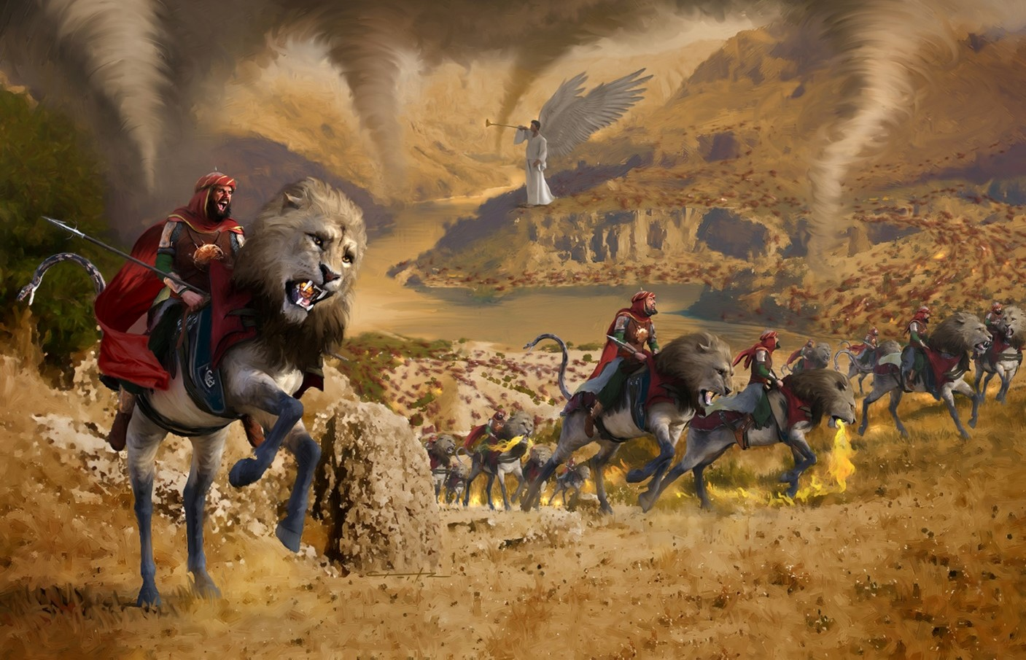
The Sixth Trumpet – The Four Demons Released to Kill Unbelievers
Rev 9:13-15, Then the sixth angel sounded, and I heard a voice from the four horns of the golden altar which is before God, 14 one saying to the sixth angel who had the trumpet, “Release the four angels who are bound at the great river Euphrates.”

Slide 17
An Interlude in Heaven
Rev 10
John is shown some things, and heard some things which he is not allowed to write down.
A “strong” angel appears with a small book, and John is commanded to eat it.
It tastes as sweet as honey, but is bitter in his stomach.
  God’s Word is sweet to the taste, but is bitter in its consequences rendered to unbelievers.
All of us should love God’s Word, but also be concerned for the consequences coming to rejectors.

Slide 18
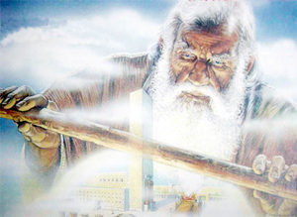
The Temple Measured
Rev 11:1-2, Then there was given me a measuring rod like a staff; and someone said, “Get up and measure the temple of God and the altar, and those who worship in it. 2 Leave out the court which is outside the temple and do not measure it, for it has been given to the nations; and they will tread under foot the holy city for forty-two months.

Slide 19
The Two Witnesses
Rev 11:3-14, And I will grant authority to my two witnesses, and they will prophesy for twelve hundred and sixty days, clothed in sackcloth.” 4 These are the two olive trees and the two lampstands that stand before the Lord of the earth. 5 And if anyone wants to harm them, fire flows out of their mouth and devours their enemies; so if anyone wants to harm them, he must be killed in this way. 6 These have the power to shut up the sky, so that rain will not fall during the days of their prophesying; and they have power over the waters to turn them into blood, and to strike the earth with every plague, as often as they desire.

Slide 20
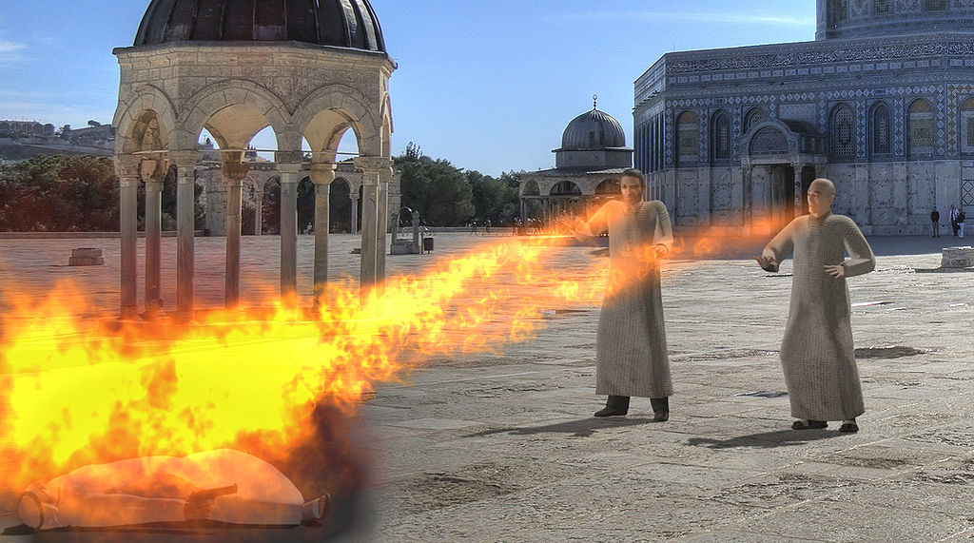

Slide 21
Rev 11:7 When they have finished their testimony, the beast that comes up out of the abyss will make war with them, and overcome them and kill them. 8 And their dead bodies will lie in the street of the great city which mystically is called Sodom and Egypt, where also their Lord was crucified. 9 Those from the peoples and tribes and tongues and nations will look at their dead bodies for three and a half days, and will not permit their dead bodies to be laid in a tomb. 10 And those who dwell on the earth will rejoice over them and celebrate; and they will send gifts to one another, because these two prophets tormented those who dwell on the earth.

Slide 22
Rev 11:11-14, But after the three and a half days, the breath of life from God came into them, and they stood on their feet; and great fear fell upon those who were watching them. 12 And they heard a loud voice from heaven saying to them, “Come up here.” Then they went up into heaven in the cloud, and their enemies watched them. 13 And in that hour there was a great earthquake, and a tenth of the city fell; seven thousand people were killed in the earthquake, and the rest were terrified and gave glory to the God of heaven. 14 The second woe is past; behold, the third woe is coming quickly.

Slide 23
The Seventh Trumpet
Rev 11:15-17, Then the seventh angel sounded; and there were loud voices in heaven, saying,
“The kingdom of the world has become the kingdom of our Lord and of His Christ; and He will reign forever and ever.” 16 And the twenty-four elders, who sit on their thrones before God, fell on their faces and worshiped God, 17 saying, “We give You thanks, O Lord God, the Almighty, who are and who were, because You have taken Your great power and have begun to reign.

Slide 24
Rev 11:18-19, And the nations were enraged, and Your wrath came, and the time came for the dead to be judged, and the time to reward Your bond-servants the prophets and the saints and those who fear Your name, the small and the great, and to destroy those who destroy the earth.” 19 And the temple of God which is in heaven was opened; and the ark of His covenant appeared in His temple, and there were flashes of lightning and sounds and peals of thunder and an earthquake and a great hailstorm.
Psa 2:1-2, Why are the nations in an uproar and the peoples devising a vain thing? 2 The kings of the earth take their stand and the rulers take counsel together against the Lord and against His Anointed

