Slide 1
Tribulation: Beasts, Bowl Judgements and Babylon Revealed (Rev 12-18)
The last Judgements revealed

Slide 2
Introduction
Symbolism in the Bible
  Throughout the bible often uses colorful, symbolism to “paint pictures”
  To do this it uses numbers, parables, similes and metaphors
  A number may have symbolic meaning apart from the actual number itself
  A parable is a story that paints a picture either to obscure or convict, or both!
  A simile is a comparison using: What?
  These are relatively easy to understand
  QUESTION: What’s a metaphor?

Slide 3
Which is more powerful, a simile or a metaphor?
Which is harder to understand? Why?
    Class exercise. Find the similes and metaphors!
      Rev 1:12, Then I turned to see the voice that was speaking with me. And after turning I saw seven golden lampstands; 13 and in the middle of the lampstands I saw one like a son of man, clothed in a robe reaching to the feet, and wrapped around the chest with a golden sash. 14 His head and His hair were white like white wool, like snow; and His eyes were like a flame of fire. 15 His feet were like burnished bronze when it has been heated to a glow in a furnace, and His voice was like the sound of many waters. 16 In His right hand He held seven stars, and out of His mouth came a sharp two-edged sword; and His face was like the sun shining in its strength.

Slide 4
QUESTION: So how are we supposed to know if the language is literal or symbolic?
    A literal interpretation of the Bible allows for figurative language. Here’s a simple rule: if the literal meaning of a passage leads to obvious absurdity, but a figurative meaning yields clarity, then the passage is probably using symbols. – gotquestions.org
QUESTION: Why does Jesus make some things hard to understand on purpose?
    Mat 13:10-11
    1 Cor 2:10-14 (NLT)
Ever wonder why so many struggle with Revelation? It’s not intended for unbelievers!
    Rev 1:1 (NLT), This is a revelation from Jesus Christ, which God gave him to show his servants the events that must soon take place.

Slide 5
Rev 12:1-2, A great sign appeared in heaven: a woman clothed with the sun, and the moon under her feet, and on her head a crown of twelve stars; 2 and she was with child; and she cried out, being in labor and in pain to give birth.
A great sign appeared in heaven
The four symbolic women of Revelation
  Jezebel (2:20), worldliness in the church (an actual woman, but also a spirit)
  Woman clothed with the sun (12:1), clothed with splendor, dignity, honor.
  Woman clothed in scarlet (17:3-6), a harlot.
  The Bride of the Lamb (19:7)

Slide 6
Rev 12:3-4, Then another sign appeared in heaven: and behold, a great red dragon having seven heads and ten horns, and on his heads were seven diadems. 4 And his tail swept away a third of the stars of heaven and threw them to the earth. And the dragon stood before the woman who was about to give birth, so that when she gave birth he might devour her child.
A dragon is described as being Satan, see 12:9, 20:2
7 Heads, 10 horns, 10 diadems
  Heads command the body, so are typically representative of successive earthy kingdoms
  Horns, diadems, are kings who have power given to them as explained in 17:12, Dan 7
1/3 of the “stars”, how many might that have been?
Devour the child? Who is this child?

Slide 7
Rev 12:5-6, 5 And she gave birth to a son, a male child, who is to rule all the nations with a rod of iron; and her child was caught up to God and to His throne. 6 Then the woman fled into the wilderness where she had a place prepared by God, so that there she would be nourished for one thousand two hundred and sixty days.
Israel flees to the mountains when the abomination appears, Mat 24:15-21
Rev 12:7-9, And there was war in heaven, Michael and his angels waging war with the dragon. The dragon and his angels waged war, 8 and they were not strong enough, and there was no longer a place found for them in heaven. 9 And the great dragon was thrown down, the serpent of old who is called the devil and Satan, who deceives the whole world; he was thrown down to the earth, and his angels were thrown down with him.
QUESTION: How many “good” angels are there vs “bad” angels? Is it a fair fight?

Slide 8
Next events
A loud voice in heaven praises God for the victory (12:10-12)
The dragon is mad and persecutes the woman [Israel] who flees to the wilderness (12:13-14)
God protects her, despite a second attack by Satan by drowning(12:15-16)
The dragon is even more upset and turns his wrath against “the rest of her children” (12:17)

Slide 9
Rev 13:1, And the dragon stood on the sand of the seashore. Then I saw a beast coming up out of the sea, having ten horns and seven heads, and on his horns were ten diadems, and on his heads were blasphemous names.
I saw one of his heads as if it had been slain, and his fatal wound was healed, (13:3)
The dragon is worshipped because he gave his authority to the beast (13:4).
He speaks blasphemies against God, with authority to act for 42 months (13:5-6)
He makes war with the saints (13:7)
“All who dwell on the earth will worship him”, (13:8-10)
Another beast (of the same kind - a demon powered person) (13:11)
  The sea beast (from the Abyss) is terrible, mysterious and foreboding. Who holds the keys?
  The earth beast (from Sheol) is perhaps more winsome, persuasive, and deceptive.
This person makes all the earth worship the first beast [Antichrist]. (13:12-14)

Slide 10
Rev 13:15-18, And it was given to him to give breath to the image of the beast, so that the image of the beast would even speak and cause as many as do not worship the image of the beast to be killed. 16 And he causes all, the small and the great, and the rich and the poor, and the free men and the slaves, to be given a mark on their right hand or on their forehead, 17 and he provides that no one will be able to buy or to sell, except the one who has the mark, either the name of the beast or the number of his name. 18 Here is wisdom. Let him who has understanding calculate the number of the beast, for the number is that of a man; and his number is six hundred and sixty-six.
QUESTION: What does it mean to “give breath” to the image?
Those who don’t worship the image will be killed.
He “marks” the faithful worshippers of the image to protect them from the wrath of Antichrist.
Unmarked individuals cannot participate in the society or the economy.
QUESTION: What does the phrase “here is wisdom” mean (v18)?
QUESTION: How should we handle the “666” issue”? Can we predict exactly what this means?

Slide 11
Rev 14:1, Then I looked, and behold, the Lamb was standing on Mount Zion, and with Him one hundred and forty-four thousand, having His name and the name of His Father written on their foreheads.
We find out they sing a new song that only they can learn (14:2-3)
They don’t lie and are “blameless”. Their lives are characterized by purity (14:4-5)
Then, we see three angels traverse the sky to preach to “those who live on the earth.” (14:6-11)
Perseverance of the saints is praised during this time. Those who keep the faith!
  Rev 14:12-13, This is one of the “beatitudes of Revelation.”
Then we see ‘The son of man” holding a sickle, ready to reap the earth. (14:14)
  Rev 14:14, How is the “Reaper” typically depicted? Here Jesus is the Reaper!
We then see a fourth angel who brings the word to start the harvest:
  Rev 14:15, The Gr word here for “is ripe” means dried up and withered! It’s way past ripe!
    Mat 13:40-42, Rev 14:16, He who sat on the cloud swung His sickle over the earth, and the earth was reaped.
  Another angel (fifth) comes out with a sickle. (14:17-20)

Slide 12
The Bowl Judgements are Coming (Rev 15)
Rev 15:1, Then I saw another sign in heaven, great and marvelous, seven angels who had seven plagues, which are the last, because in them the wrath of God is finished. And I saw something like a sea of glass mixed with fire, and those who had been victorious [a]over the beast and his image and the number of his name, standing on the sea of glass, holding harps of God.
God proclaims these are the last judgements on the planet. God’s wrath will finish with these.
Those victorious are standing before the throne of God singing the song of Moses (15:3-4)
The tabernacle is opened and the seven angels with the seven plagues come out (15:5-8)
The four living beings around the throne present to them golden bowls full of God’s wrath.

Slide 13
The Bowl Judgements (Rev 16)
These are seven more judgements that are contained within the timeframe of the seventh trumpet
Bowl judgements are sequential, but also seem to be cumulative, coming one right after the other
Rev 16:1-2, Then I heard a loud voice from the temple, saying to the seven angels, “Go and pour out on the earth the seven bowls of the wrath of God.” 2 So the first angel went and poured out his bowl on the earth; and it became a loathsome and malignant sore on the ^{[d]}people who had the mark of the beast and who worshiped his image.
QUESTION: Where did the loud voice come from?
QUESTION: Do you think these judgements have a natural cause?
QUESTION: Do the malignant sores affect believers?

Slide 14
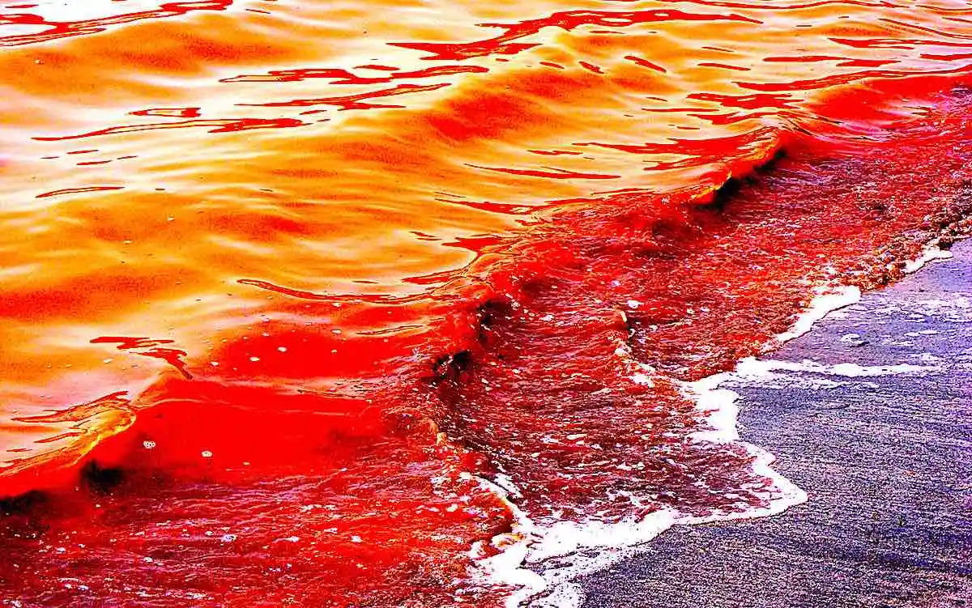
Rev 16:3, The second angel poured out his bowl into the sea, and it became blood like that of a dead man; and every living thing in the sea died.

Slide 15
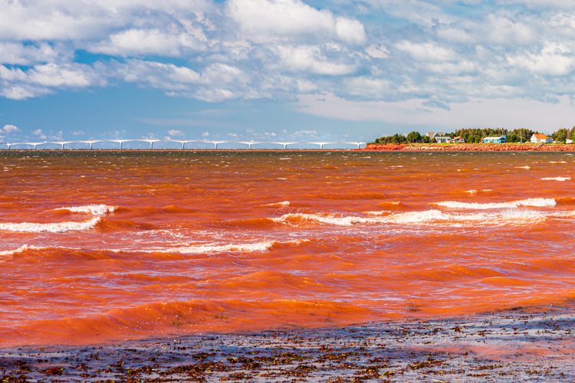

Slide 16
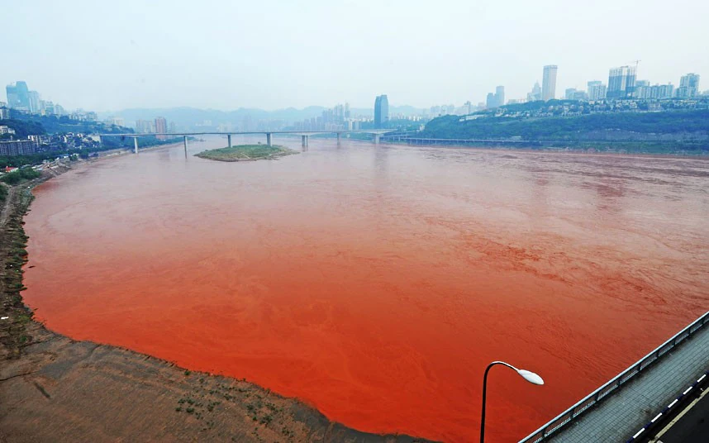
Rev 16:4-7, Then the third angel poured out his bowl into the rivers and the springs of waters; and they became blood. 5 And I heard the angel of the waters saying, “Righteous are You, who are and who were, O Holy One, because You judged these things; 6 for they poured out the blood of saints and prophets, and You have given them blood to drink. They deserve it.” 7 And I heard the altar saying, “Yes, O Lord God, the Almighty, true and righteous are Your judgments.”
Rev 16:4-7, Then the third angel poured out his bowl into the rivers and the springs of waters; and they became blood. 5 And I heard the angel of the waters saying, “Righteous are You, who are and who were, O Holy One, because You judged these things; 6 for they poured out the blood of saints and prophets, and You have given them blood to drink. They deserve it.” 7 And I heard the altar saying, “Yes, O Lord God, the Almighty, true and righteous are Your judgments.”

Slide 17
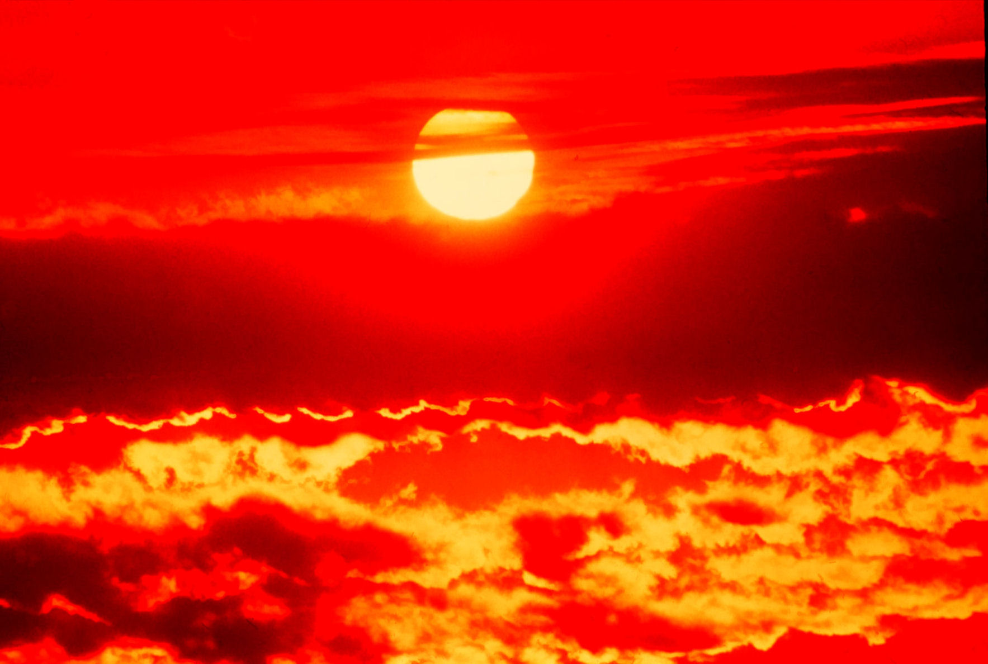
Rev 16:8-9, The fourth angel poured out his bowl upon the sun, and it was given to it to scorch men with fire. 9 Men were scorched with fierce heat; and they blasphemed the name of God who has the power over these plagues, and they did not repent so as to give Him glory.
QUESTION: They are blaspheming God, so are they believers?
QUESTION: Do you think this will have an impact on the climate? Polar ice caps? Ocean levels?
QUESTION: Is there any indication that anyone is repenting now?

Slide 18
Rev 16:10-11, Then the fifth angel poured out his bowl on the throne of the beast, and his kingdom became darkened; and they gnawed their tongues because of pain, 11 and they blasphemed the God of heaven because of their pains and their sores; and they did not repent of their deeds.
This is a plague of darkness, somehow causing intolerable pain.
Chewing their tongues for relief?
QUESTION: In Exodus, God used a plague of darkness effectively, when was it?
  Exo 10:21-23, Then the Lord said to Moses, “Stretch out your hand toward the sky, that there may be darkness over the land of Egypt, even a darkness which may be felt.” 22 So Moses stretched out his hand toward the sky, and there was thick darkness in all the land of Egypt for three days. 23 They did not see one another, nor did anyone rise from his place for three days, but all the sons of Israel had light in their dwellings.
  This was the plague just before the plague of the firstborn, also called… The Passover.

Slide 19
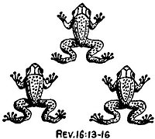
Rev 16:12-16, The sixth angel poured out his bowl on the great river, the Euphrates; and its water was dried up, so that the way would be prepared for the kings from the east. 13 And I saw coming out of the mouth of the dragon and out of the mouth of the beast and out of the mouth of the false prophet, three unclean spirits like frogs; 14 for they are spirits of demons, performing signs, which go out to the kings of the whole world, to gather them together for the war of the great day of God, the Almighty. 15 (“Behold, I am coming like a thief. Blessed is the one who stays awake and keeps his clothes, so that he will not walk about naked and men will not see his shame.”) 16 And they gathered them together to the place which in Hebrew is called Har-Magedon.
QUESTION: What’s the purpose of the Euphrates
drying up?
QUESTION: What do the “frog-like” spirits do?
And why do they do it?
QUESTION: What is the Dragon collecting the
kings of the world for?

Slide 20
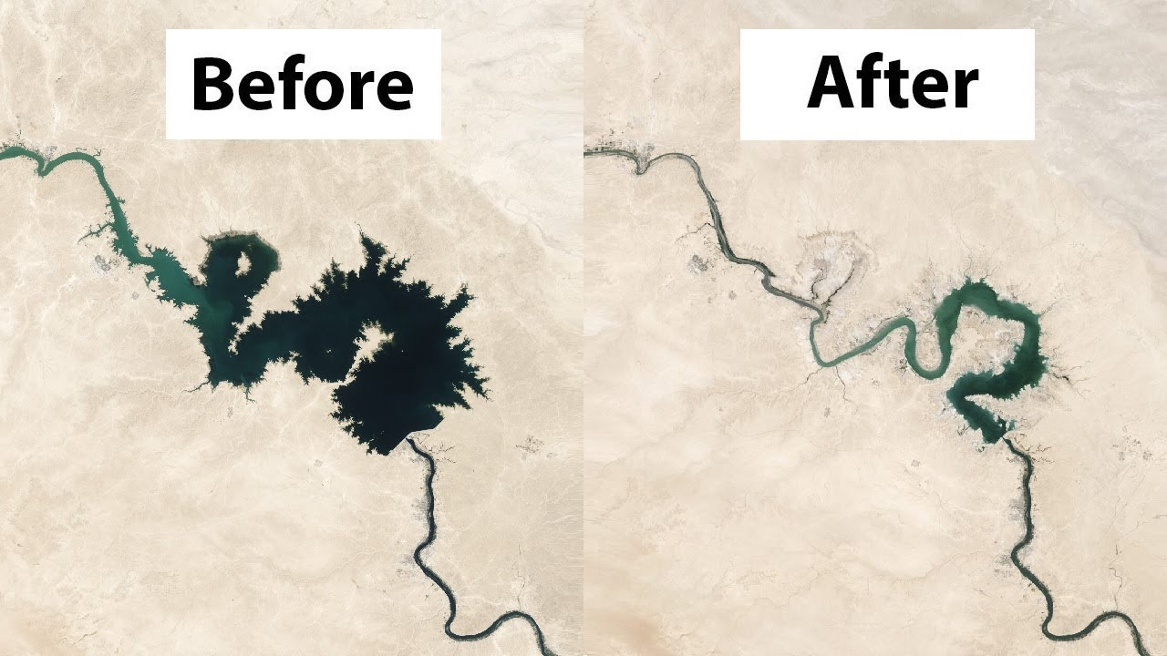
This seems to be a manmade problem and not what is indicated in Revelation

Slide 21
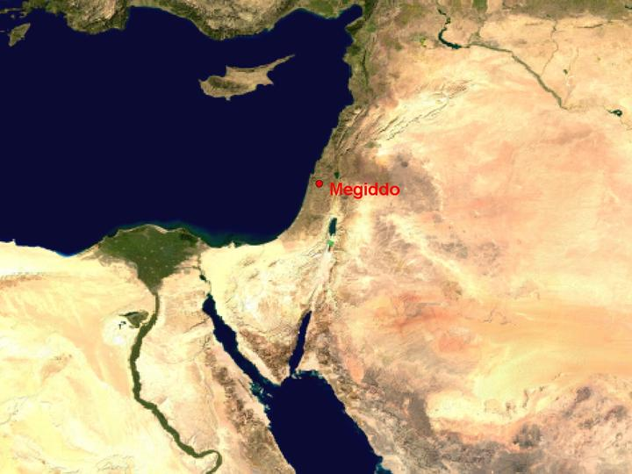

Slide 22
Rev 16:17-21, Then the seventh angel poured out his bowl upon the air, and a loud voice came out of the temple from the throne, saying, “It is done.” 18 And there were flashes of lightning and sounds and peals of thunder; and there was a great earthquake, such as there had not been since man came to be upon the earth, so great an earthquake was it, and so mighty. 19 The great city was split into three parts, and the cities of the nations fell. Babylon the great was remembered before God, to give her the cup of the wine of His fierce wrath. 20 And every island fled away, and the mountains were not found. 21 And huge hailstones, about one hundred pounds each, came down from heaven upon men; and men blasphemed God because of the plague of the hail, because its plague was extremely severe.

Slide 23
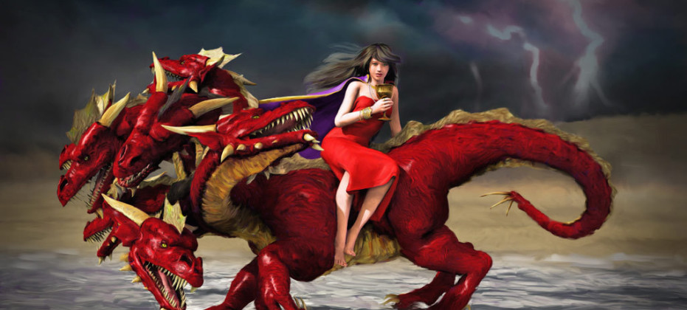
Rev 17:4-6 The woman was clothed in purple and scarlet, and adorned with gold and precious stones and pearls, having in her hand a gold cup full of abominations and of the unclean things of her immorality, 5 and on her forehead a name was written, a mystery, “BABYLON THE GREAT, THE MOTHER OF HARLOTS AND OF THE ABOMINATIONS OF THE EARTH.” 6 And I saw the woman drunk with the blood of the [d]saints, and with the blood of the witnesses of Jesus.

Slide 24
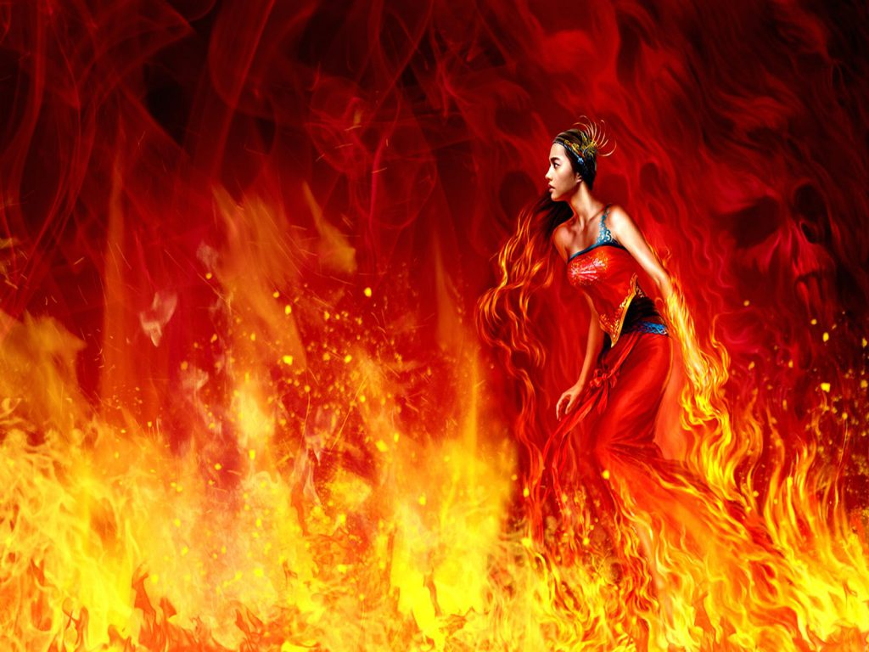
Rev 17:16-18, And the ten horns which you saw, and the beast, these will hate the harlot and will make her desolate and naked, and will eat her flesh and will burn her up with fire. 17 For God has put it in their hearts to execute His purpose by having a common purpose, and by giving their kingdom to the beast, until the words of God will be fulfilled. 18 The woman whom you saw is the great city, which reigns over the kings of the earth.”

Slide 25
Rev 18:3, For all the nations have drunk of the wine of the passion of her immorality, and the kings of the earth have committed acts of immorality with her, and the merchants of the earth have become rich by the wealth of her sensuality.”
Rev 18:4-6, I heard another voice from heaven, saying, “Come out of her, my people, so that you will not participate in her sins and receive of her plagues; 5 for her sins have piled up as high as heaven, and God has remembered her iniquities. 6 Pay her back even as she has paid, and give back to her double according to her deeds; in the cup which she has mixed, mix twice as much for her.

Slide 26
Rev 18:9-10, “And the kings of the earth, who committed acts of immorality and lived [l]sensuously with her, will weep and lament over her when they see the smoke of her burning, 10 standing at a distance because of the fear of her torment, saying, ‘Woe, woe, the great city, Babylon, the strong city! For in one hour your judgment has come.’
Rev 18:20-21, Rejoice over her, O heaven, and you [w]saints and apostles and prophets, because God has pronounced judgment for you against her.” 21 Then a strong angel took up a stone like a great millstone and threw it into the sea, saying, “So will Babylon, the great city, be thrown down with violence, and will not be found any longer.

Slide 27
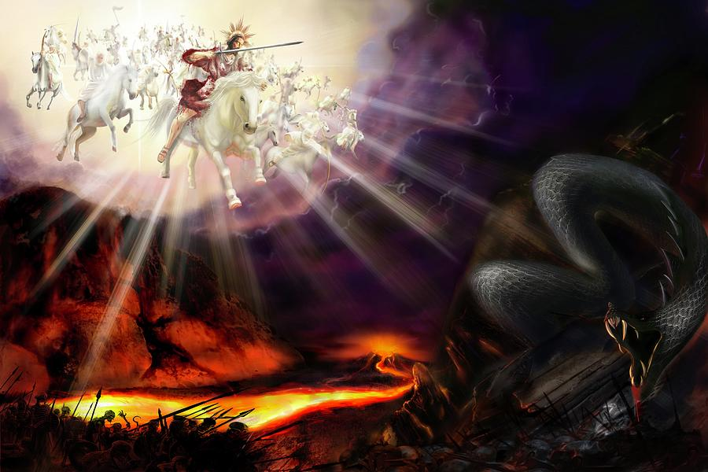
Who’s coming next week?

