Slide 1
The Final Rebellion
Revelation 20:7-10

Slide 2
Rev 5:9-10, “Worthy are You to take the book and to break its seals; for You were slain, and purchased for God with Your blood men from every tribe and tongue and people and nation. 10 “You have made them to be a kingdom and priests to our God; and they will reign upon the earth.”
Jesus is the only rightful (legal) owner of the title deed to earth.
Jesus was slain, yet no one “took” his life.
We have been purchased by Jesus for God with His blood. He owns us!
We have been purchased from every tribe, tongue, people, and nation.
We are made into a kingdom.
We are priests of the King.
We will reign upon the earth.

Slide 3
Jesus is the only rightful (legal) owner of the title deed to earth.
  Psa 2:8, ‘Ask of Me, and I will surely give the nations as Your inheritance, And the very ends of the earth as Your possession.’

Slide 4
2. Jesus was slain, yet no one “took” his life
John 10:17-20, “the Father loves Me, because I lay down My life so that I may take it again. 18 No one has taken it away from Me, but I lay it down on My own initiative. I have authority to lay it down, and I have authority to take it up again. This commandment I received from My Father.”
Luke 23:46, Jesus, crying out with a loud voice, said, “Father, into Your hands I commit My spirit.” Having said this, He breathed His last.
Isa 53:10, But the Lord was pleased To crush Him, putting Him to grief; If He would render Himself as a guilt offering,

Slide 5
We have been purchased by Jesus for God with His blood. He owns us!
  1 Cor 6:20, For you have been bought with a price: therefore glorify God in your body.

Slide 6
We have been purchased from every tribe, tongue, people, and nation.
  Tribe refers to family lineage (there are members from every family)
  Tongue refers to language (every language will be represented)
  “With 195 countries in the world, the total number of different languages spoken is impressive. According to the Ethnologue guide, there are 7,139 officially known languages in the world.”
  People refers to cultural or societal groups.

Slide 7
  Nation (ethnos) refers to races. There are distinct people group types, such as Caucasian, African, Arabian, Asian, American Indians (north and south – includes Eskimoes, First Nation, Mayans, Incas), Latino, Pacific Islander, Indian, Melanesian (Papuan, Fijians, Aboriginals), Mongolian.
  But then many groups within these ethnic groups. Africa alone has more than 20 major ethnic groups and thousands of minor ethnic groups.
  Rev 7:9, After these things I looked, and behold, a great multitude which no one could count, from every nation and all tribes and peoples and tongues, standing before the throne and before the Lamb, clothed in white robes, and palm branches were in their hands.

Slide 8
We are made into a kingdom
  This is why Jesus spoke the word “kingdom” 126 times.
  He used the phrase “the kingdom of God” 65 times.
  He used the phrase “the kingdom of heaven” 31 times.
  Most of the parables begin with “The kingdom of heaven is like”.
  QUESTION: What’s a Kingdom? Does it have an elected president?

Slide 9
We are priests of the King.
QUESTION: What is the function of priests?
We are Christs Ambassadors, representing God before the people.
  2 Cor 5:20, Therefore, we are ambassadors for Christ, as though God were making an appeal through us; we beg you on behalf of Christ, be reconciled to God.
  1 Pet 2:9, But you are a chosen race, a royal priesthood, a holy nation, a people for God’s own possession, so that you may proclaim the excellencies of Him who has called you out of darkness into His marvelous light;

Slide 10
We will reign upon the earth!
  The disciples will be judging the twelve tribes of Israel, Mat 19:28
  We will be judging angels, 1 Cor 6:3
  We will be in charge of the cities of earth, Luke 19:17

Slide 11
We (those of us in this room) will all have glorified bodies in the Millennium.
Satan and his demons have been bound in the abyss.
The curse on earth has been lifted. Isa 11:7-9, 30:23-24, 35
The landscape is changed, the climate is perfect, and people live many hundreds of years.
There is peace, prosperity, and productivity. Isa 2:4
No hunger, Joel 2:21-27
Health and healing everywhere Isa 29:18, 33:24, 35, 65

Slide 12
Truth abounds. Isa 11:9
Joy abounds. Isa 12
The Holy Spirit is poured out on earth’s inhabitants. Joel 2:28-29
The righteous judge rules, along with sinless, glorified saints as kingdom administrators.
None of the unrighteous enter the Millennial kingdom. Why? No unbeliever survives!
Everything is the way it should be. It is literally a thousand years of heaven on earth!
Except for one thing! What is it?

Slide 13
Something begins to happen ….
More sinners are being born to godly parents, and then ungodly ones
So, how many people will there be? Get out your exponential growth calculator!
  144,000 initial population (we know this is the minimum number entering)
    Jews from each tribe who are sealed (Rev 7:4)
    The seals - they are protected throughout the Tribulation (Rev 14:1)
  Current .91% growth rate (this takes into account all births and deaths today)
  Today’s lifespan (Current average global lifespan is 72.8 years)
  1,000 years
    .91% growth = 1.2 billion (this is the 2023 worldwide growth rate)
    1.0% growth = 3.0 billion
    2.0% growth = 57.4 billion
    2.5% growth= 7.6 quadrillion people!

Slide 14
What is the purpose for the Millennial Kingdom on earth?
Fulfilling God’s Covenants and Promises.
Proving that while Satan is an enemy, the real enemy is sin.
Providing a Sabbath rest for the Jewish nation, and for the earth.

Slide 15
Fulfilling God’s Covenants and Promises to Israel
  The land part of the Abrahamic Covenant
  The Davidic Covenant
  The New Covenant (Let’s let scripture speak)
  Other promises to be fulfilled
Proving to everyone that sin is the enemy
  With Satan bound and living in a perfect world, and Christ as King, billions will reject God
A Sabbath rest for the Jewish nation, and for the earth
  The Millennial Day theory. Psalm 90:4, 2 Pet 3:8.

Slide 16
Rev 20:7-8, When the thousand years are completed, Satan will be released from his prison, 8 and will come out to deceive the nations which are in the four corners of the earth, Gog and Magog, to gather them together for the war; the number of them is like the sand of the seashore.
He will be released for a “short time”, Rev 20:3
He went into the abyss as deceiver …
How does he come out?
How can the Millennial nations possibly be deceived?
  They have lived under Christ’s holy rule for 1000 years
  They know what happened at the end of the Tribulation
What makes them think any war against Christ could prosper?
Why is Satan released? What’s the purpose here?
There’s only one explanation.

Slide 17
The plan of God is being executed!
When Jesus was crucified who was in control there?
  Acts 2:22-23, “Men of Israel, listen to these words: Jesus the Nazarene, a man attested to you by God with miracles and wonders and signs which God performed through Him in your midst, just as you yourselves know— 23 this Man, delivered over by the predetermined plan and foreknowledge of God, you nailed to a cross by the hands of godless men and put Him to death.
Satan can only function within the sovereign, permissive purpose of God!
  Job 1:12, Then the Lord said to Satan, “Behold, all that he has is in your power, only do not put forth your hand on him.” So Satan departed from the presence of the Lord.
  Job 2:6, So the Lord said to Satan, “Behold, he is in your power, only spare his life.”

Slide 18
The deception is worldwide, and must have to do with believing they can overthrow Christ.
Gog and Magog (this is a symbolic name)
Historically, Magog was a grandson of Noah
Gog is the leader of the Magog army that fought at Armageddon
Probably God calls them Gog and Magog remembering what happened at Megiddo
How many warriors are there?

Slide 19
Rev 20:9, And they came up on the broad plain of the earth and surrounded the camp of the saints and the beloved city, and fire came down from heaven and devoured them.
The broad plain. This is the reconfigured (relatively flat) earth. With Jerusalem the highest mount.
They come against Jerusalem (the beloved city).
They are immediately destroyed by fire from heaven! They are consumed and annihilated.

Slide 20
Rev 20:10, And the devil who deceived them was thrown into the lake of fire and brimstone, where the beast and the false prophet are also; and they will be tormented day and night forever and ever.
Lake of Fire and Brimstone
  Mark describes it a place where, “where their worm does not die, and the fire is not quenched.”
Brimstone is the word for Sulphur, a flammable element.
The Beast and the False prophet are already there
Now Satan joins them, to receive an eternal torment
How long? The Greek word is aion, the root of the word eon, meaning an eternity.
The righteous will spend eternity with God, but the unrighteous spend eternity without Him

Slide 21
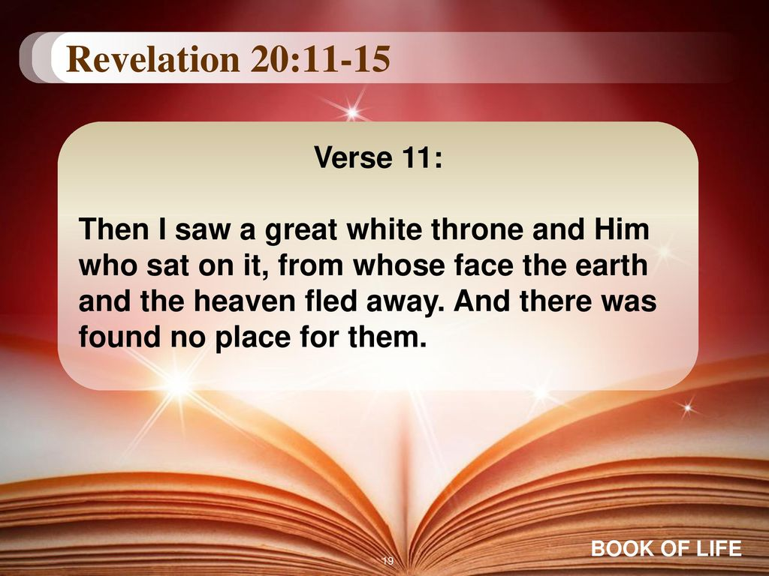
Next Time!

